Slide 1
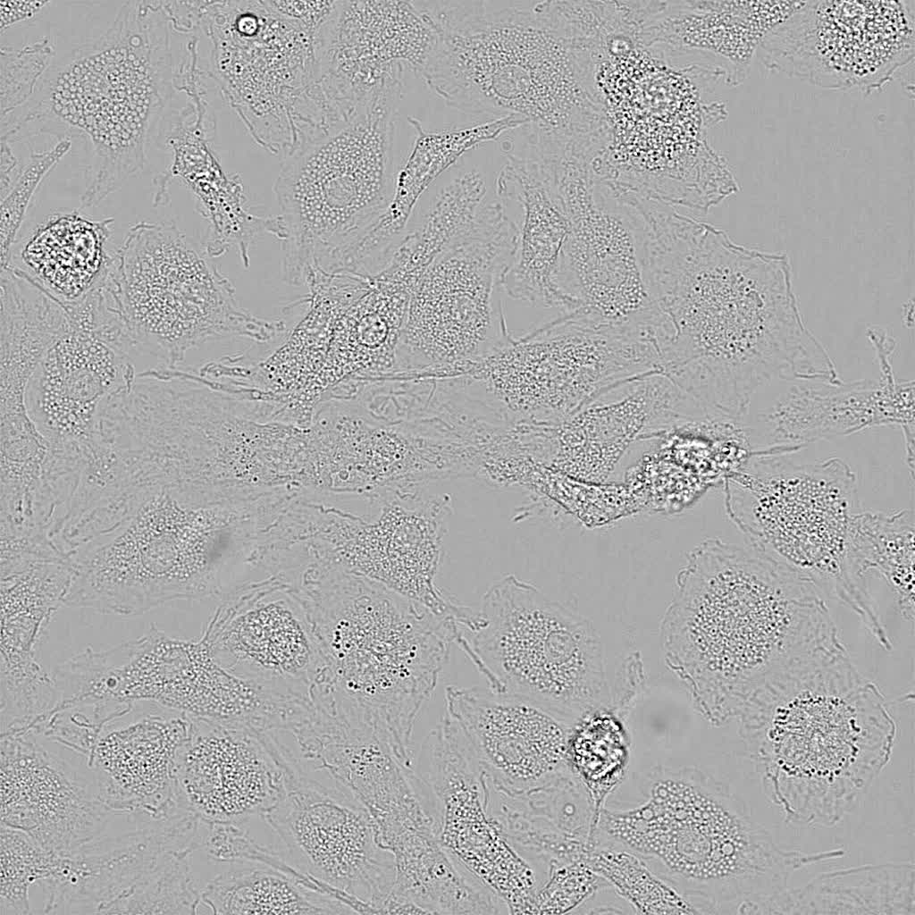
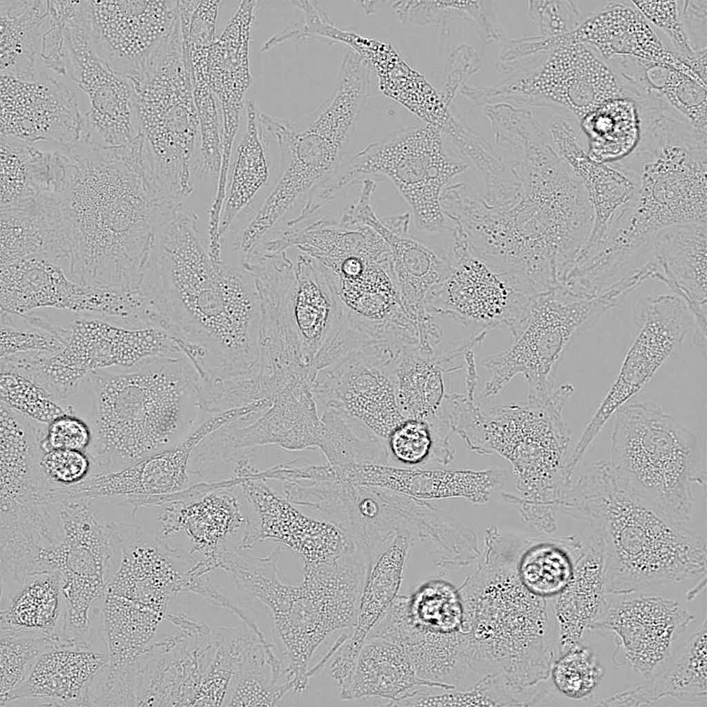
nigericin
Wt
Ninj1–/–
Kayagaki et al., Supplementary Video 1

