Slide 1
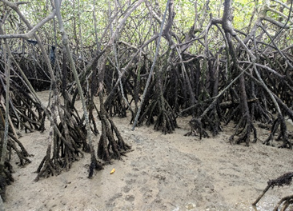
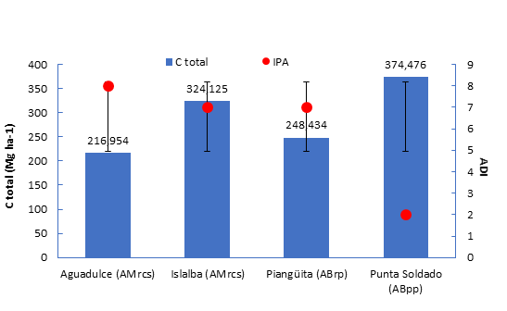
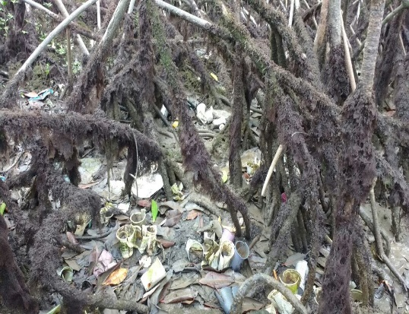
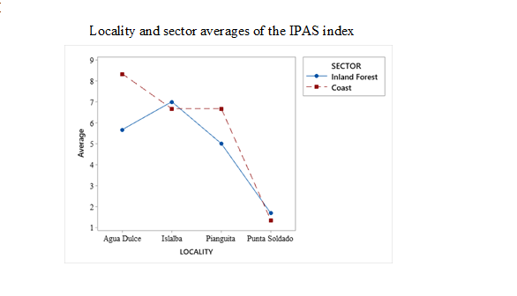
Due to anthropogenic disturbances, carbon capture and storage in the mangrove ecosystem in the Colombian Pacific is affected
CARBON DYNAMICS OF MANGROVE FORESTS SUBMITTED TO DISTINCT LEVELS OF ANTHROPOGENIC STRESS

