Slide 1
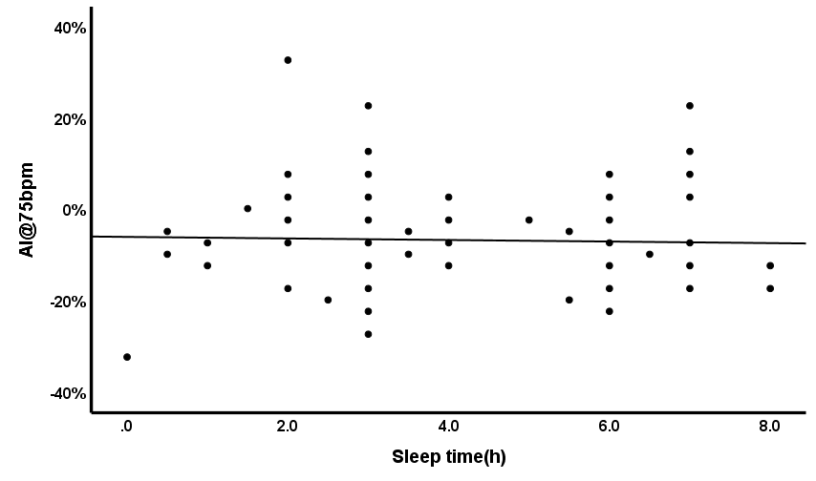
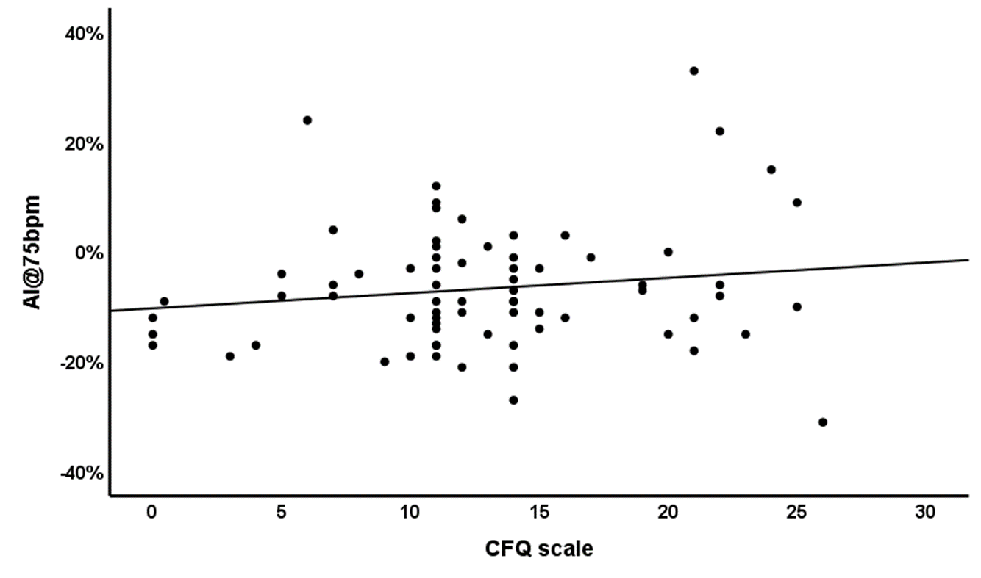
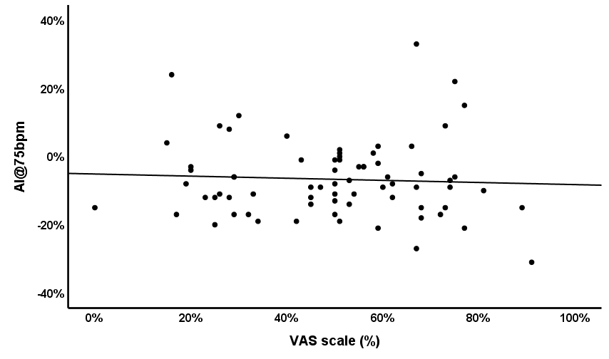
Supplementary Fig. 1
a
b
R＝-0.001
P＝0.787
R＝0.022
P＝0.214
c
R＝-0.003
P＝0.648

