Slide 1
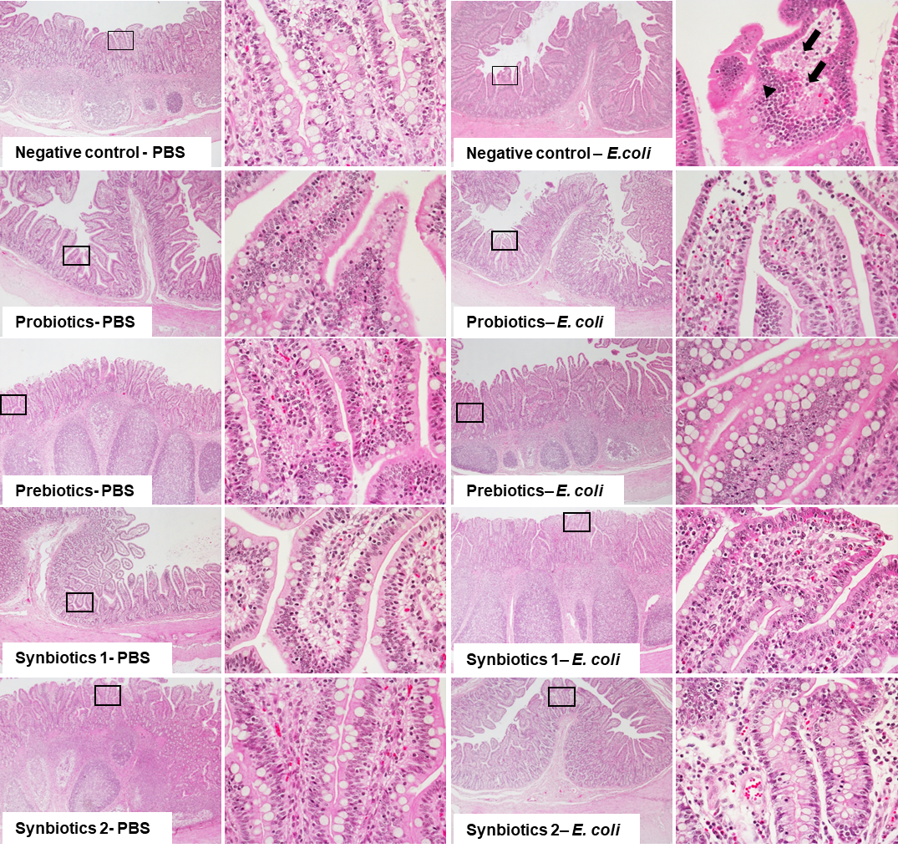
Without STEC challenge
With STEC challenge
40X 100X
40X 100X
CONT
PRO
PRE
SYN1
SYN2
Supplementary Fig. 1. Histology of the intestinal tissue. Histological examinations were performed in one pig per treatment group (CONT, PRE, PRO, SYN1, and SYN2) orally challenged with STEC as compared to the negative control pigs fed PBS in ileum. Intestinal tissue morphology was viewed at magnification 40X (left) and at 100X (right) as indicated by black rectangle, respectively.

Slide 2
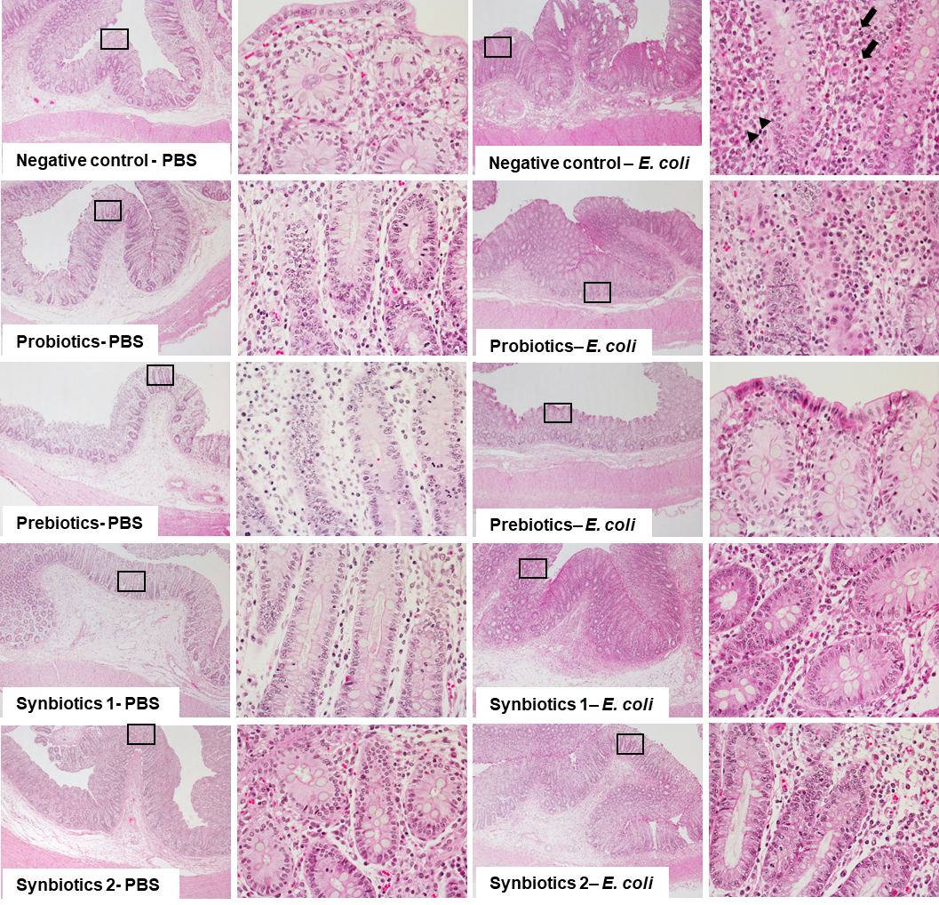
Without STEC challenge
With STEC challenge
40X 100X
40X 100X
CONT
PRO
PRE
SYN1
SYN2
Supplementary Fig. 2. Histology of the intestinal tissue. Histological examinations were performed in one pig per treatment group (CONT, PRE, PRO, SYN1, and SYN2) orally challenged with STEC as compared to the negative control pigs fed PBS in cecum. Intestinal tissue morphology was viewed at magnification 40X (left) and at 100X (right) as indicated by black rectangle, respectively.

Slide 3
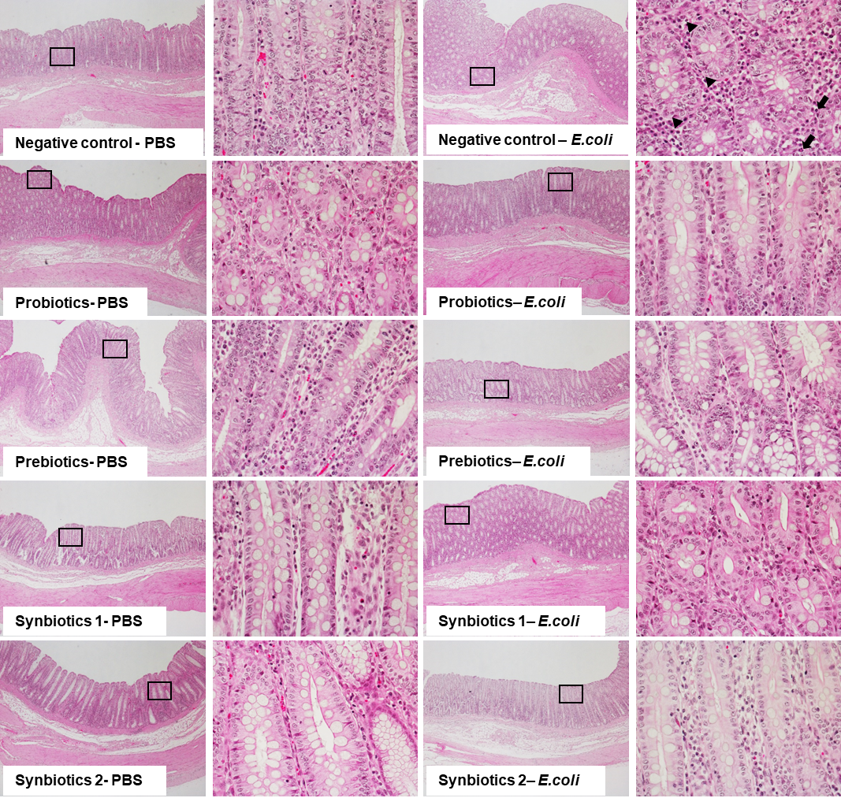
Without STEC challenge
With STEC challenge
40X 100X
40X 100X
CONT
PRO
PRE
SYN1
SYN2
Supplementary Fig. 3. Histology of the intestinal tissue. Histological examinations were performed in one pig per treatment group (CONT, PRE, PRO, SYN1, and SYN2) orally challenged with STEC as compared to the negative control pigs fed PBS in colon. Intestinal tissue morphology was viewed at magnification 40X (left) and at 100X (right) as indicated by black rectangle, respectively.

Slide 4
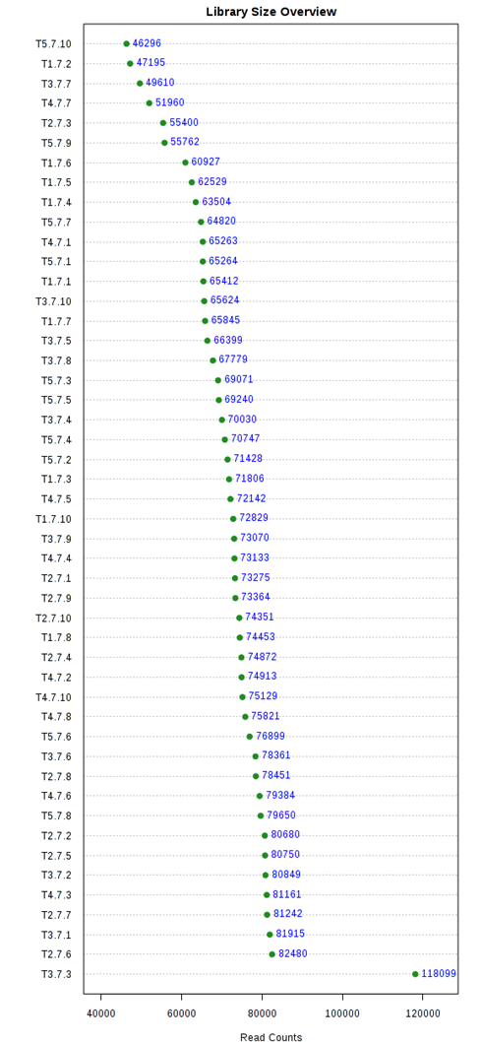
Supplementary Fig. 4. Dot plot showing the overview of library size. The X-axis denotes the number of sequences and Y-axis denotes the name of the samples.

Slide 5
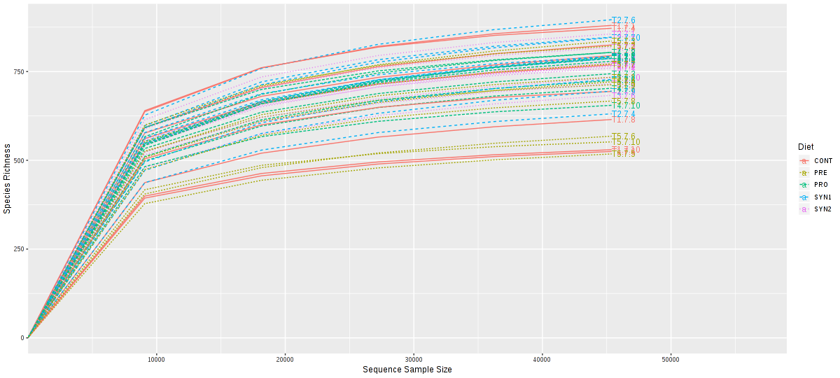
Supplementary Fig. 5. Rarefaction curve of species richness in pigs fed PRE, PRO, SYN1 and SYN2. The number of sequences were normalized to the minimum number of sequences among all the samples to account for the differences in sampling depth. Each curve represents individual pig sample and were color coded according to treatment (CONT, PRE, PRO, SYN1 and SYN2) as shown in the legend. The X-axis represents the number of sequences, whereas Y-axis represents species richness.

Slide 6
Supplementary Table 1. Effect of synbiotics supplementation on growth performance of weaned piglets.
Items | CON | SYN1 | SYN2 | PRO | PRE | SEM²
Body weight, kg
Initial | 5.35 | 5.34 | 5.30 | 5.31 | 5.33 | 0.02
week 2 | 9.01^{b} | 9.76ª | 9.77ª | 9.10^{ab} | 9.11^{ab} | 0.18
week 4 | 14.66^{b} | 16.99ª | 16.87ª | 15.38^{ab} | 15.38^{ab} | 0.45
Week 2
ADG, g | 259^{b} | 316ª | 319ª | 268^{ab} | 270^{ab} | 13.0
ADFI, g | 304 | 335 | 335 | 307 | 300 | 10.0
GF | 0.851^{b} | 0.943ª | 0.952ª | 0.870^{b} | 0.899^{ab} | 0.017
FCR | 1.175ª | 1.060^{b} | 1.050^{b} | 1.149ª | 1.115^{ab} | 0.021
Week 4
ADG, g | 403^{b} | 516ª | 507ª | 449^{ab} | 448^{ab} | 24.0
ADFI, g | 668^{b} | 703ª | 704ª | 674^{b} | 672^{b} | 7.00
GF | 0.603^{b} | 0.735ª | 0.719^{ab} | 0.666^{ab} | 0.665^{ab} | 0.032
FCR | 1.668ª | 1.363^{b} | 1.427^{ab} | 1.513^{ab} | 1.513^{ab} | 0.061
Overall
ADG, g | 331^{b} | 416ª | 413ª | 358^{ab} | 359^{ab} | 16.0
ADFI, g | 486 | 519 | 520 | 491 | 486 | 9.00
GF | 0.681^{b} | 0.802ª | 0.794ª | 0.730^{ab} | 0.737^{ab} | 0.022
FCR | 1.472ª | 1.247^{b} | 1.272^{b} | 1.375^{ab} | 1.363^{ab} | 0.035
¹Abbreviation: CONT, Basal diet; SYN1, CONT + 0.05% synbiotics; SYN2, CONT + 0.1% synbiotics; PRO, CONT + 0.1% probiotics; PRE, CONT + 0.05% prebiotics;
² Standard error of the mean
^{a,b} Means in the same row with different superscripts differ (P < 0.05).

Slide 7
Supplementary Table 2. Effects of synbiotics on fecal index in weaned piglets.¹
Items | CONT | SYN1 | SYN2 | PRO | PRE | SEM²
Fecal score³
Initial | 3.54 | 3.38 | 3.54 | 3.46 | 3.58 | 0.14
2wk | 3.68ª | 3.29^{b} | 3.25^{b} | 3.50^{ab} | 3.43^{ab} | 0.08
4wk | 3.61ª | 3.39^{b} | 3.36^{b} | 3.46^{ab} | 3.50^{ab} | 0.05
¹ Abbreviation : CONT, Basal diet; SYN1, CONT + 0.05% synbiotics; SYN2, CONT + 0.1% synbiotics; PRO, CONT + 0.1% probiotics; PRE,CONT + 0.05% prebiotics;
² Standard error of means.
³ Fecal score: 1 = hard, dry pellets in a small, hard mass; 2 = hard, formed stool that remains firm and soft; 3 = soft, formed, and moist stool that retains its shape; 4 = soft, unformed stool that assumes the shape of the container; 5 = watery, liquid stool that can be poured.
⁴ Survival: (live pigs/total number of pigs) * 100
^{a,b} Means in the same row with different superscripts differ (P < 0.05).

