Slide 1
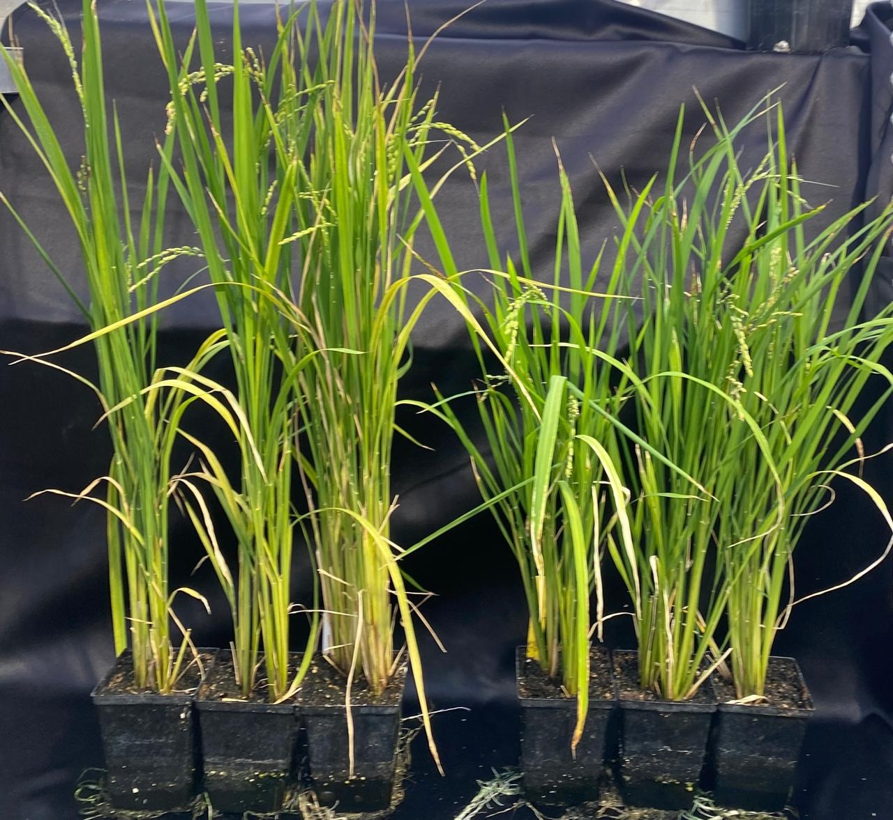
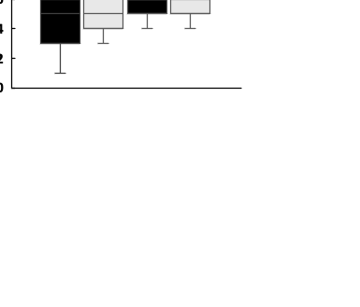
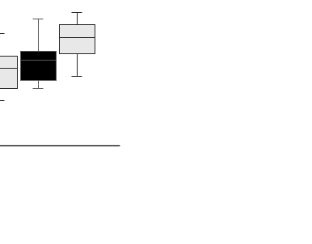
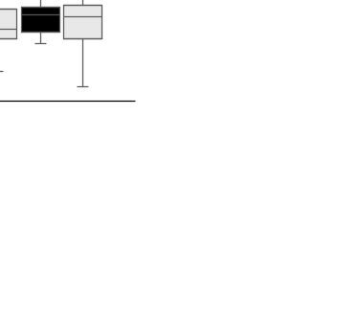
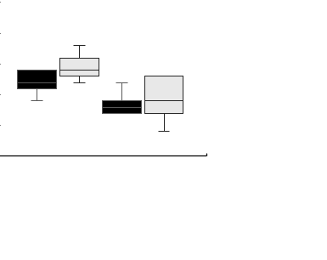
(a)
(b)
(c)
Days to Flowering
Plant height (cm)
B
A
A
B
C
B
C
C
HNT
GH
HNT
GH
HNT
GH
HNT
GH
Nip_vpp5
Nip_WT
Nip_vpp5
Nip_WT
(d)
(e)
Panicle number
Panicle length (cm)
Nip_WT
Nip_vpp5
A
Fig. S1. Phenotype of plants grown in the greenhouse (GH) or exposed to high nighttime temperature (HNT) starting at booting stage until maturity. (a) Number of days from seedling emergence to flowering, (b-c) plant height at seed filling stage, (d) panicle number per plant, (e) panicle length based on measurements of all panicles per plant. Error bars represent the standard deviation of 15 plants in each genotype/environment. Significance in Tukey’s multiple comparison at p<0.05 is shown by capital letters. Nip_vpp5: vpp5 mutant lines in Nipponbare background, Nip_WT: wildtype Nipponbare.
A
A
A
A
A
A
A
HNT
GH
HNT
GH
HNT
GH
HNT
GH
Nip_vpp5
Nip_WT
Nip_vpp5
Nip_WT
Fig. S1

Slide 2
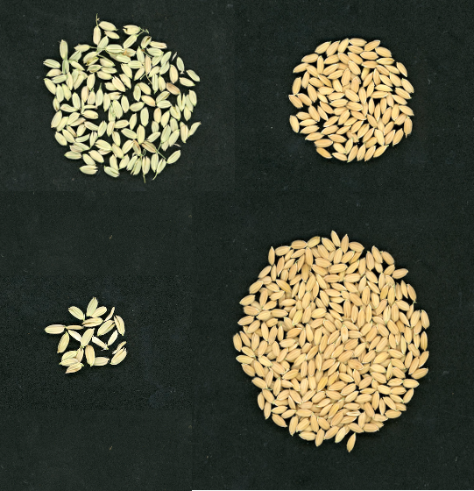
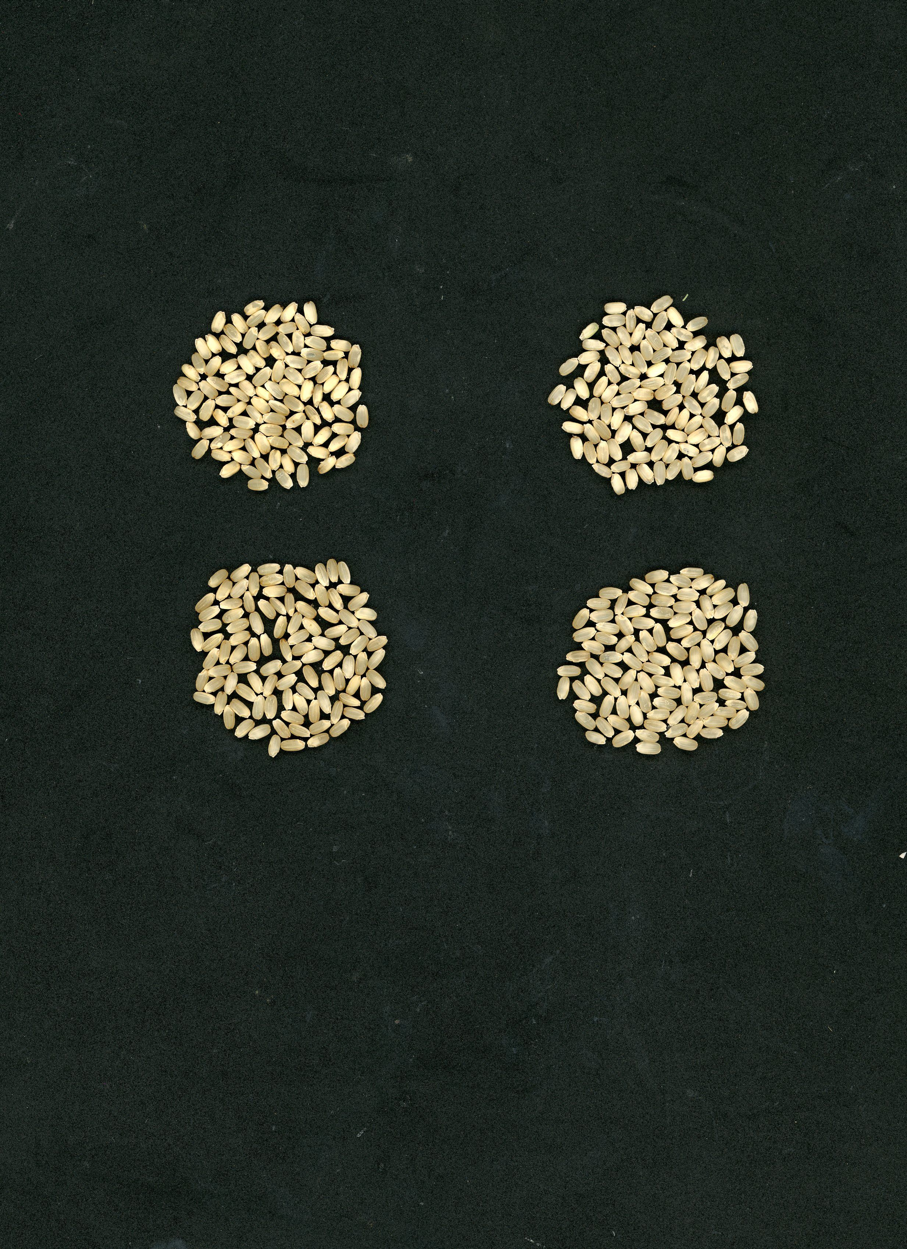
(a)
Nip_vpp5
Nip_WT
(b)
GH
HNT
Empty
Nip_vpp5
Filled
Nip_WT
Fig. S2. Major yield traits. (a) Spikelet fertility in the plants grown in the greenhouse is indicated by the number of filled vs empty spikelets. A higher number of filled spikelets indicates higher fertility. The image shows spikelets collected from 4 randomly selected panicles per genotype, (b) grain chalkiness, indicated by white opaque areas. The grains were ripened in the greenhouse (GH) or in high nighttime temperature (HNT). Nip_vvp5: vpp5 mutant lines in Nipponbare background, Nip_WT: wildtype Nipponbare.

Slide 3
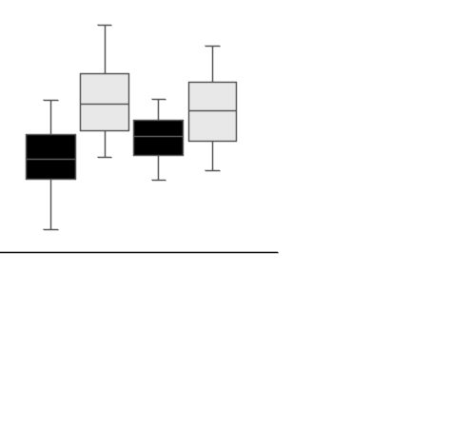
(a)
(b)
A
A
A
A
B
B
B
B
HNT
GH
HNT
GH
Nip_vpp5
Nip_WT
Fig. S3. Grain weight and grain length of the grains ripened in the greenhouse (GH) or under high nighttime temperature (HNT). (a) Weight of 100 grains, (b) grain length. Nip_vvp5: vpp5 mutant in Nipponbare background, Nip_WT: wildtype Nipponbare. Error bars represent the standard deviation of data obtained from 15 plants in each genotype. Significance in Tukey’s multiple comparison at p<0.05 is shown by capital letters.

Slide 4
(a)
CCAAAG^ATCTACATGACCCAGAG
CTAGACGGTGCCGTTTG^TAGCGG
ATG
-732
-707
-503
-481
(b)
202 bp
Kit_WT
CCAAAGAAGAGAAAAGTGCCAAAGATCTACATGACCCAGAG………………..GATTCTAGACGGTGCCGTTTGTAGCGGCTTTTTCGCTACTTTTCTT
Kit_vpp5-6
CCAAAGAAGAG………………………………………..tagcctttccaag…………………………………………………………………………….CTTTTTCGCTACTTTTCTT
Kit_vpp5-7
CCAAAGAAGAGGAAAAGTGCCAAAGA…………………………………(aa)…………………………………………………………….CCGCTTTTTCGCTACTTTTCTT
(c)
A
Fig. S4: CRISPR/Cas9 mutagenesis of VPP5 in Kitaake rice. (a) schematic design of CRISPR targeting of VPP5 promoter. Coding region is shown as arrow and start codon is indicated. The targeted sequences and their positions are shown with PAM site underlined and predicted double stranded break site indicated (^), (b) Sequence alignments showing insertion (red small case) and deletions (dashes) at the targeted site. The sequence in parenthesis indicates monoallelic occurrence, (c) Expression of VPP5 relative to rice ubiquitin gene, n=3.
Relative expression
A
B

Slide 5

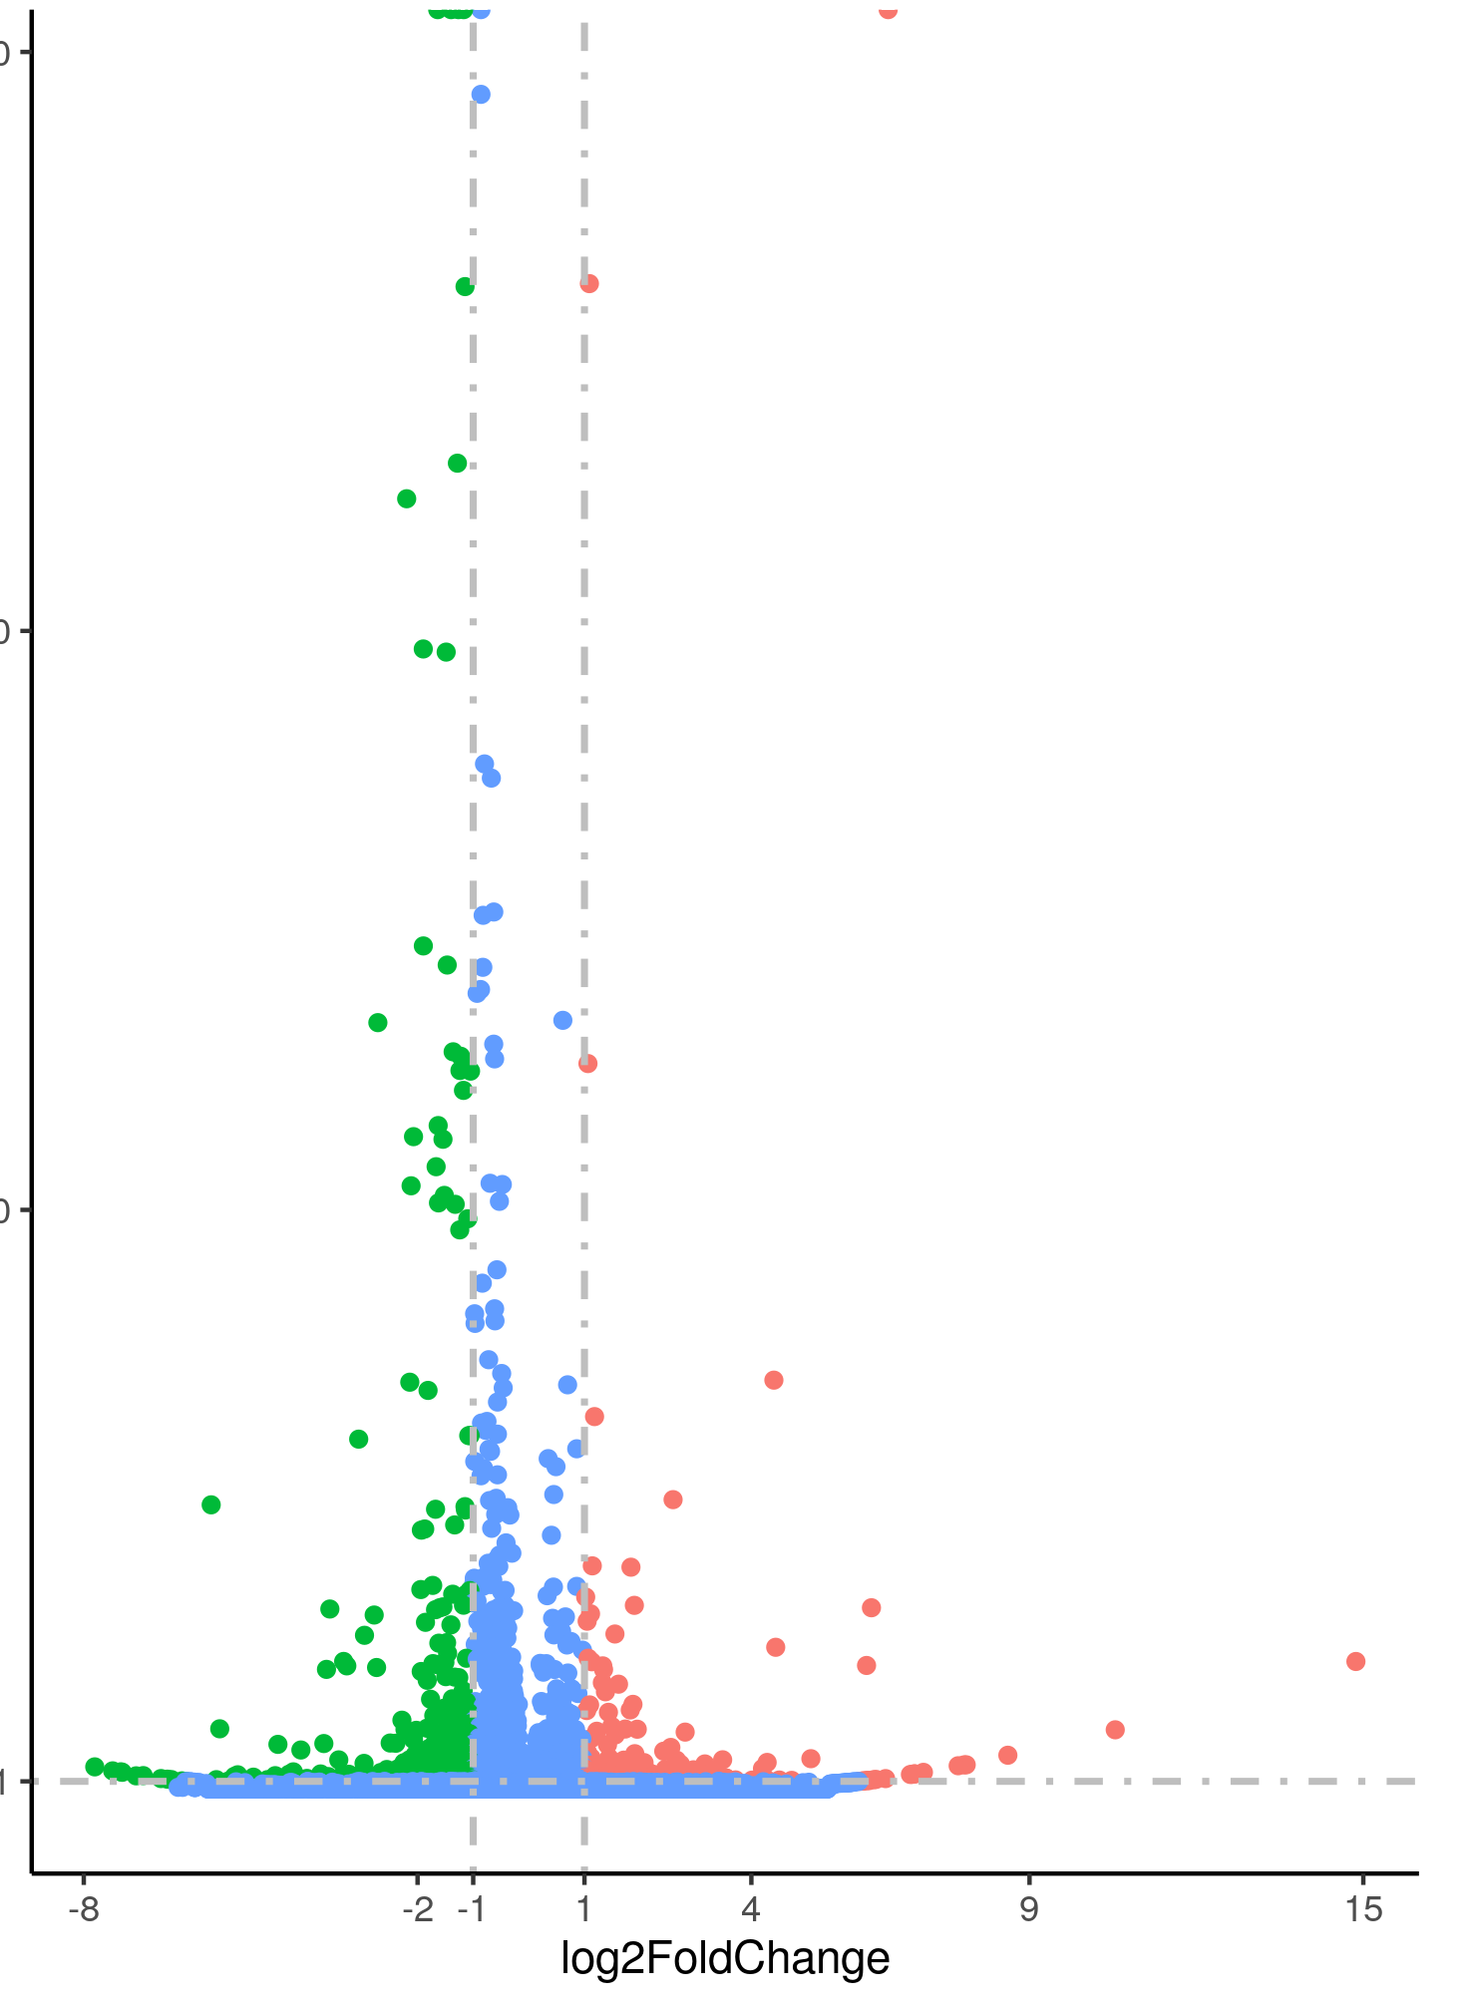
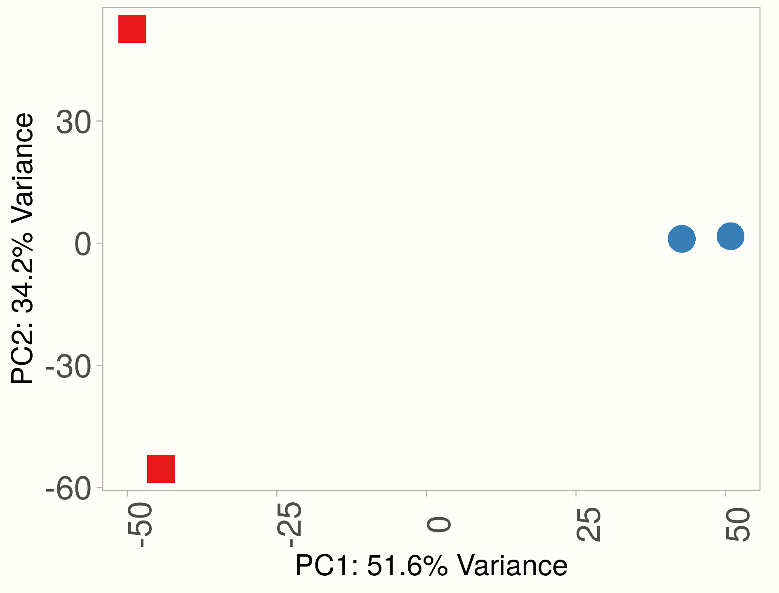
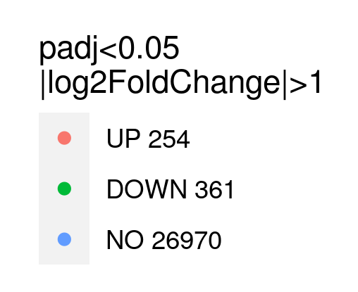
(a)
Nip_WT
(b)
Nip_vpp5
300
(e)
200
Gene Name | Gene ID | Primer sequence (5’ – 3’)
VPP5 | Os05g0156900 | Forward: CACCTGTTCATCTGCGTCTC Reverse: CGTAAGCATTGCTCGTGAAGTA
HSP26 | Os03g0245800 | Forward: GATGGACCGGATTTTCGACG Reverse: CGCATCCTCACCTCCTTGTC
HSP18 | Os03g0267000 | Forward: GAGCAGATCAAGGCGTCCAT Reverse: GACTTGACGTCGGGCTTCTT
HSP90.1 | Os04g0107900 | Forward: ACCCCATCTACCTCTGGTCC Reverse: TCCTTGCCTTTGGAGTCGTC
11S Globulin | Os08g0127900 | Forward: TTGATGAAGCTCCGCGAGAA Reverse: AGCTTCTGGCTGTTGAGGAC
13 KDA PROLAMIN B.16 | Os05g0329200 | Forward: GCAAGCCCCTTCTTGCAATC Reverse: GCGCTATGGCCTGAACAATG
13 KDA PROLAMIN B.5 | Os05g0328333 | Forward: TGACTTCGTAAGGCAGCGAT Reverse: GAGCTGTTGCCAGACTTGGT
13 KDA PROLAMIN B.18 | Os05g0330600 | Forward: GCAGTCGCCTGTCCTACTAC Reverse: GCTGTTGCCAGACTTGGTTG
UBIQ2 | Os02g0161900 | Forward: TGGTCAGTAATCAGCCAGTTTG Reverse: CAAATACTTGACGAACAGAGGC
-log10(padj)
100
1.301
-8
-2
-8
-1
1
4
9
15
-1
1
4
9
15
Log2 (Fold_Change)
(c)
(d)
27
19
-log10(padj)
17
Log2 Fold_Change
Fig. S5. RNA-seq analysis. (a) Principal component analysis showing variation in the transcriptomes of Nip_vpp5 and Nip_WT and their replicates, (b) Volcano plot showing differentially expressed genes (DEGs) in Nip_vpp5 caryopses. Significantly upregulated and downregulated (padj.<0.05, log2FC>±1) genes are indicated by red and green dots. Non-significant genes (No) are shown in blue, (c) Fold change (log2) of V5 and selected starch pathway genes (padj.<0.05) in Nip_vpp5 compared to Nip_WT, (d) Enrichment of gene ontology terms in Nip_vpp5. Top three pathways based on significance are shown. Number of DEGs with each pathway are indicated, (e) PCR primers used in real time qPCR analysis shown in Fig. 1j-k.

