Slide 1
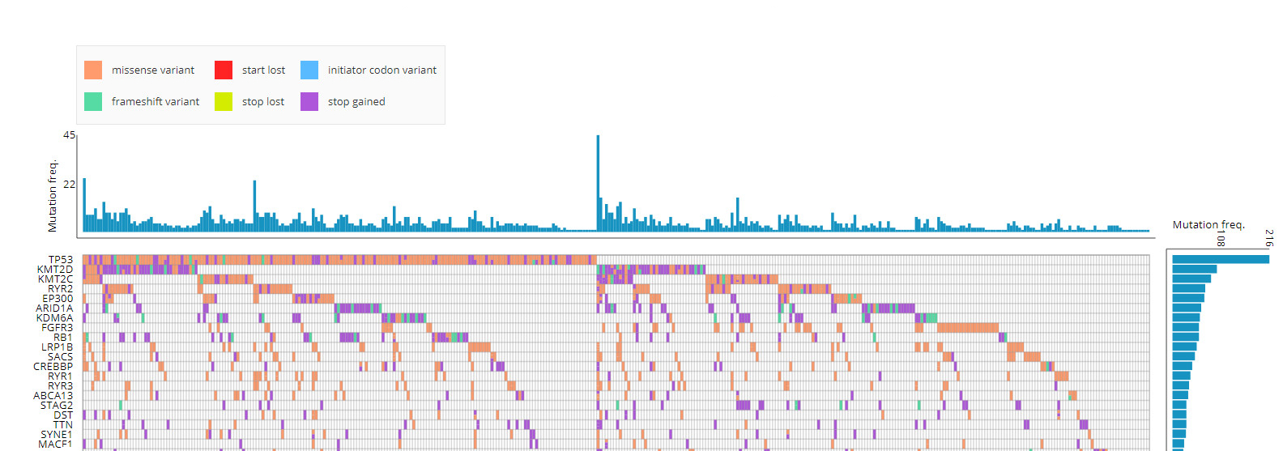
A

Slide 2
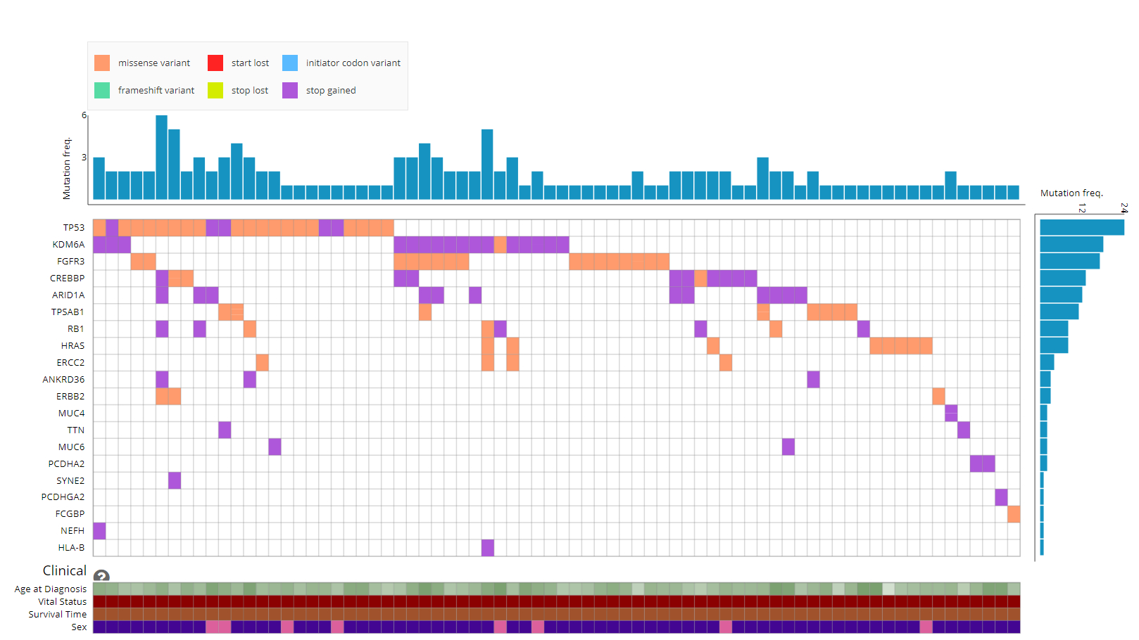
B

Slide 3
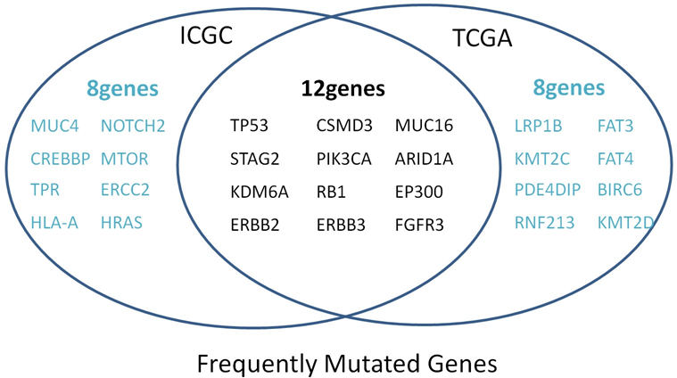
C
Sup. 1. Landscapes of frequently mutated genes in BC. (A) (B) Waterfall plot displayed the frequently mutated genes in BC from TCGA cohort and ICGC cohort. The left panel displayed the genes ordered by their mutation frequencies. The upper panel showed mutation types. (C) Venn diagram of frequently mutated genes covered by both TCGA and ICGC cohorts.

Slide 4
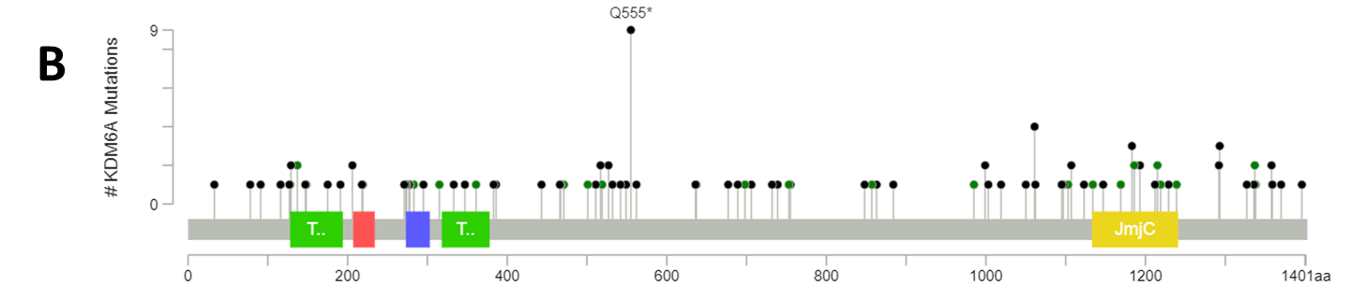
A
4.9%
21.1%
74%
Sup.2. Mutation frequency and types of KDM6A in BC from TCGA database. (A) Mutation frequency of KDM6A in BC. (B) KDM6A protein mutation diagram showed the mutation types of KDM6A in BC.

Slide 5
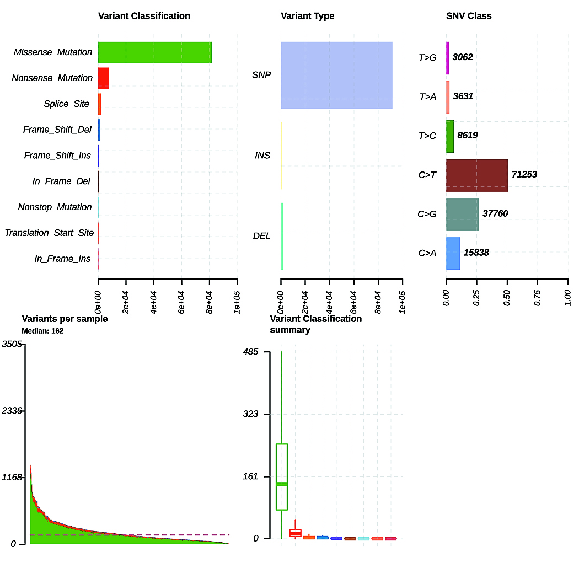
A
B
C
D
E
Sup. 3 Summary of the mutation information with statistical calculations. (A, B, C) Classifcation of mutation types according to different categories, in which missense mutation accounts for the most fraction, SNP was more common than insertion or deletion, and C>T was the most common SNV; (D,E) tumor mutation burden in specifc samples. SNP, single nucleotide polymorphism; SNV, single nucleotide variants

Slide 6
Sup. 4 Clinical Characteristics of BC Patients and KDM6A status in TCGA
characteristics | KDM6A status |  | Statistical parameters | P value
 | Wild type | Mutated
Mean Age,years | 68.2 | 67.8 | t=0.3364 | 0.37
Range | 34-90 | 42-87
Gender |  |  | χ²=0.0002 | 1
Female | 80 | 28
Male | 225 | 79
Tumor T stage |  |  | χ²=2.5384 | 0.575
T1 | 3 | 0
T2 | 84 | 37
T3 | 146 | 49
T4 | 45 | 14
N stage |  |  | χ²=0.9390 | 0.919
N0 | 84 | 57
N1 | 23 | 12
N2 | 35 | 23
N3 | 4 | 4
Nx | 13 | 10
M stage |  |  | χ²=7.2262 | 0.027
M0 | 134 | 62
M1 | 7 | 4
Mx | 161 | 41
AJCC stage |  |  | χ²=3.1840 | 0.364
StageⅠ | 2 | 0
StageⅡ | 95 | 37
StageⅢ | 110 | 31
StageⅣ | 96 | 41
Histologic grade |  |  | χ²=0.5894 | 0.449
High | 288 | 100
Low | 14 | 7
P < 0.05 was considered statistically significant. Chi-square test was used.

