Slide 1
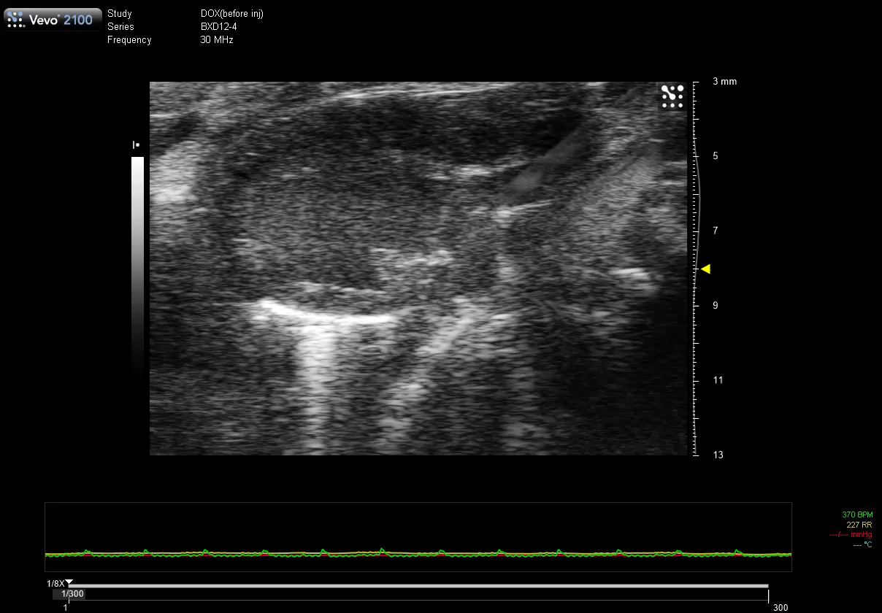
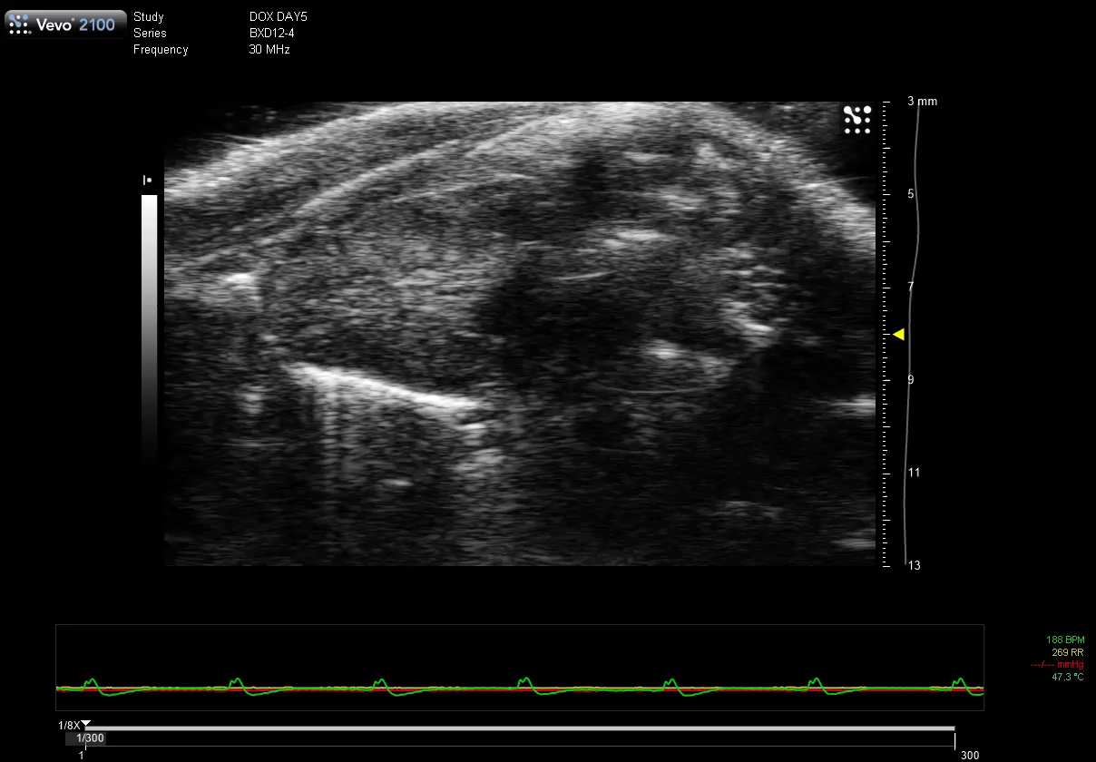
Cardiac Function in BXD mice on DOX treatment
Day -1 (Baseline)
Day 5 (post-DOX)

