Slide 1
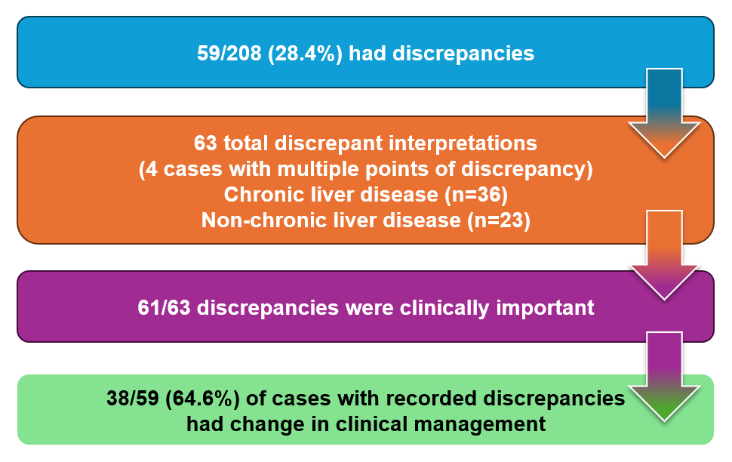
Reinterpretation of outside imaging and review at hepatobiliary tumor board: impact on diagnosis and management of patients with hepatobiliary neoplasms
208 cases were reviewed over our 1-year study period. 28.4% of those cases had a discrepancy identified and 64.6% of those discrepancies led to a change in clinical management.
Notes:
Figure 1

