Slide 1
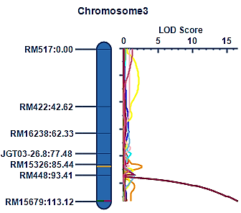
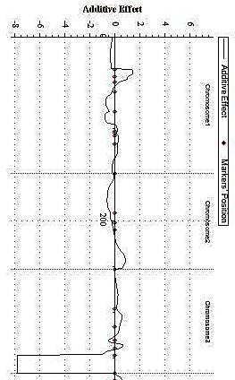
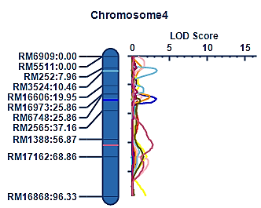
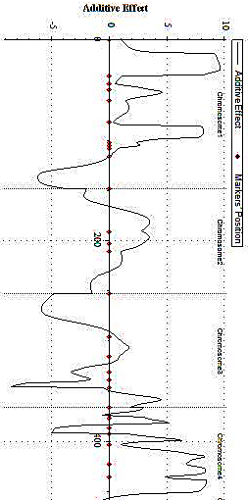
(I) Additive effect of qYLD3-1, qPL3-1
qYLD3-1*
qPL3-1*
(II) Additive effect of qBM4-1
qBM4-1*
Supplementary Figure 1a: Additive effect of significant major effect QTLs (indicated with *) identified for qYLD3-1, qPL3-1 and qBM4-1 indicated by additive effect peak (denoted by black arrow). The inheritance of YLD & PL QTLs is from KMR-3R parent & BM from IR58025A.

Slide 2
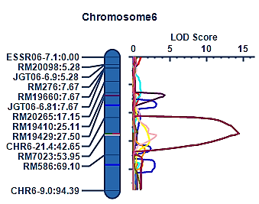
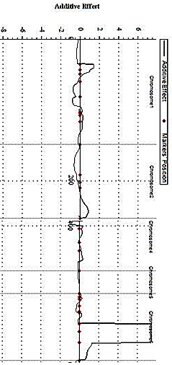
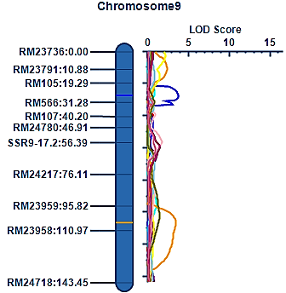
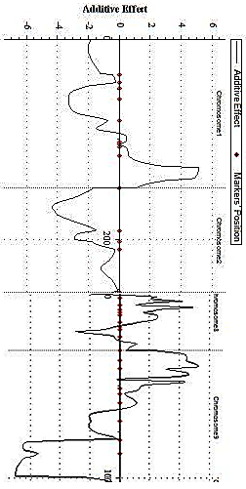
(I) Additive effect of qYLD6 -1, qPL6-1
qYLD6-1*
qPL6-1*
(II) Additive effect of qPW9 -1
qPW9-1*
Supplementary Figure 1b: Additive effect of significant major effect QTLs (indicated with *) identified for qYLD6-1, qPL6-1 and qPW9-1 indicated by additive effect peak (denoted by black arrow). The inheritance of YLD, PL QTLs is from IR58025A and that of PW QTL is from KMR-3R.

Slide 3
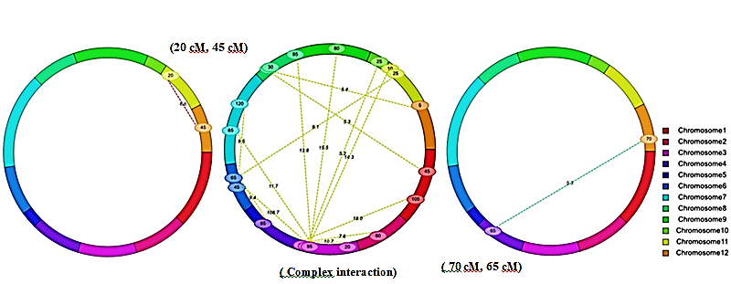
Major effect DFF epistatic interaction
Major effect PW epistatic interaction
Major effect FLL epistatic interaction
Supplementary Figure 2: In 125 KRH-2 derived DHLss-126 SSR marker data set, significant major effect epistatic interactions were observed for the traits DFF, panicle weight (g)(PW), flag leaf length (cm) (FLL). DFF epistatic interaction was observed between chr 11 (20 cM)-chr 12 (45 cM), for PW trait complex epistatic interaction was observed. For flag leaf length (cm) (FLL) trait, epistatic interaction was observed between chr 12(70 cM)-chr 4 (65 cM).

Slide 4
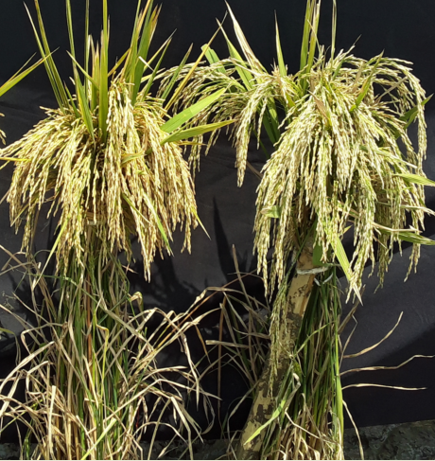
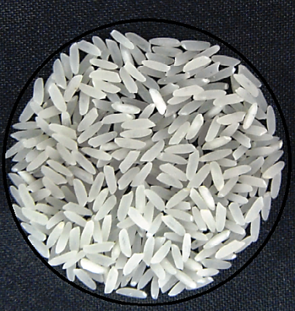
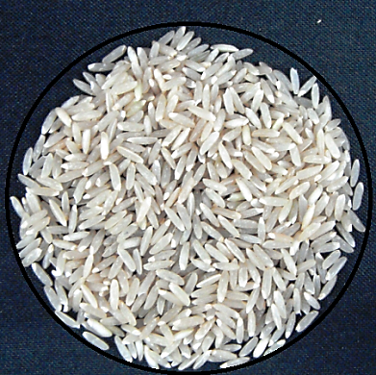
DHL-1 DHL-2
Supplementary Figure 3 : The best performing DH line no 1 (RP6301-189-17-2) has highest yield, longer panicles, more number of productive tillers and medium bold (MB) grain type. The second best performing DH line no 2 (RP6301-188-15-47) with longer-dense panicles and highly desirable medium slender (MS) grain type. Both these lines may have novel major effect QTLs, qPL3-1 and qPW9-1, identified in this study.

