Slide 1
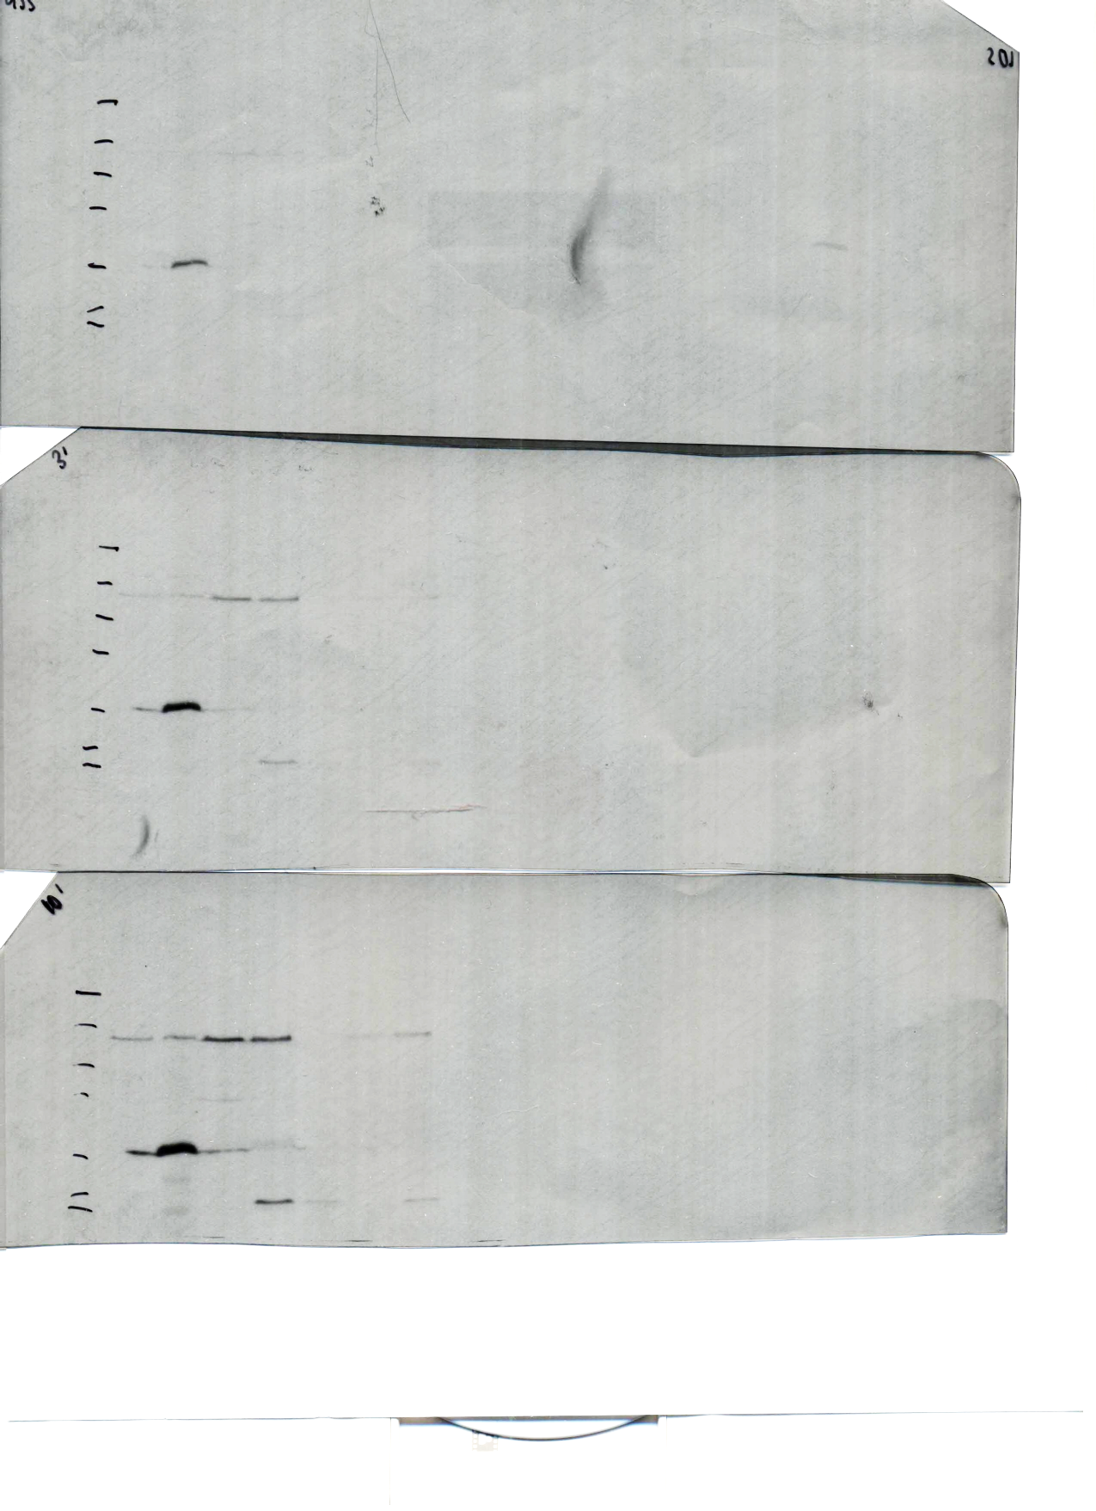
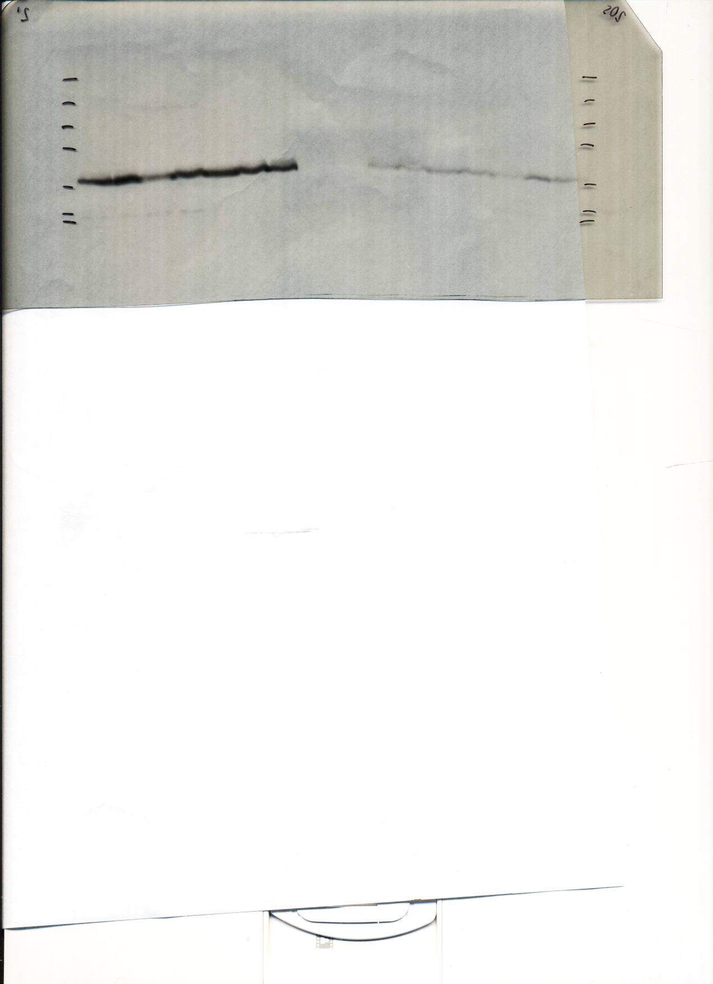
Less exposed blot
More exposed blot
GDSL esterase/lipase-HA
GDSL esterase/lipase-HA
Nucleolar RBP-HA
Nucleolar RBP-HA
MW
marker
WT
MW
marker
WT
kDa
kDa
1 2 3 4 5 6 7
1 2 3 4 5 6 7
50
50
37
37
25
25
Anti-HA
Anti-HA
1. WT
2. Nucleolar RBP-HA cl27 *
3. GDSL esterase/lipase-HA cl34 (Passage 4)
4. GDSL esterase/lipase-HA cl12 *
5. GDSL esterase/lipase-HA cl6
6. Nucleolar RBP-HA cl39
7. GDSL esterase/lipase-HA cl34 (Passage 5)
* Following transfections to target selected lncRNAs by CRISPR-Cas9 editing, parasites were cloned. Clones shown in Fig. 8D are those that worked the best for Nucleolar RBP (clone 27) and GDSL esterase/lipase (clone 12).
1 2 3 4 5 6 7
50
α-tub
Fig. 8D (uncropped)

