Slide 1
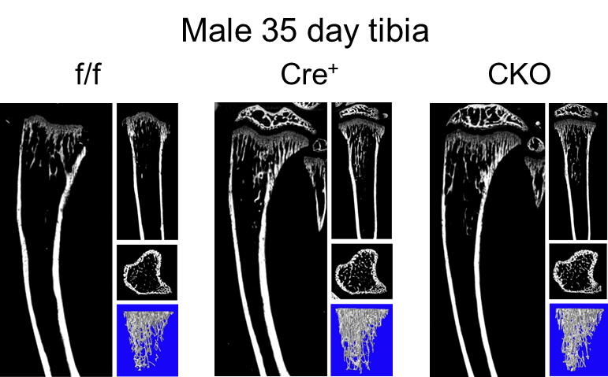
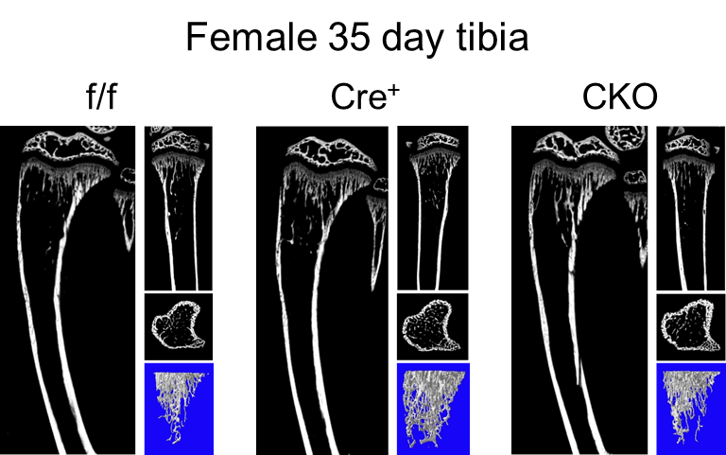
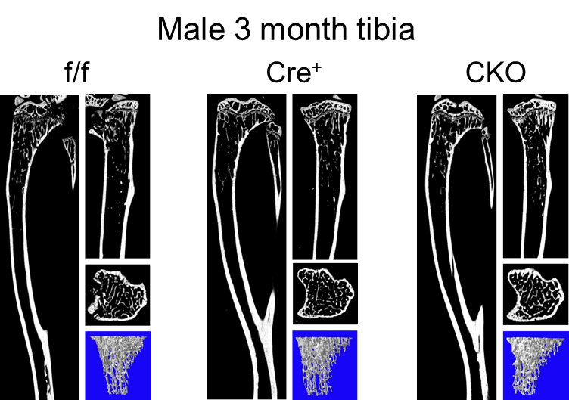
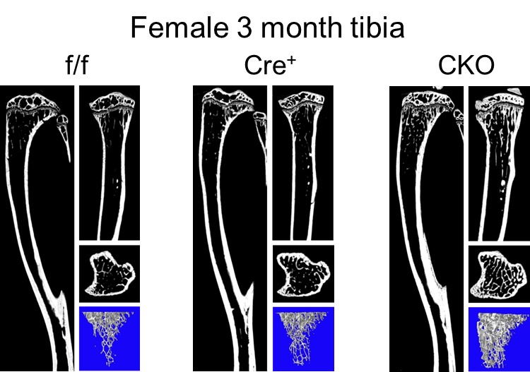
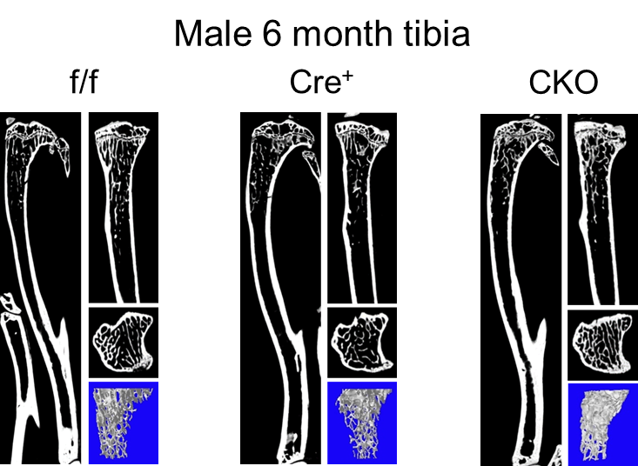
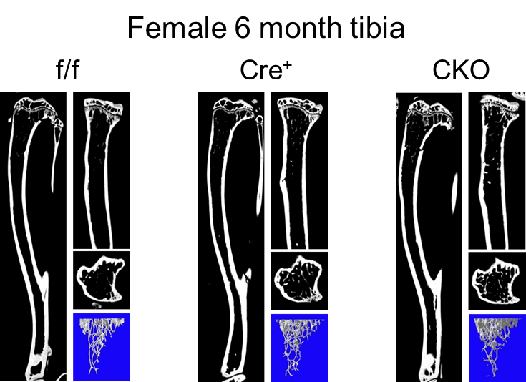
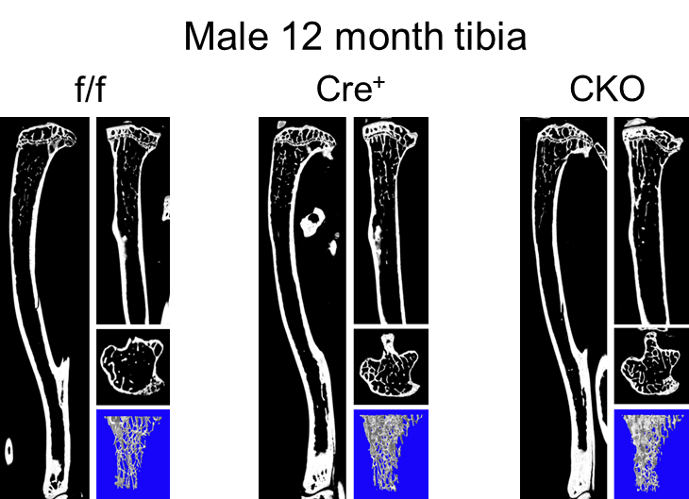
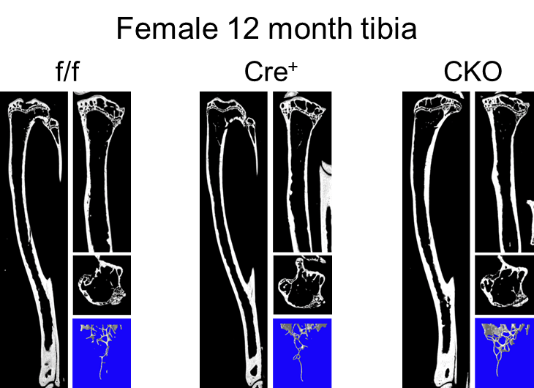
Supplemental Figure 1
A
B
C
D
Supplemental Figure 1: Representative images from µCT analysis of male and female tibia from f/f, Cre⁺ and CKO mice across all time points (35 days, 3 months, 6 months, 12 months). A: For both male and female mice, at 35 days, images collected during µCT scans for f/f, Cre⁺ and CKO mice appear similar. B: For female mice at 3 months, images collected during µCT scans show increased trabecular bone for CKO mice compared to f/f and Cre⁺ control mice. C: At 6 months, for both male and female mice images collected during µCT scans for show increased trabecular bone for CKO mice compared to f/f and Cre⁺ control mice. D: At 12 months for males, images collected µCT scans show increased trabecular bone for both Cre⁺ and CKO mice compared to f/f mice. For females collected images show increased trabecular bone for CKO mice compared to both f/f/ and Cre⁺ controls.

