Slide 1
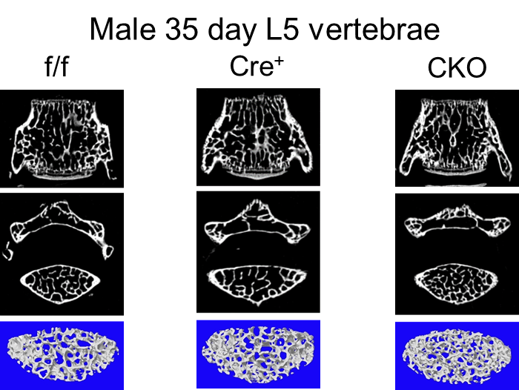
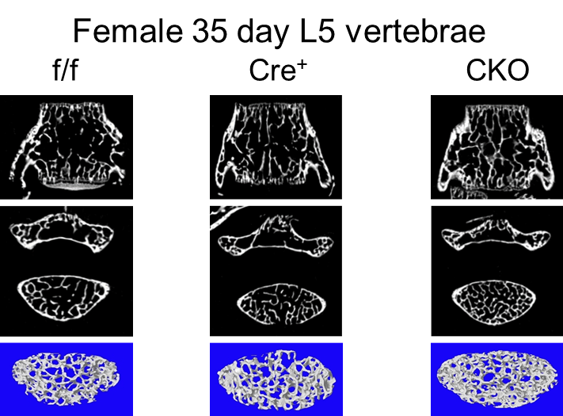
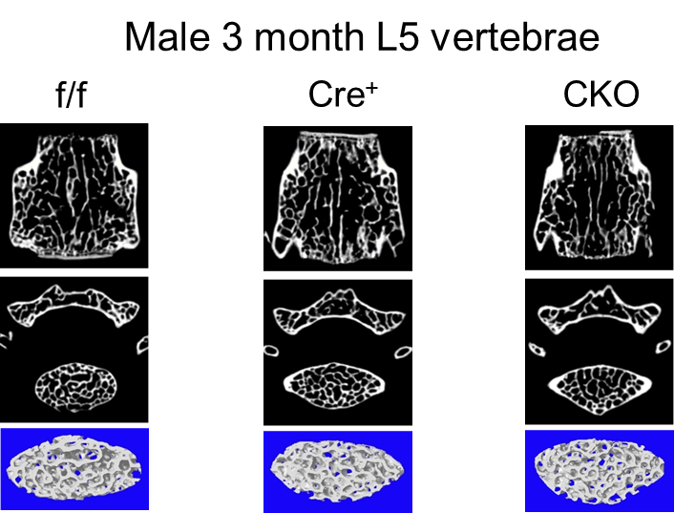
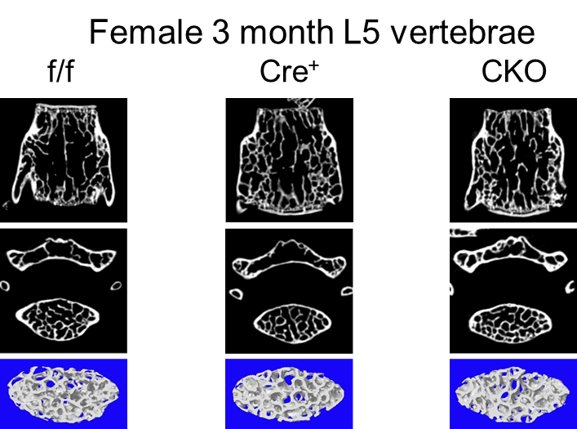
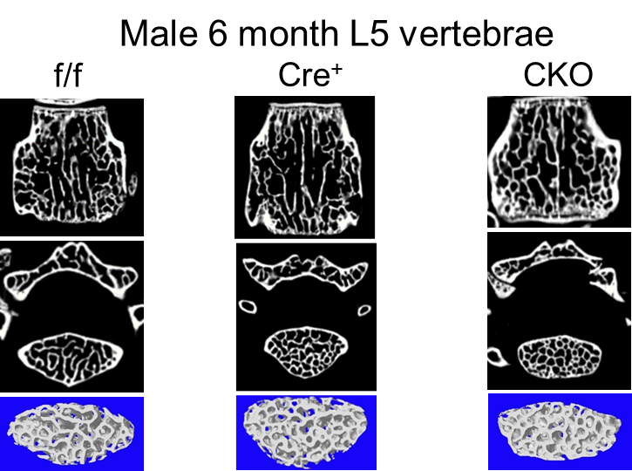
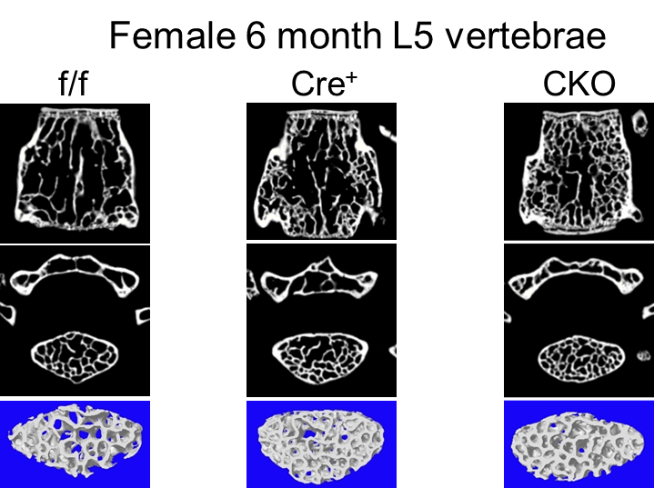
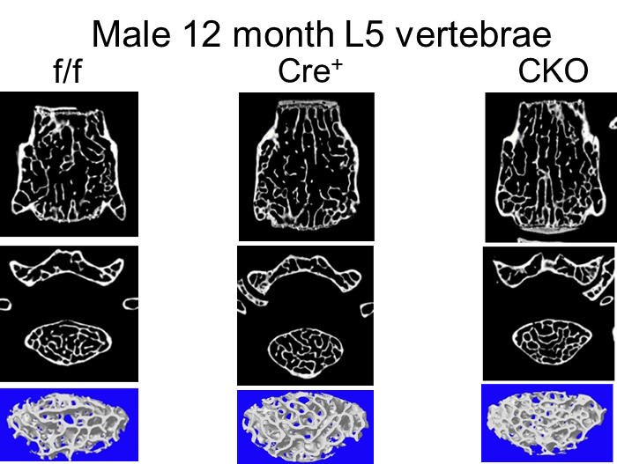
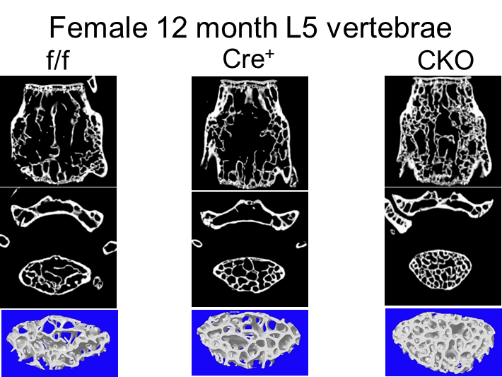
Supplemental Figure 2
A
B
C
D
Supplemental Figure 2: Representative images from µCT analysis of male and female L5 vertebrae from f/f, Cre⁺ and CKO mice across all time points (35 days, 3 months, 6 months, 12 months). A: At 35 days for both male and female mice, images collected during µCT scanning show increased trabecular bone for CKO mice compared to both f/f and Cre⁺ controls. B: At 3 months for both male and female mice, images collected during µCT scanning do not appear to show any change in trabecular bone between f/f, Cre⁺ or CKO mice. C: At 6 months for both male and female mice, images collected during µCT scanning appear to show increased trabecular bone for both Cre⁺ and CKO mice compared to f/f mice. D: At 12 months for males, images collected during µCT scanning appear to show increased trabecular bone for both Cre⁺ and CKO mice compared to f/f controls. While for females, µCT collected images show increased trabecular bone for CKO mice compared to both f/f and Cre⁺ controls.

