Slide 1
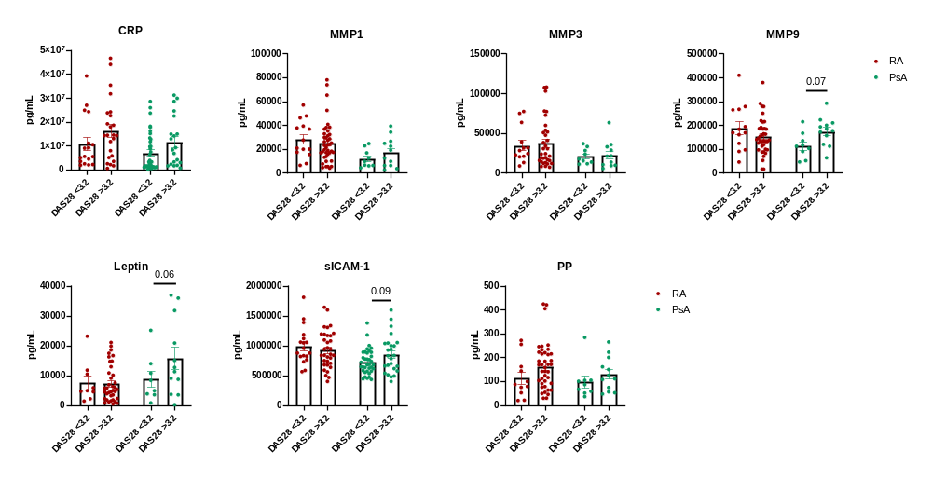
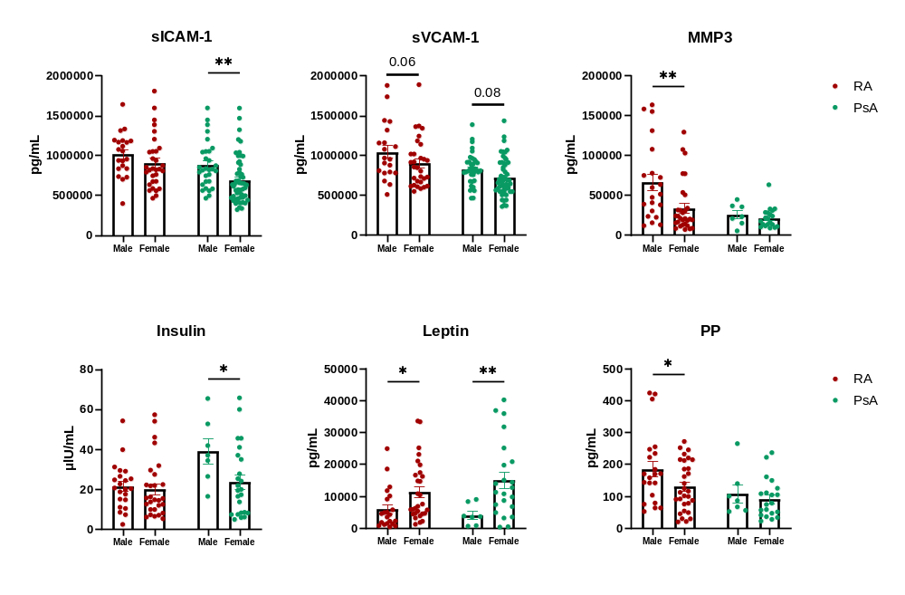
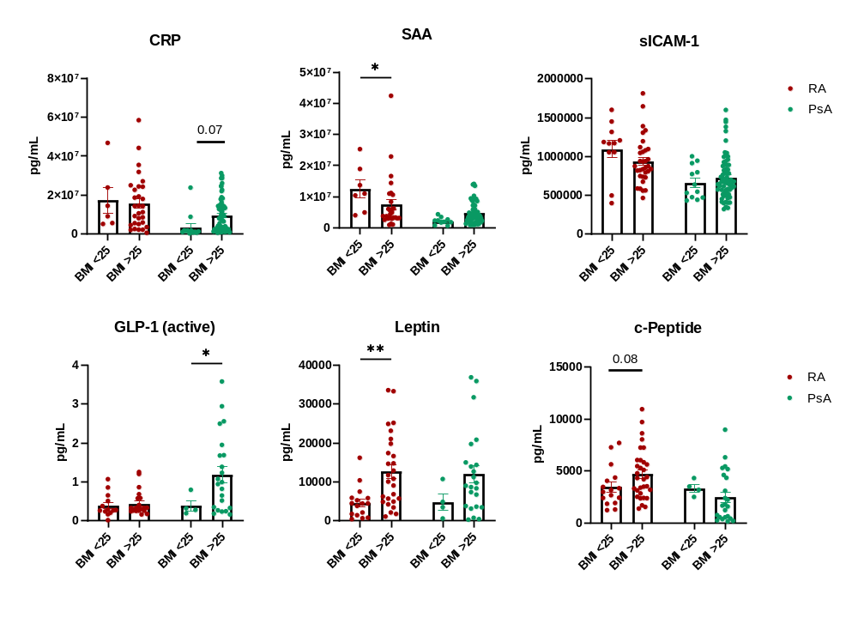
Supplementary Figure 1
A
B
C

Slide 2
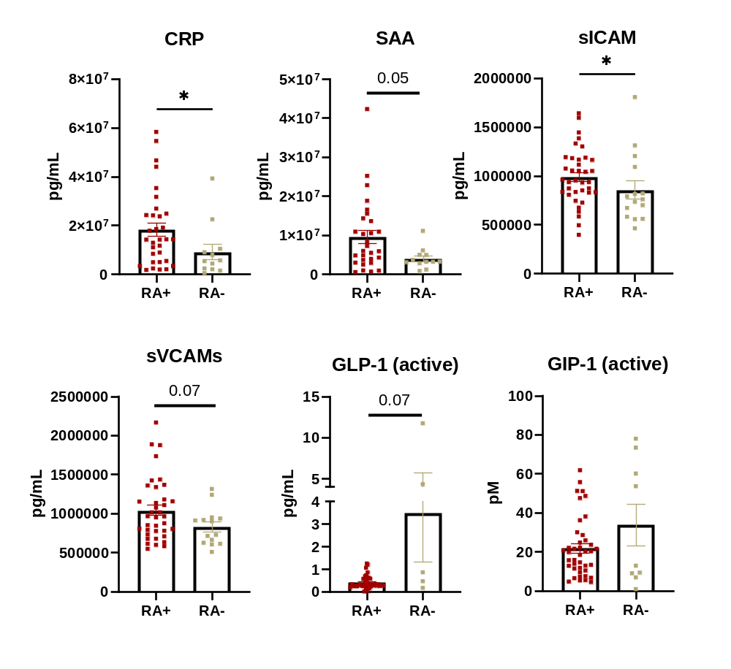
Supplementary Figure 2

Slide 3
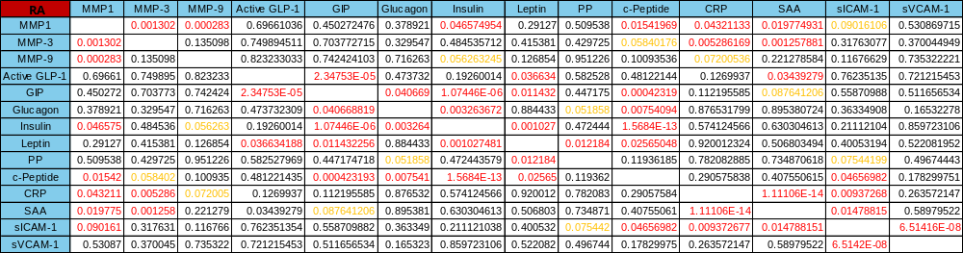
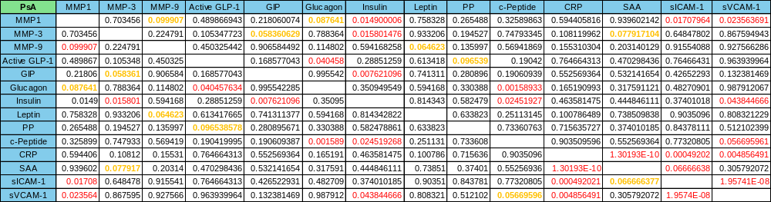
Supplementary Figure 3
A
B

Slide 4
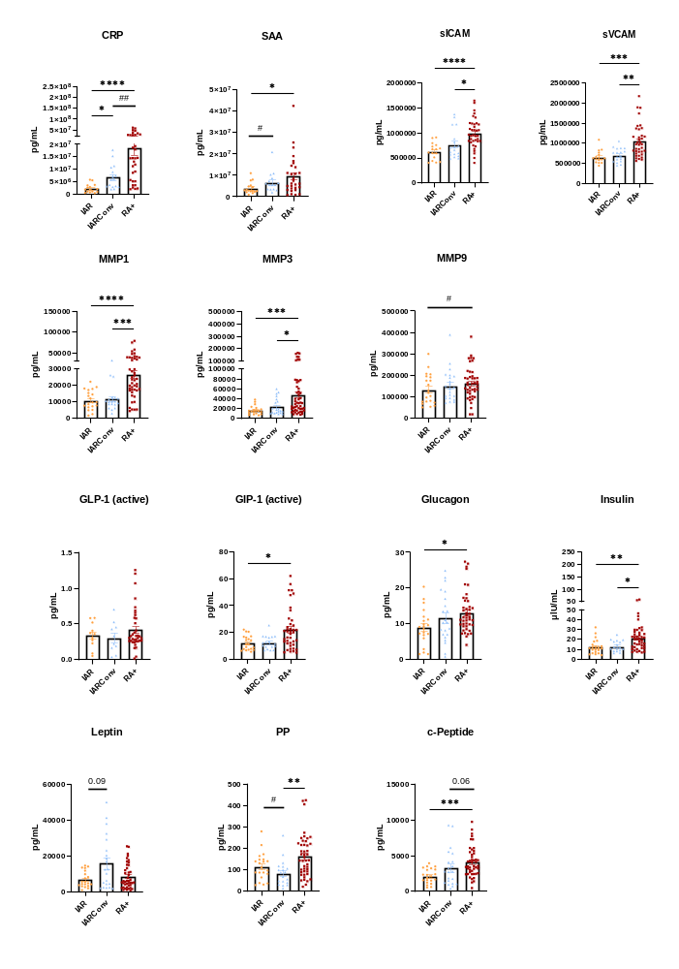
Supplementary Figure 4
A
B
C

Slide 5



Supplementary Figure 5
A
B
C

Slide 6
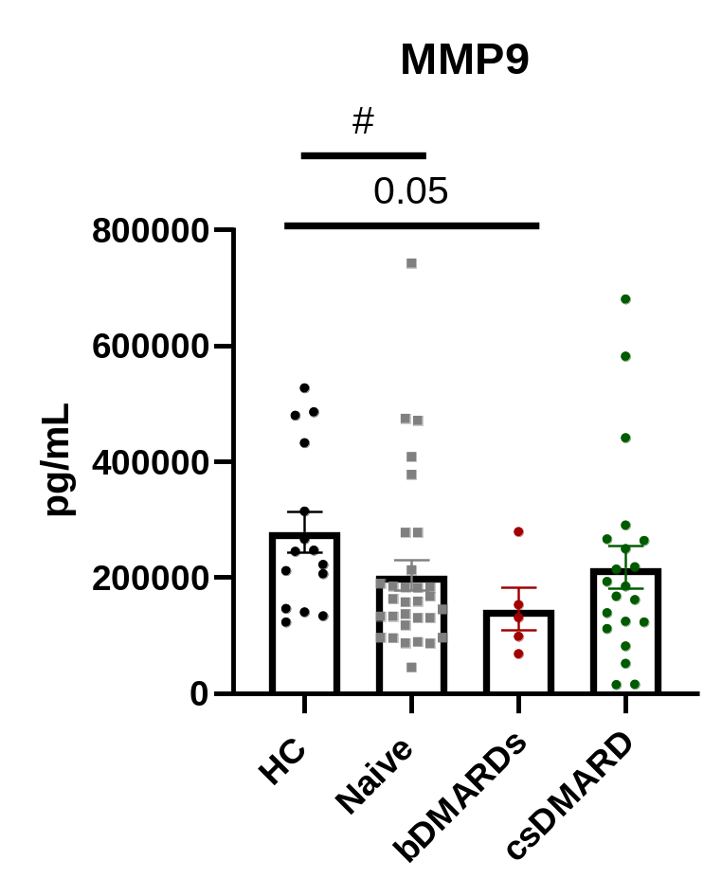
Supplementary Figure 6

