Slide 1
Supplementary Figure 1
CLINICAL EFFICACY
GOOD
BAD
PFS > 24 months
PFS < 24 months
HORMONE-SENSITIVE
Without prior treatment for metastatic disease; de novo onset, relapse >12 month after last adjuvant endocrine treatment<v
Based on: MONARCH3, MONALEESA2, MONALEESA7, PALOMA2
PFS > 12 months
PFS < 12 months
HORMONE-RESISTANT
PATIENT SUBGROUP
Progression during hormone therapy for advanced disease; progression during adjuvant endocrine treatment
Based on: MONARCH2, MONALEESA3, PALOMA3
PFS > 7 months
PFS < 7 months
PREVIOUS CHEMOTHER.
Previous chemotherapeutic treatment
Based on: MONARCH1, PALOMA3

Slide 2
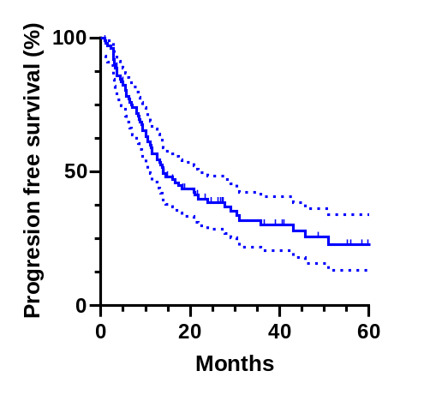
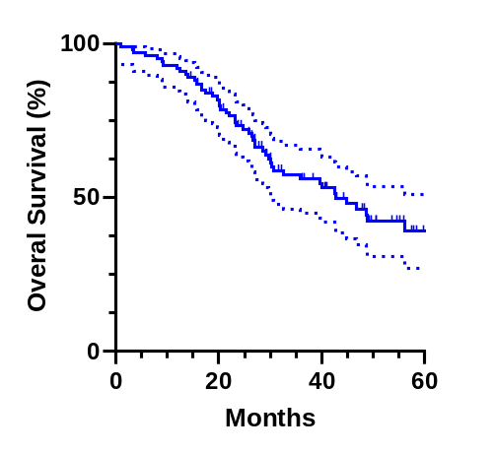
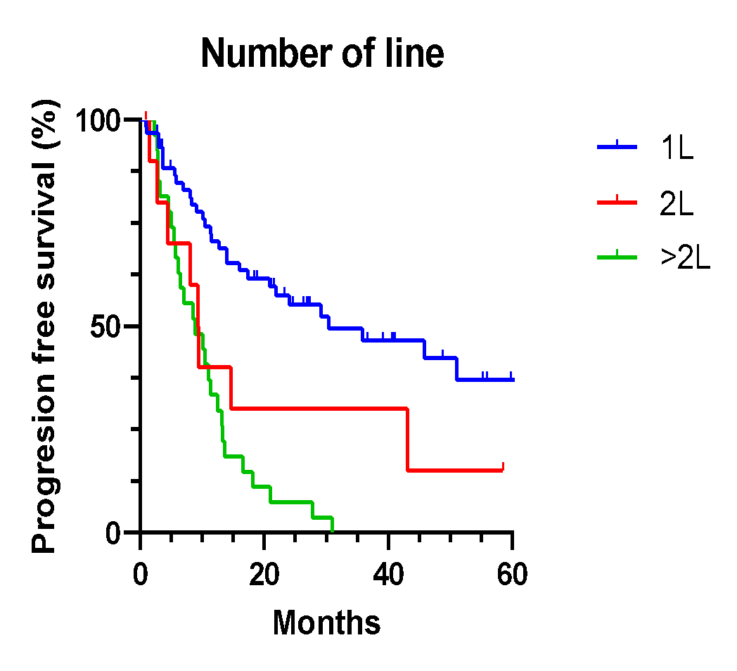
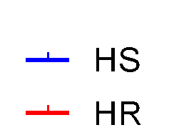


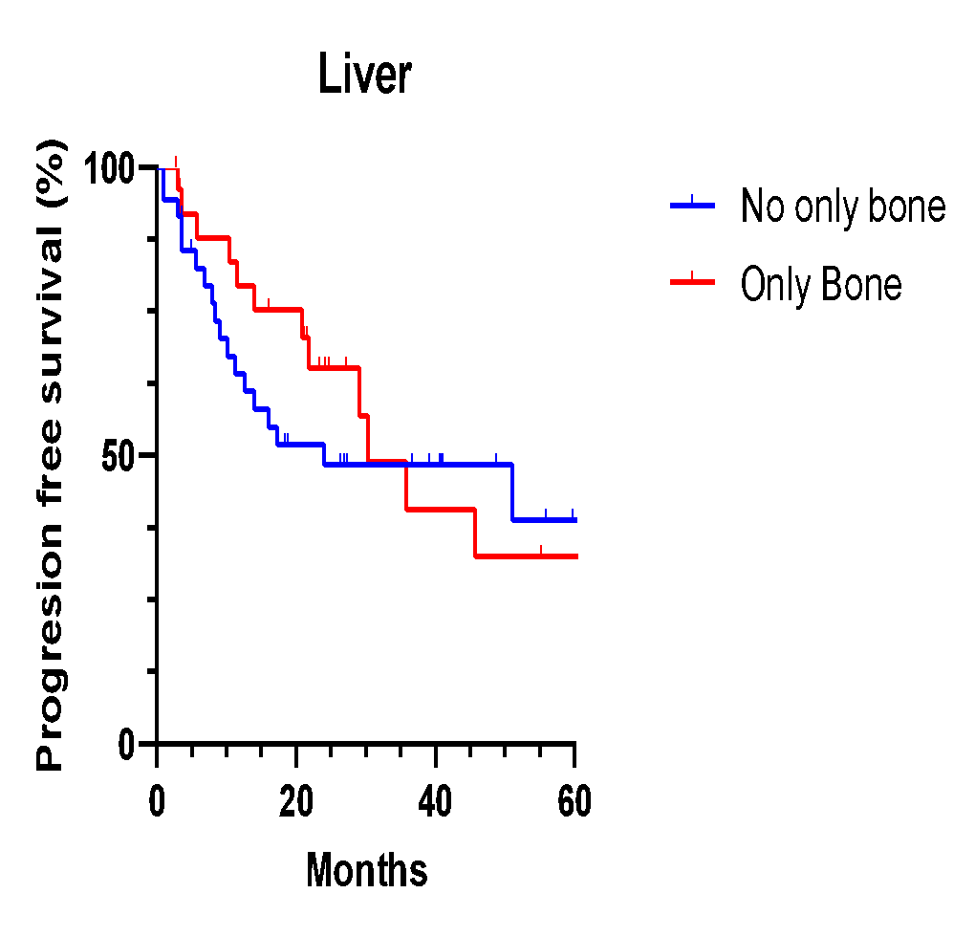

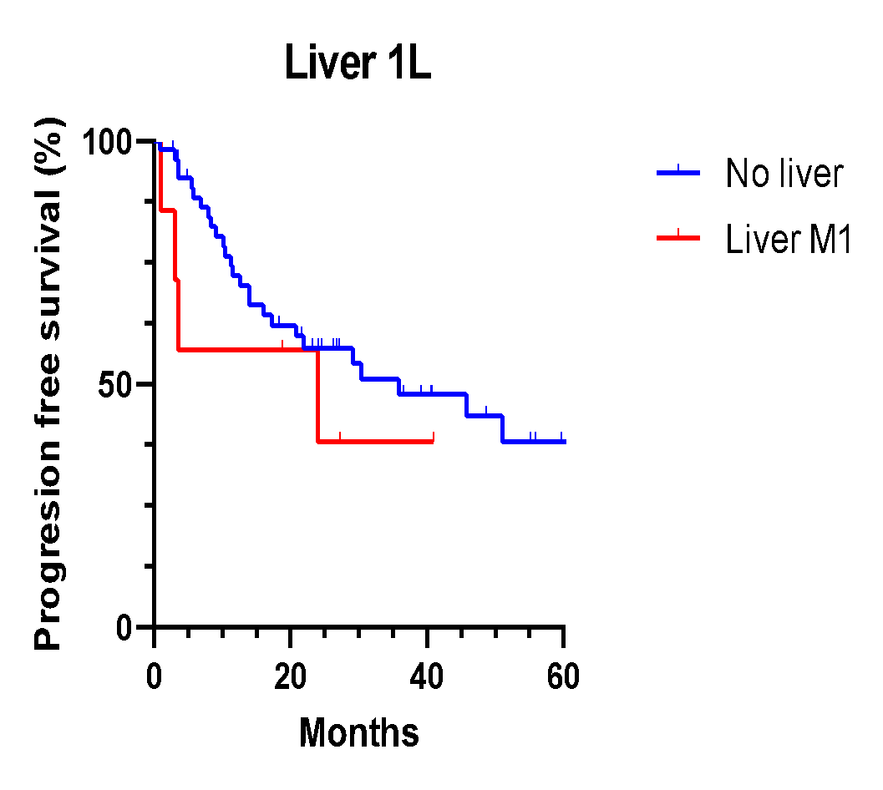

Supplementary Figure 2.
A.
B.
14 months
IQR: (5.6m – 26.56m)
42.8m
IQR: (20.33m – 47.30m)
C.
D.
30.4m vs. 9.35m vs. 8.8m
p=0.001
45.8 vs 14m
HR: 0.56; p=0.11
E.
F.
24m vs. 30.4m
HR: 0.82; p=0.592
35.9m vs. 24m
HR: 0.62; p=0.364

Slide 3
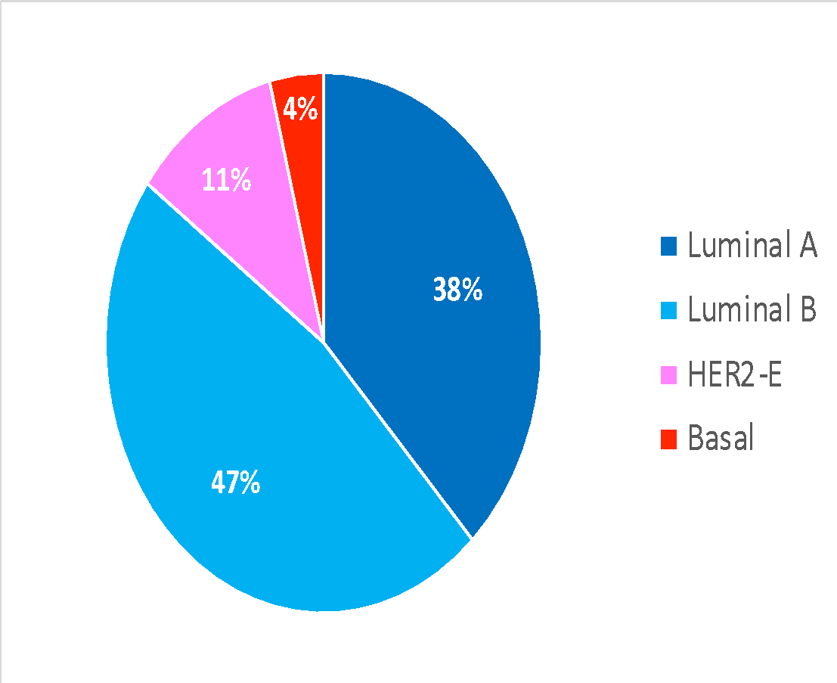
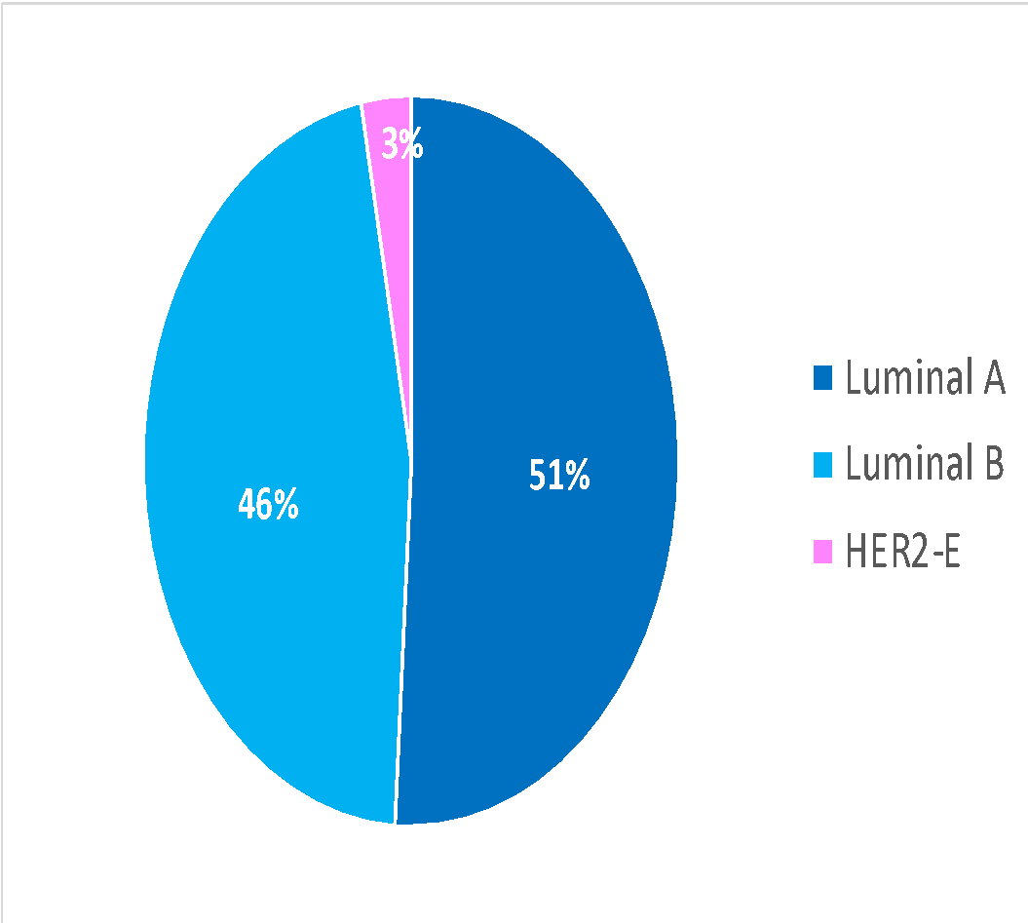
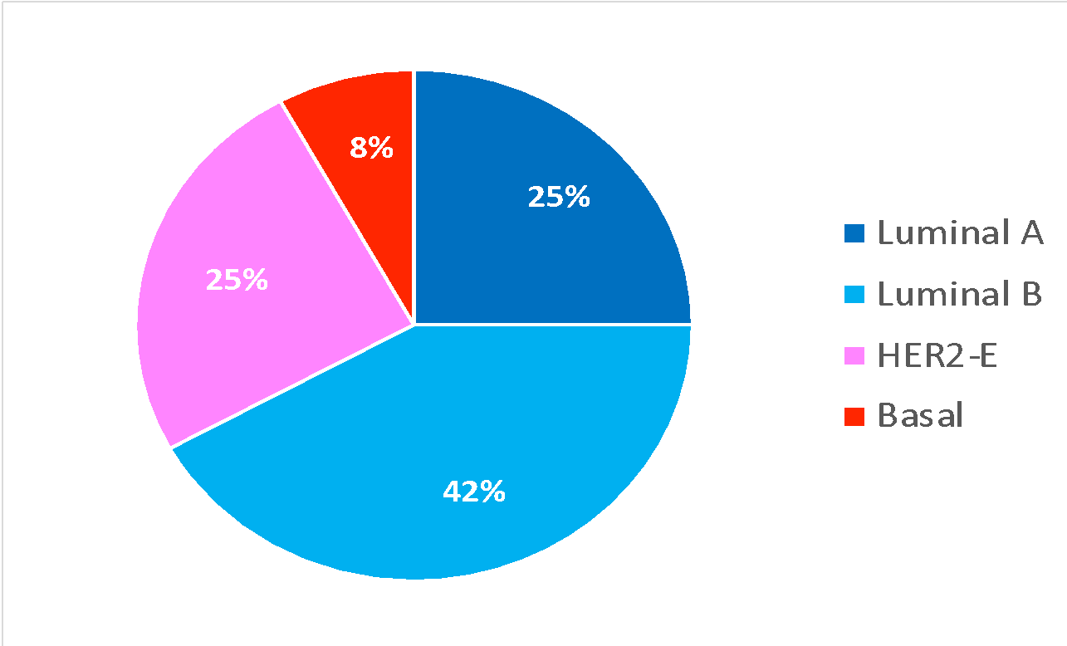
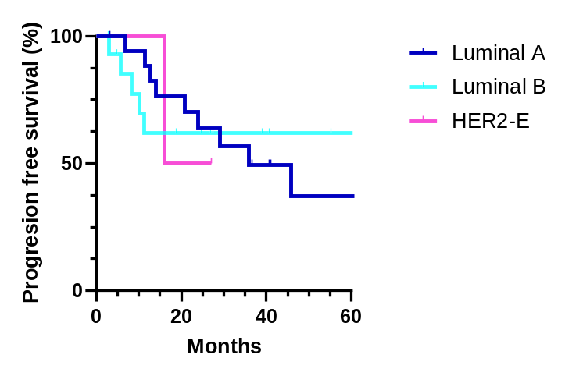
Supplementary Figure 3.
A.
PAM50 subtypes
All cohort (n=55)
Primary (n=39)
Metastasis (n=24)
B.
35.9m vs. NR vs. 21.55m
p=0.979

Slide 4
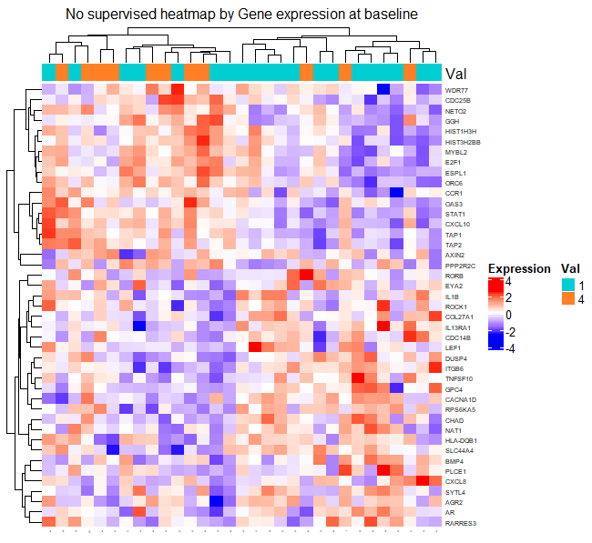
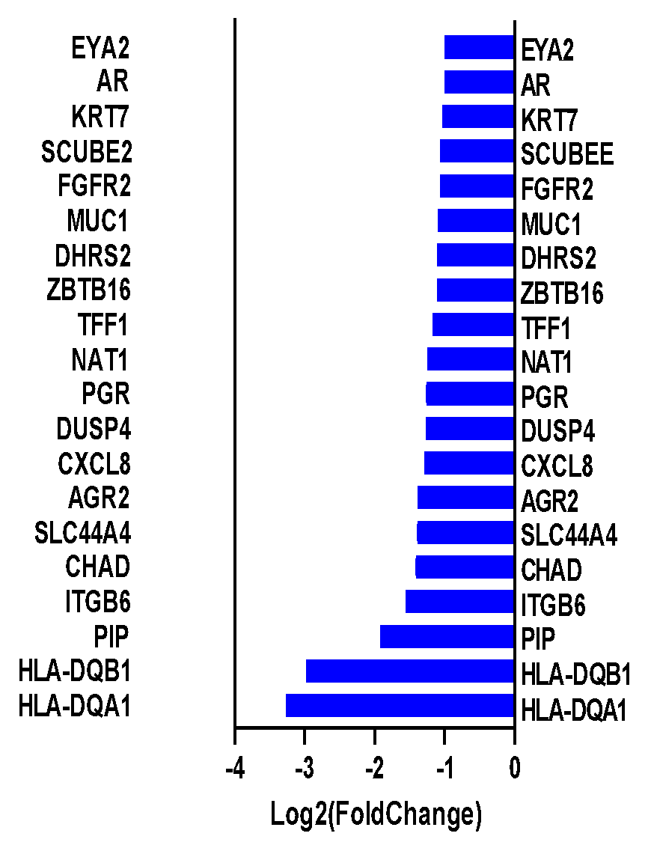
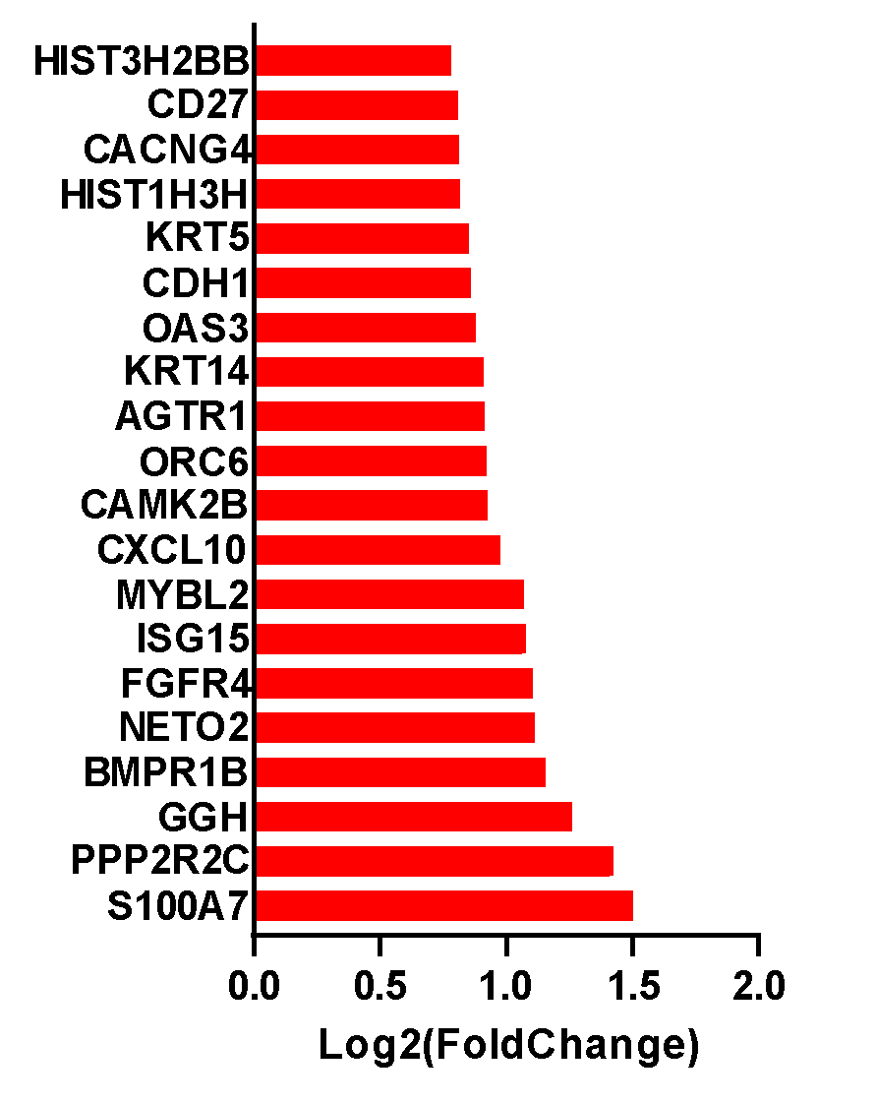

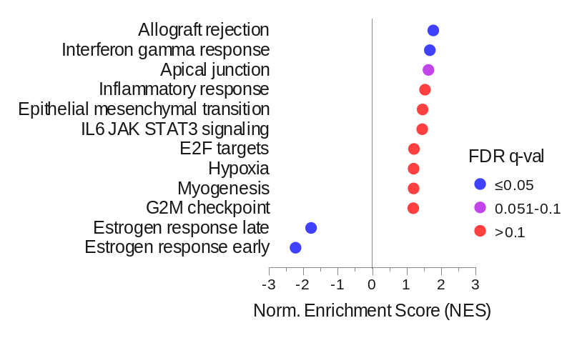
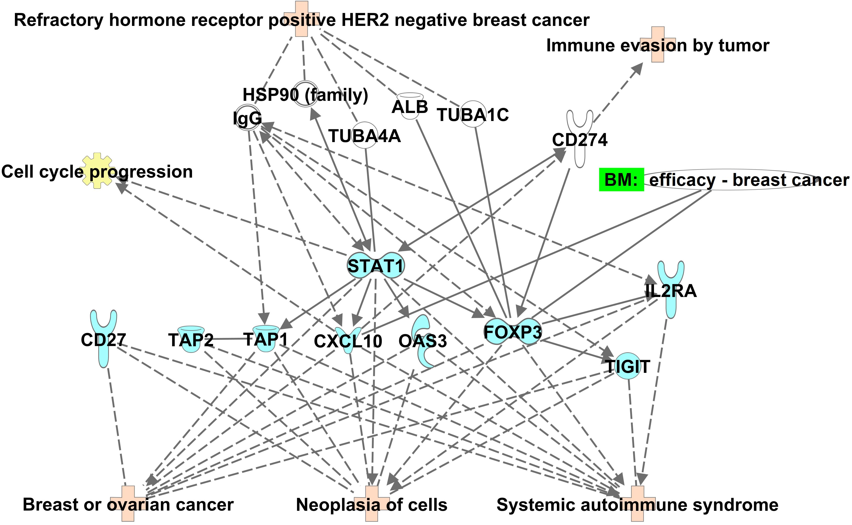
Supplementary figure 4.
A.
B.
C.
D.

Slide 5
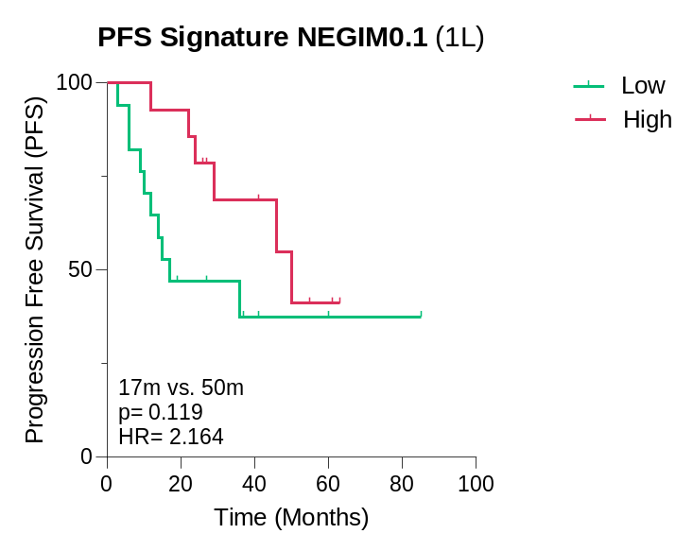
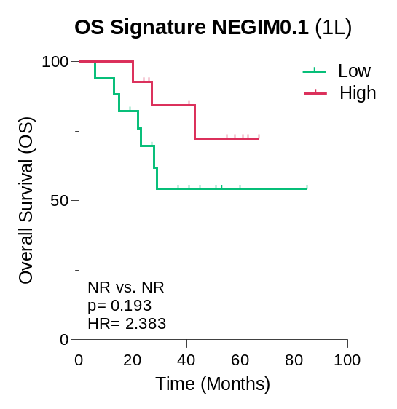
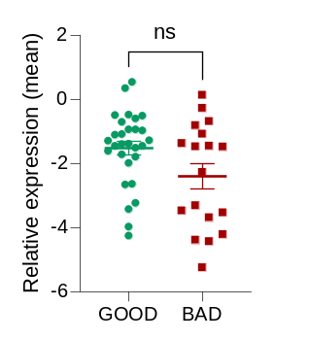
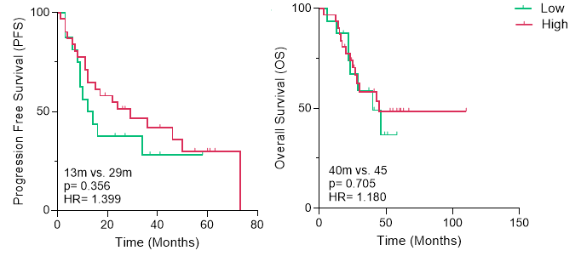
Supplementary Figure 5.
A.
B.
C.

Slide 6
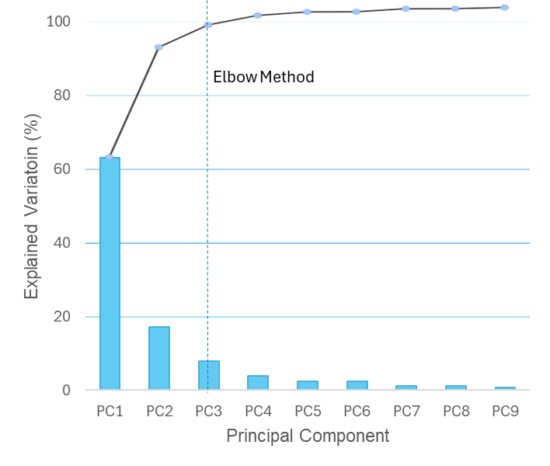
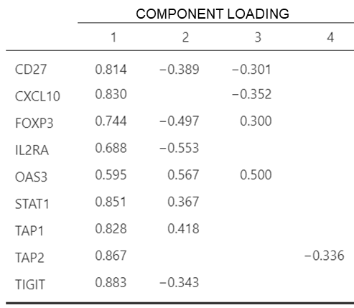
Supplementary figure 6.
A.
B.

