Slide 1
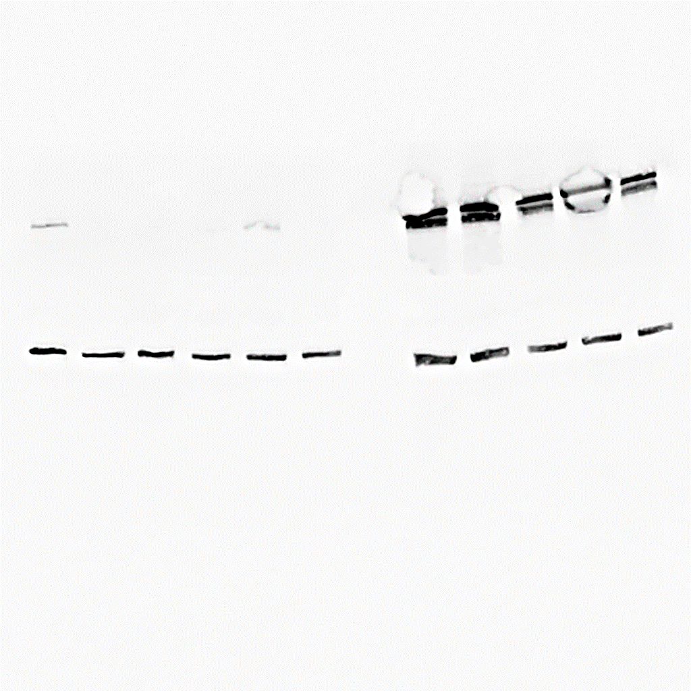
Figure S1. Testing shRNAs for optimal gene depletion.
ctrl
1-41
1-47
1-79
1-80
Striatin
Zinedin
Tubulin
shStriatin
3-64
3-17
3-83
ctrl
3-52
3-88
SG2NA
Tubulin
shSG2NA
ctrl
4-28
4-68
4-69
4-70
4-92
Striatin
Zinedin
Tubulin
shZinedin

Slide 2
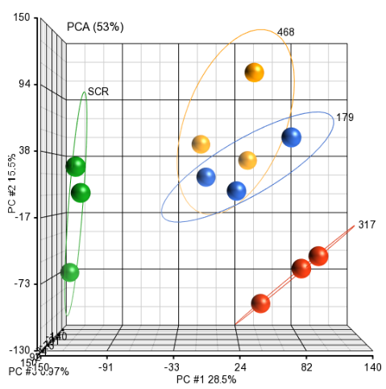
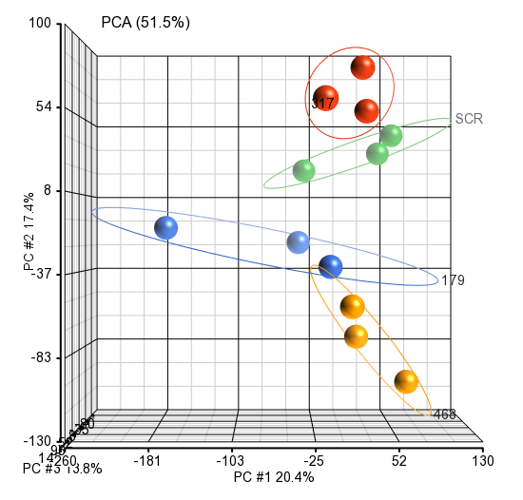
Figure S2. PCA analysis presents sample homogeneity
Fibroblasts
Keratinocytes
Zinedin
SG2NA
SCR
Striatin
SCR
SG2NA
Striatin
Zinedin

Slide 3
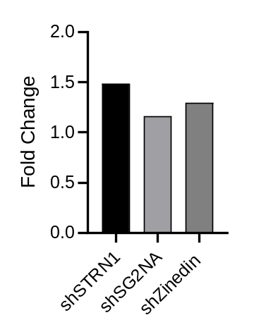
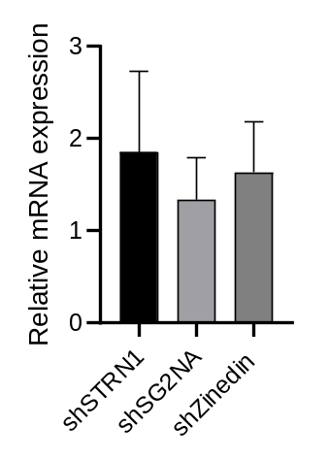
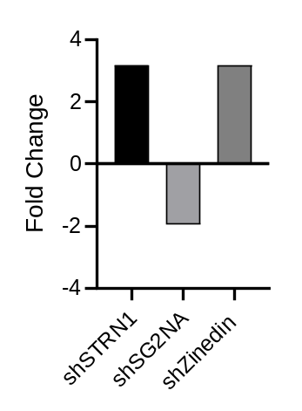
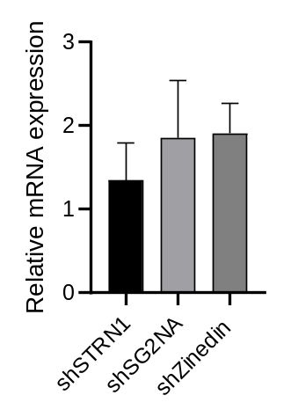
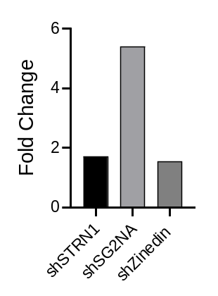
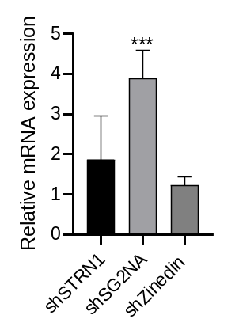
Figure S3. qRT-PCR validation of RNA-seq results.
RNA-Seq
qRT-PCR
Smad7
Cdh6
Klk7

Slide 4
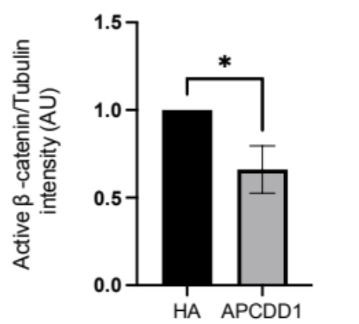
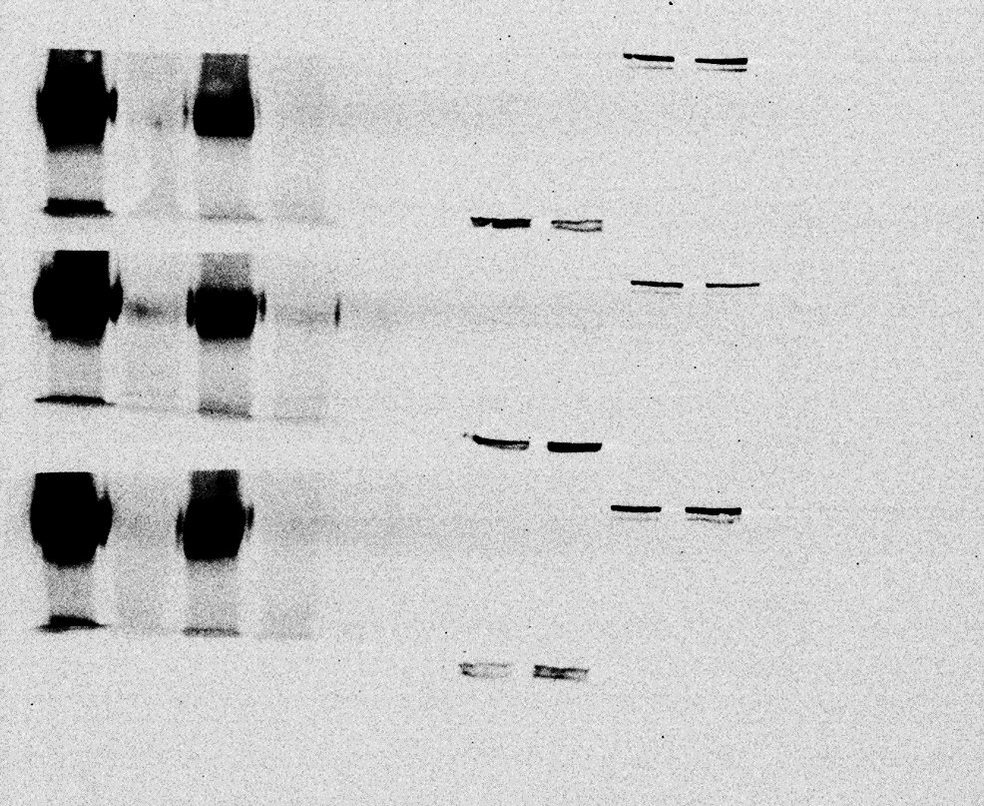
Figure S4. APCDD1 reduces the levels of active β-catenin.
A.
B.
kDa
Active β-catenin
95
HA
65
Tubulin
-
55
HA-APCDD1
+

Slide 5
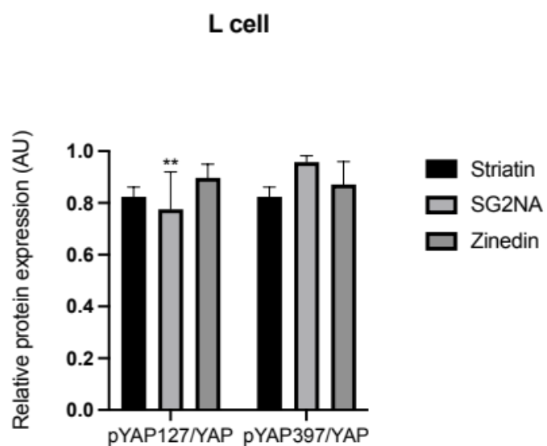
Figure S5. The effect of the Striatin proteins on the Hippo pathway is cell type specific.
Fibroblasts

Slide 6
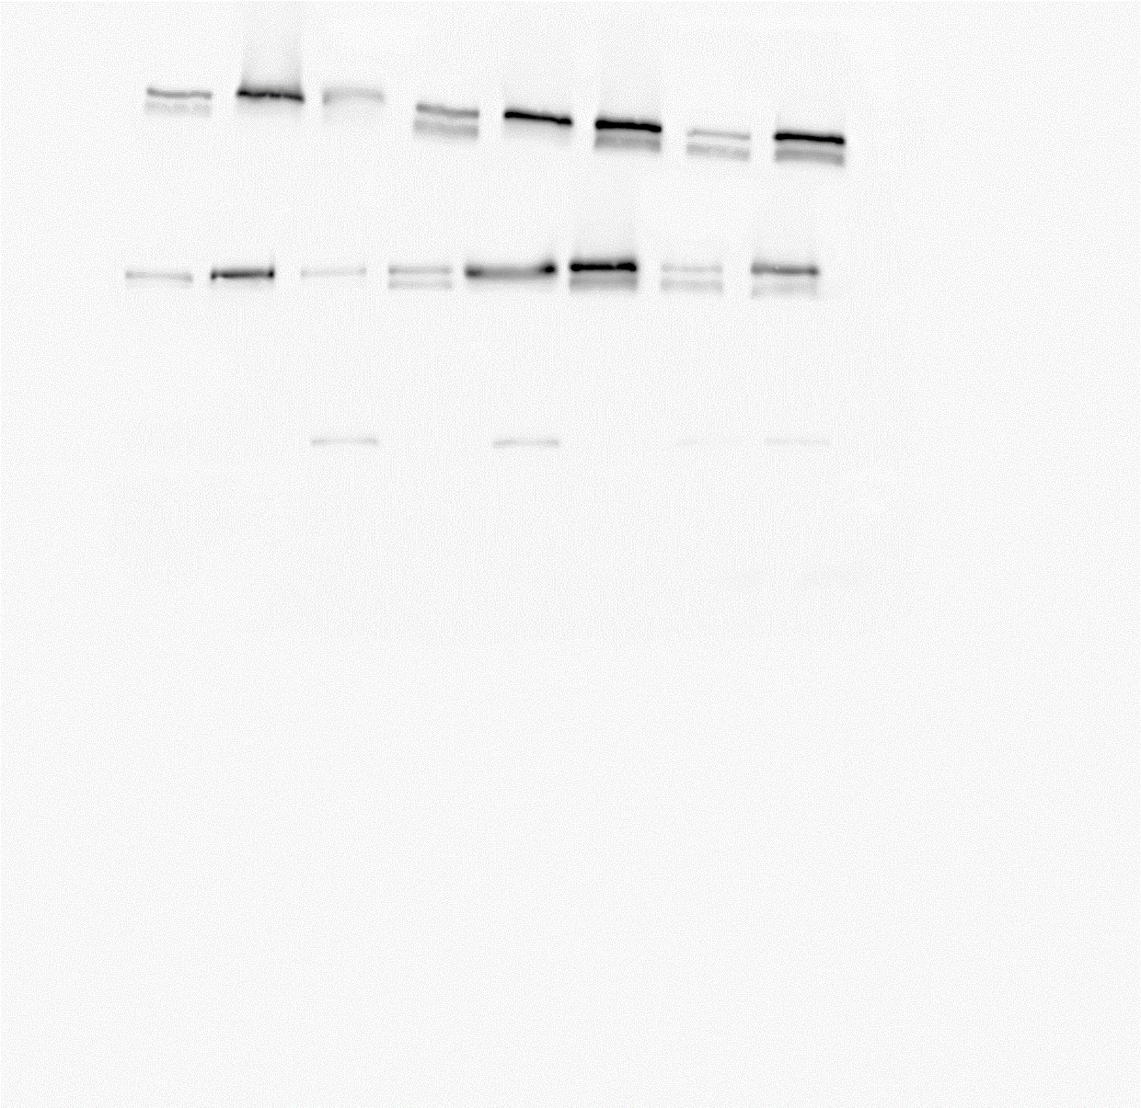
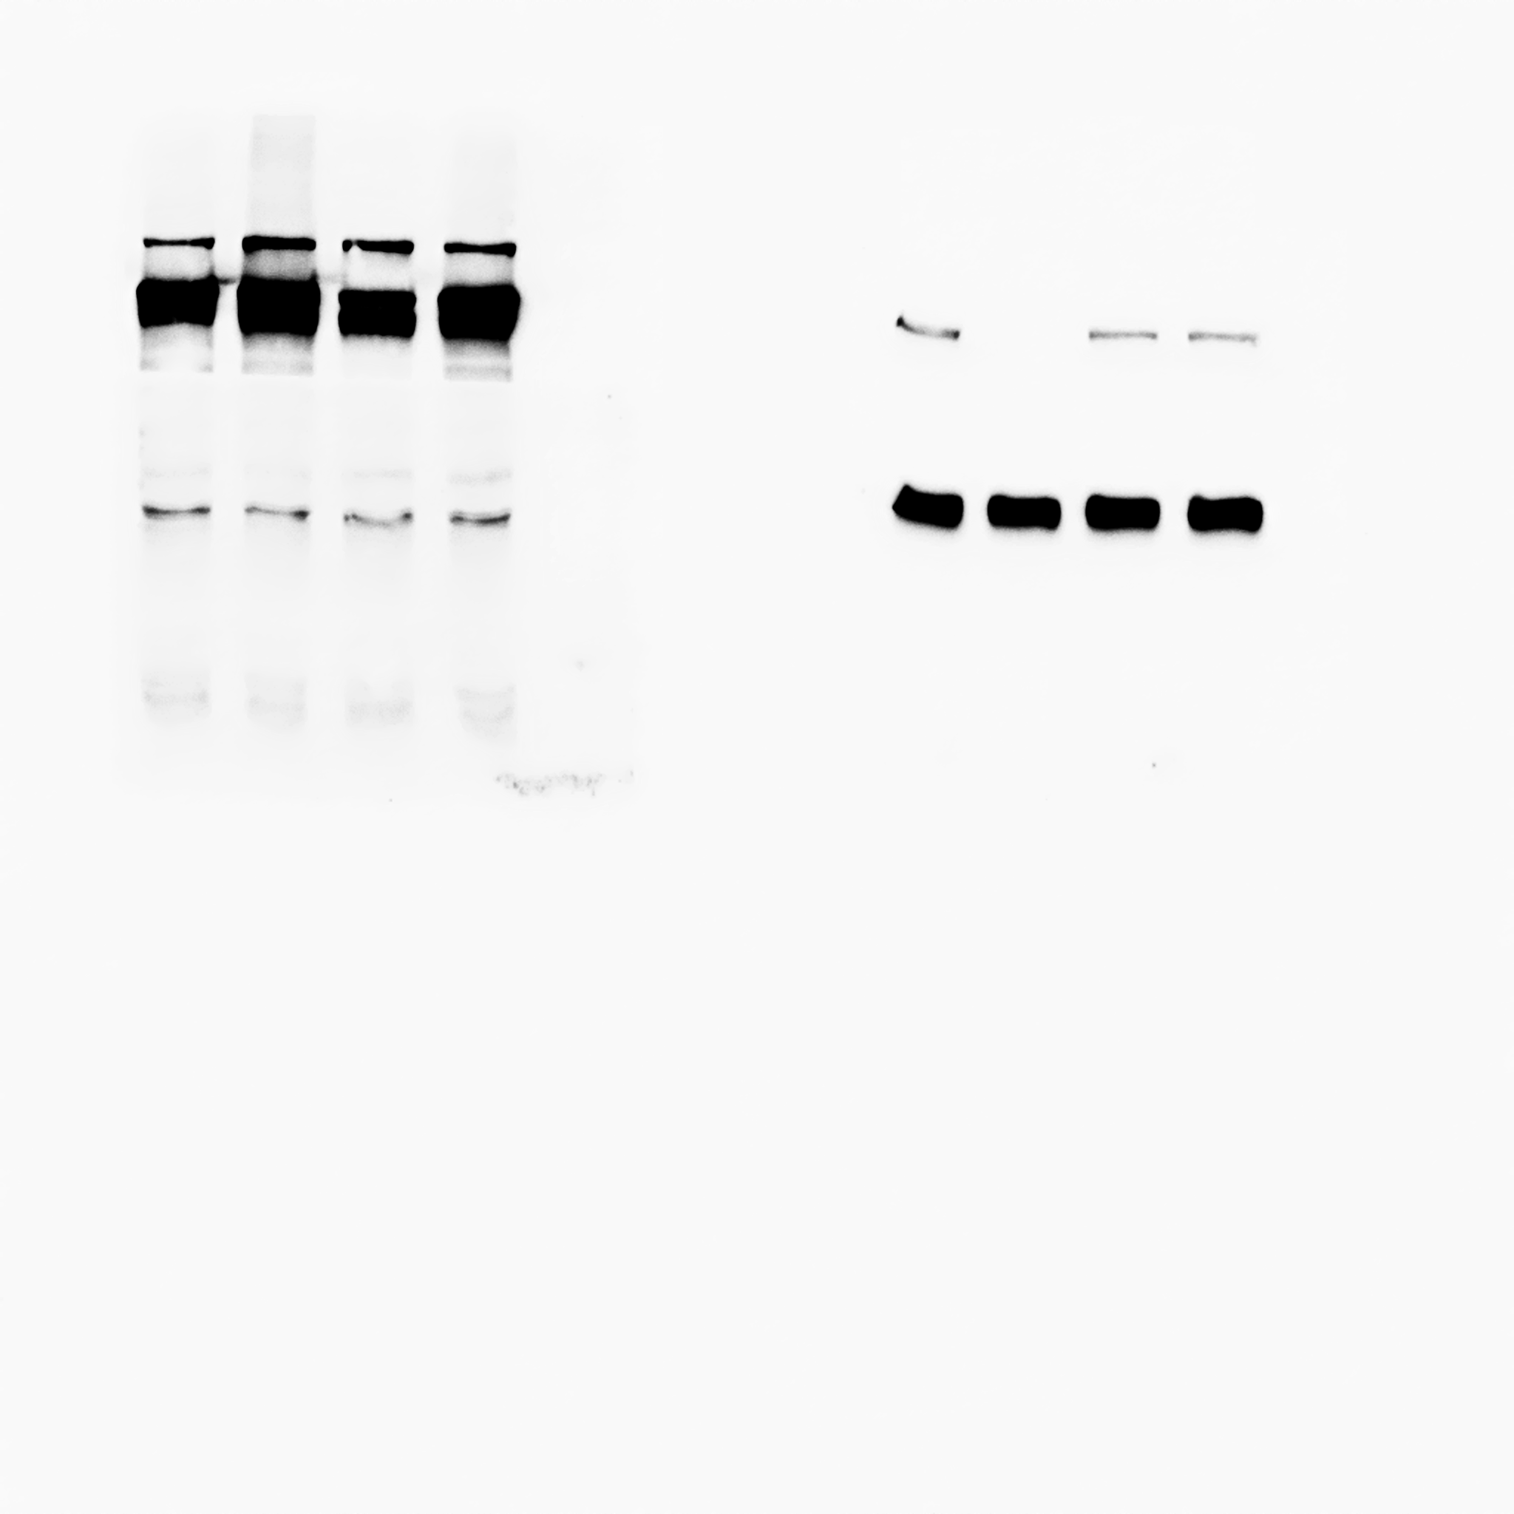
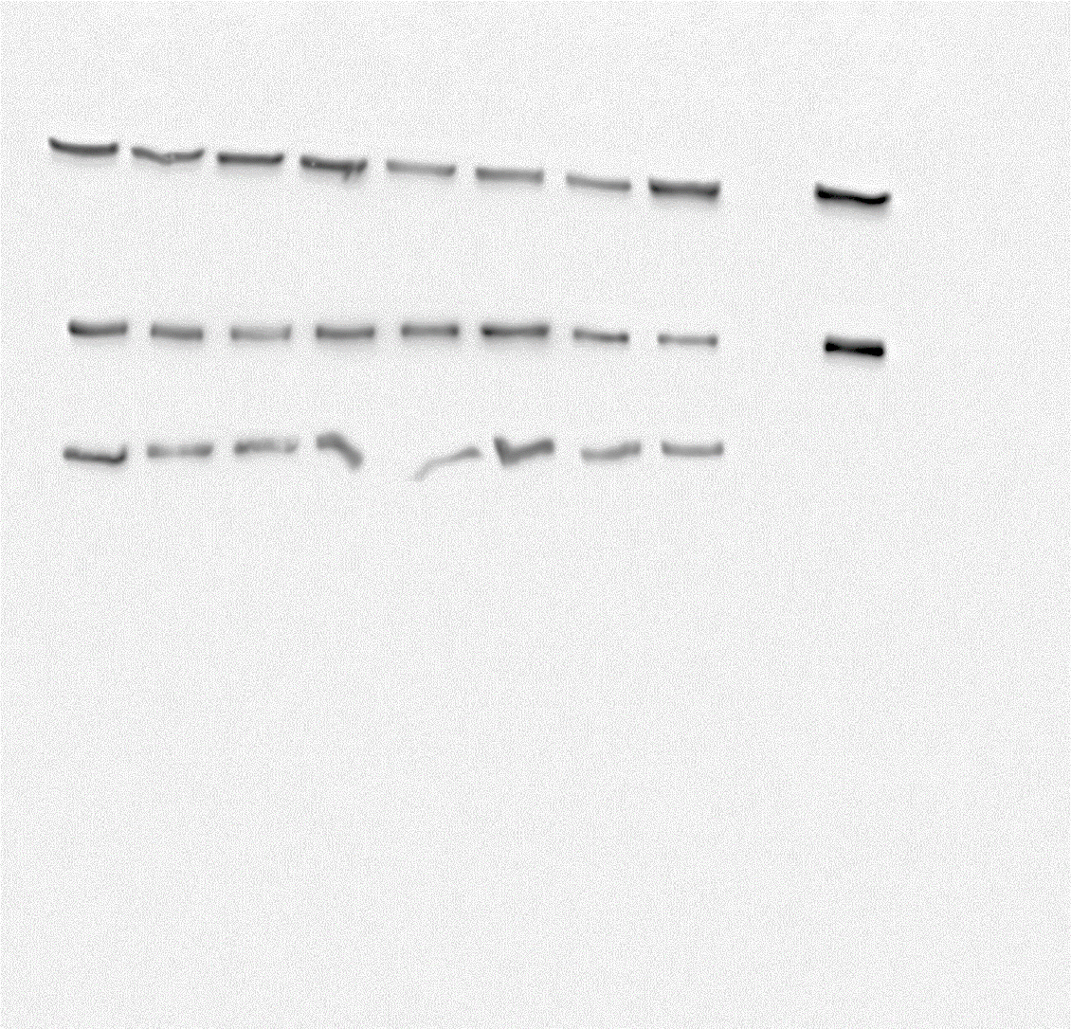
Raw western blot data
Figure 1A– Fibroblasts
Figure 1D – KT
Strn m
Strn m
Scr
shZinedin
Scr
shStriatin
shStriatin
shZinedin
shSG2NA
shSG2NA
kDa
kDa
100-110
100-110
SG2NA
SG2NA
shZinedin
Scr
kDa
shSG2NA
shStriatin
shStriatin
Scr
kDa
shZinedin
shSG2NA
95
95
Actin
Tubulin
Scr
shZinedin
shStriatin
shSG2NA
Scr
shZinedin
shStriatin
kDa
shSG2NA
45
kDa
55

Slide 7
Figure 5C
Strn m
Scr
shSG2NA
shStriatin
shZinedin
kDa
100-110
Active β-catenin
Scr
shZinedin
shStriatin
shSG2NA
kDa
95
APCDD1
shZinedin
Scr
shSG2NA
shStriatin
kDa
65
Tubulin
Scr
shZinedin
shStriatin
shSG2NA
kDa
55

Slide 8
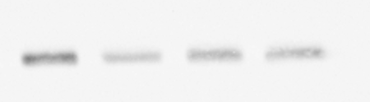
Figure 6B
LATS
SAV
shStriatin
shZinedin
shStriatin
shZinedin
SCR
shSG2NA
shSG2NA
KDa
SCR
KDa
140
45
pYAP127
Axin2
shStriatin
shSG2NA
shZinedin
shZinedin
shSG2NA
SCR
SCR
shStriatin
KDa
KDa
65
100
pYAP397
shStriatin
shZinedin
Slug
SCR
shSG2NA
KDa
shStriatin
shZinedin
65
SCR
shSG2NA
kDa
35
YAP/TAZ
shZinedin
shStriatin
Tubulin
SCR
shSG2NA
KDa
shStriatin
shZinedin
Yap
TAZ
SCR
shSG2NA
KDa
65
55
55

Slide 9
Figure 6E
DMSO
MG132
pYAP127
pYAP127
shStriatin
shStriatin
Scr
shZinedin
Scr
shZinedin
shSG2NA
shSG2NA
KDa
65
KDa
65
pYAP397
pYAP397
shStriatin
Scr
shZinedin
shStriatin
shSG2NA
Scr
shZinedin
shSG2NA
KDa
KDa
65
65
YAP total
YAP total
shStriatin
shZinedin
shStriatin
Scr
shSG2NA
Scr
shZinedin
shSG2NA
KDa
65
KDa
65
Tubulin
Tubulin
shStriatin
Scr
shZinedin
shStriatin
shSG2NA
Scr
shZinedin
shSG2NA
KDa
KDa
55
55

Slide 10
Figure 8A
STRN m
shStriatin+shZinedin
scr
shStriatin+SG2NA
shZinedin+SG2NA
kDa
100-110
SG2NA
shStriatin+shZinedin
scr
shStriatin+SG2NA
shZinedin+SG2NA
kDa
95
Tubulin
shStriatin+shZinedin
scr
shStriatin+SG2NA
shZinedin+SG2NA
kDa
55

Slide 11
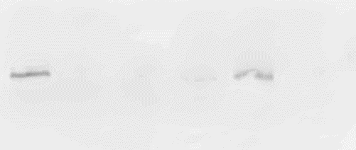
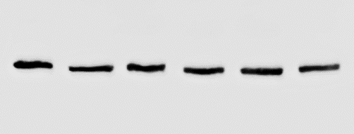
Figure S1
STRN m
Tubulin
ctrl
1-41
1-47
1-79
1-80
ctrl
1-41
1-47
1-79
1-80
SG2NA
Tubulin
ctrl
3-17
3-52
3-64
3-83
3-88
ctrl
3-17
3-52
3-64
3-83
3-88
Zinedin
Tubulin
ctrl
4-28
4-68
4-69
4-70
4-92
4-92
ctrl
4-28
4-68
4-69
4-70

Slide 12
Figure S4
HA
LWNT3A-HA
LWNT3A-APCDD1
L-APCDD1
L-HA
kDa
65
Active b-catenin
LWNT3A-HA
LWNT3A-APCDD1
L-APCDD1
L-HA
kDa
95
Tubulin
LWNT3A-HA
LWNT3A-APCDD1
L-HA
L-APCDD1
kDa
55

