Slide 1
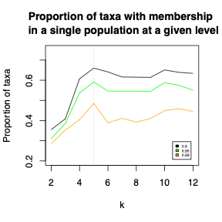
Notes:
Figure S1. The proportion of unimproved J. regia taxa (n=2514) with FastStructure membership in a single sub-population, for k = 2-12 and membership cutoffs of 0.90, 0.95, and 0.99. The vertical dashed line shows that k=5 maximizes membership regardless of which cutoff is used.

Slide 2
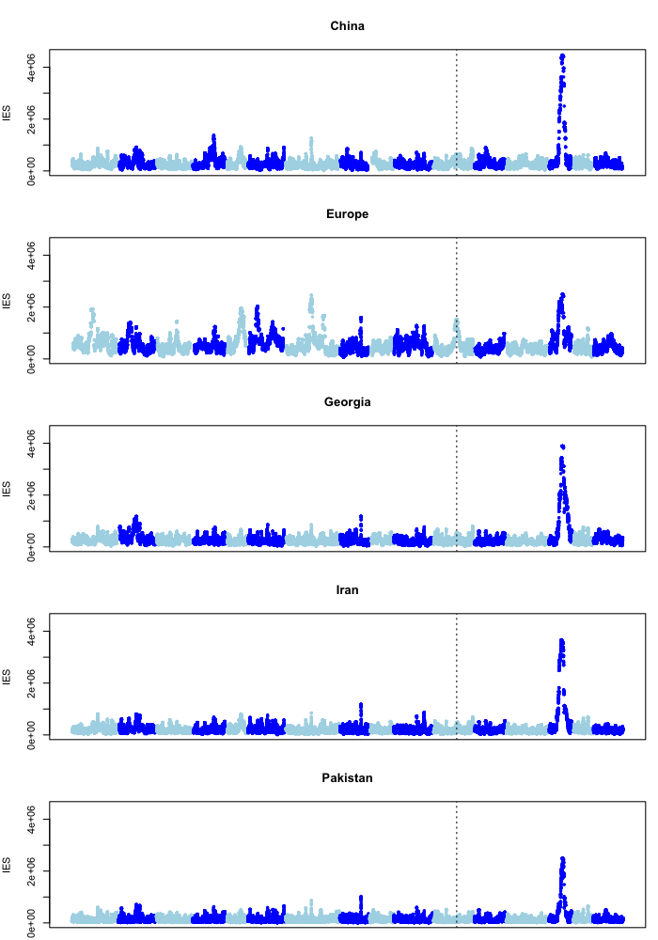
Unimproved (n = 2514)
Improved (n = 343)
China
Western Europe
Caucasus
Iran
Himalayas
Notes:
Figure S2. IES scores in unimproved and improved panels of J. regia, and in each of the five J. regia subpopulations. The dashed vertical line indicates the approximate position of the Lb1 locus, which regulates lateral bearing and shows evidence of selection in improved, but not unimproved, lines of J. regia.

Slide 3
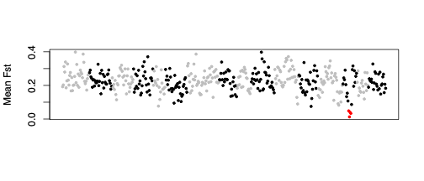
Notes:
Figure S3. Mean F_{ST} between J. regia and J. sigillata calculated in 100-SNP windows. The four lowest-F_{ST} windows colored in red are all within the swept region on chr14.

Slide 4
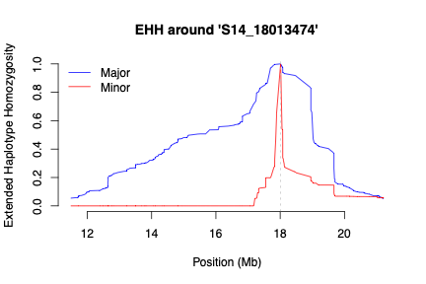
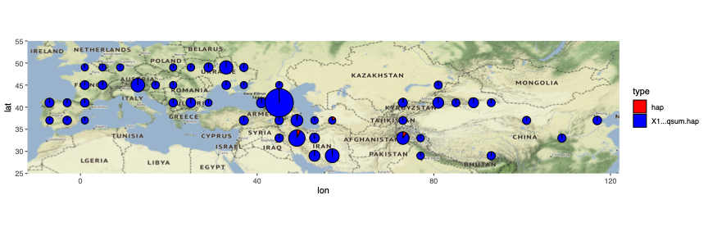
Notes:
Figure S4. Top: EHH for major (blue) and minor (red) alleles at the SNP at 18.01 Mb with the highest IES score. Bottom: Geographic distribution of the minor allele.

Slide 5
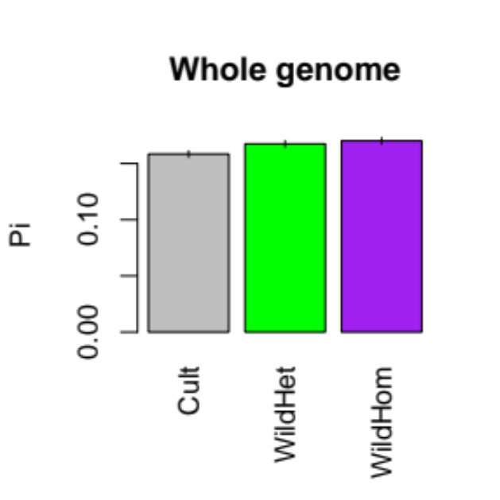
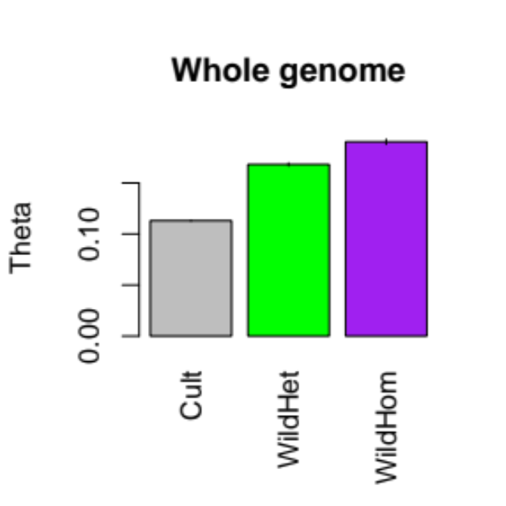
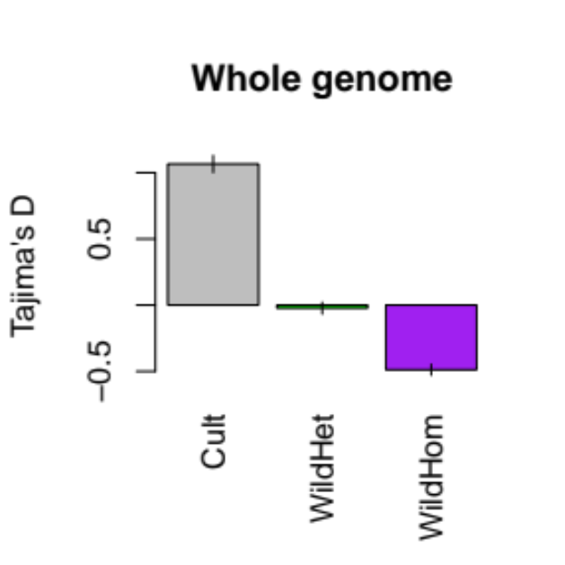
a b b
a b c
a b c
Notes:
Figure S5. Pi, theta, and Tajima’s D calculated in non-overlapping 100-SNP windows across all chromosomes except chromosome 14 for individuals carrying the major haplotype at the SNP with the highest IES on chromosome 14 (“Cult”) as well as heteterozygotes and homozygotes for the minor haplotype (“WildHet” and ”WildHom” respectively). Cult is always significantly different from the other two genotypic classes.

Slide 6
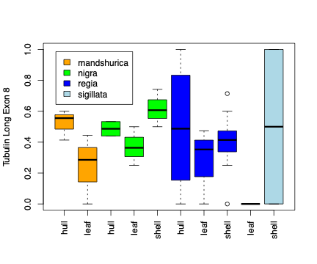
Notes:
Figure S6. Alternative splicing of a tubulin gene (LOC109014007) in the swept region on chr14. The frequency of a long exon 8 that contains 6 additional base pairs is shown, across the same transcriptome samples shown in Figure 4C.

