Slide 1
WELCOME
MCW Cancer Center Careers in Clinical Oncology and Cancer Research Symposium
September 30, 2023

Slide 2
Radiation Oncology
Aronne Schottstaedt, MD, PGY IV
MCW Cancer Center Careers in Clinical Oncology and Cancer Research Symposium - September 30, 2023

Slide 3

Rad Oncs are:
Doctors
Oncologists
Radiation Oncologist

Slide 4
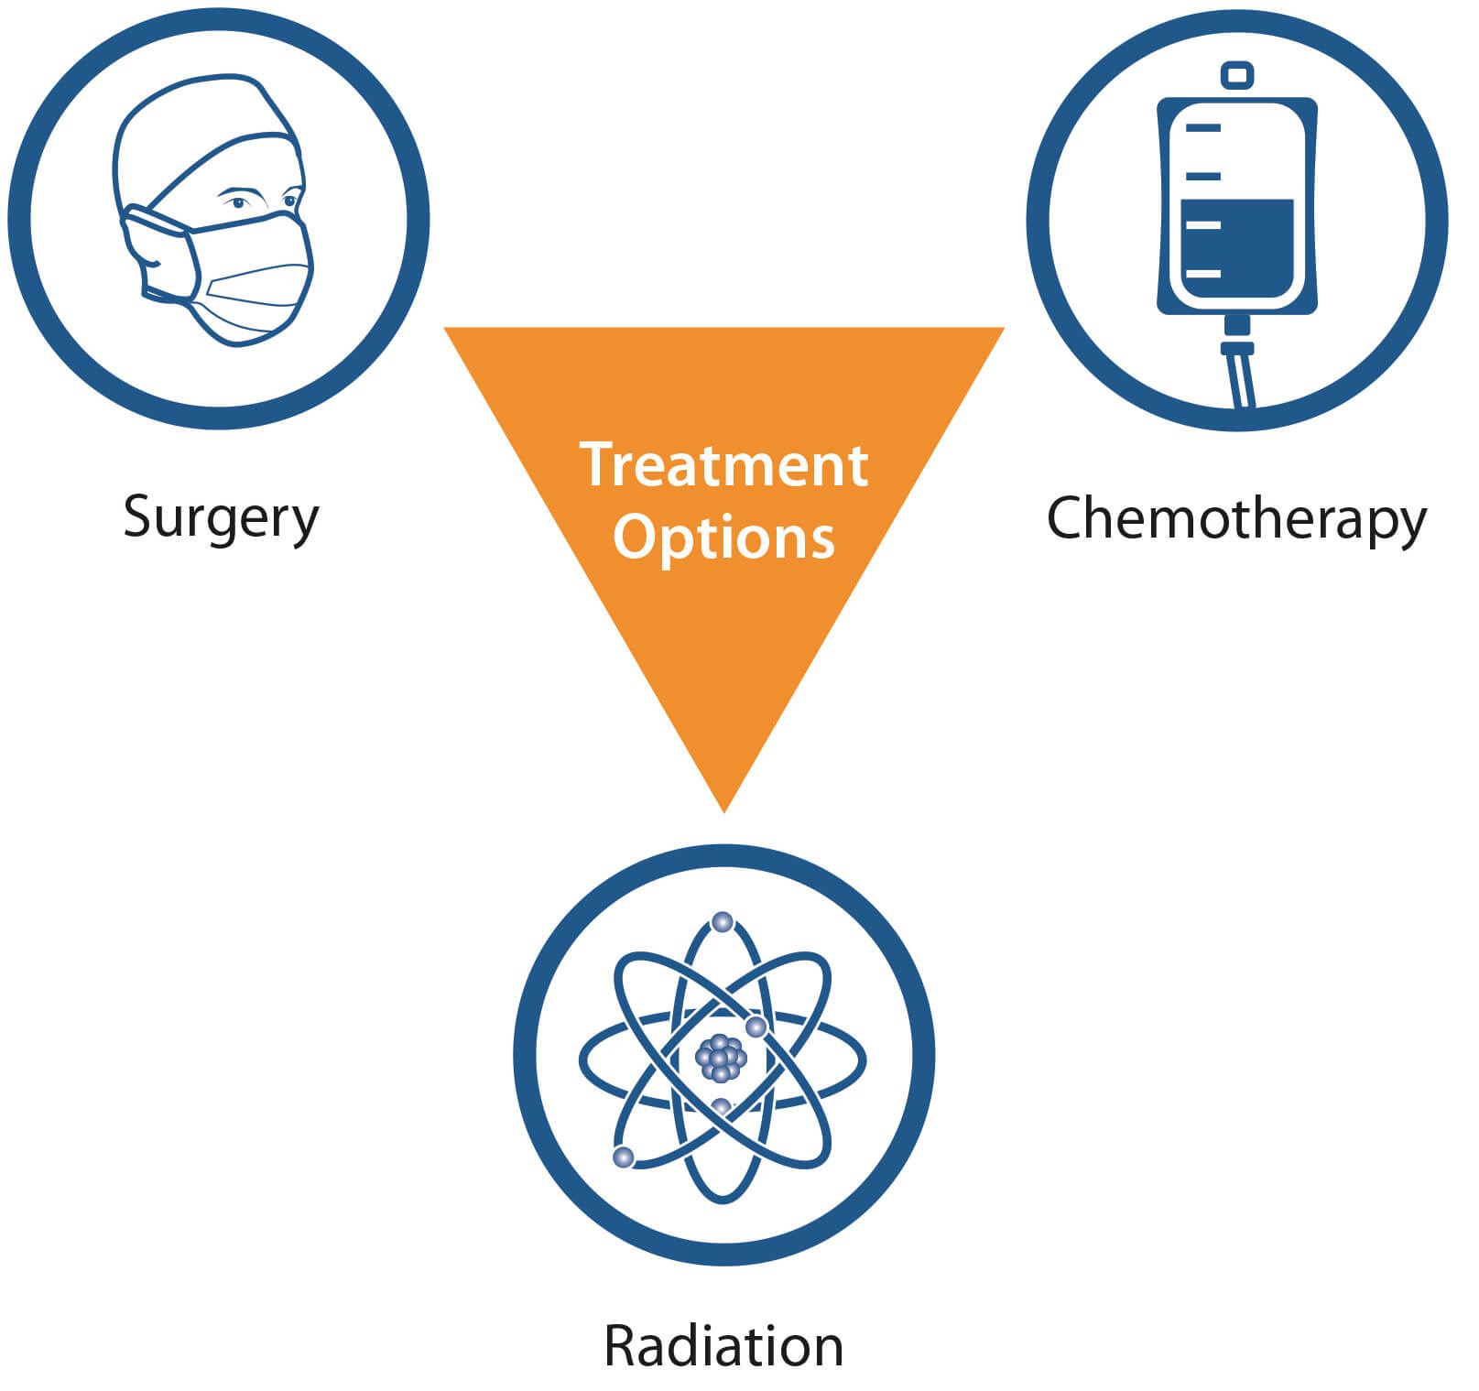
3 Ways to Treat Cancer

Slide 5
Radiation Oncologists deliver very localized radiation to the target!
Photons, Electrons, Protons, Etc.
  Generate ROS, facilitate DNA damage and mutation accumulation to kill cancer cells with relative sparing of nearby normal tissue
Often fractionated – thus many patients receive radiation for up to 8 weeks
Unit of Radiation = Gray
What is Rad Onc?

Slide 6
Who do we treat?
Cancer Patients! (mostly)
Children → Adults
Almost all cancer sites (even liquid malignancies)
All stages of disease (treat primary/prevent recurrence → oligo/widely metastatic)
Healthy (aside from cancer) → ICU patients
Curative, Definitive, Palliative Intent
Benign diseases

Slide 7
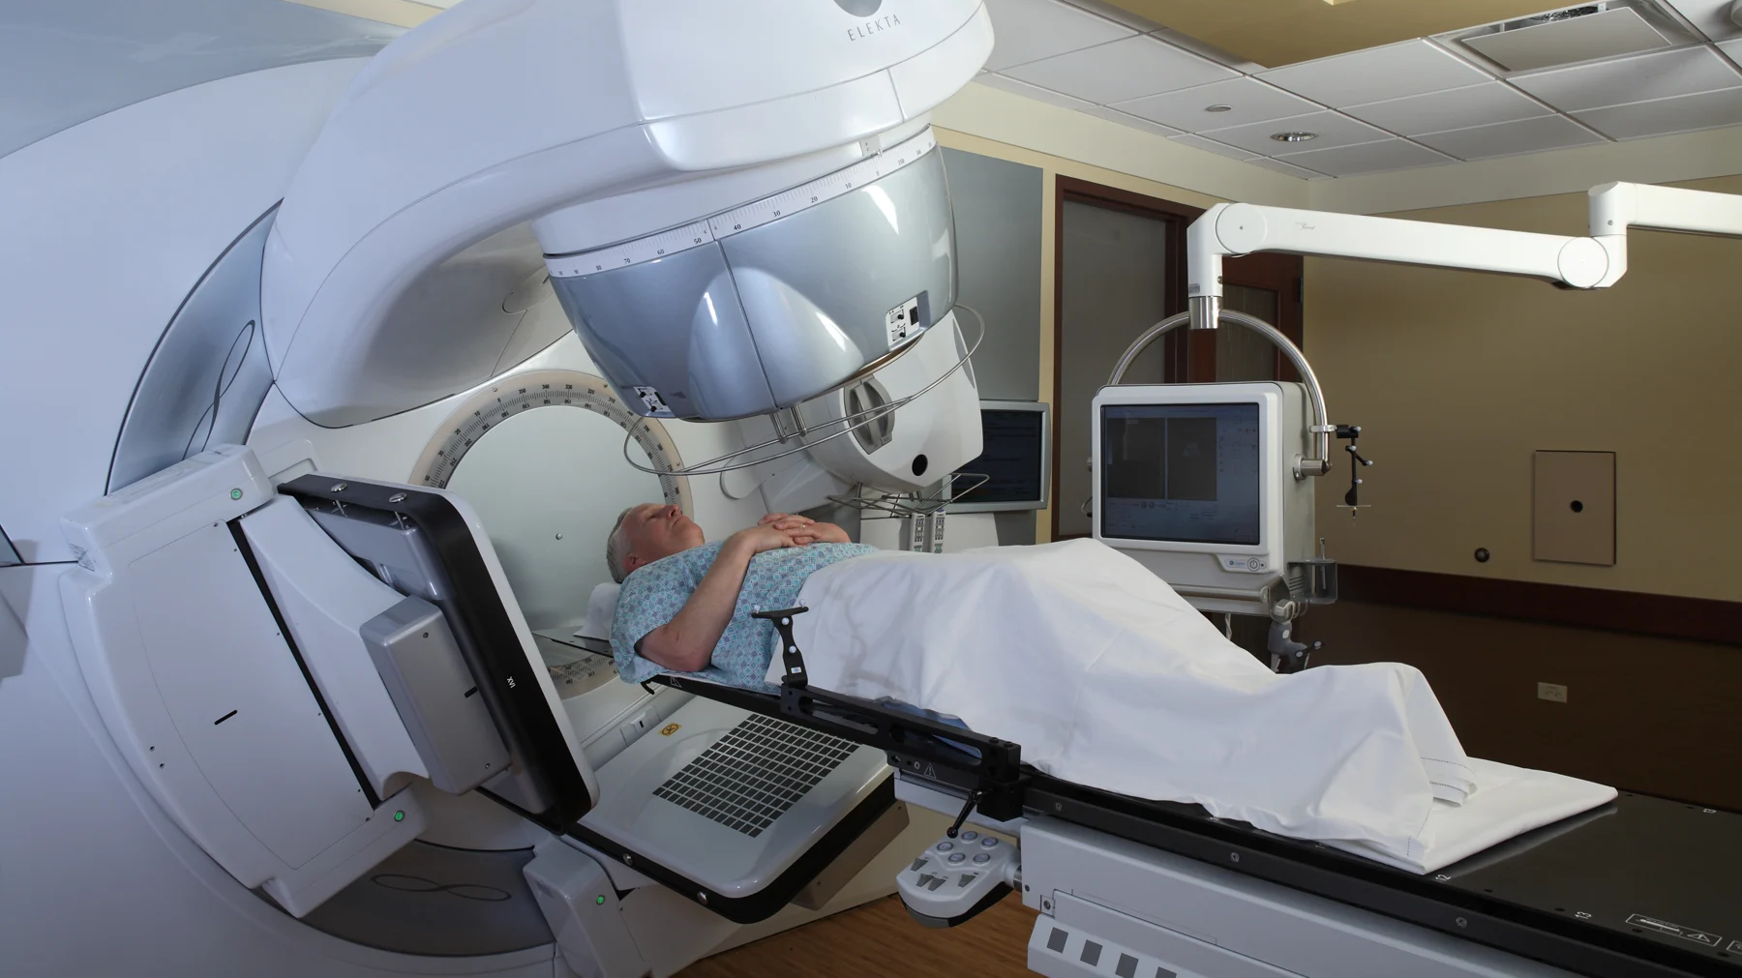
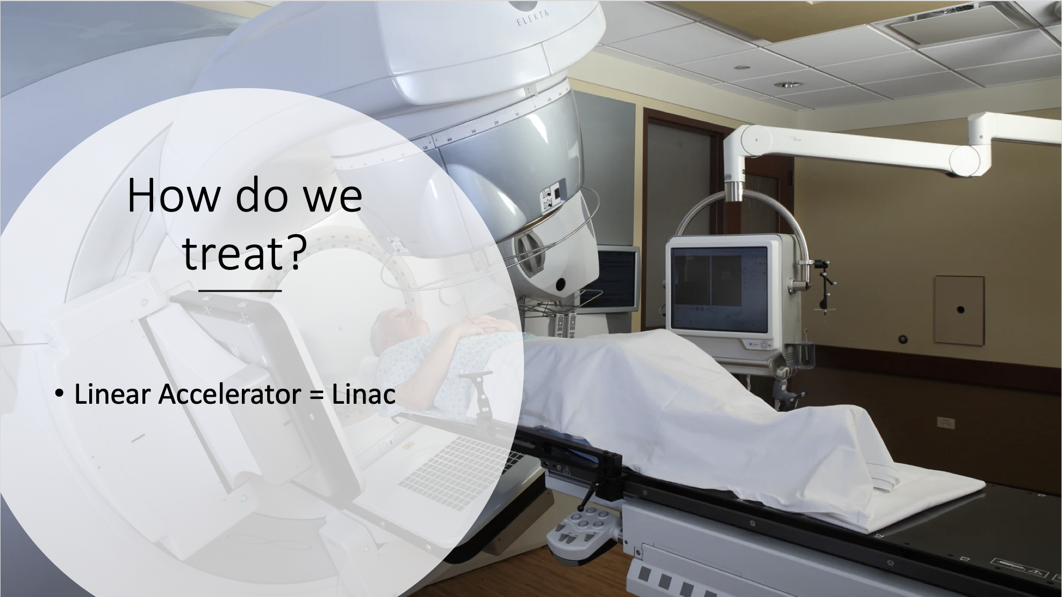
How do we treat?
Linear Accelerator = Linac
Notes:
https://www.google.com/search?q=linear+accelerator&tbm=isch&ved=2ahUKEwibkono_uzyAhWTUawKHX58AEkQ2-cCegQIABAA&oq=linear+accelerator&gs_lcp=CgNpbWcQAzIFCAAQgAQyBQgAEIAEMgUIABCABDIFCAAQgAQyBQgAEIAEMgUIABCABDIFCAAQgAQyBQgAEIAEMgUIABCABDIFCAAQgAQ6BwgjEO8DECc6CAgAELEDEIMBOgsIABCABBCxAxCDAToICAAQgAQQsQM6BAgAEANQjuwDWMj_A2C7gQRoAHAAeACAAU6IAcwIkgECMTiYAQCgAQGqAQtnd3Mtd2l6LWltZ8ABAQ&sclient=img&ei=FWw3YduzO5OjsQX--IHIBA&bih=673&biw=1383#imgrc=x2l7NVHsfMiQeM

Slide 8
How do we treat?
Consult
Tumor Board
CT sim
Linac Sim/Positioning
Treatment
Weekly Visits
Follow up
Notes:
Thus we are mostly in clinic, but also doing radiation treatment planning

Slide 9
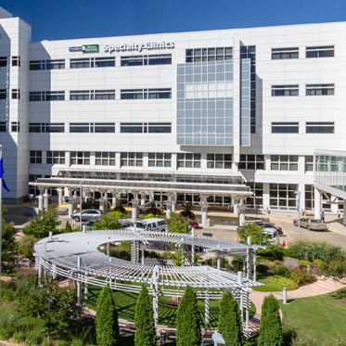
Mostly Outpatient
Consults
Pre sim
Weekly
Follow up
~10-30 per day

Slide 10
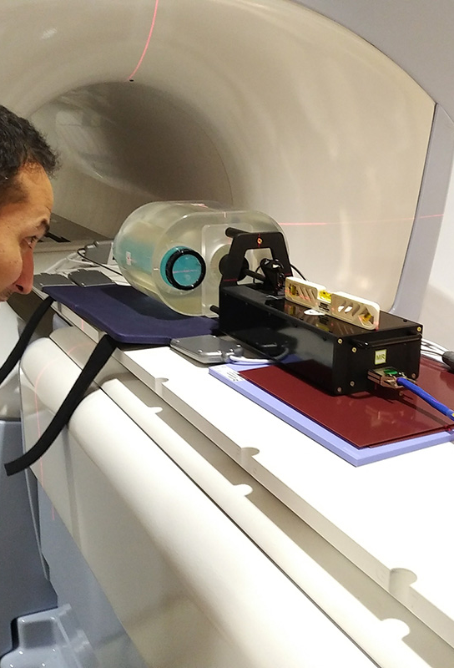
Helpful Staff
Nurses
Radiation therapists
Dosimetrists
Physics

Slide 11
What do we actually do?
Counsel patients, treat, manage symptoms, review images, follow up
Sim and Contours
Check plans (made by dosimetry, QA by physics)
Confirm treatment set up

Slide 12
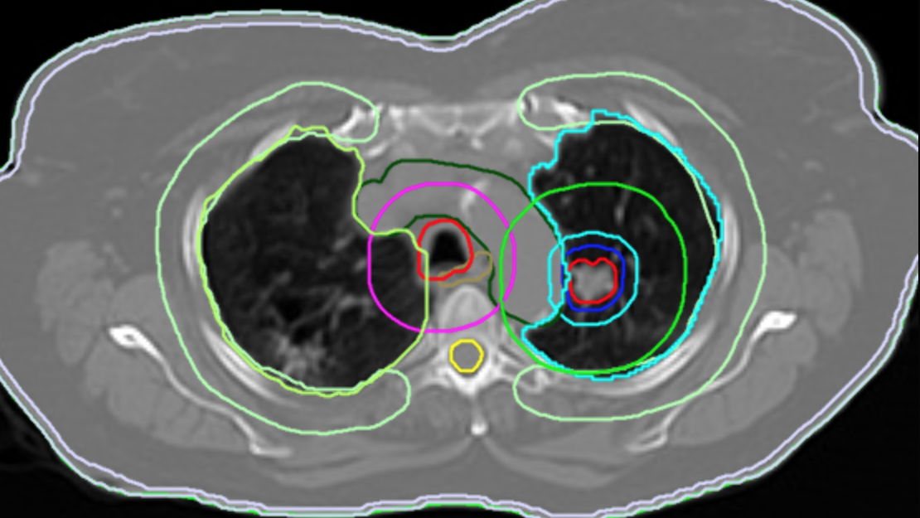
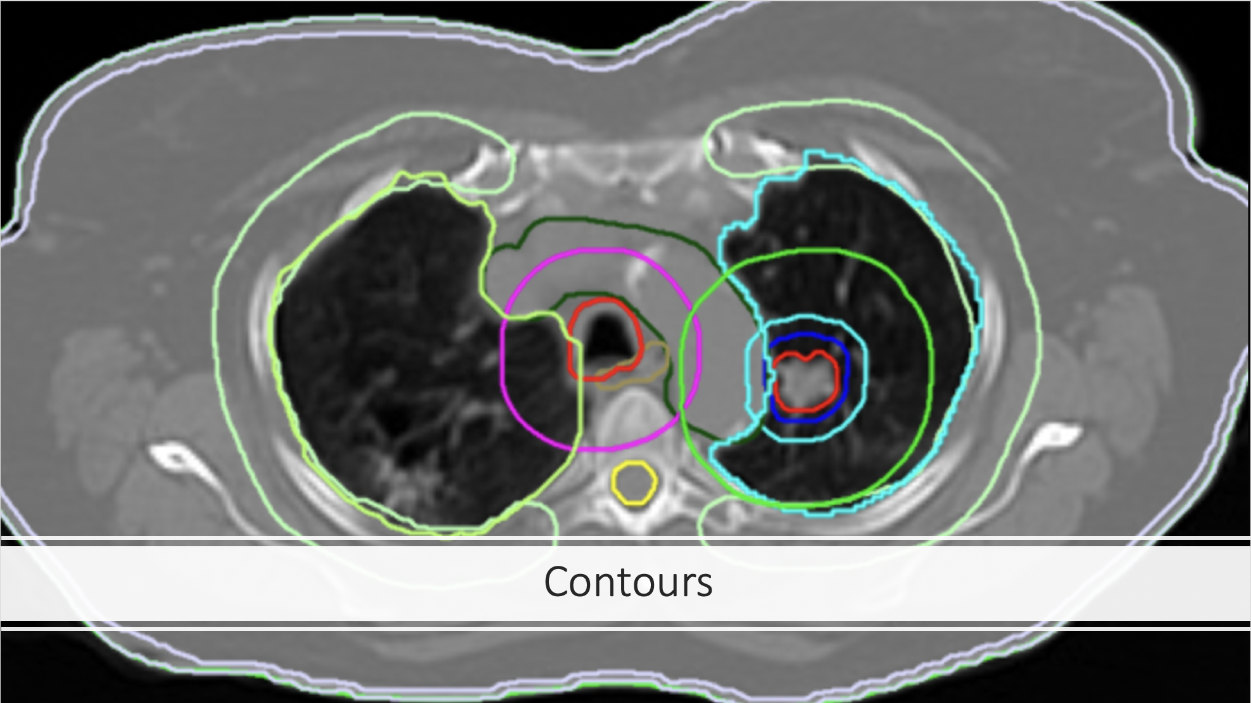
Contours

Slide 13
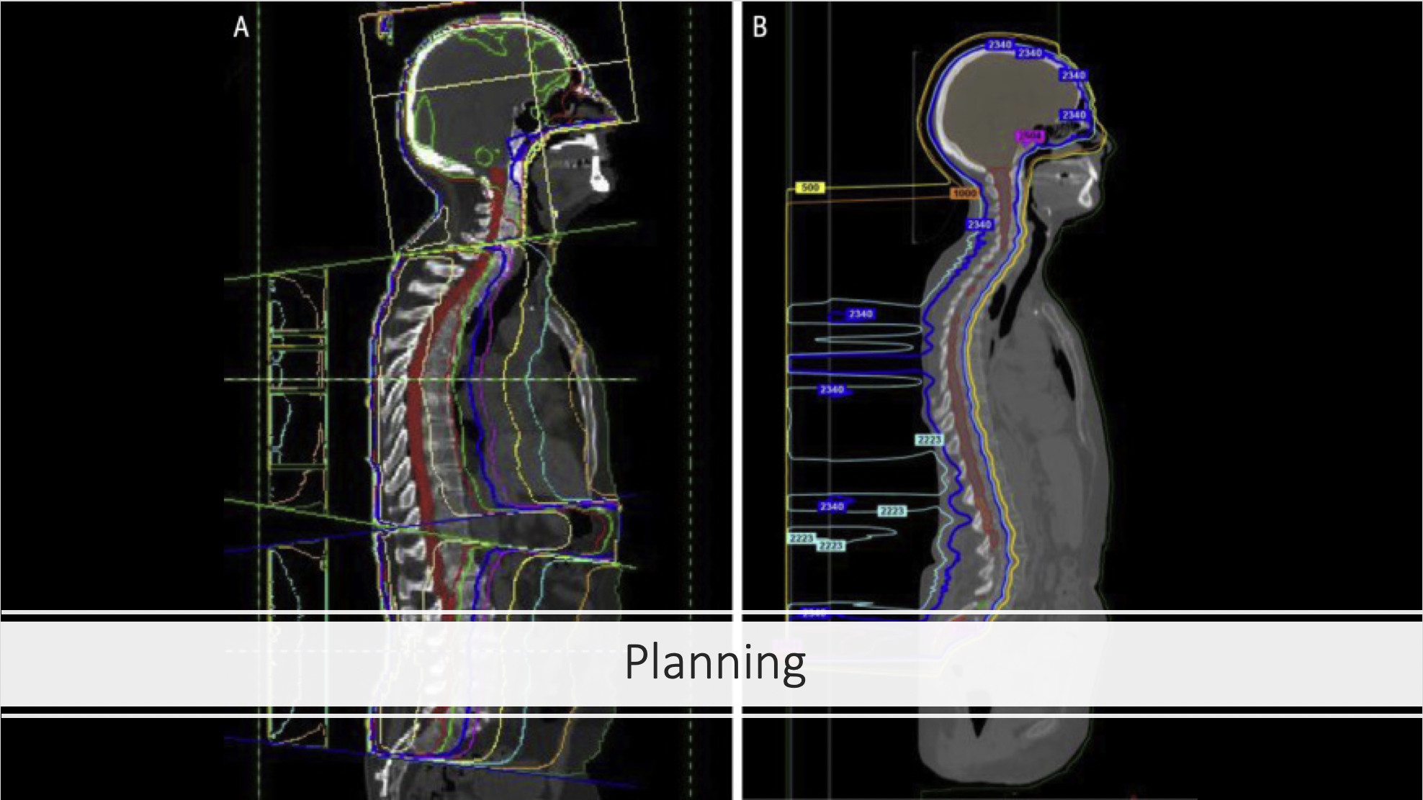
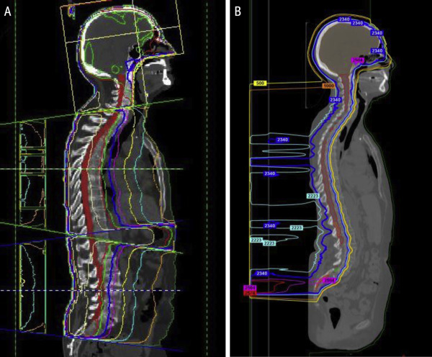
Planning
Notes:
https://els-jbs-prod-cdn.jbs.elsevierhealth.com/cms/attachment/77ee6a49-b456-484a-a7a1-2402fd1ab1af/gr2.jpg

Slide 14
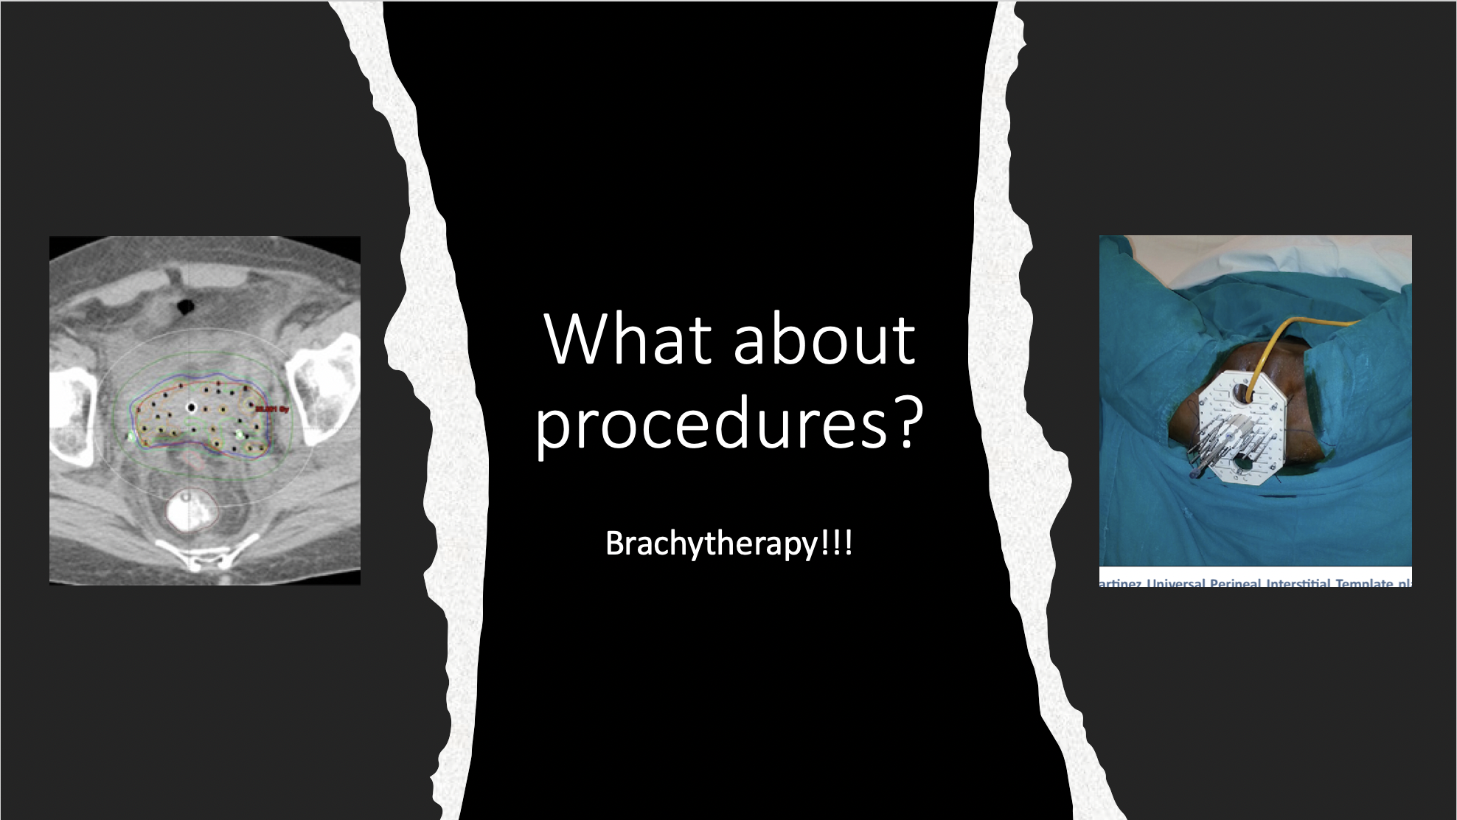
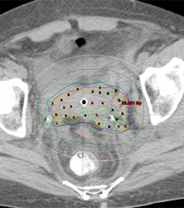
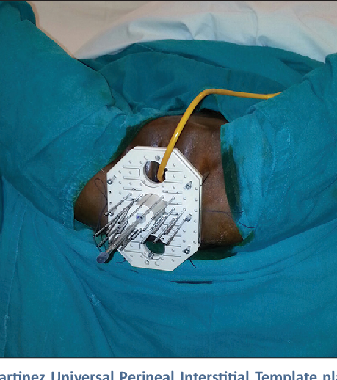
What about procedures?
Brachytherapy!!!

Slide 15
Why Rad onc?
Continuity of Care
  See pts more than their PCP during treatment!
  F/u 10+ years out!
Cancer
Huge impact on patients survival, quality of life, often quick relief and/or direct evidence of tumor control
Lots of Radiology
Expert in all cancers, Treat (nearly) all cancers
Outpatient clinic, quick pace
A little bit of everything – Pts, procedures, drawing contours, planning
Notes:
Also great hours, family friendly,

Slide 16
Mentorship
Working directly with attending
Direct and near constant feedback

Slide 17
Research
Rad Oncs love research
Everything is extremely data driven

Slide 18
M1/M2
Shadow – is rad onc for you? (answer is obviously yes!)
Different attendings, different days to get a feel for everything we do!
Mentor
Consider research!
M3/4
Rotation in Rad Onc
Away Rotations?
Research
Prelim/TY year
Residency
Not necessary but give more experience
(TY >>> Prelim)
1 year
4 years
Notes:
Roadmap to rad onc!

Slide 19
Gynecologic Oncology
------------------- MD, MA, PGY6 Gyn Oncology Fellow
-------------------, MD, PGY7 Gyn Oncology Fellow
MCW Cancer Center Careers in Clinical Oncology and Cancer Research Symposium - September 30, 2023

Slide 20
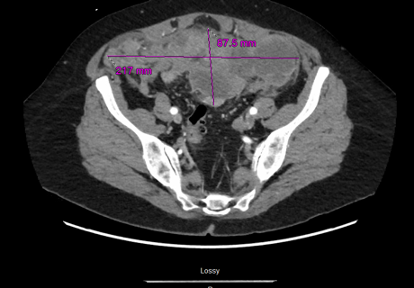
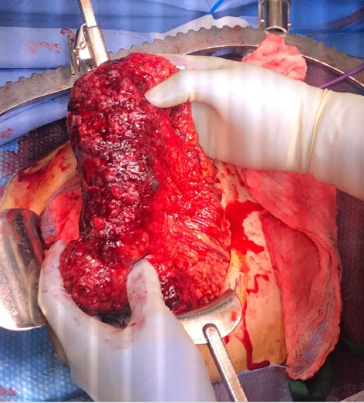
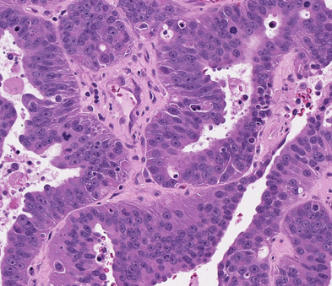
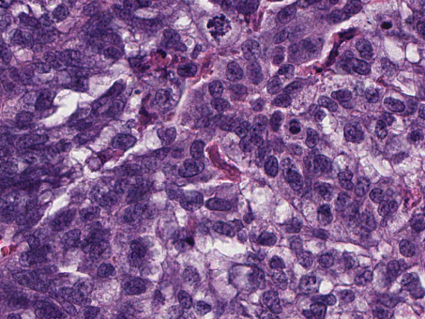
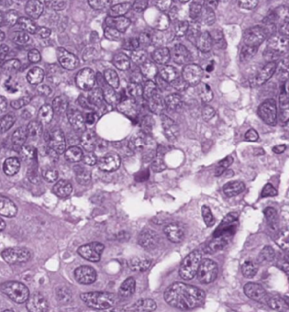
Gynecologic Oncologists
Surgeons + oncologists
Treat cancers of the uterus, ovary, cervix, vulva, gestational trophoblastic disease
Administer chemotherapy, novel therapeutics
Clinical trials

Slide 21
Training
Medical School
OBGYN Residency: 4 years
Gynecologic Oncology fellowship: 3-4 years
  2 years clinical, 1-2 years research

Slide 22
Clinical Collaboration
Radiation Oncologists
Gyn Pathologists
Surgical sub-specialists
Palliative Care

Slide 23
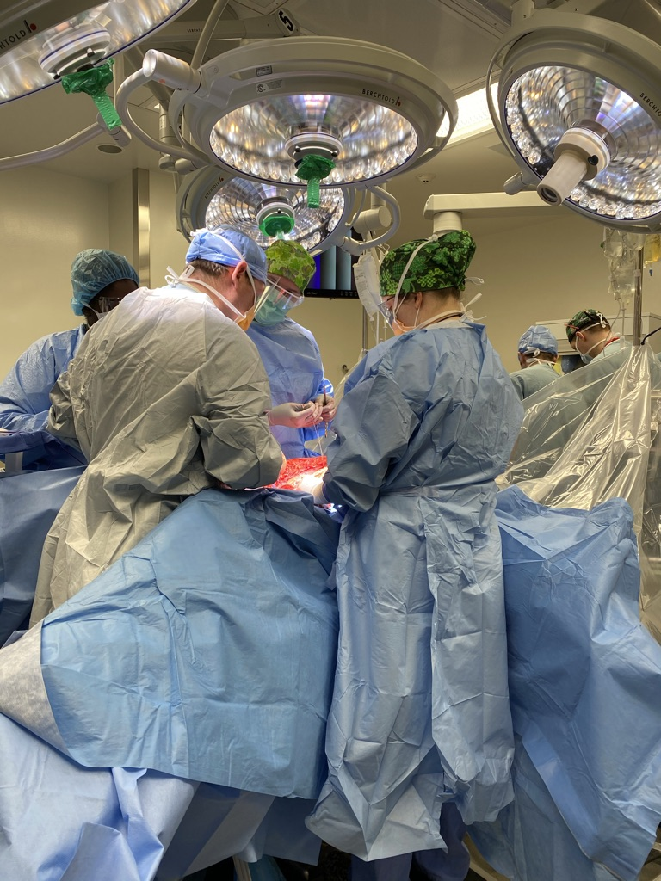
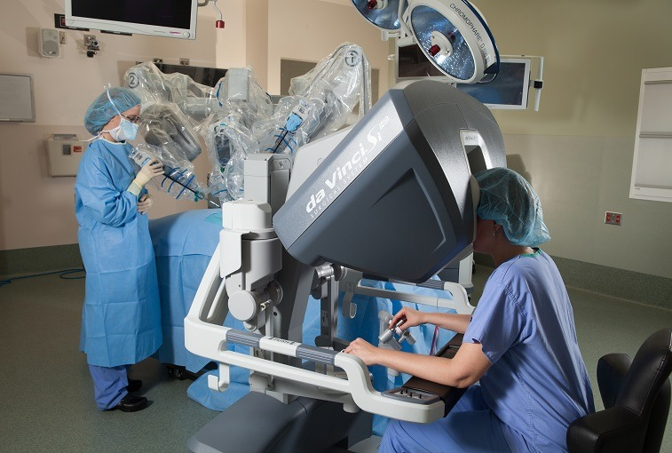
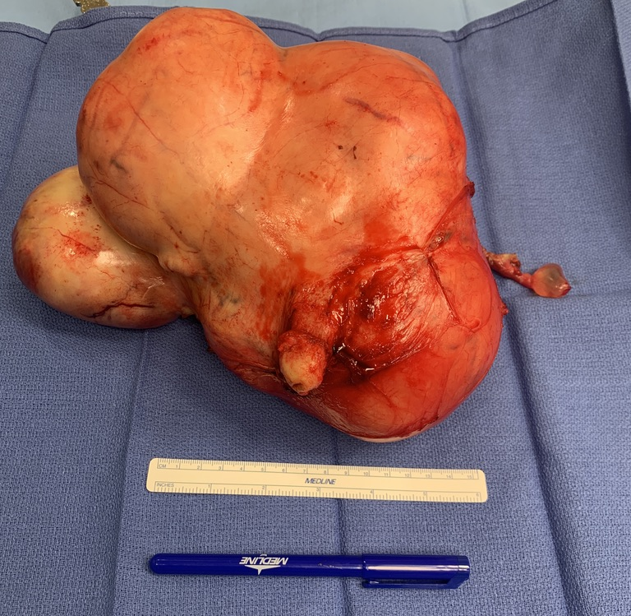
Surgery
Minimally invasive
Open
Collaborative cases
Abnormal placentation/OB hemorrhage

Slide 24
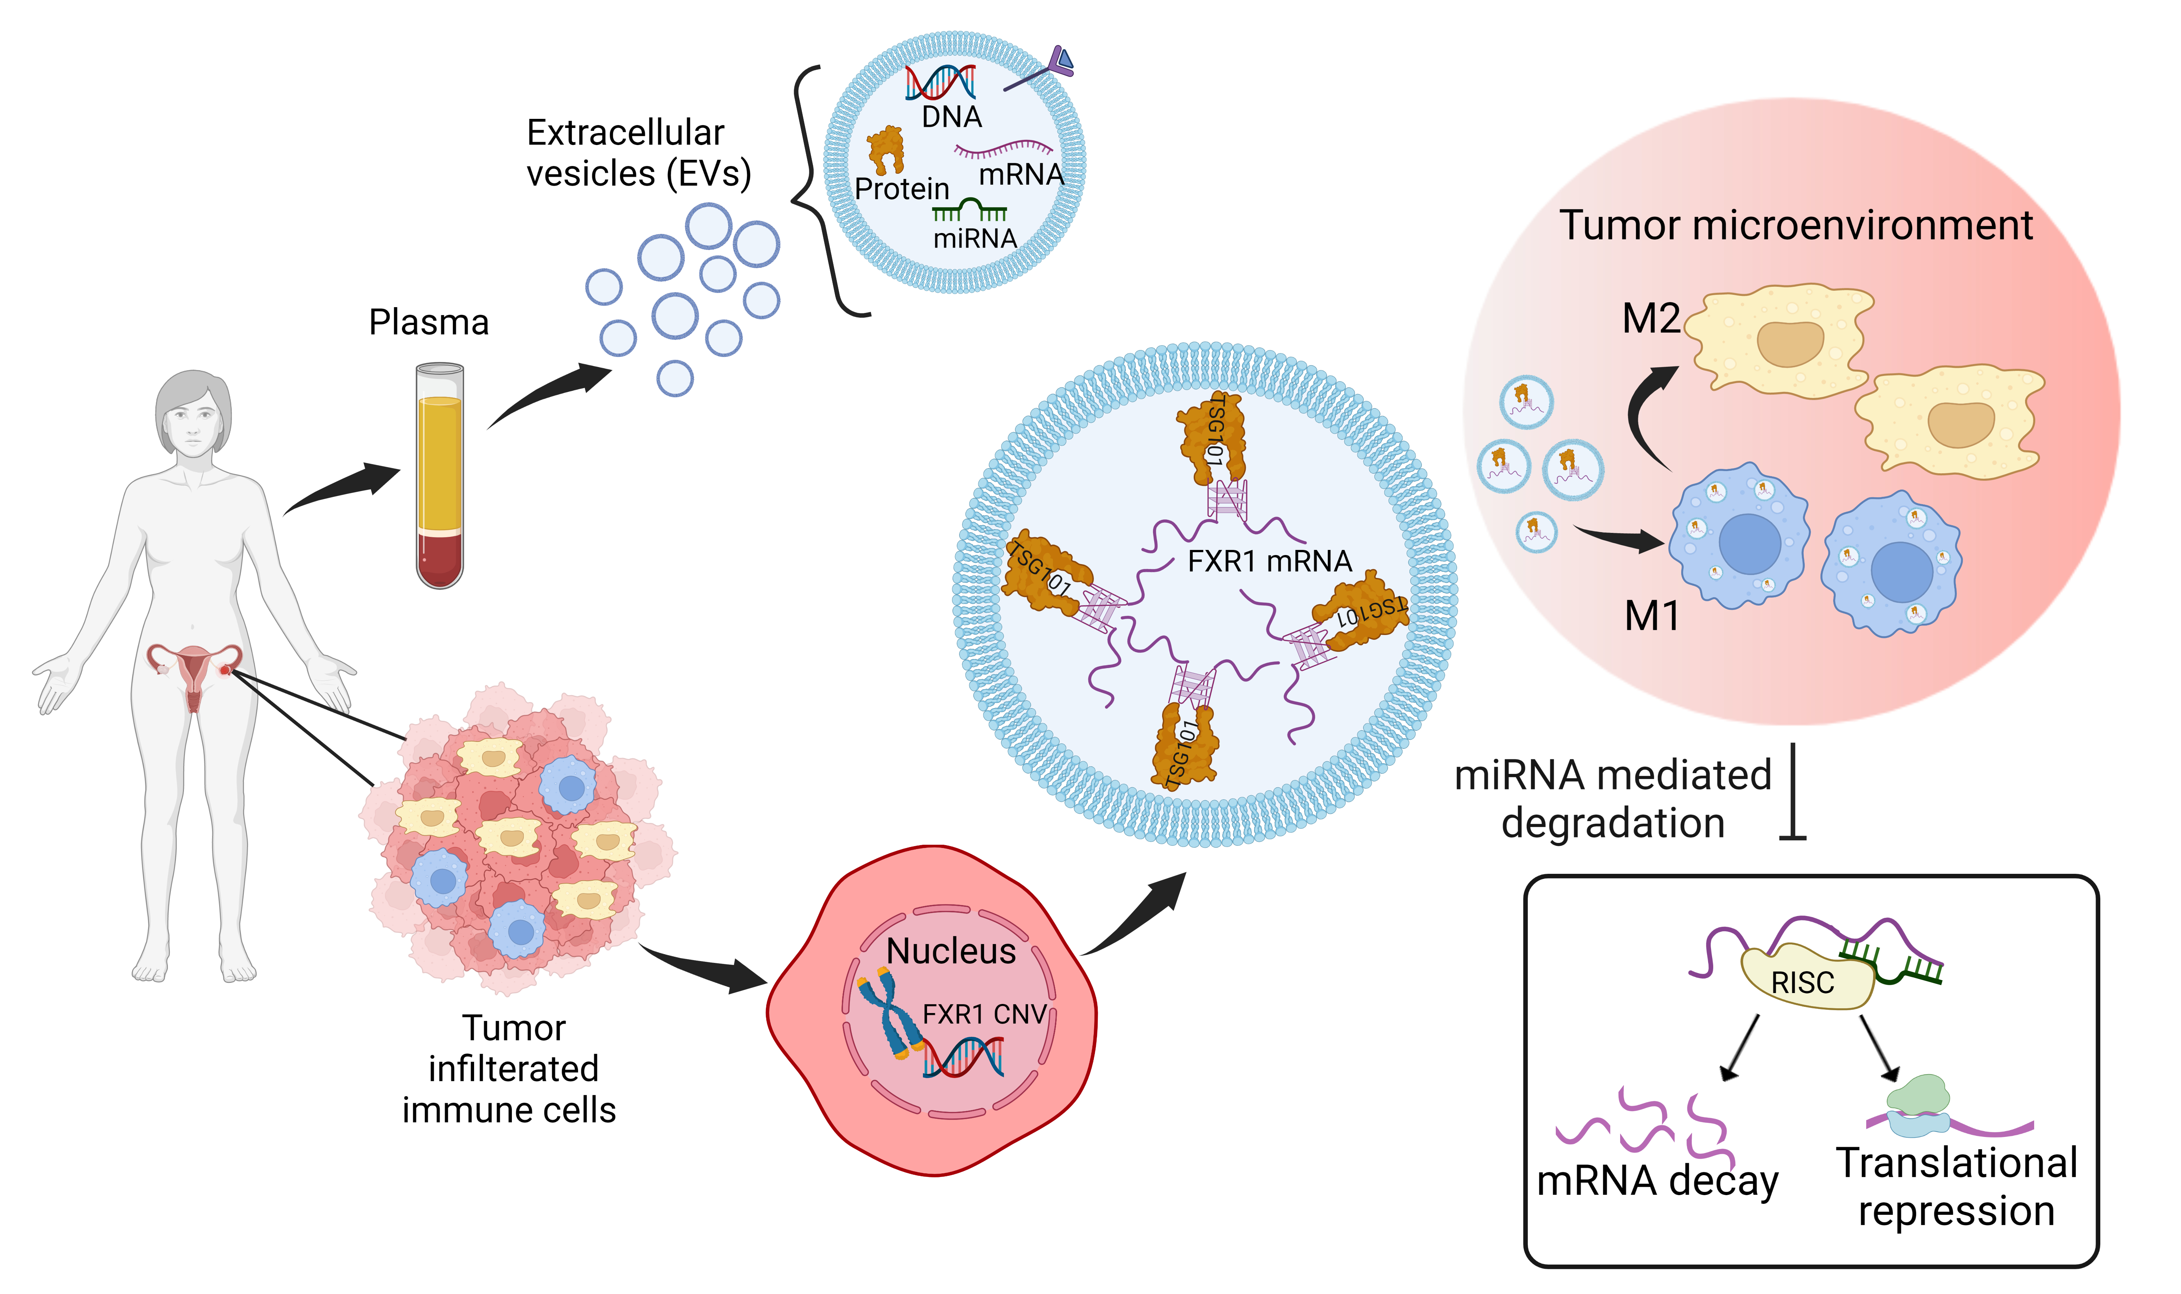
Research
Basic Science
Translational
Clinical Research
Clinical Trials

Slide 25
Medical Education

Slide 26
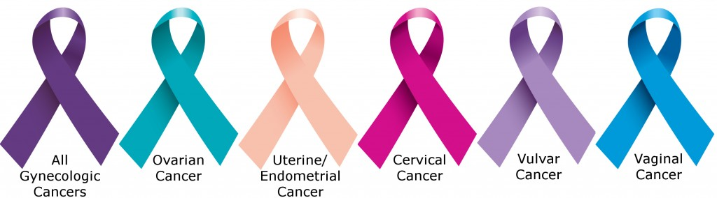
If you’re interested in surgery, oncology, long-term relationships with patients, consider gynecologic oncology

Slide 27
Hematology & medical Oncology
-------------------, MD, PGY V
MCW Cancer Center Careers in Clinical Oncology and Cancer Research Symposium - September 30, 2023

Slide 28
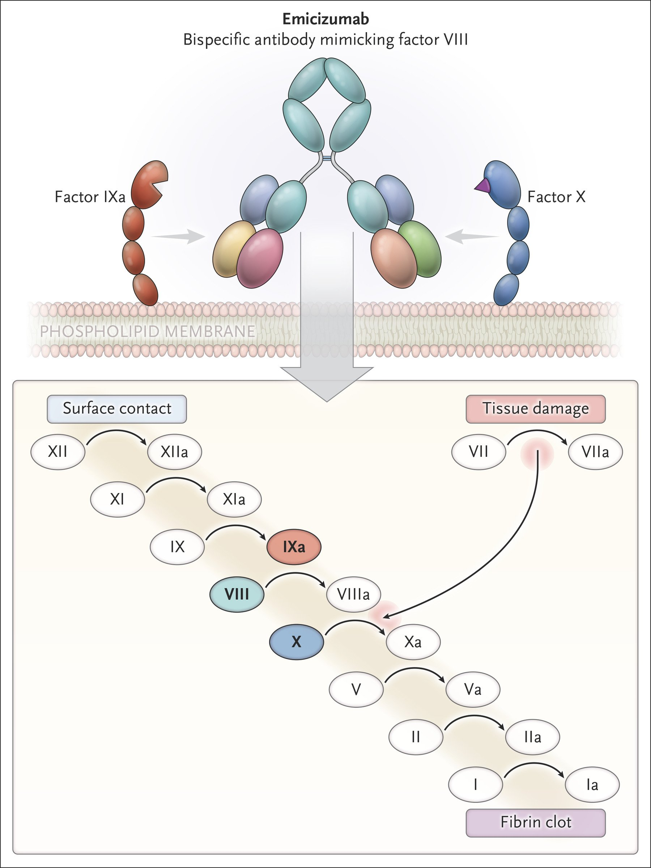
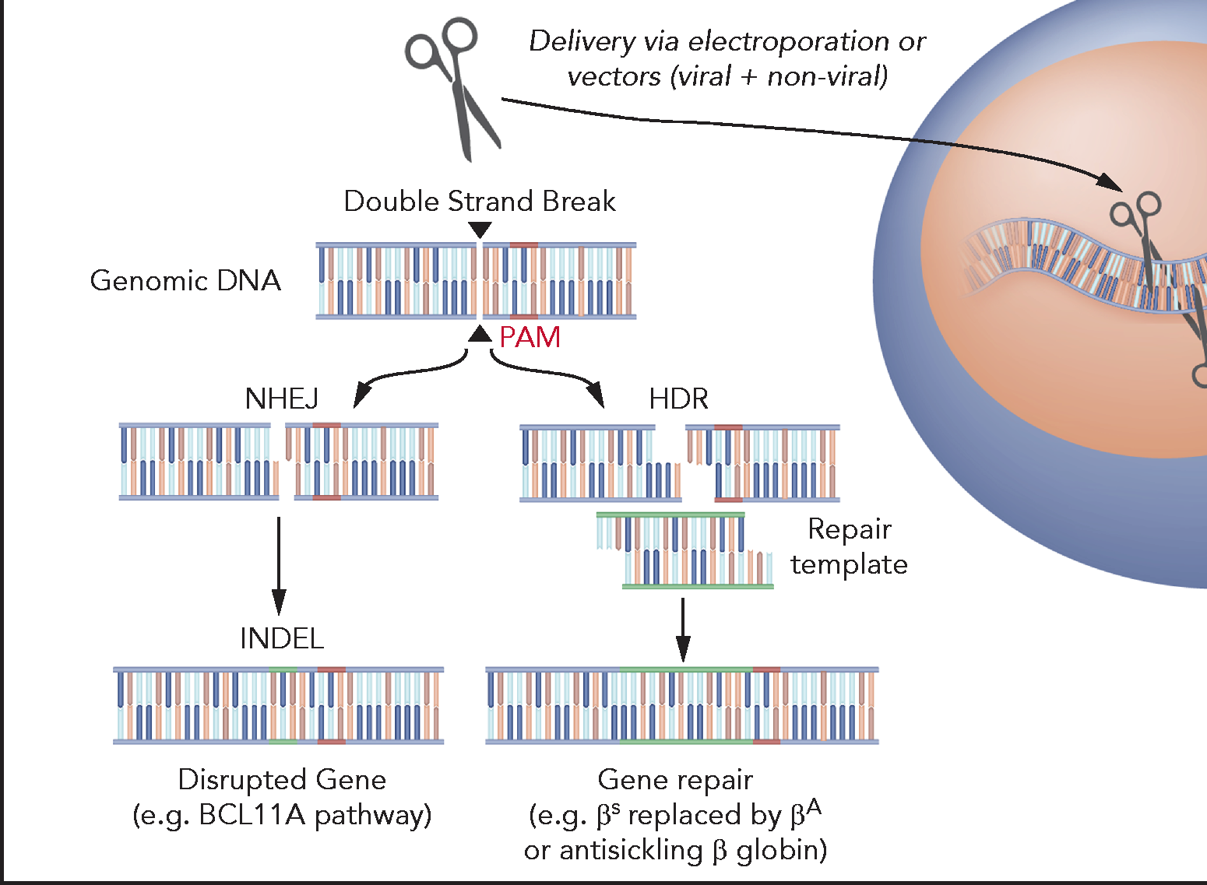
What is hematology & medical oncology?
We treat:
  Solid tumor cancers
  Hematologic malignancies
  Non-malignant hematologic conditions
    Not just anemia
    Hemoglobinopathies
    Bleeding and clotting disorders
    Bone marrow failure
Allistair & Tisdale 2021
Mahlangu et al 2018

Slide 29
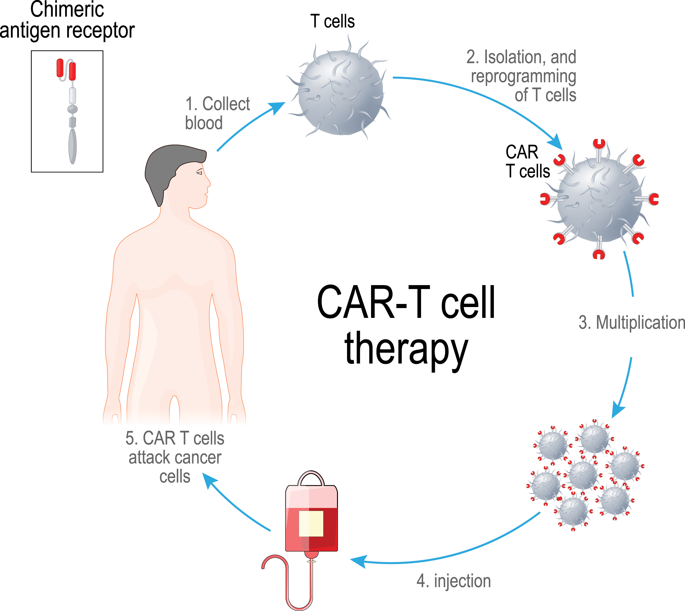
What is hematology & medical oncology?
We use a variety of systemic therapy:
  Chemotherapy
  Hormone-based Therapy
  Immunotherapy
  Targeted Therapy
  Cellular Therapy (Chimeric Antigen Receptor T cells)
  Hematopoietic Stem Cell Transplant

Slide 30
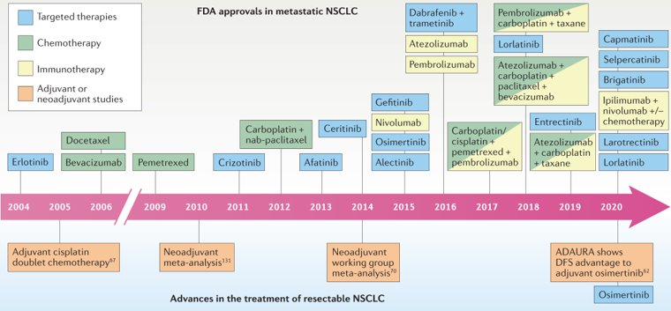
WHY hematology & medical oncology?

Slide 31
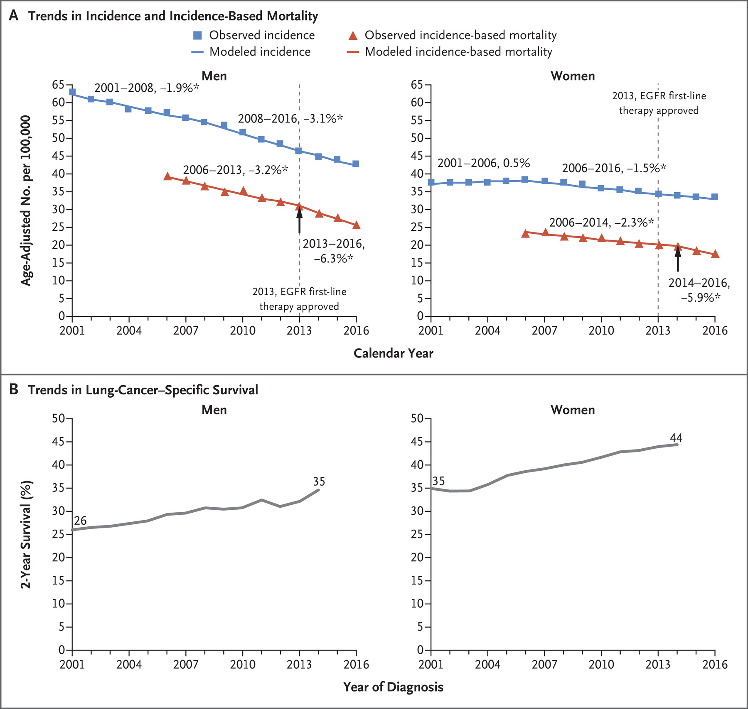
WHY hematology & medical oncology?
Rapidly advancing field with improving outcomes
Extremely rewarding to build relationships with patients
Outpatient-based, home calls make for better work/life balance
Howlader et al 2020

Slide 32
A typical week
Mon | Tues | Weds | Thurs | Fri
Lectures Independent Study | Hepatic tumor board GI oncology clinic | GI oncology clinic | Thoracic tumor board GI oncology clinic | Pancreatic tumor board Pancreatic cancer clinic
VA Clinic Molecular tumor board | Neuro-endocrine Tumors clinic | Precision Oncology Clinic | Independent study | Lectures Pancreatic cancer clinic

Slide 33
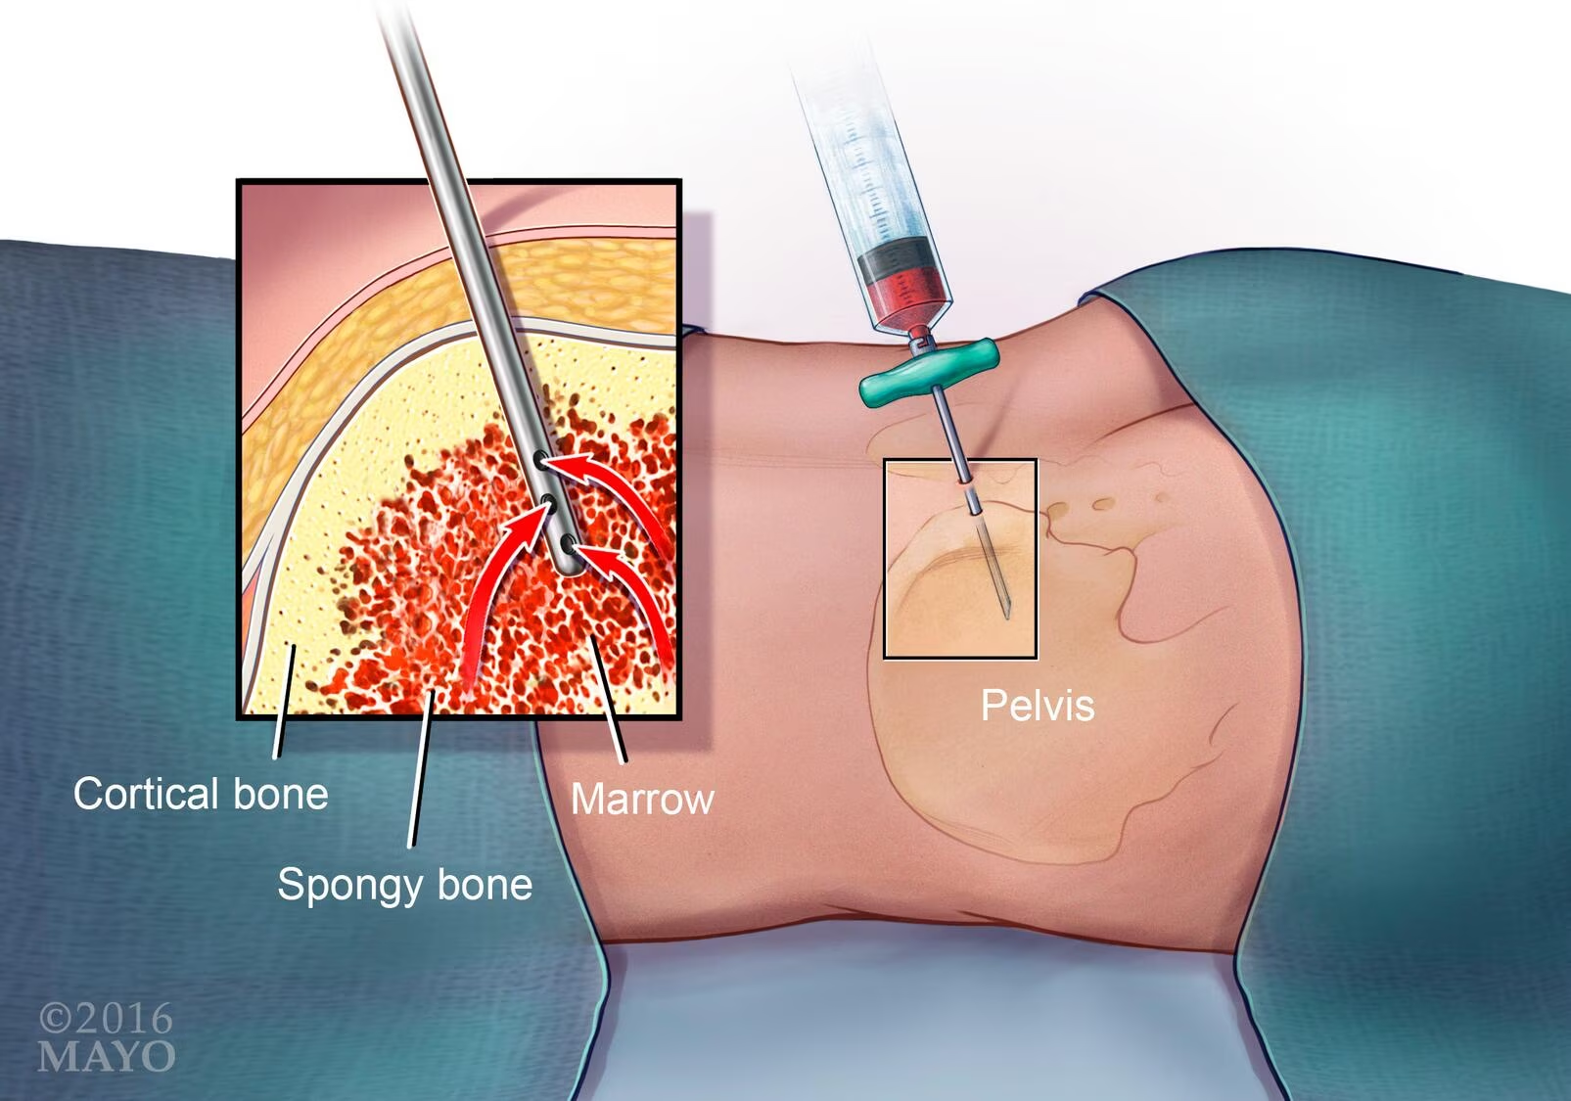
A typical week
Outpatient clinic
  seeing new patients and patients undergoing treatment
Inpatient oncology services (6 teams at FH)
Consult services (Benign hematology, malignant hematology, solid tumor)
Procedures
  Bone marrow biopsy
  Intrathecal chemotherapy

Slide 34
Roadmap to hematology/medical oncology
Medical school
  Identify a mentor, get involved in research
Internal medicine residency (3 years)
  Elective time in hematology and oncology
  Aim to have some projects completed by end of PGY-2
Hematology/Medical Oncology fellowship (3 years)

Slide 35
Is Heme/onc a good fit for you?
  Good communication skills
  Interest in academic medicine
  Enjoyment of working in multi-disciplinary teams
  Enjoyment of developing long term patient relationships and high degree of involvement with patient care
  Preference for (primarily) outpatient setting

Slide 36
Surgical oncology
-------------------, MD, MPH, Complex General Surgical Oncology Fellow
MCW Cancer Center Careers in Clinical Oncology and Cancer Research Symposium - September 30, 2023

Slide 37
Surgical oncologists are general surgeons with specialty training in diagnosing, staging, and removing solid tumors

Slide 38
Surgical Oncology
Sarcoma
Breast
Endocrine
HPB &
Upper GI
Melanoma
Peritoneal Surface
Colorectal
The field of surgical oncology is broad
Multiple subspecialties
Multiple pathways to each individual subspecialty
One philosophy in the treatment of surgically treatable malignancies
Complex general surgical oncology (CGSO) pathway provides comprehensive training in all areas
Surgical Oncology
subspecialties

Slide 39





Additional Components Of CGSO Training
Medical
Oncology
Radiation
Oncology
Pathology
Palliative
Care
Research
Understanding all areas of cancer care is critical

Slide 40
Myths about Cancer Treatment
Surgery is often viewed as the definitive treatment
Surgery is necessary, but many times not sufficient alone for cure
Surgical oncologist work with a multidisciplinary team to develop individualized treatment plans for each patient
  Curative intent surgery
  Palliative intent surgery
Surgical oncologists have the ability to impact their patients care in a unique way

Slide 41
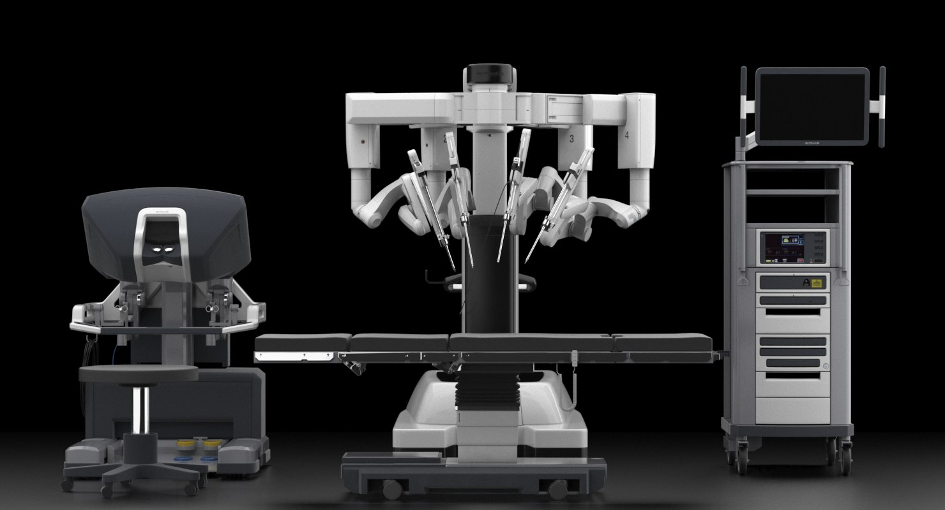
Surgical Technique
Types of surgery
  Open
  Laparoscopic
  Robotic
  Endoscopic
Adjuncts to surgery
  Ultrasound
  Microwave ablation

Slide 42
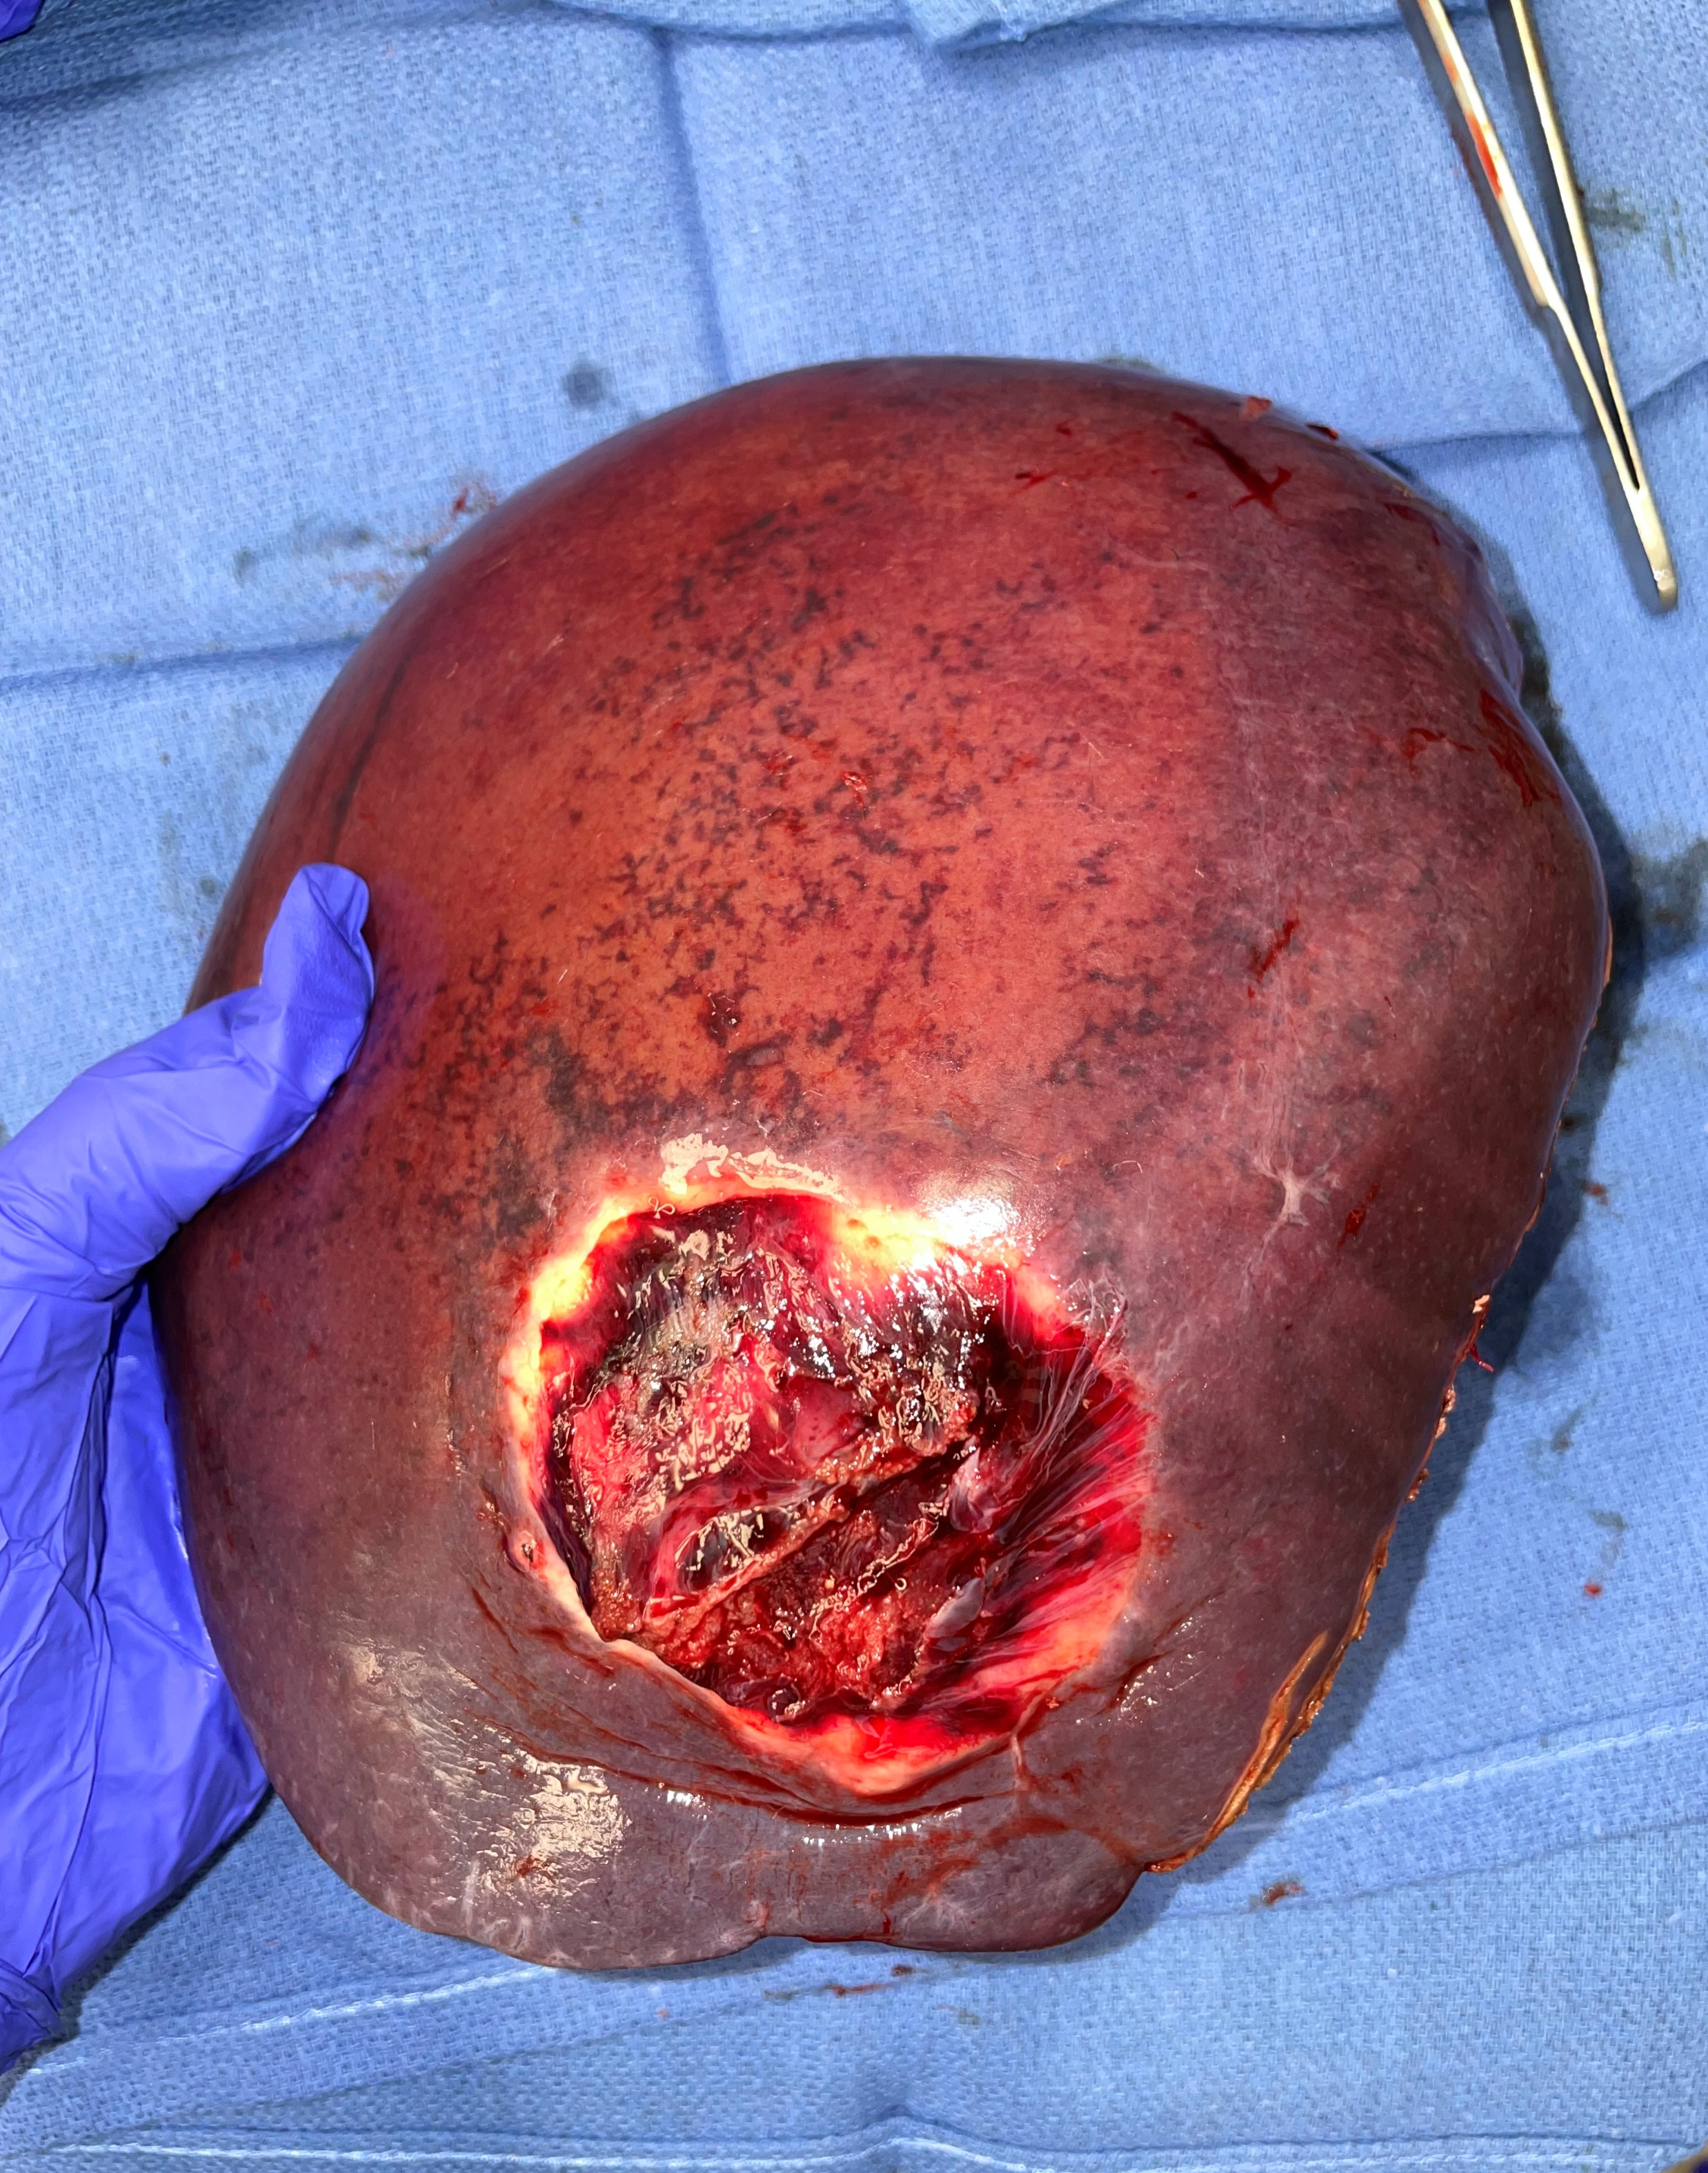
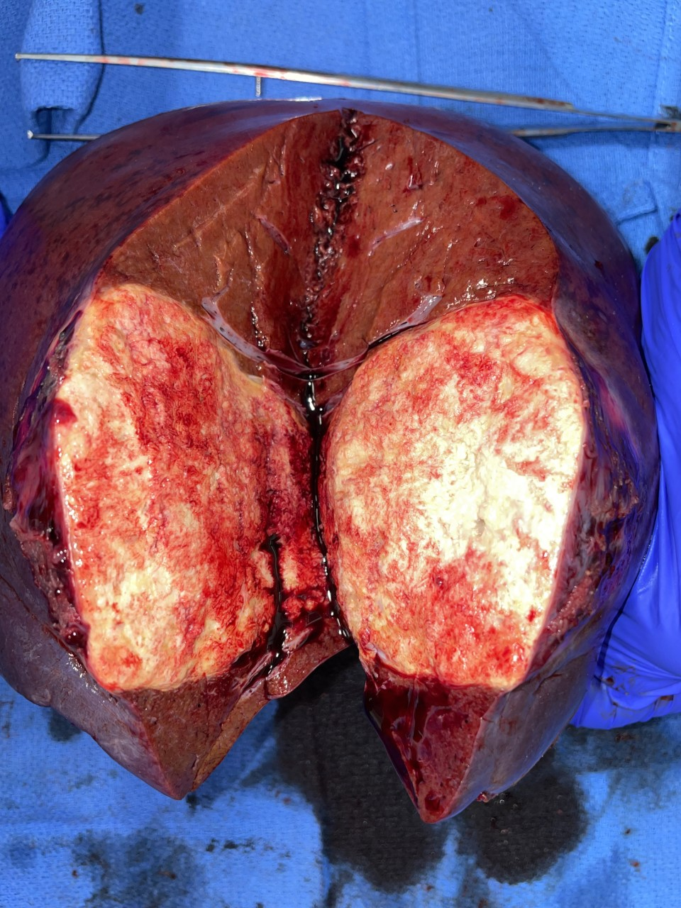
53 yo M with metastatic colon cancer to the liver
Procedures:
Right hepatic lobectomy
Cholecystectomy
Intraoperative US
On table cholangiogram

Slide 43
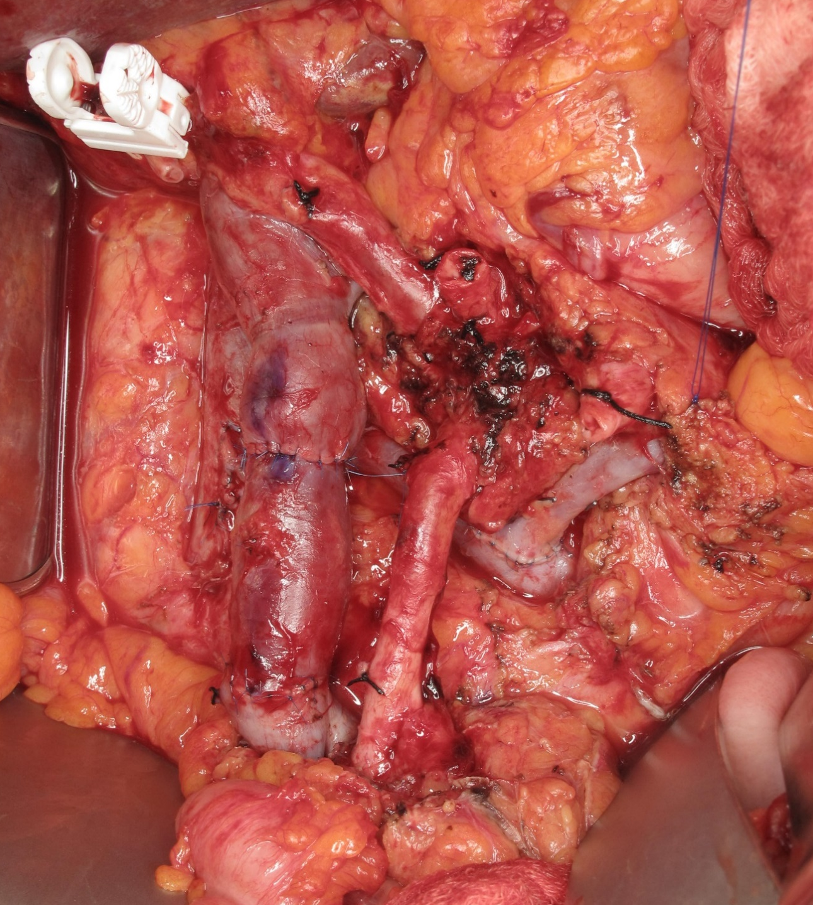
68 yo F with locally advanced pancreatic cancer
Procedures:
Pancreaticoduodenectomy
Cholecystectomy
En bloc resection of PV-SMV confluence with right IJV interposition graft reconstruction and distal splenorenal shunt
PV
IJV
Graft
SMA
Splenorenal
Shunt
SMV

Slide 44
THE PRACTICE OF A SURGICAL ONCOLOGIST
Research
10-20%
Lots of variety in practice
Clinic
20%
50%
Administrative/
Education
10-20%

Slide 45
Surgical Oncologists are scientists
Research is a large part of all cancer related specialties
Types of research
  Clinical outcomes
  Translational
  Basic science
  Qualitative
Necessary for the advancement of the field

Slide 46





Surgical Oncology
Surgical oncologists cure cancer
Genetic
Counselors
Gastroenterologist
Medical Oncologists
Surgical Oncologists
Radiation Oncologists
Treating cancer is a team sport
Palliative Care
Specialists
Interventional Radiologist

Slide 47
Pediatric hematology/Oncology/BMT fellowship
-------------------, MD
MCW Cancer Center Careers in Clinical Oncology and Cancer Research Symposium- September 30, 2023

Slide 48


September is
Pediatric cancer and
Sickle cell disease awareness month

Slide 49
We are…
Doctors
Medical school (4 years)
Pediatricians
Residency (3 years)
Peds Hem/Onc/BMT
Fellowship (3 years)

Slide 50
Always part of a Team
Pathology
Blood bank/Heme lab
Surgeons
Rad Onc
Ortho Onc
Palliative care
Clinical trials office
PMNR – PT/OT

Slide 51
3 in 1
Benign hematology
Coagulation and thrombosis
Hemoglobinopathies
Oncology
Leukemia and Lymphoma
Solid tumors
Bone marrow transplant
Malignant diseases
Non-malignant disease
Cytopenias
Immune and congenital
Brain tumors
Immunodeficiencies

Slide 52
Areas of practice
Research
Clinical
A combination of both

Slide 53
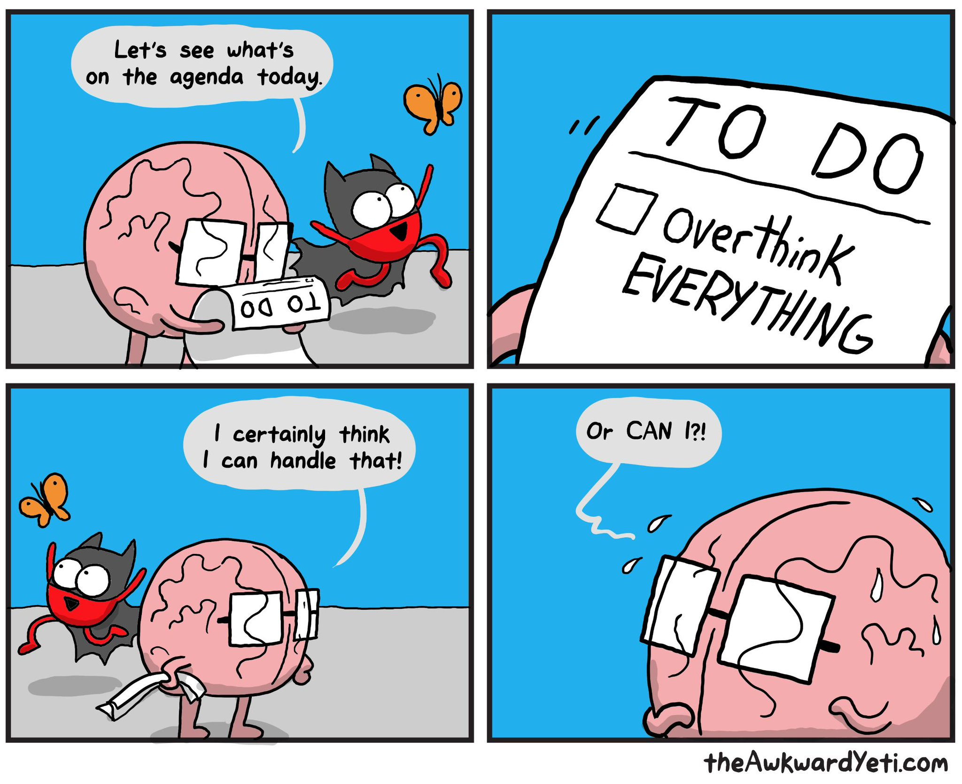
Generalist
Hematology
Oncology
Oncologist
General
Superspecialist
Hematologist
General
Superspecialist
Transplant
1 year fellowship

Slide 54

Unique to Peds Oncology and BMT…
SURVIVORSHIP
Long term follow up
Monitor side effects of therapy

Slide 55
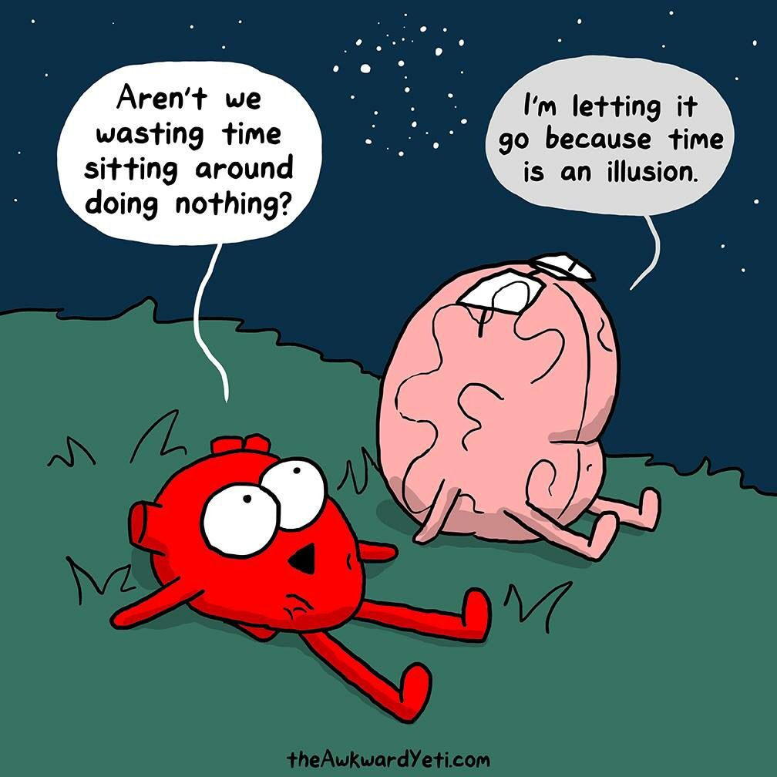
A day in the life…
Inpatient: Acute care
Outpatient clinic
Procedures
Bone marrow aspirate/biopsy
Lumbar puncture
Diagnostic
Therapeutic
Bone marrow harvest

Slide 56

We do it for them…

