Slide 1
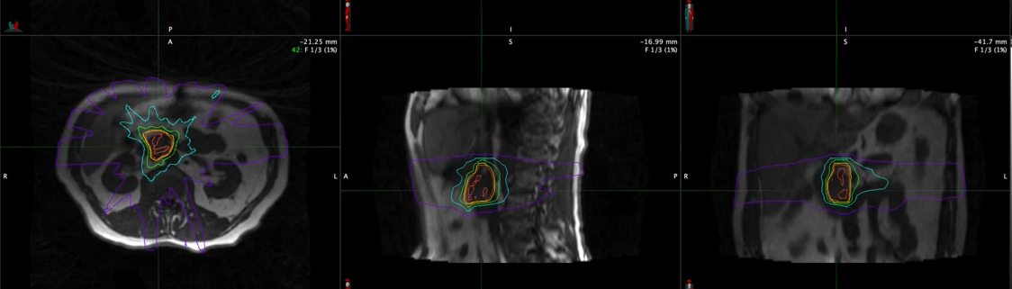


From Bench To Bedside: Careers in Oncology
-------------------, MD
Associate Professor
Department of Radiation Oncology
Department of Surgery
School of Graduate Studies
Medical College of Wisconsin

Slide 2
Outline
Discussion passion for oncology
Review the inseparable nature of research and oncologic practice
Outline of current schedule
Discussion of research projects
Questions

Slide 3
Selecting a specialty is hard…factors that sent me to oncology
Wanted something extremely serious, life threatening, profound discussions of “life and death”
Wanted something complex, highly complicated, that I felt would take a career to master
Many family members with cancer, disappointed with outcomes
Amazed by technology and the blend of imaging and intervention that radiation oncology provided

Slide 4
My weekly schedule as an oncologist and researcher
Monday:
  7-8am Tumor Board
  8 am – 3:30 pm Clinic, see patients in consultation, follow up, “on treatment”, IP consults
Tuesday:
  7-8am Tumor Board
  MR guided RT procedures
  Research Time (writing grants, abstracts, papers, protocol related administrative work, meetings)
  5-6 Tumor Board
Wednesday:
  Research Time (writing grants, abstracts, papers, protocol related administrative work, meetings)
  Grand Founds
Thursday:
  Research Time (writing grants, abstracts, papers, protocol related administrative work, meetings)
  Clinic in the afternoon
Friday:
  Tumor board 6:30 am – 8 am
  Clinic
  MRL Procedures
  Inpatient consults

Slide 5

“SOFT Pre-Op” NCT03704662
Pancreatic Adenocarcinoma (Sample Size = 102)
Resectable
Borderline Resectable
Locally Advanced Type A
September 2022: 62 patients have been enrolled and randomized
Neoadjuvant Chemotherapy “dealer’s choice”
(FOLFIRINOX or Gem/Nab)
Stratify: 1. Resectable/Borderline/LA
2. Neoadjuvant chemotherapy duration (< = 2 months or > 2 months)
3. Clinical node positivity
N=51
Randomize
N=51
SBRT (25-35Gy over 5 fractions) boost to vascular interface
Concurrent Chemo-RT (50.4 Gy over 28 fractions) with concurrent gemcitabine
3-8 weeks-
Restage- No evidence of distant disease progression
Surgical Resection
Primary Endpoint: Pathologic Node Positivity
Secondary Endpoints: Tumor path response, quality of life, CTCAE toxicity, local recurrence, novel MR response biomarkers

Slide 6
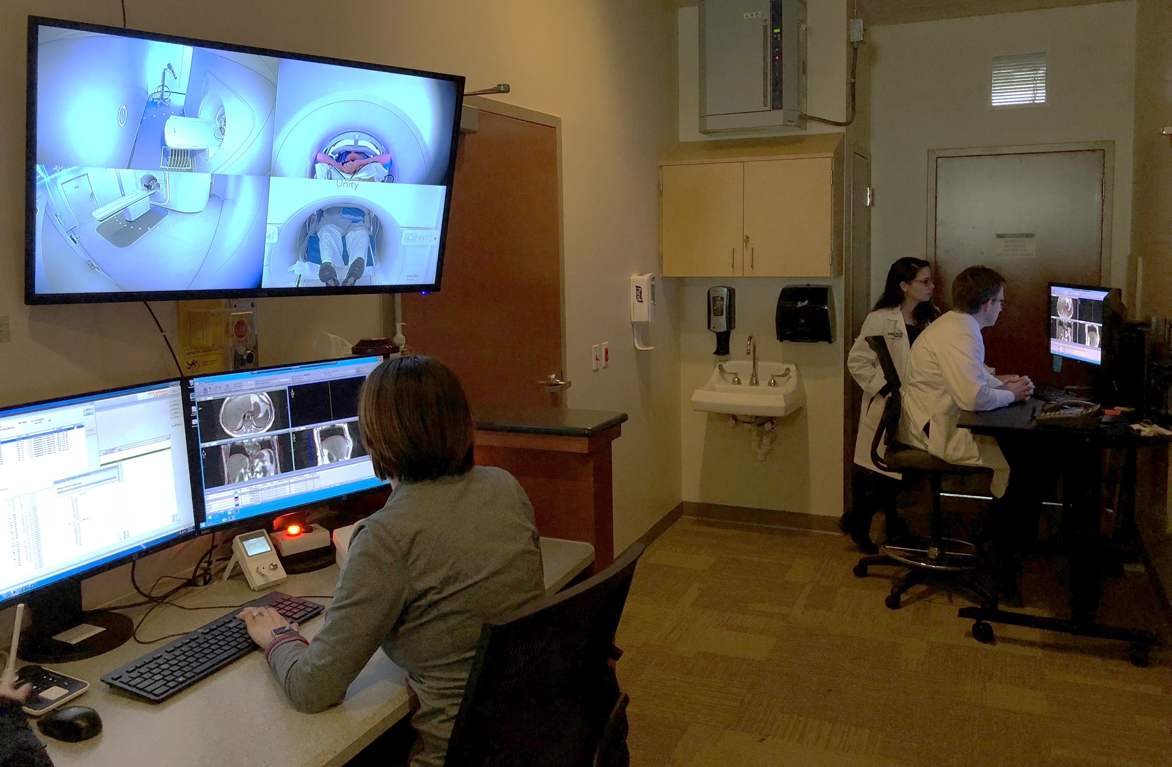
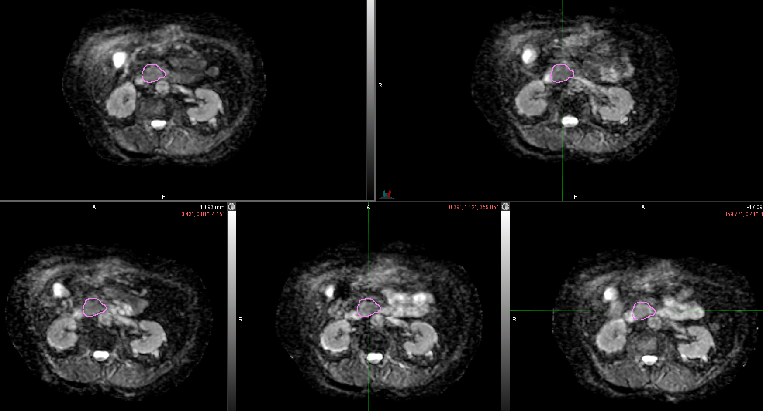
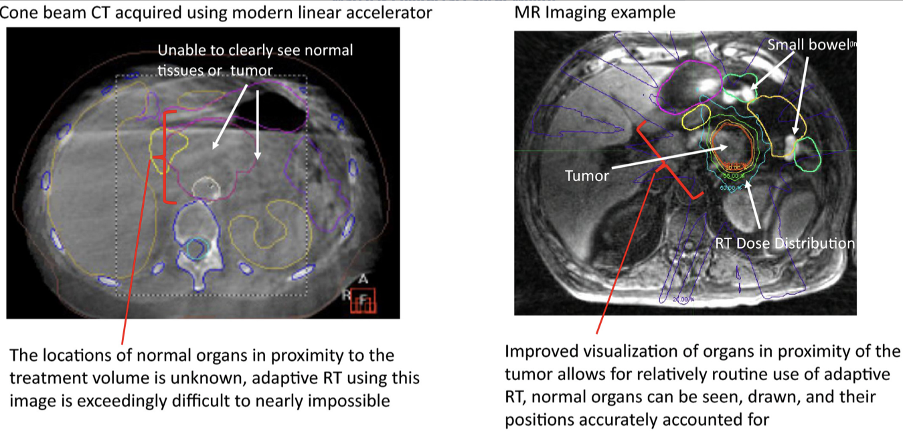
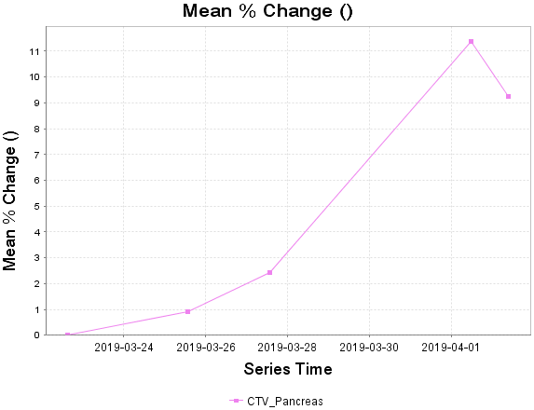
SBRT
Hall WA, CA: Cancer J Clin, 2022

Slide 7
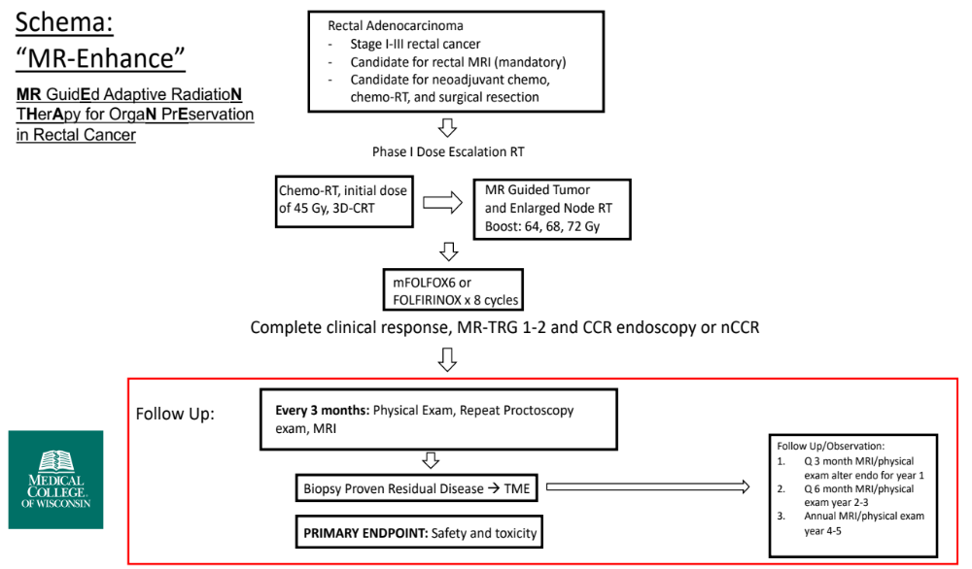
NCT04808323

Slide 8
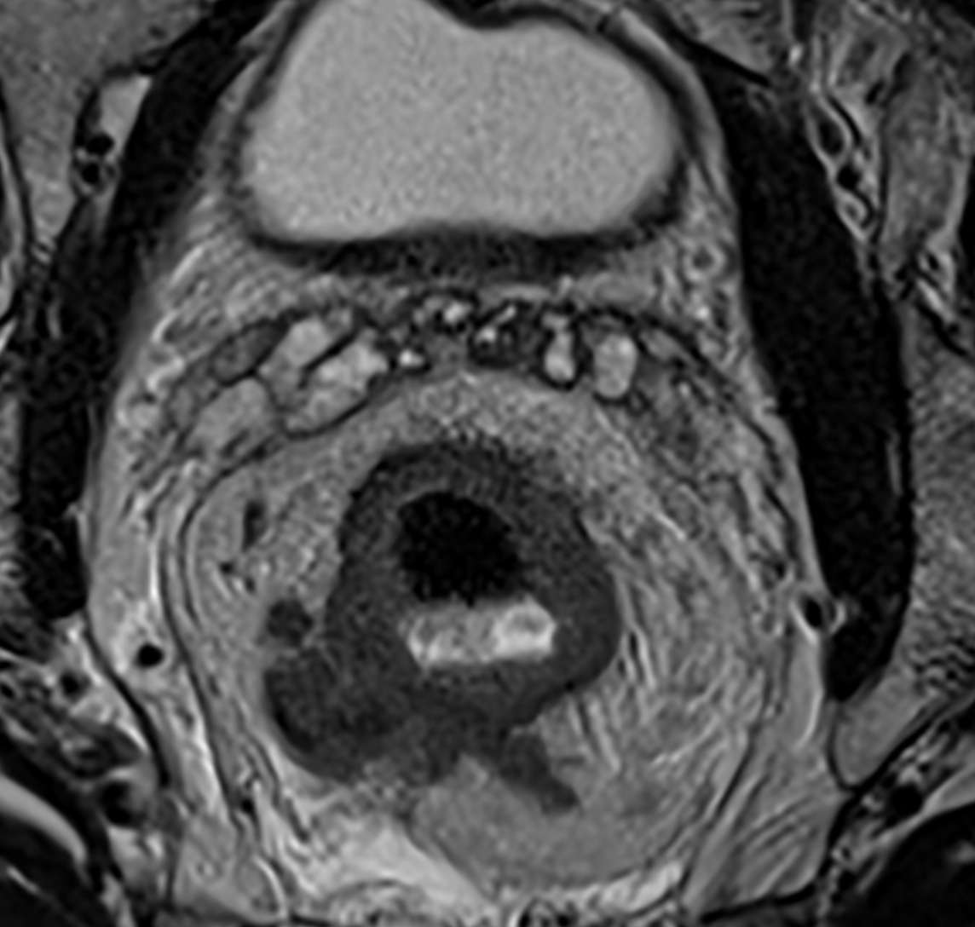

Slide 10
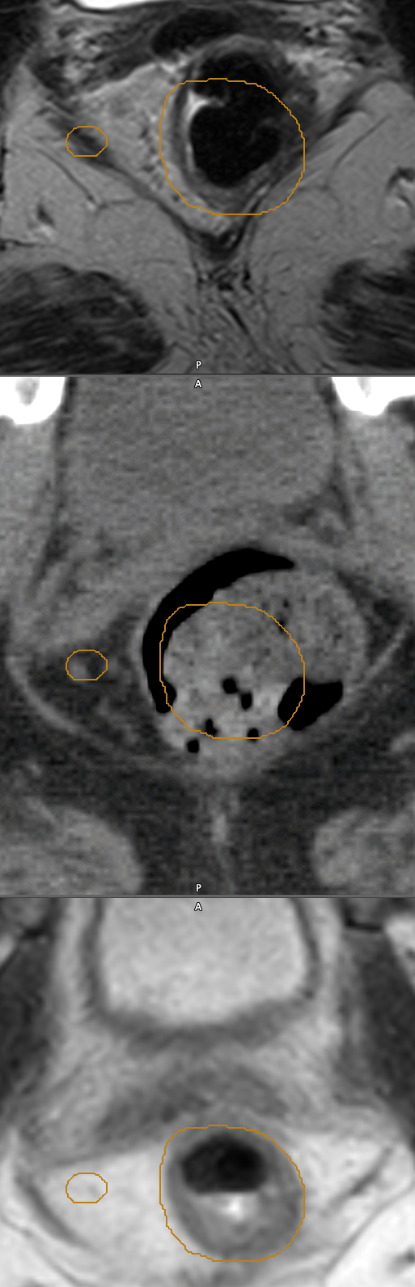

Slide 11
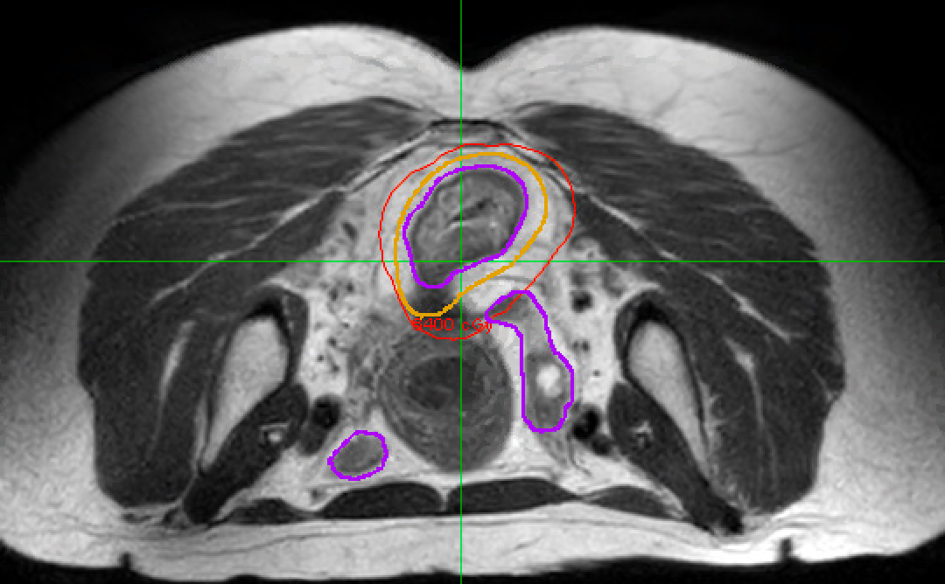
Example patient

Slide 12
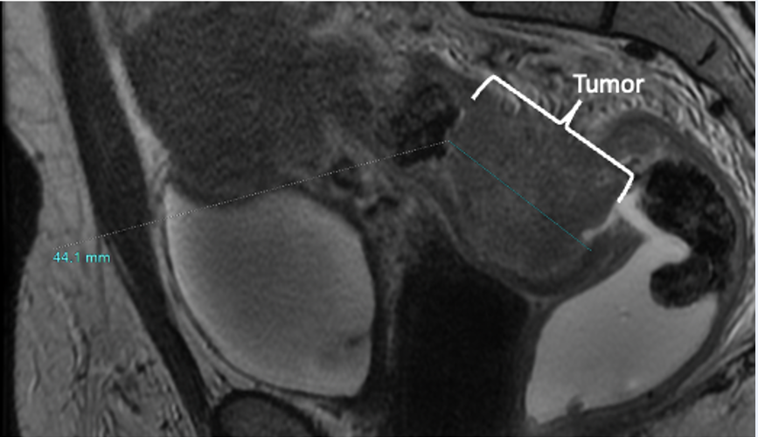
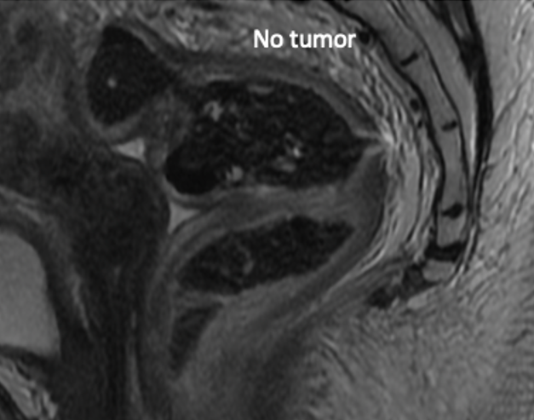
Example patient
Dose escalated, MR Guided radiation
----------------->
64 Gy in 32 fractions

Slide 13
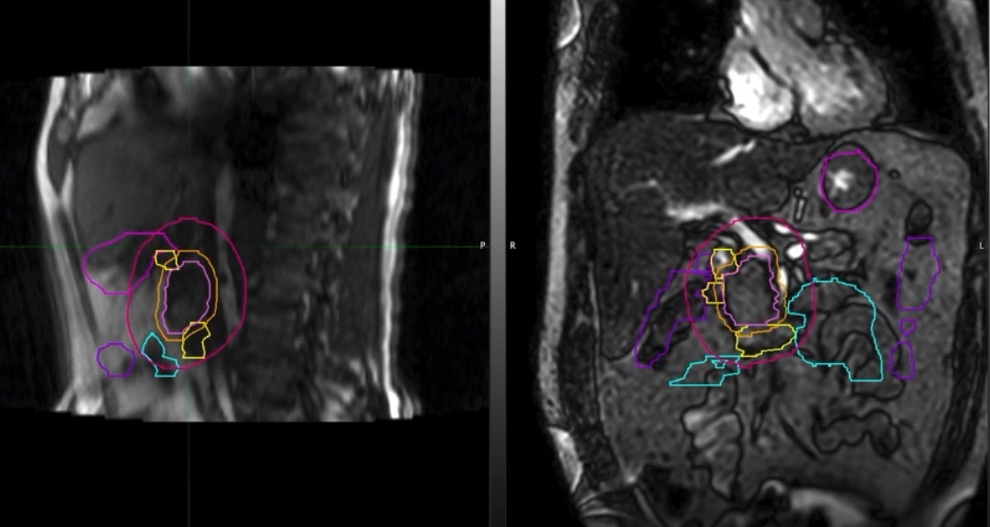

Slide 14
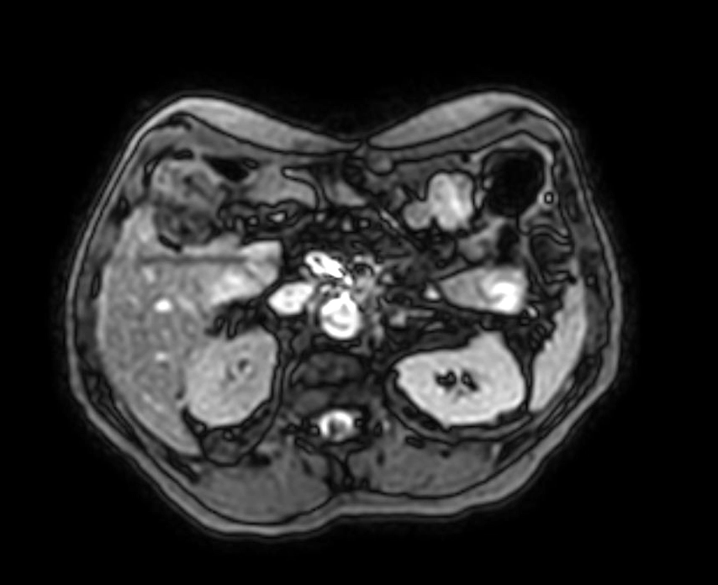

Slide 15
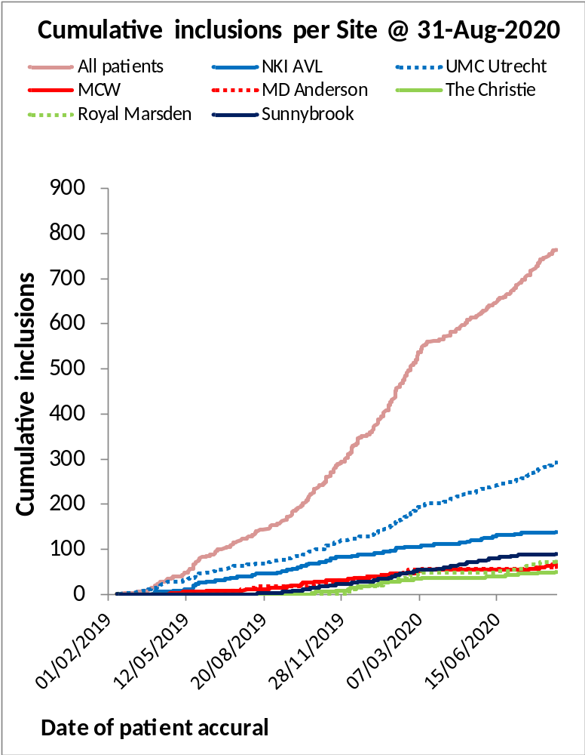
MOMENTUM Registry: 3000 patients accrued September 2022

Slide 16
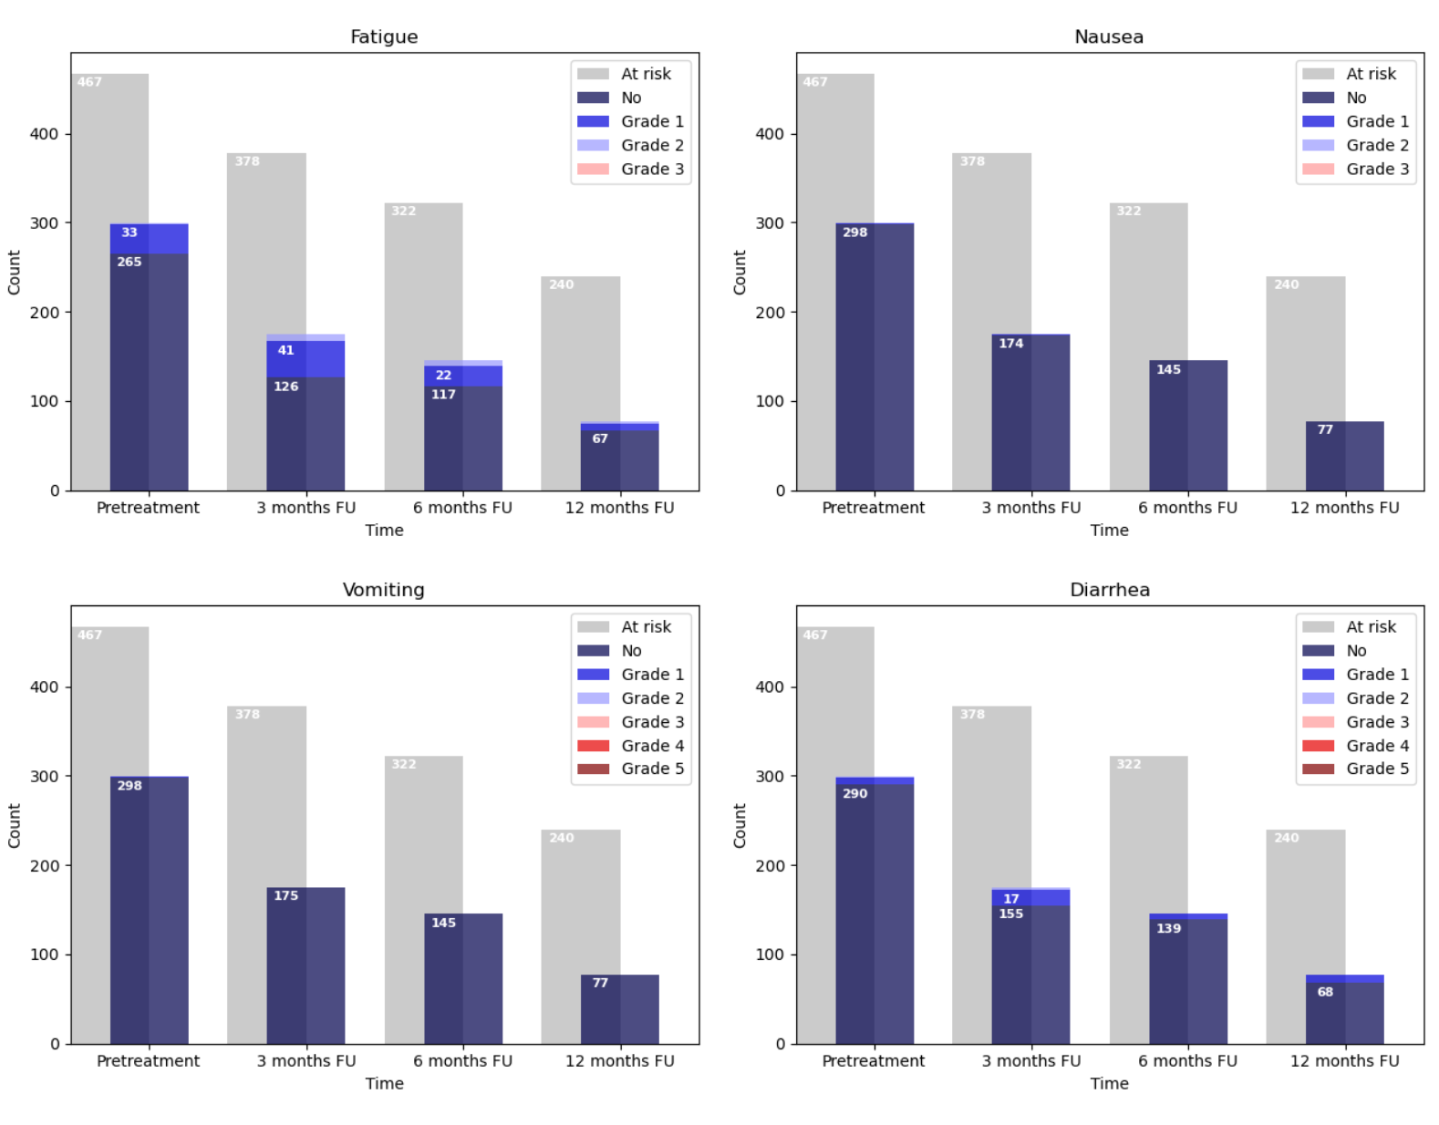
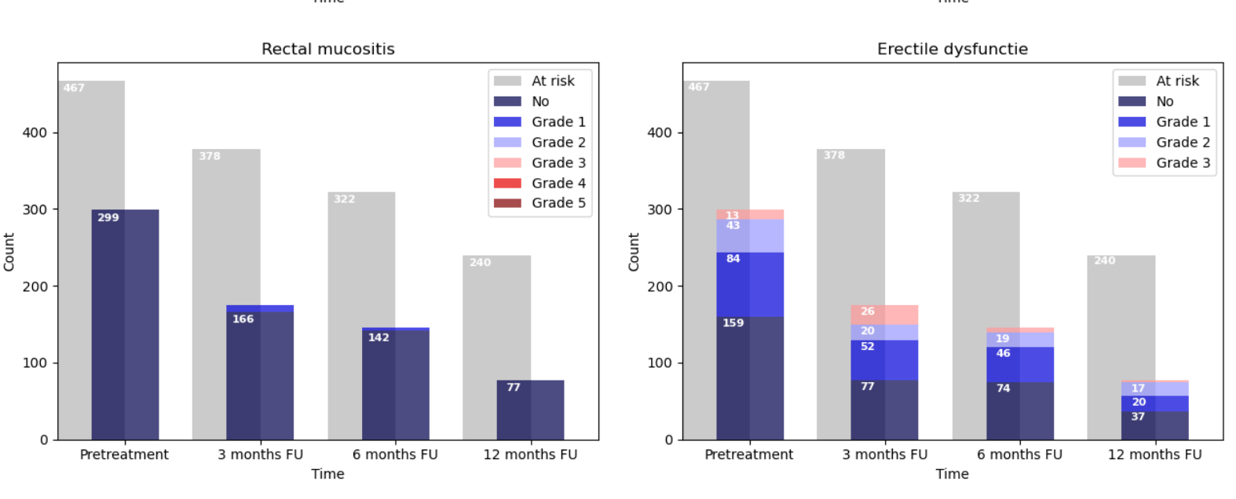
PRO directed interventional trials
Improved patient and provider education
Massive MR biomarker repository

Slide 17
Conclusions
Oncologic practice and research provides an extremely stimulating and exciting variety of activities, literally never feel mundane or board
Research is extremely rewarding
Work/life balance is a constant effort, constantly trying to keep the pendulum in the middle
Questions?

