Slide 1
Cancer Center Symposium 2022
Gynecologic and Radiation Oncology, Interactive Case

Slide 2
Case I
64 yo F w L flank/leg pain and postmenopausal bleeding, started as spotting after intercourse, now using 3 pads per day
What history and physical is important?
What is next step?
Notes:
Ask about current symptoms: esp. PMB, vaginal, urinary, bowel symptoms, general cancer symptoms (appetite, energy, weight loss, fever/chills, night sweats)
Complete history: Past medical, surgical, fmhx (genetics?), sexual, social, contraindications for radiation/surgery, gynecologic hx
Physical: Speculum, Bimanual, rectal exam
Imaging: US
Biopsy – gyn onc can describe

Slide 3
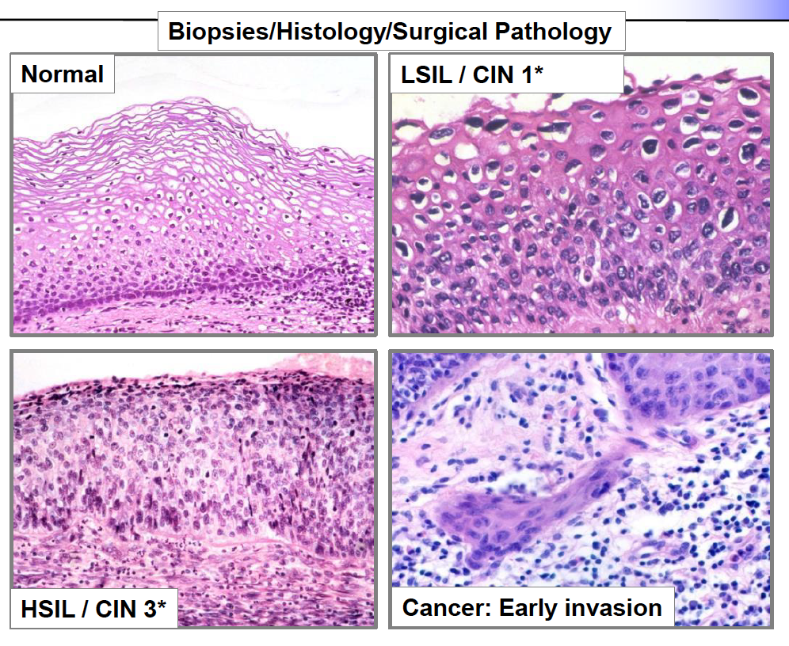
Pathology
Notes:
Pathology slide cause theyre in medical school
https://media.memorang.com/images/cc6e1152-a8e7-4ed2-bc11-84d5bbb9432b.jpg

Slide 4
Case I
64 yo F w L flank/leg pain and post menopausal bleeding started as spotting after intercourse, now using 3 pads per day
Physical exam reveals lesion on cervix, bleeds when touched, biopsy taken with tischler biopsy forceps
Cervical/endometrial biopsies positive for squamous cell carcinoma (SCC), stains p16+
What imaging do we want, and why?
Notes:
MR pelvis – better soft tissue contrast
PET scan – (CT CAP if PET unavailable), systemic imaging

Slide 5
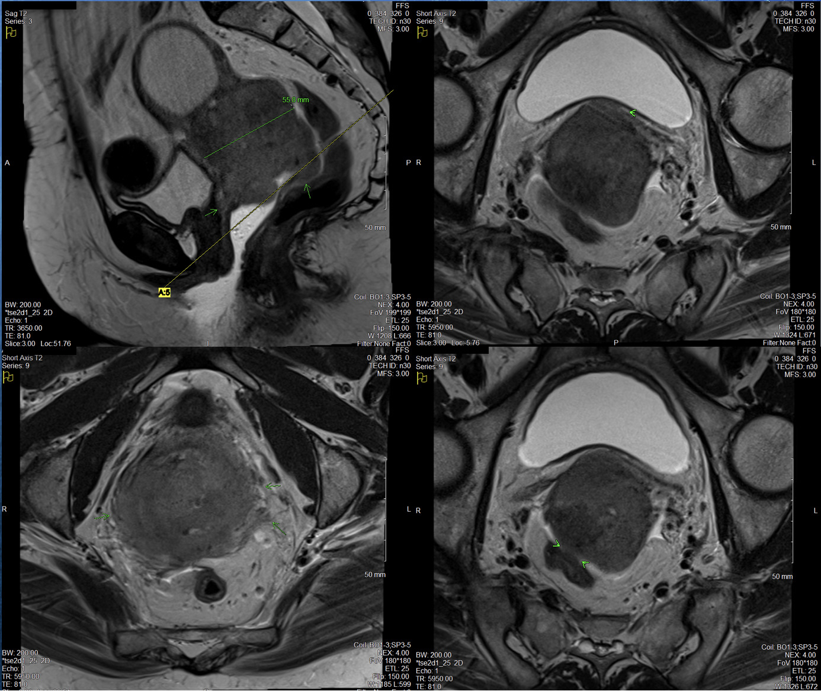
64 year-old woman with newly diagnosed SCC of the cervix
Stage?
Notes:
Top left shows parametrial invasion, vaginal invasion, and sheer size of tumor
Top right shows abutting but not invading bladder
Bottom left shows parametrial invasion
Bottom right shows abutting but not invading rectum
Assuming nodes are negative, but has parametrial involvement, Stage IIB
No hydronephrosis, which was expected given her pain on presentation
Official read:
MR pelvis with 6.6 cm endocervical tumor with invasion of the lower uterine segment, bilateral parametria, upper one third of the vagina, abutting bladder and rectum without definitive invasion. Fluid distended endometrial canal (hydrometra) secondary to the tumor likely explains previously noted ovarian lesion, no ovarian masses noted. Borderline to mildly enlarged left iliac chain lymph nodes suspicious for metastatic disease.

Slide 6
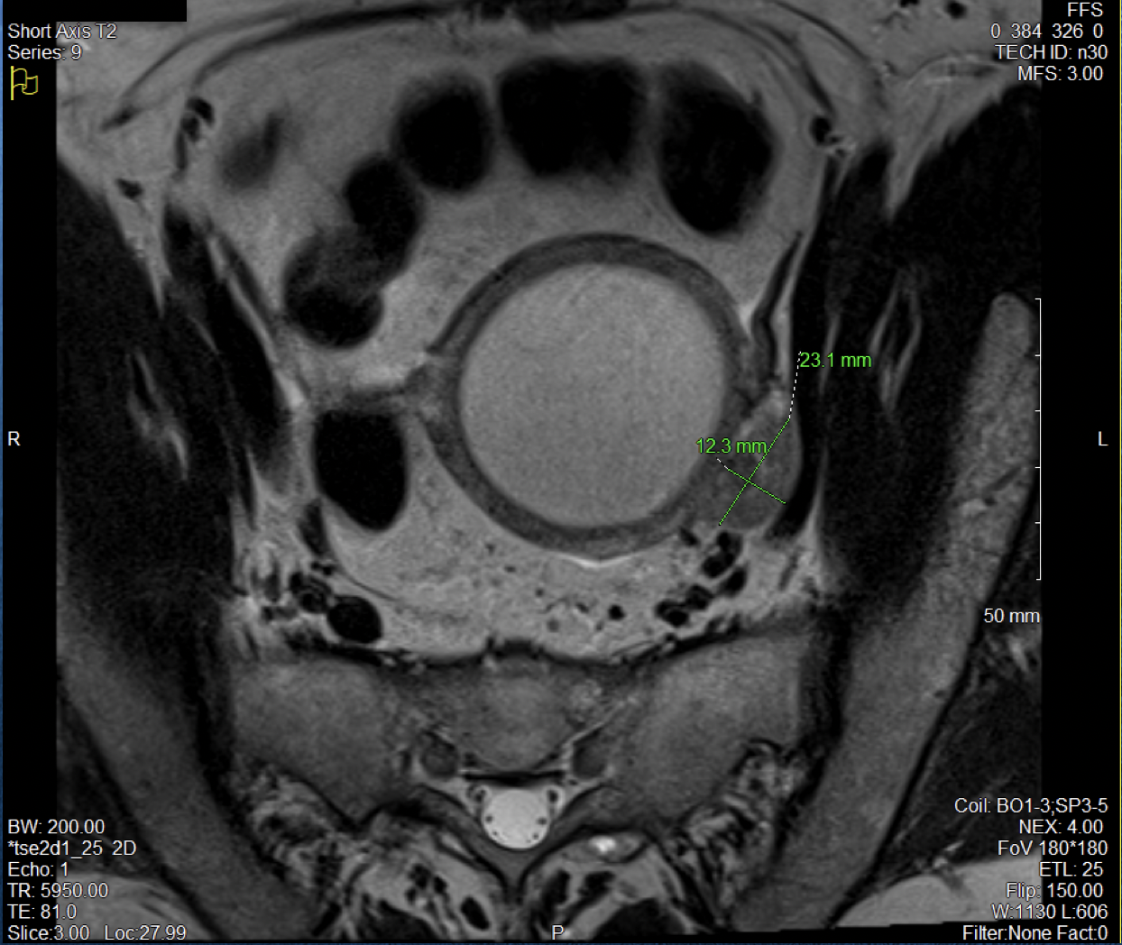
64 year-old woman with newly diagnosed SCC of the cervix
Stage?
Notes:
She is a IIICI

Slide 7
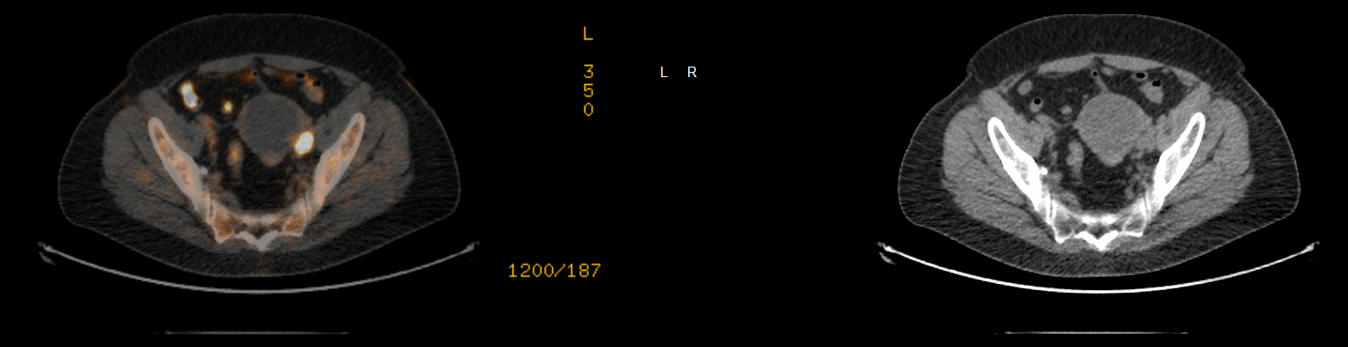
64 year-old woman with newly diagnosed SCC of the cervix
Notes:
She is a IIICI
Hypermetabolic left external iliac lymph node measuring up to 1.5 cm, concerning for nodal metastasis. Additional
smaller left common iliac lymph node with milder uptake indeterminate, but suspicious for additional metastatic disease. Other small para-aortic/retroperitoneal lymph nodes with low-level uptake are nonspecific.

Slide 8
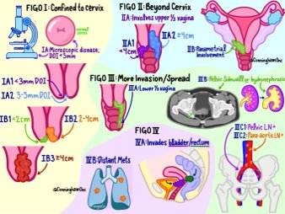
Staging
Notes:
Just for there reference/curiosity

Slide 9
Case I
64 yo F w Stage IIIC1 SCC (6.6 cm, vaginal and parametrial involvement, pelvic node)
What would you recommend for treatment?
Is surgical removal an option?
Are there additional tumor testing, genetic testing, or combination approaches you might consider?
Notes:
We discuss virtually all cases at a multi disciplinary tumor board
Don’t forget ancillary services like nutrition, psych onc, social work. Genetics less for cervical but consideration for other cancers! Is she a trial candidate? Etc.
ChemoRT f/b brachytherapy

Slide 10
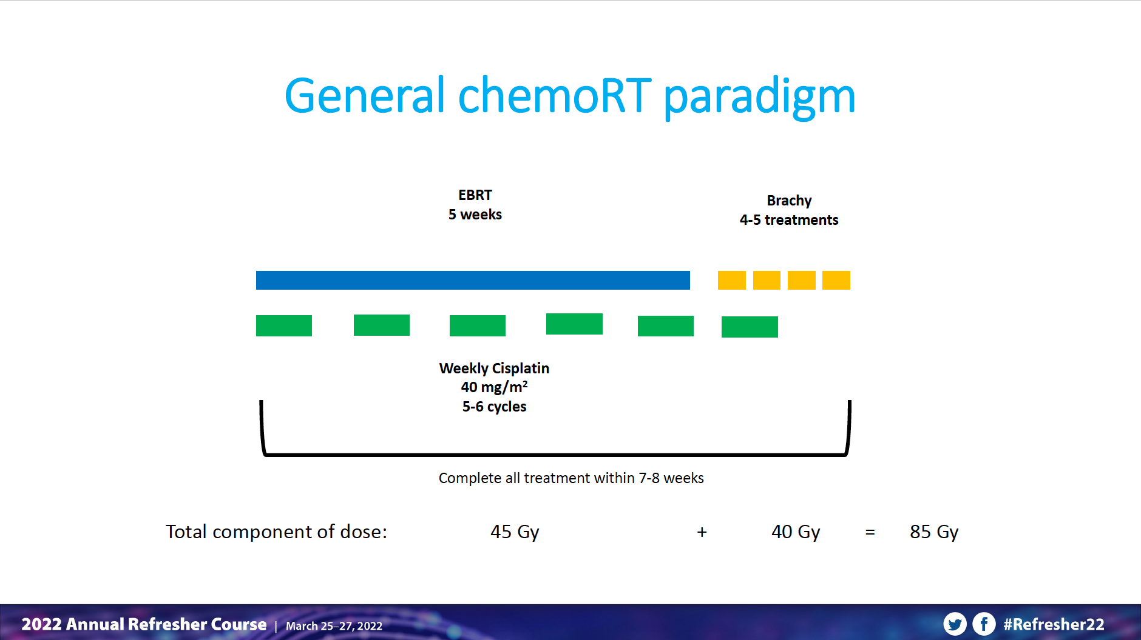
Notes:
Can also start brachy during/at the end of EBRT. Planning starts during EBRT. Essential to have total treatment within 56 days (7-8 weeks)

Slide 11
Case I
64 yo F w Stage IIIC1 SCC (6.6 cm, vaginal and parametrial involvement, pelvic node)
How would you give chemo? What chemo?
Notes:
CIsiplatin – but will let gyn onc discuss

Slide 12
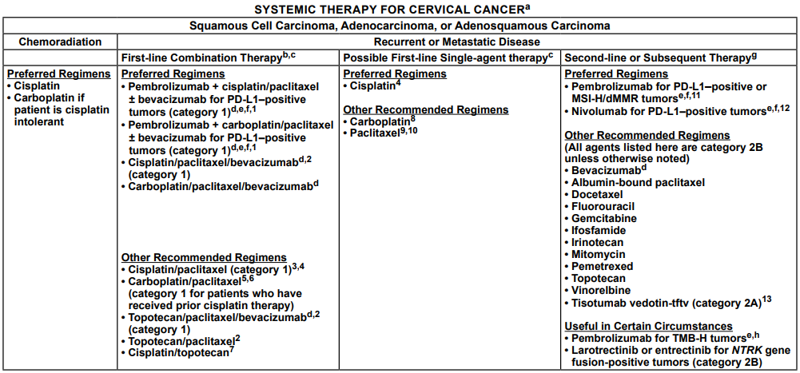
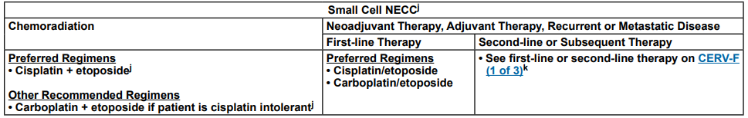
NCCN (2022)
Notes:
Feel free to add more chemo related slides!

Slide 13
Case I
64 yo F w Stage IIIC1 SCC (6.6 cm, vaginal and parametrial involvement, pelvic node)
What is the first step for radiotherapy (external)?
Notes:
Sim
Supine, vac fix, Bladder full, bladder empty, IV contrast, +/- vaginal contrast, rectal contrast
Fuse MR and PET
Scan high enough to be able to treat para aortics – make sure arms up enough!

Slide 14
Radiation Planning

Slide 15
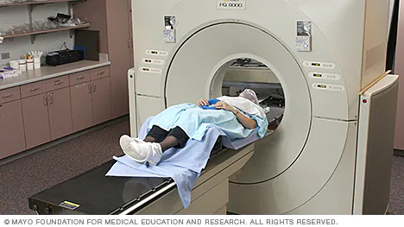
CT Simulation
Notes:
Supine, vac fix, Bladder full, bladder empty, IV contrast, +/- vaginal contrast, rectal contrast
Fuse MR and PET

Slide 16
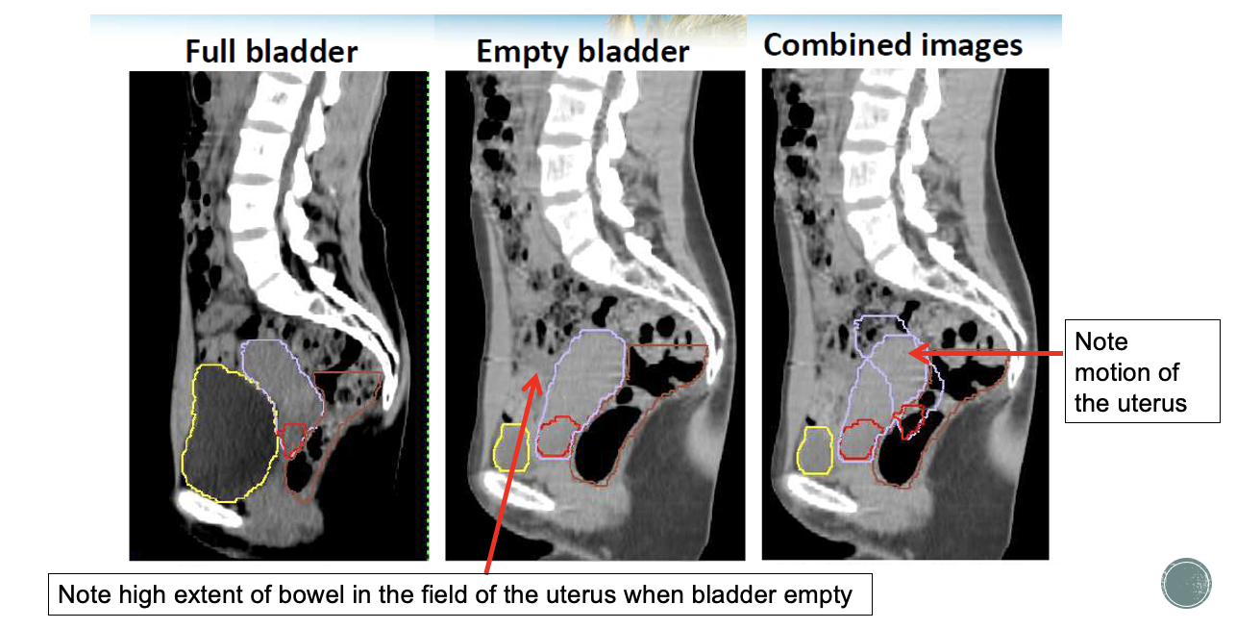
CT Simulation (EBRT)
Courtesy of Dr. Lin, ASTRO Refresher 2018
Notes:
Resources
ASTRO Refresher (2018)

Slide 17
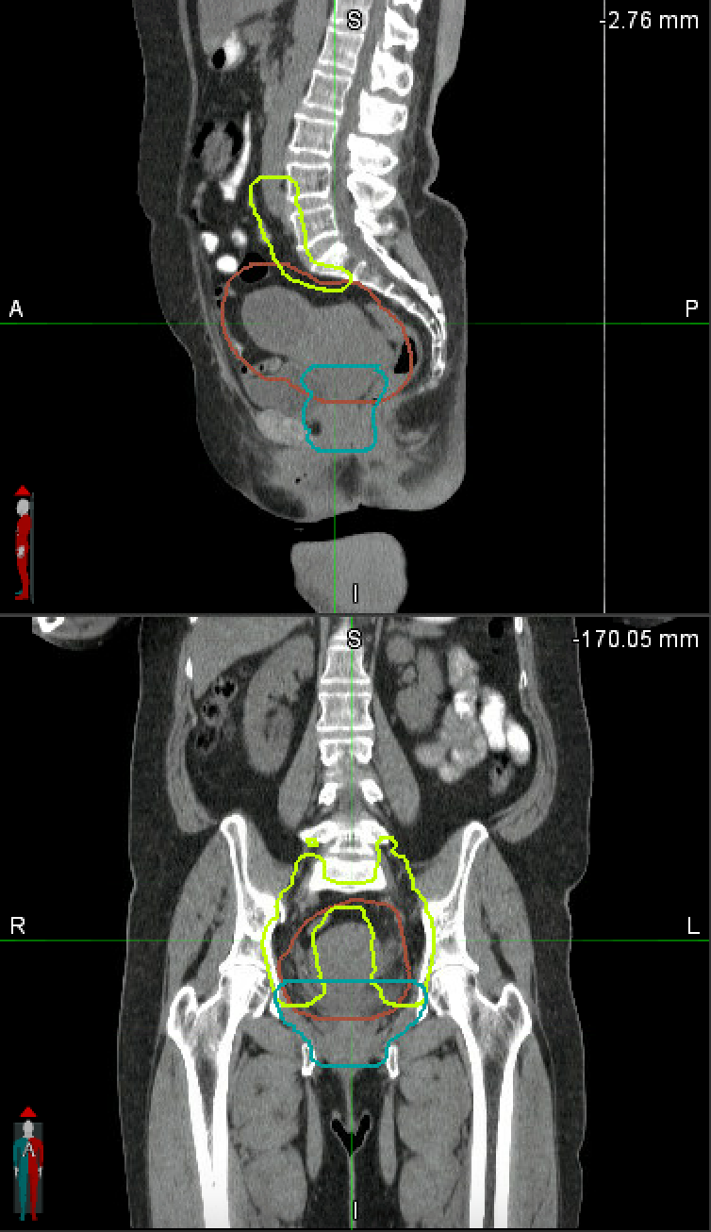
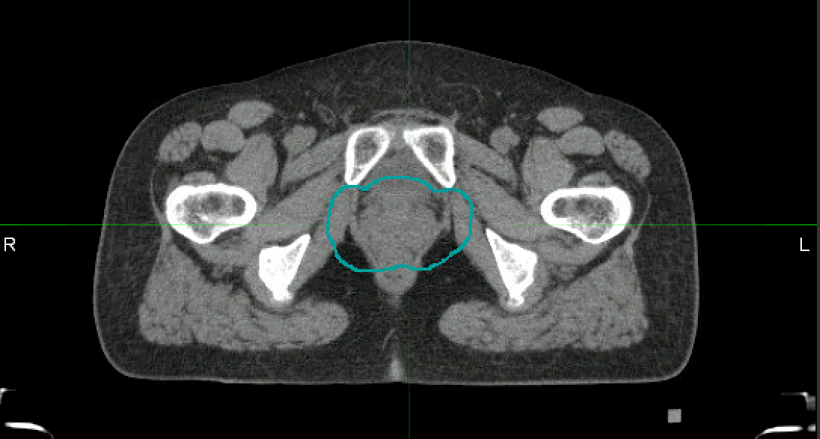
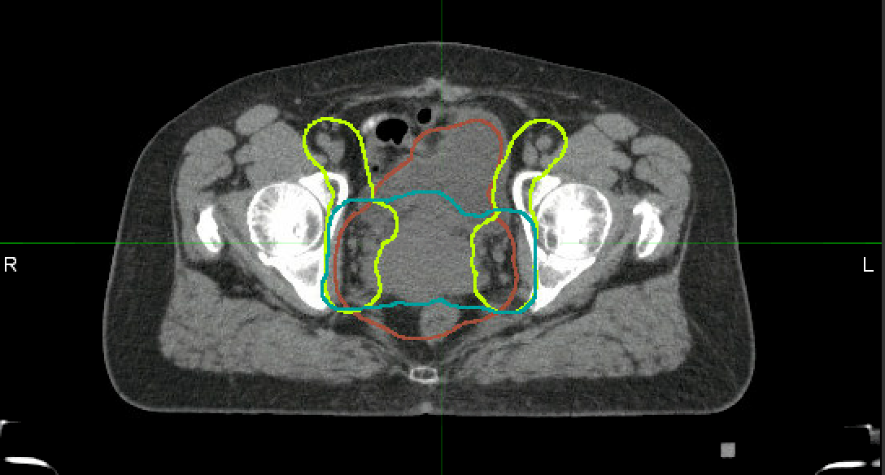
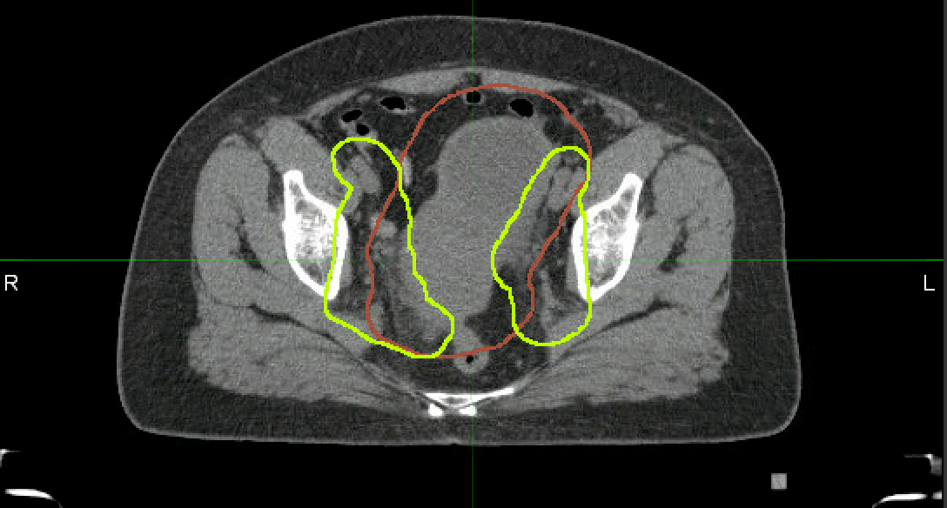
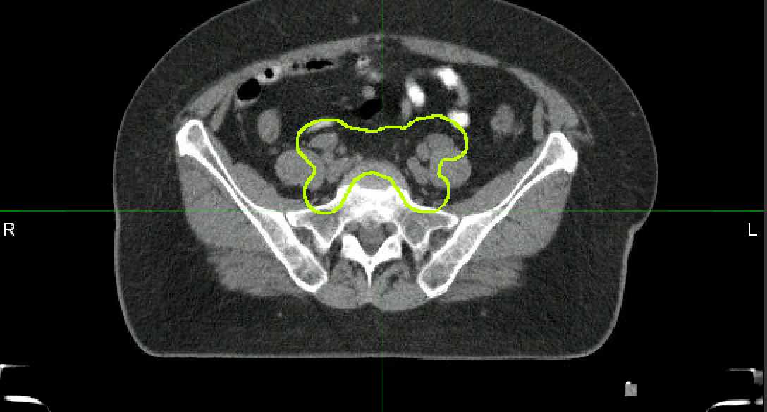
Contours
Notes:
Try to get contours up remotely, but if not then this will have to do. This is for Regina Lathan but any cervix case should be fine

Slide 18
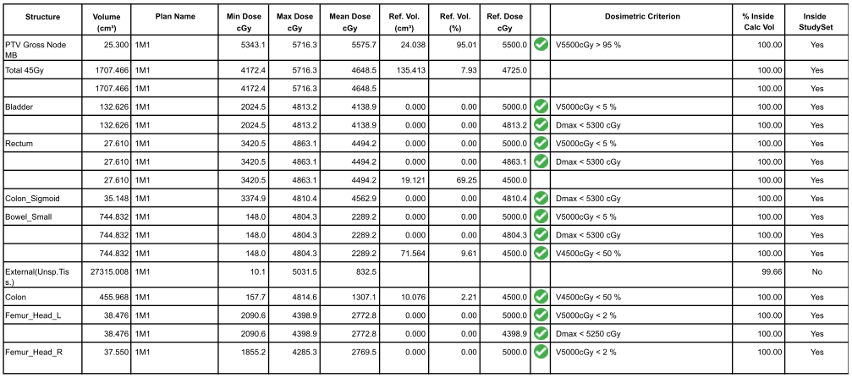
Constraints
Notes:
Just show that we have a wish list to guide planning

Slide 19
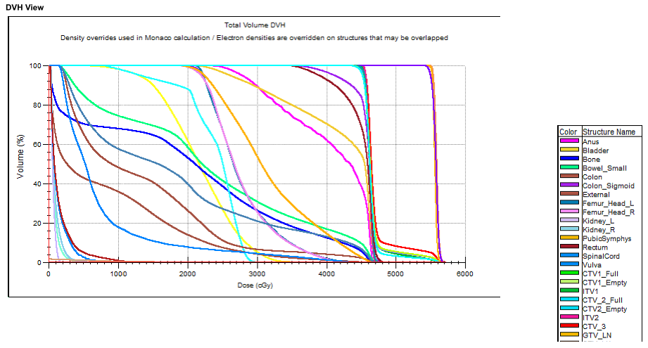
Plan Review
Notes:
DVH - One of the ways we evaluate a plan, to make sure we get enough/not too much dose to appropriate structures

Slide 20
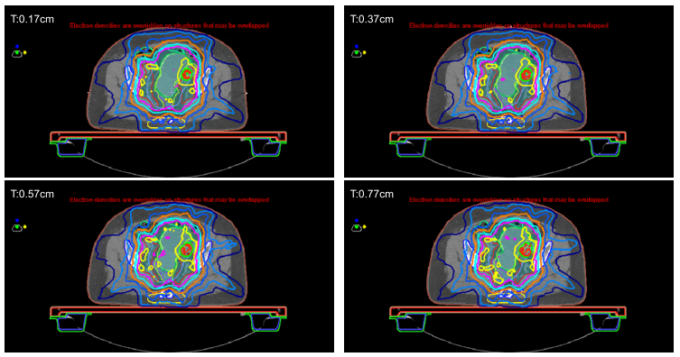

Plan Review

Slide 21
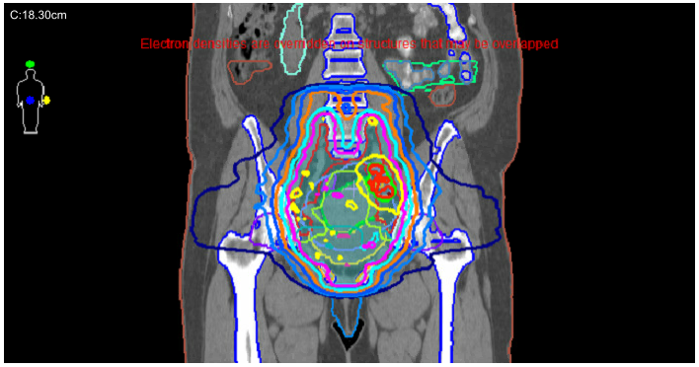
Plan Review

Slide 22
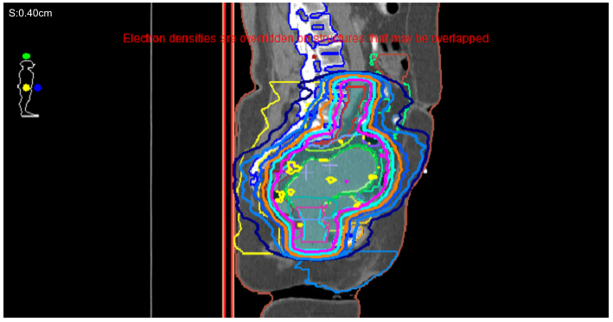
Plan Review
Notes:
DVH - One of the ways we evaluate a plan, to make sure we get enough/not too much dose to appropriate structures

Slide 23
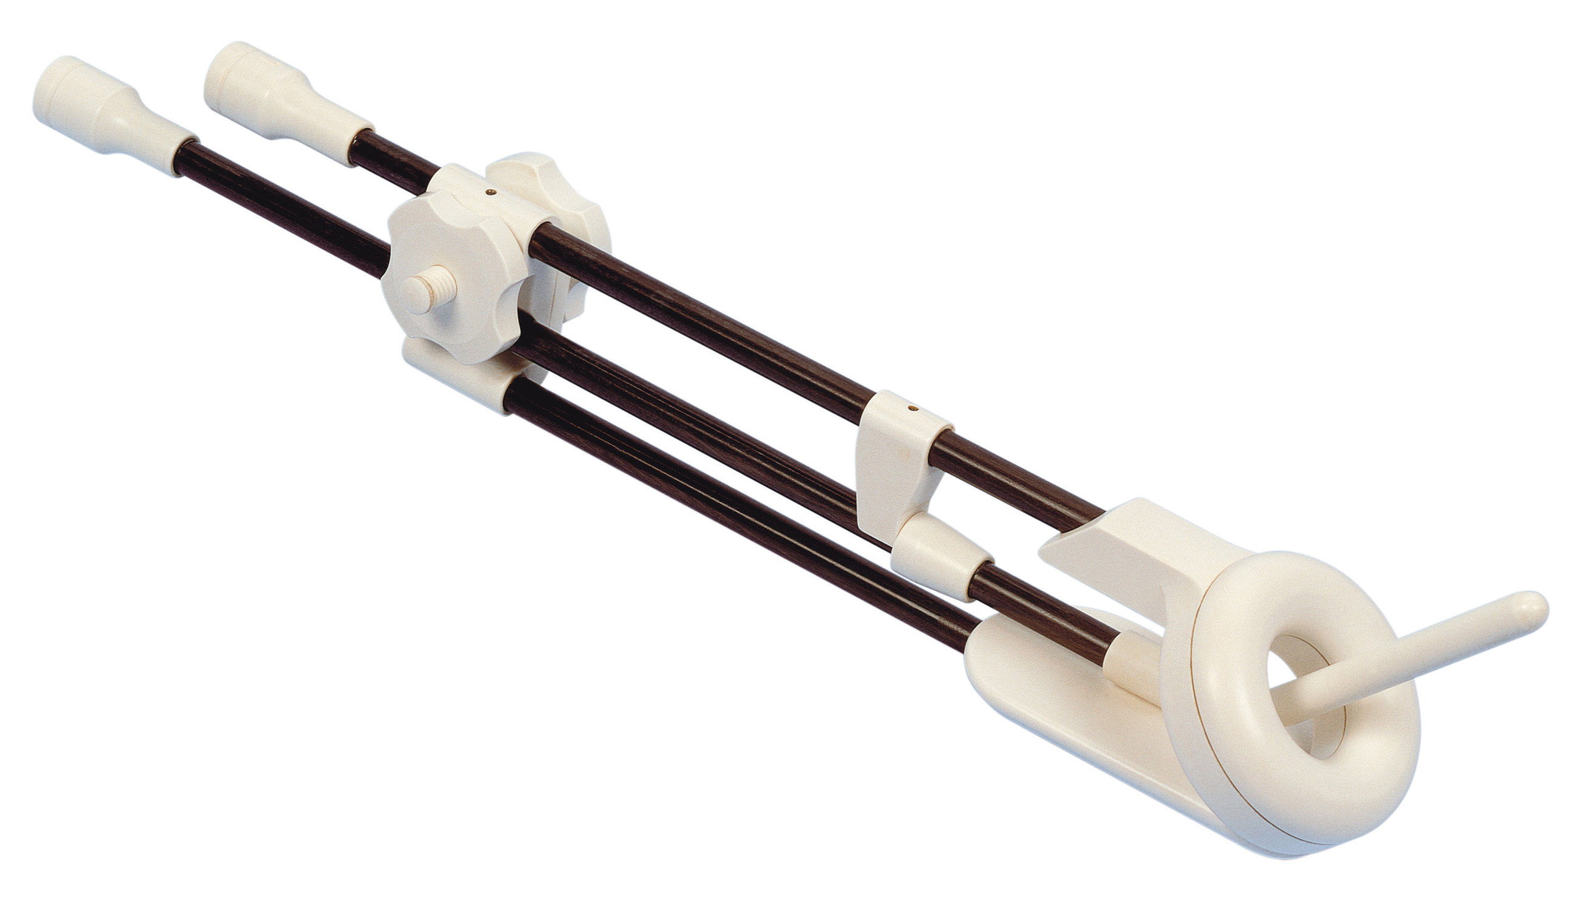
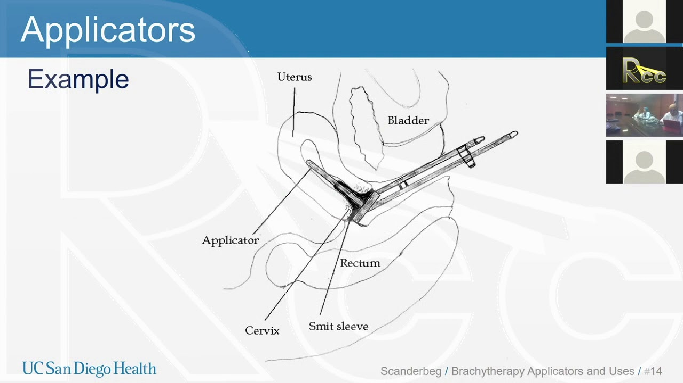
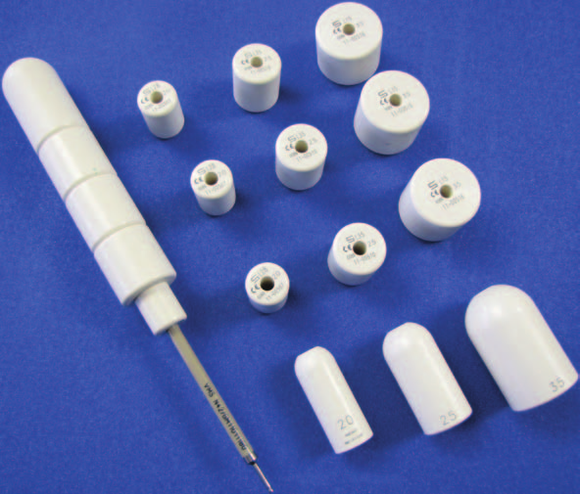
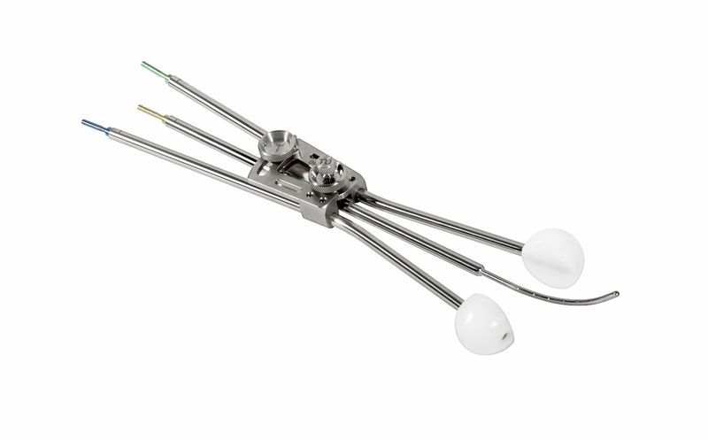
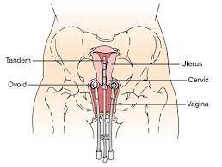
Brachytherapy
Notes:
Just to show there are different applicators depending on anatomy
Hopefully we will have the physical applicators to show!

Slide 24
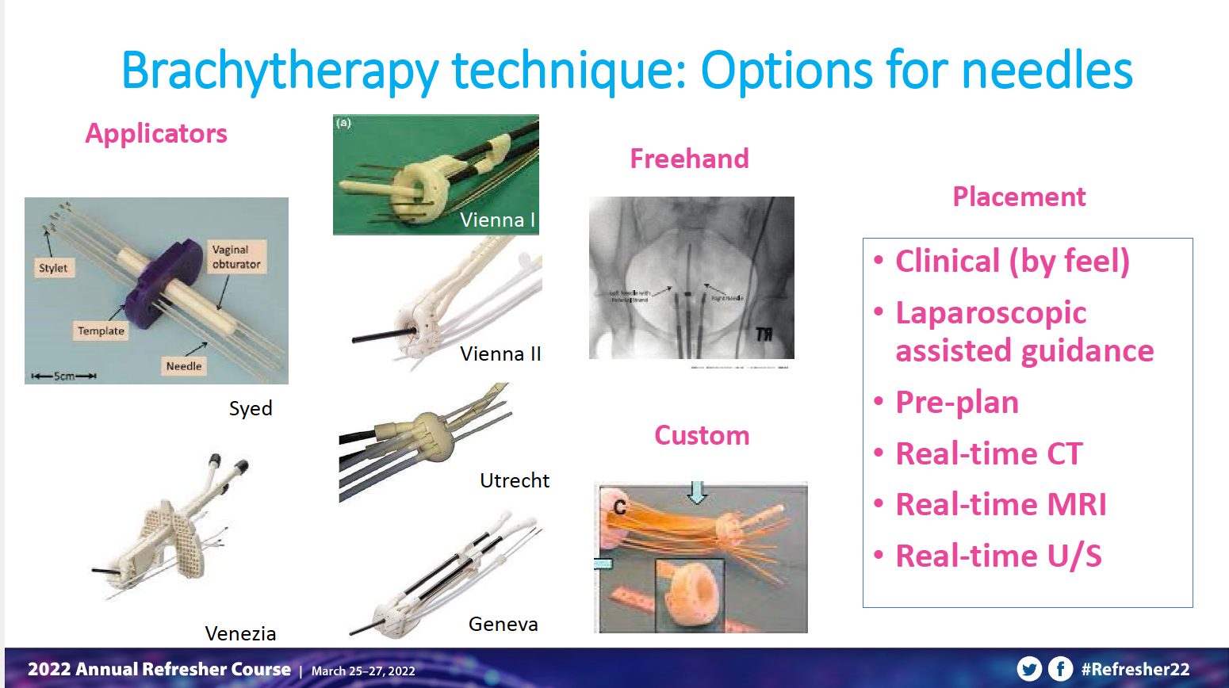
Notes:
And needles as an option
Explain that these procedures are done in the OR/procedure room, with varying degrees of help from gyn onc

Slide 25
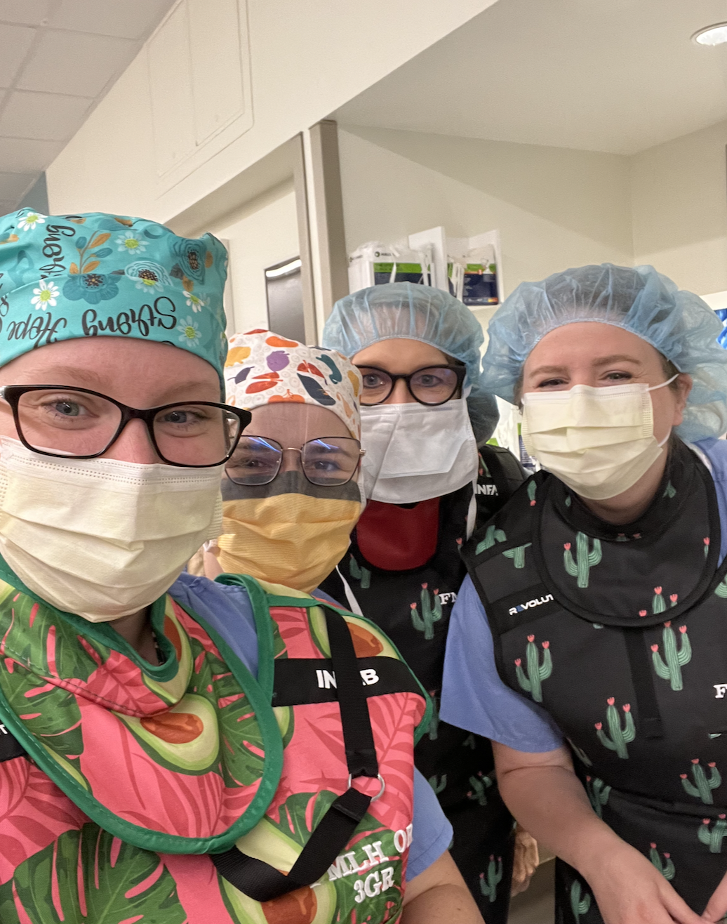
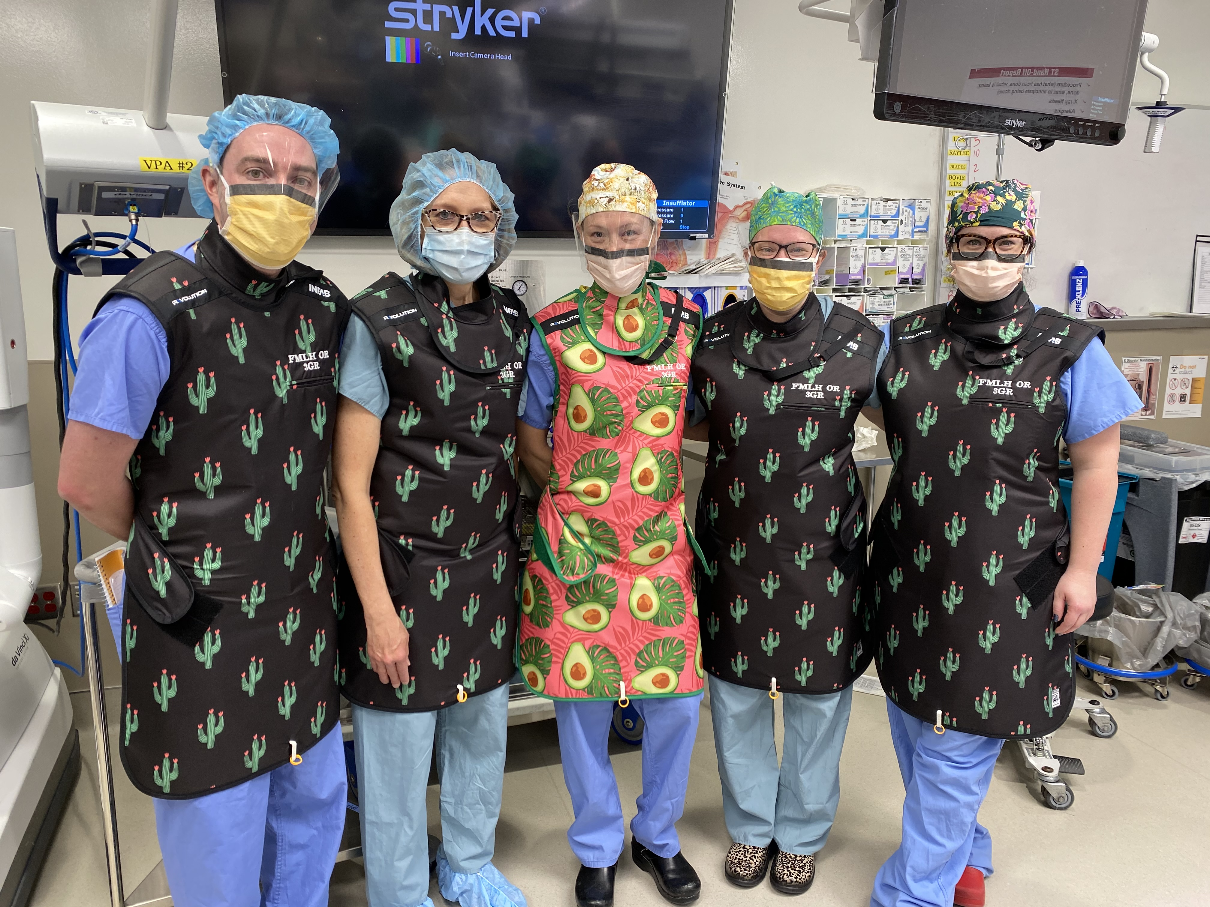
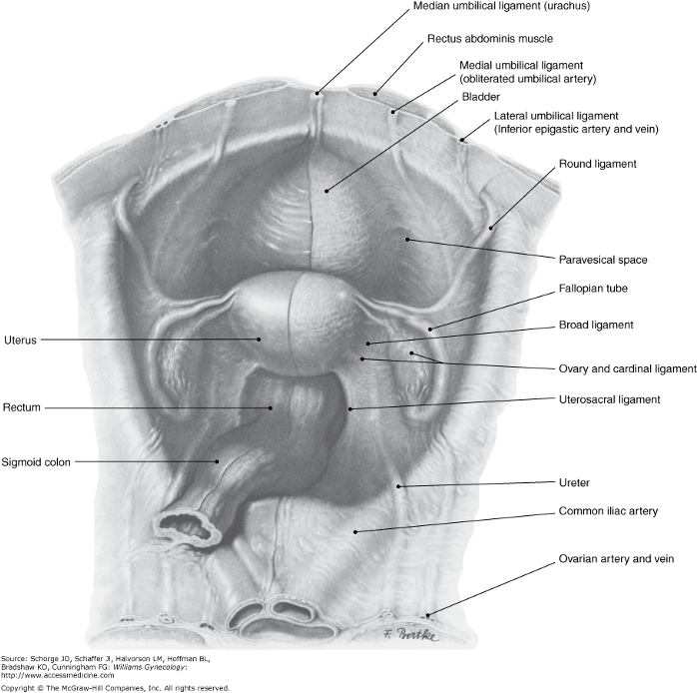
COLLABORATION IN THE OPERATING ROOM
Notes:
DVH - One of the ways we evaluate a plan, to make sure we get enough/not too much dose to appropriate structures

Slide 26
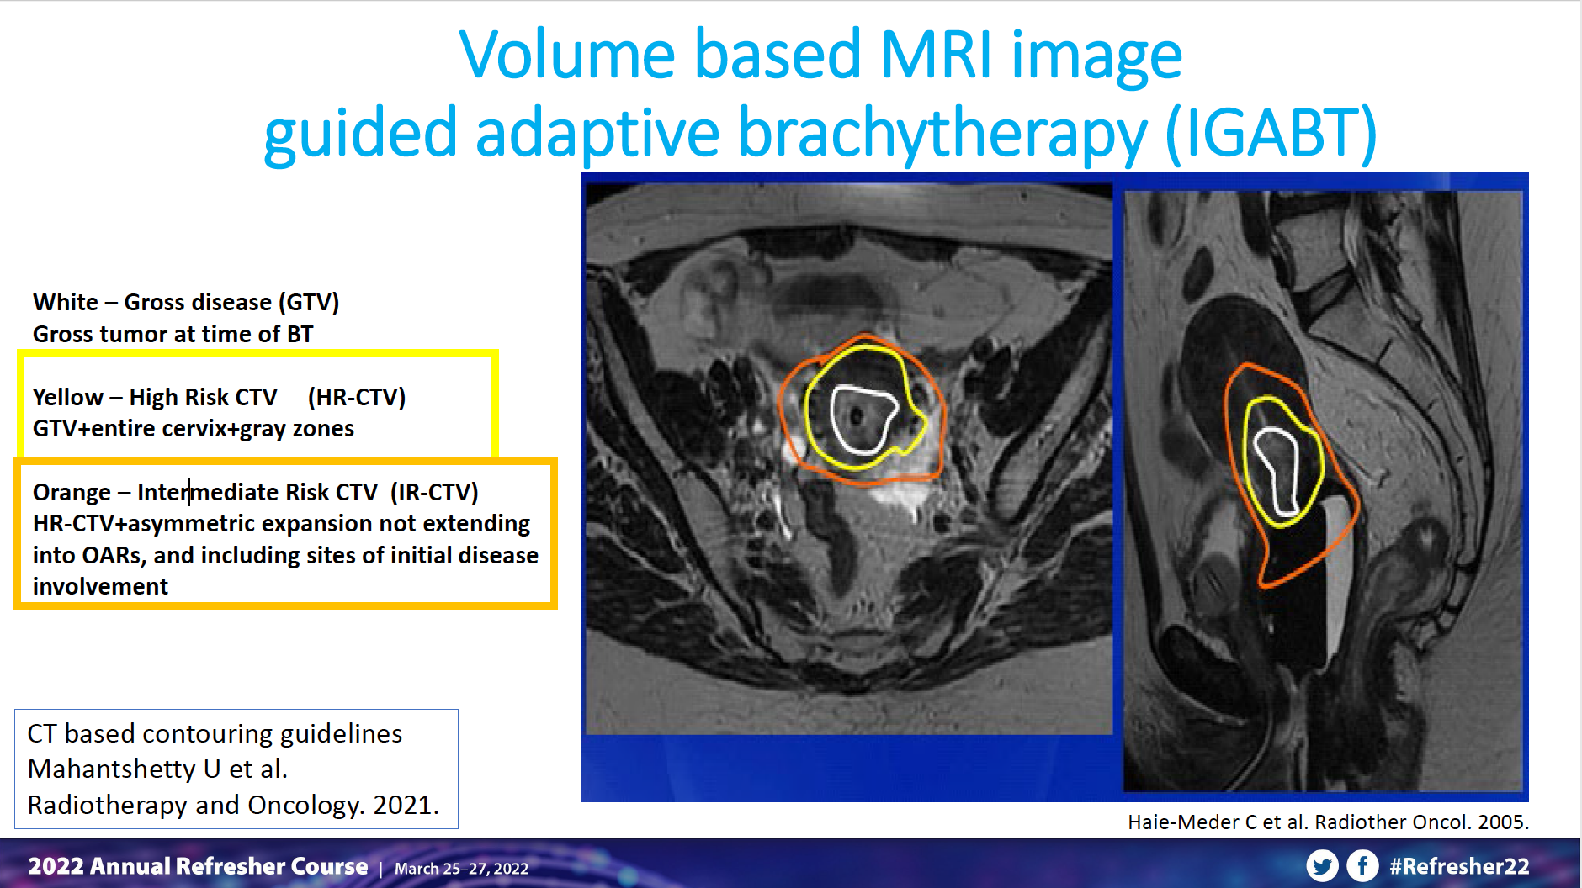
Notes:
Contours similar to before

Slide 27
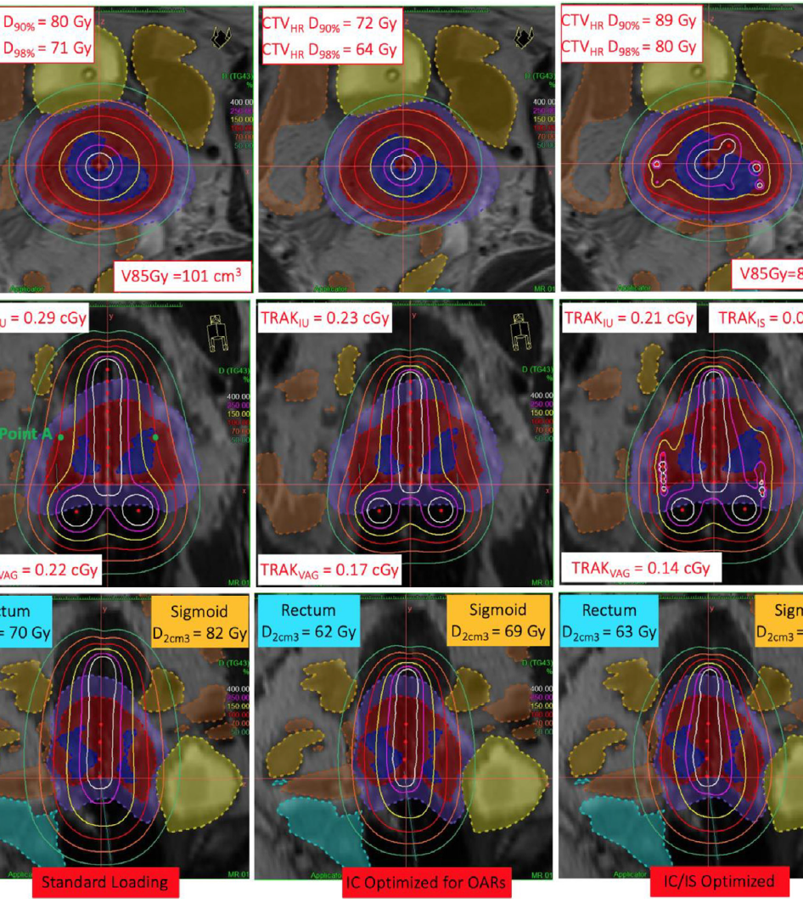
tanderup, et al. 2020
Notes:
May be helpful to answer questions, but again just for reference

Slide 28
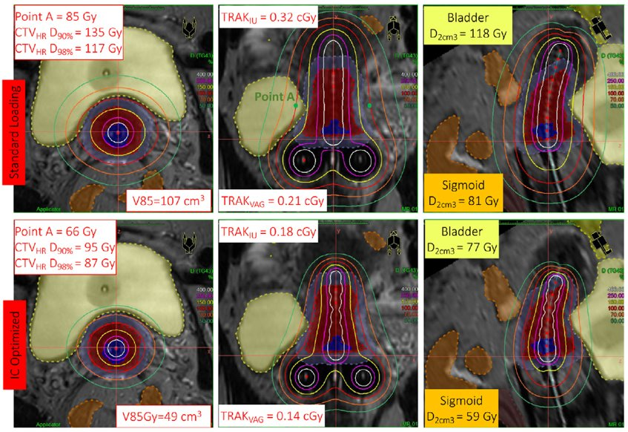
TANDERUP, ET AL. 2020
Notes:
May be helpful to answer questions, but again just for reference

Slide 29
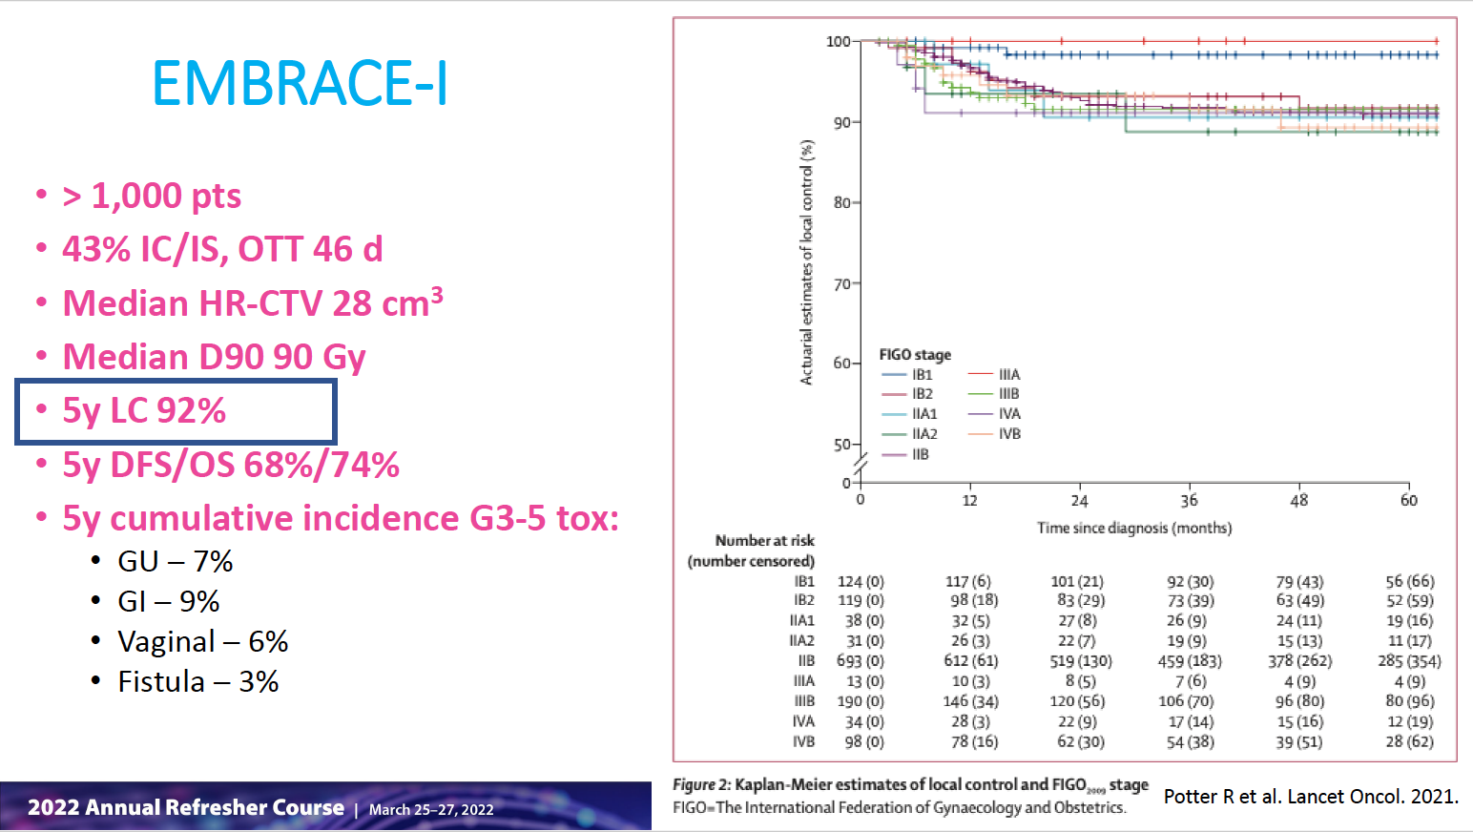
Embrace I (mazeron, et al. 2016)
Notes:
Highlight that chemoRT provides excellent local control! Good disease free and overall survival though room for improvement (chemo, target treatments?)

Slide 30
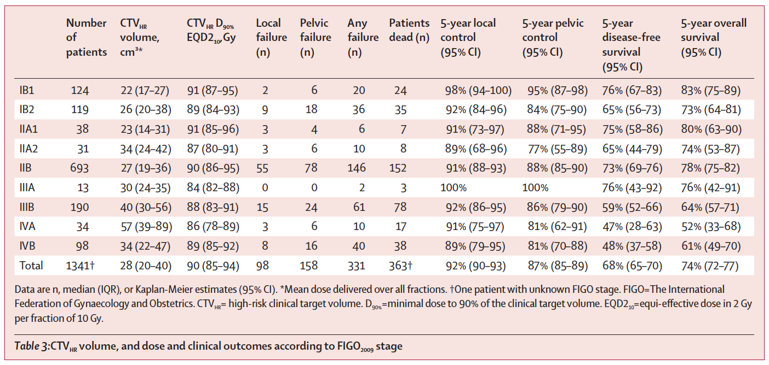
Embrace I (Potter, et al. 2021)

Slide 31
Toxicity

Slide 32
ACUTE TOXICITy
General​
  Fatigue​
GU​
  Cystitis (frequency/urgency)​
  Urethritis (dysuria)​
GI​
  Loose stools/diarrhea​
  Fecal frequency/urgency​
Skin​
  Mild dermatitis
Notes:
CIsiplatin – but will let gyn onc discuss

Slide 33
Late TOXICITy
GU
  Hematuria
  Chronic cystitis
  Ureteral stricture
GI
  Proctitis
  Hematochezia (<5%)
  Small bowel obstruction (<5%; <1% requiring surgical intervention)
  Fistula formation
Sexual
  Vaginal stenosis/fibrosis → give dilator (2-10) minutes 2x per week x2 years)
  Vaginal dryness → estrogen cream
  Apical vaginal ulceration/necrosis
  Infertility
  Menopause → consider hormones (unless contraindicated)
Other
  Pelvic insufficiency fracture (15%)
  Avascular necrosis (<1%)
  Lymphedema → 10% risk following surgery and an additional 5-10% risk following RT
Notes:
CIsiplatin – but will let gyn onc discuss

Slide 34
Follow Up

Slide 35
Follow up
Vaginal Dilator
  Start ~2 weeks post-treatment
  2-10 minutes, 2x per week x2 years
H&P w/ Gyn Exam
  q3 months x 2 years, then q6 months years 3-5, then annually
Annual Cervical/Vaginal Cytology
  Detection can be limited
  Accuracy of cytology can be affected by pelvic RT
Notes:
CIsiplatin – but will let gyn onc discuss

Slide 36
Questions?
Notes:
If we have time, let them practice contouring!

Slide 37
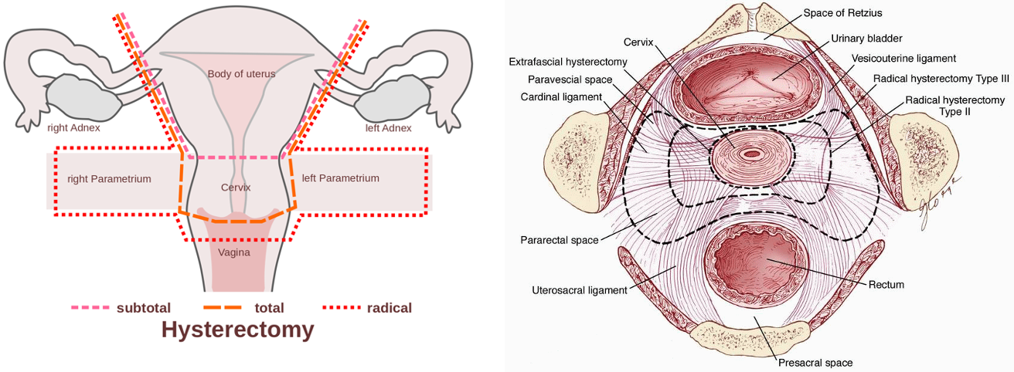
WHAT IF THE PATIENT HAD 2 CM TUMOR AND PET nEG
Surgical options:
Notes:
CIsiplatin – but will let gyn onc discuss

Slide 38
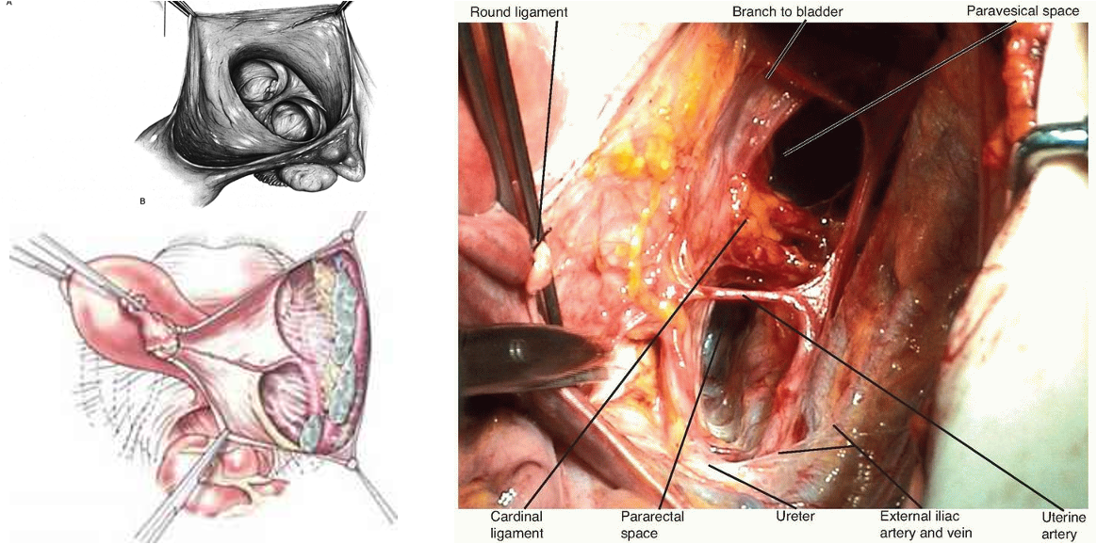
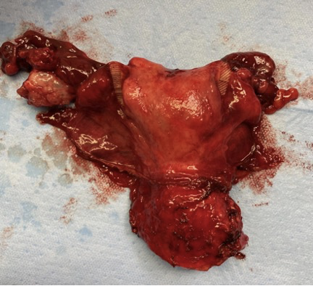
WHAT IF THE PATIENT HAD 2 CM TUMOR AND PET nEG
Radical Hysterectomy
Notes:
CIsiplatin – but will let gyn onc discuss

