Slide 1
Cancer Center Symposium 2023
Medical and Radiation Oncology, Interactive Case

Slide 2
Case I
68 yo M with Blurry vision, double vision, sinus pressure, rhinitis, R eye discomfort and intermittent headaches.
Whats next?
Notes:
Ask about current symptoms: esp. full history – when started, inciting events, severity, frequency, duraiton, other neuro symptoms, infectious symptoms or contacts, general cancer symptoms (appetite, energy, weight loss, fever/chills, night sweats)
Complete history: Past medical, surgical, fmhx (genetics?), sexual, social, contraindications for radiation/surgery, gynecologic hx
Physical: Neuro exam, H&N exam

Slide 3
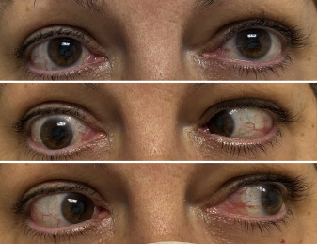
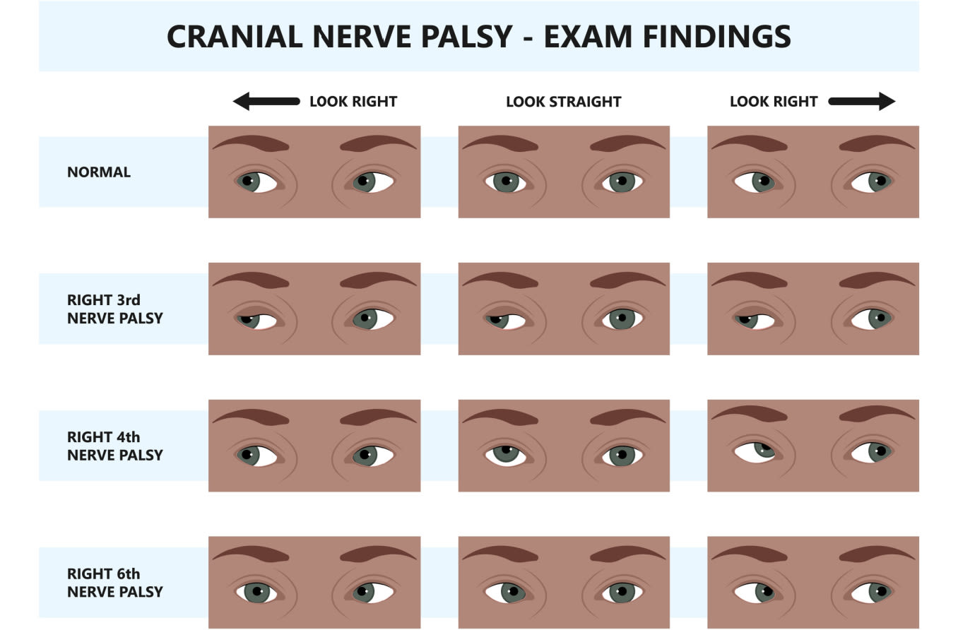
Case I
68 yo M with Blurry vision, double vision, sinus pressure, rhinitis, R eye discomfort and intermittent headaches.
Neuro exam:
Notes:
Top = forward
Middle = look right
Left = look left
What is this called? CNVI palsy (abducens nerve)
CNVI palsy – what are we worried about?
Invasion into the cavernous sinus via sphenoid erosion
He asks if this is how his cancer normally presents

Slide 4
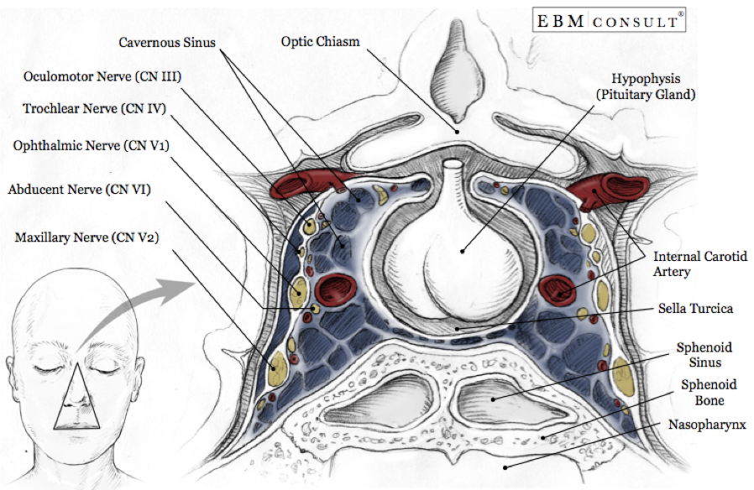
Anatomy: Cavernous Sinus
Most commonly involved cranial nerves: CN V and CN VI via erosion of the sphenoid bone

Slide 5
Case I
68 yo M with Blurry vision, double vision, sinus pressure, rhinitis, R eye discomfort and intermittent headaches.
Neuro exam with CN VI palsy.
CT/MR orbit with large infiltrative central skull base mass

Slide 6
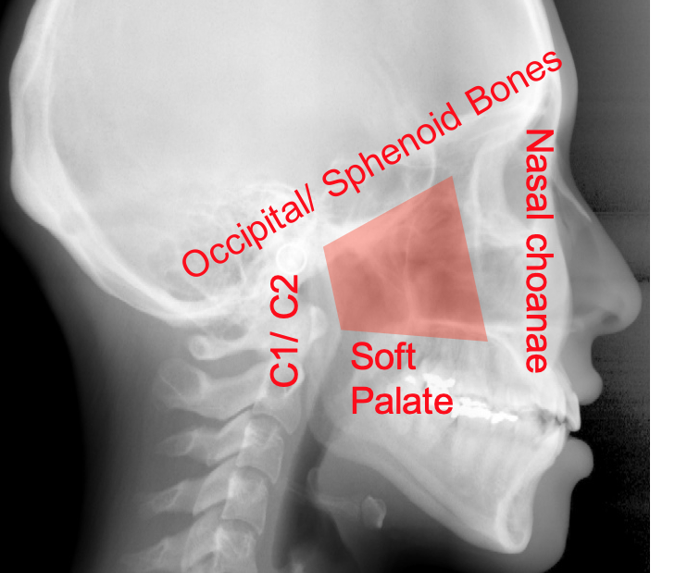
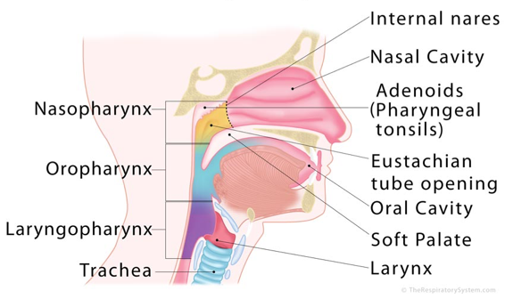
Anatomy
Boundaries:
Anterior: Posterior edge of nasal cavity; Posterior choanae
Posterior: Vertebrae (C1-2)/prevertebral muscles
Superior: Skull base
Inferior: Soft palate
Lateral walls: Parapharyngeal tissue
Notes:
From what structure do most nasopharyngeal cancers arise? Fossa of rosenmuller (posterior to opening of eustachian tube)

Slide 7
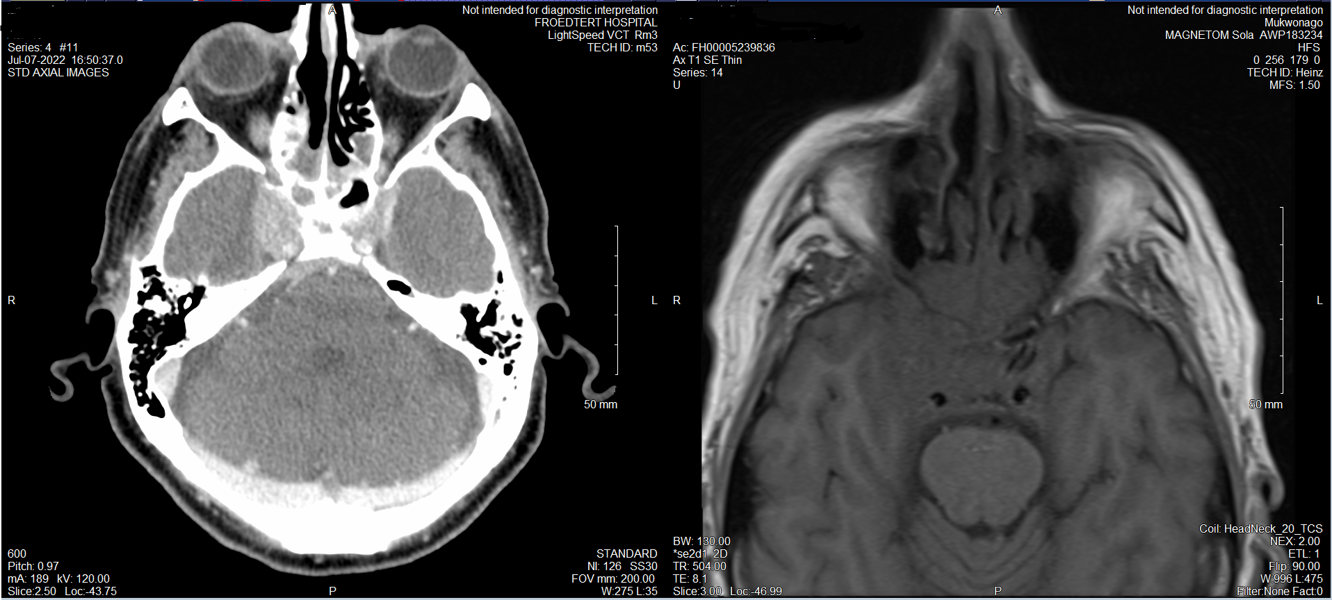
Case 1: CT/MR
Notes:
~6 cm nasopharyngeal mass with invasion of clivus, basisphenoid, masticator spaces, orbital apices and associated neurovascular foramina, cavernous sinus and retroclival dural invasion

Slide 8
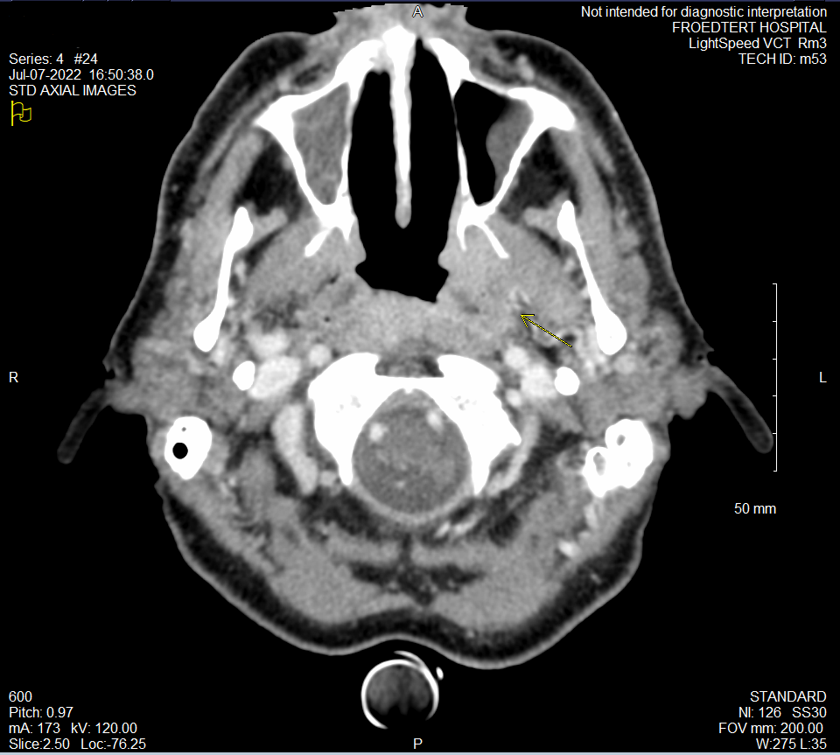
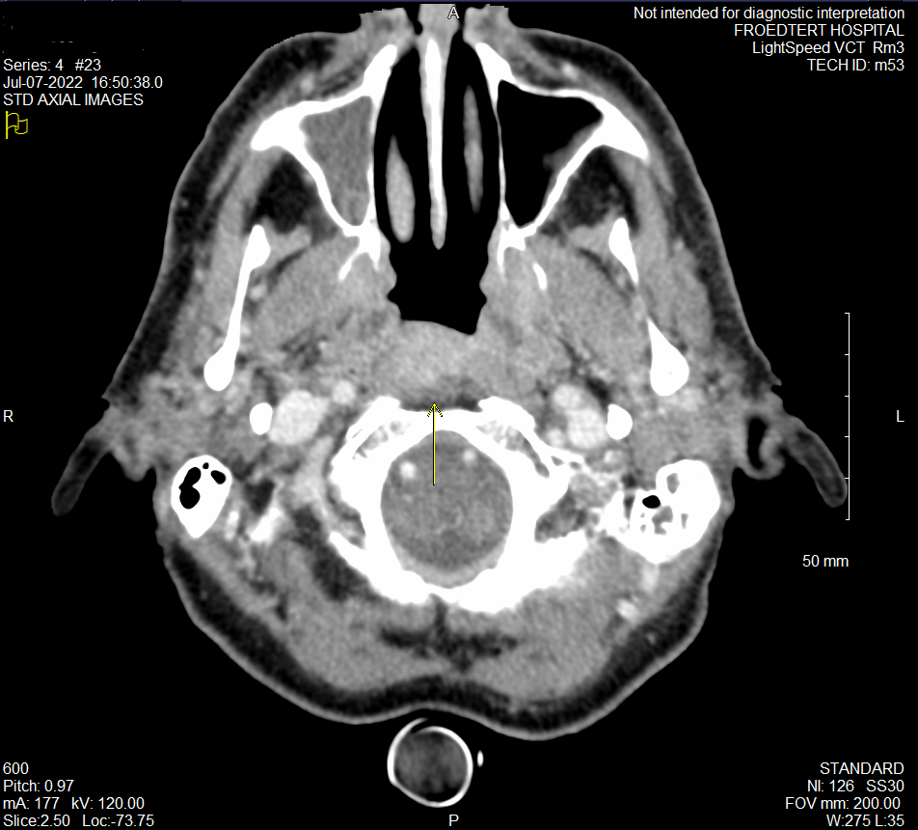
Case 1: CT

Slide 9
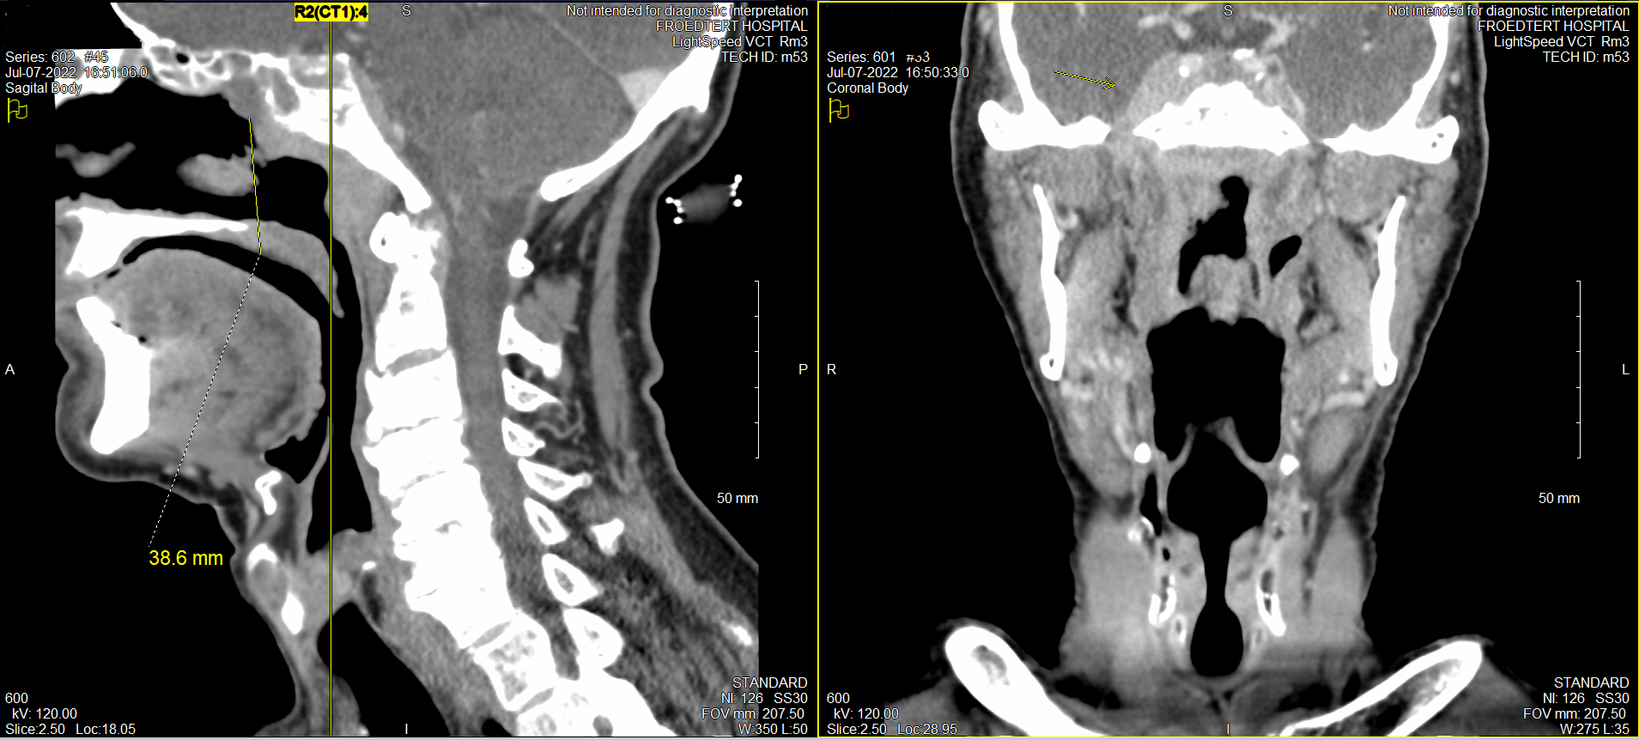
Case 1: CT

Slide 10
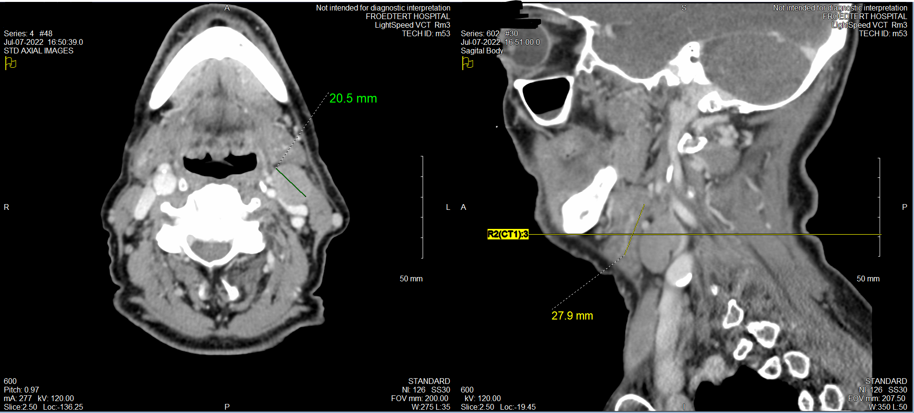
Case 1: CT

Slide 11
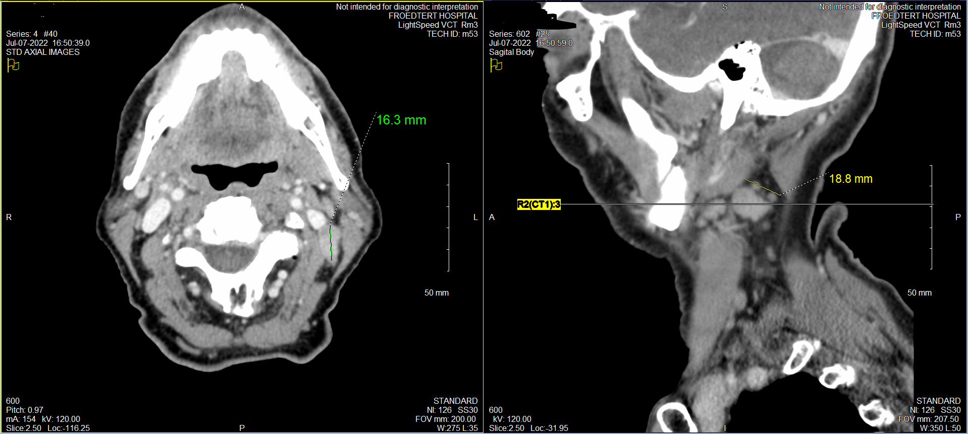
Case 1: CT
Notes:
https://radiopaedia.org/cases/ct-head-bone-window-axial-skull-base-labelling-questions?lang=us

Slide 12
Case I
68 yo M with Blurry vision, double vision, sinus pressure, rhinitis, R eye discomfort and intermittent headaches.
Neuro exam with CN VI palsy.
MR orbit with large infiltrative central skull base mass
Next step?
Notes:
FLL and Biopsy - Endoscopic endonasal approach for sinonasal biopsy

Slide 13
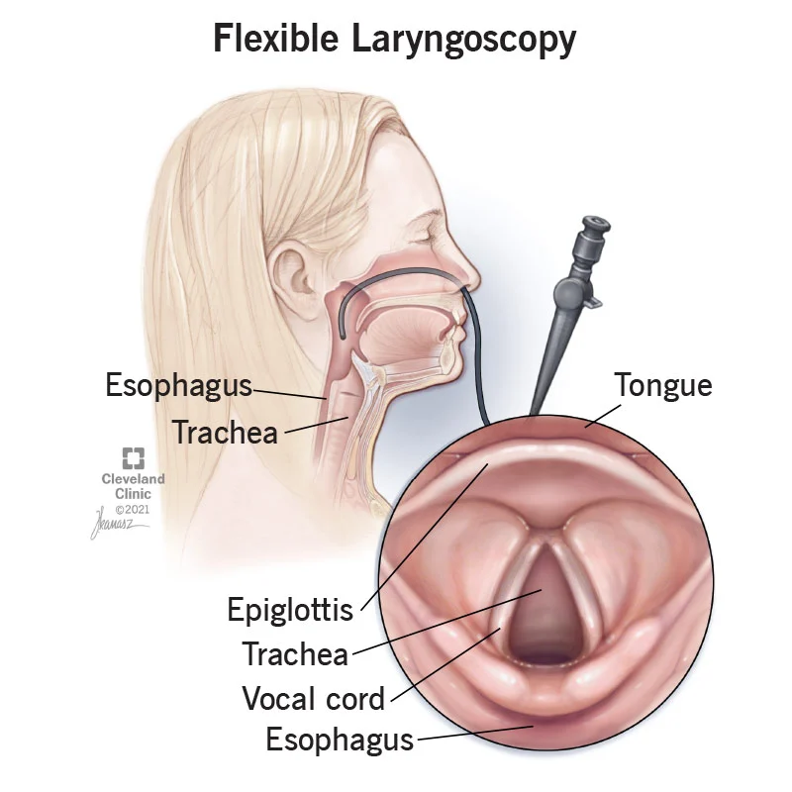
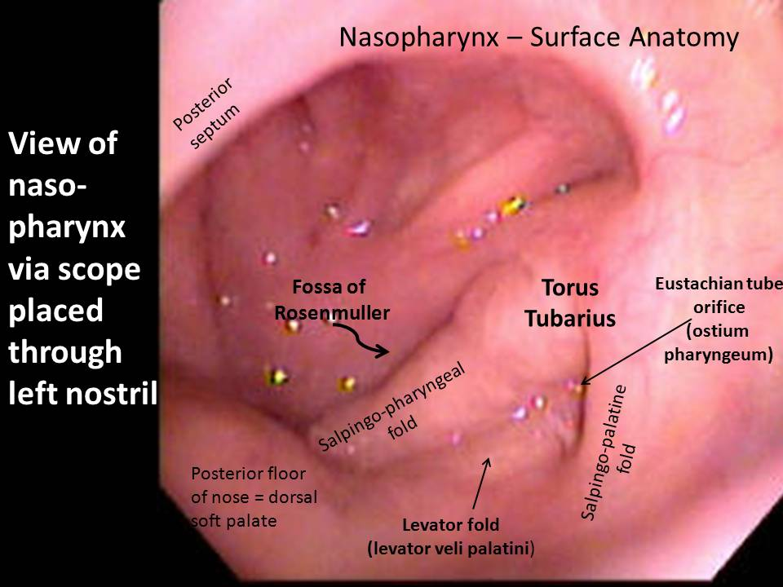
FLL (flexible fiberoptic laryngoscopy)
Notes:
Starting outside patient, general exam – https://www.youtube.com/watch?v=GMS8dEtfis4
Good normal anatomy – https://www.youtube.com/watch?v=13Hb3OxNB5k
Nasopharynx – https://www.youtube.com/watch?v=fLGS4CVPfH4

Slide 14
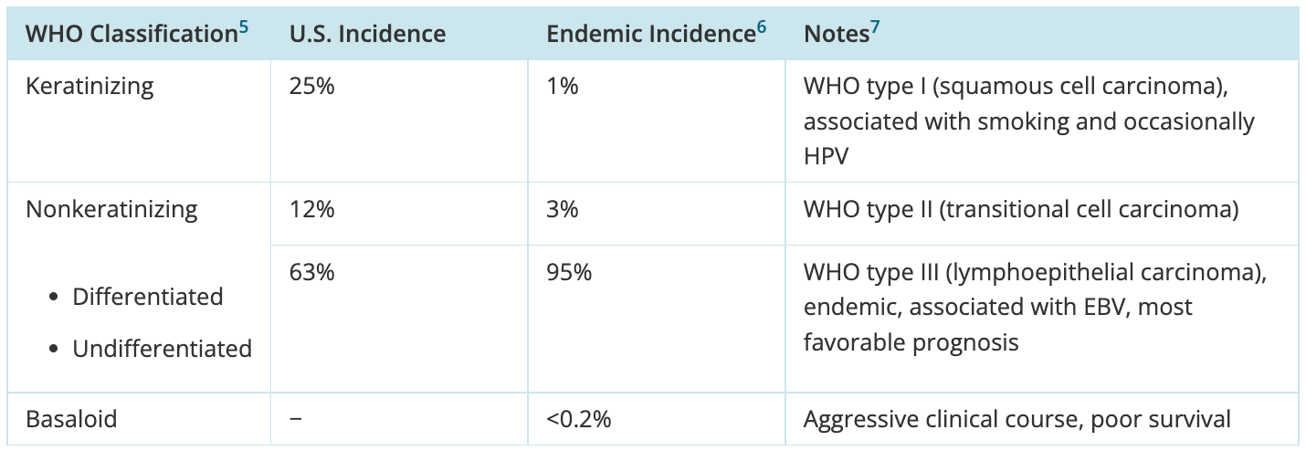
Pathology
Notes:
Non keratinizing is the most common, especially in endemic areas, and is EBV associated
Keratinizing is more locally aggressive, seen in non endemic areas, worse OS

Slide 15
Case I
68 yo M with Blurry vision, double vision, sinus pressure, rhinitis, R eye discomfort and intermittent headaches.
Neuro exam with CN VI palsy.
MR orbit with large infiltrative central skull base mass
Endoscopic endonasal sinonasal biopsy demonstrating nasopharyngeal carcinoma, non keratinzing, undifferentiated lymphoepithelial type, EBER positive
Next step?
Notes:
PET, EBV DNA, Ancillary services

Slide 16
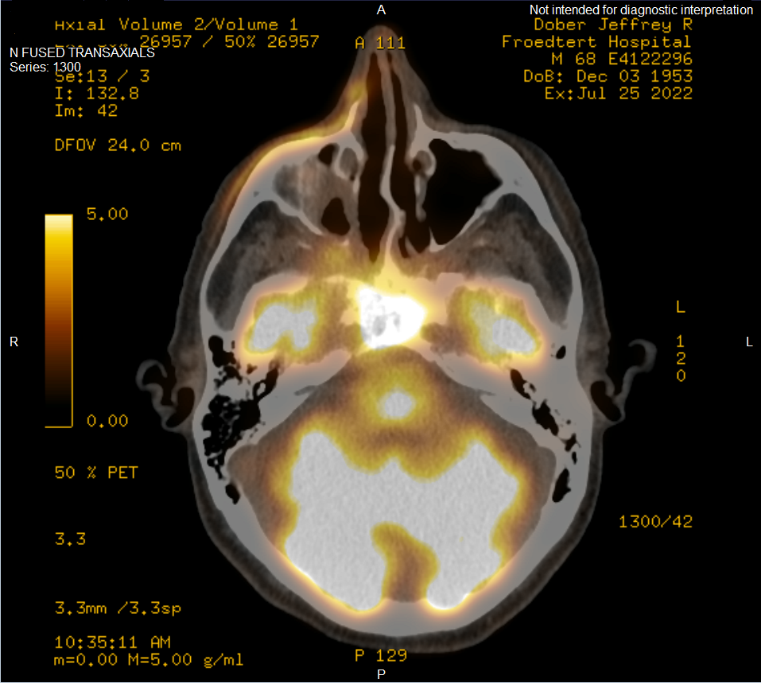
Case 1: PET

Slide 17
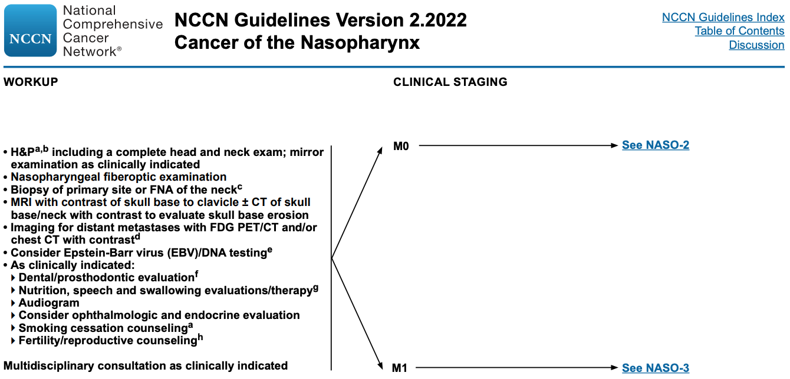
Work Up:
Notes:
FLL, Biopsy, MRI +/- CT, PET, EBV DNA, Ancillary services

Slide 18
Case 1: Staging
~6 cm nasopharyngeal mass with invasion of clivus, basisphenoid, masticator spaces, orbital apices and associated neurovascular foramina, cavernous sinus and retroclival dural invasion
Enlarged left level II lymph nodes (2 total) and multiple indeterminate nonenlarged morphologically abnormal nodes scattered throughout both anterior cervical chains bilaterally.
How would you stage our patient?
Stage IVA, cT4N2 Nasopharynx cancer, EBER positive
Notes:
c Stage IVA, cT4N2 Nasopharynx cancer, EBER positive
Intracranial/CN nerve invasion is T4
Bony only invasion is T3
N1 is unilateral < 6 cm
N2 is bilateral < 6 cm. Awan staged him N2

Slide 19
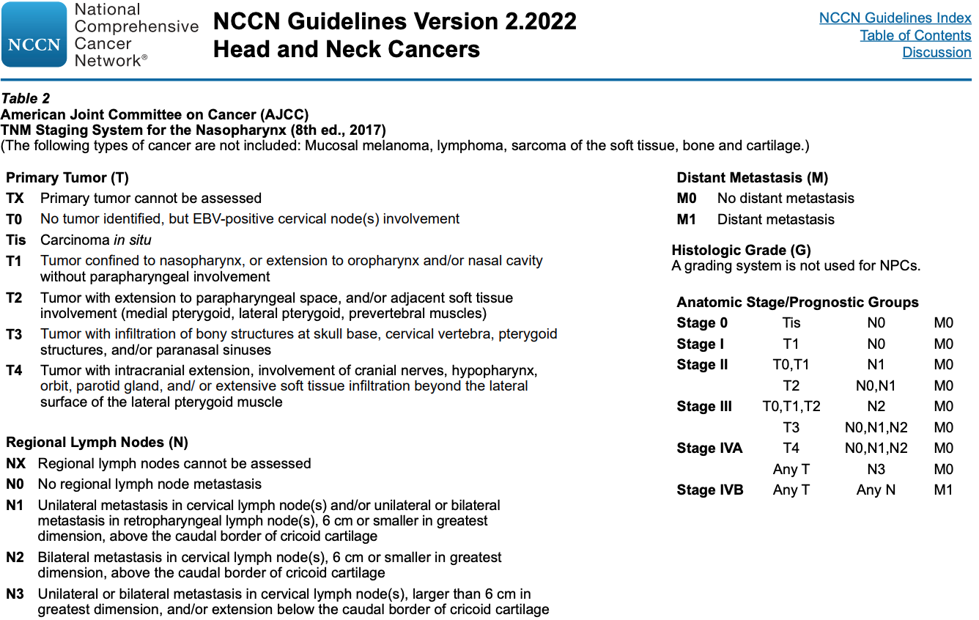

Slide 20
Case 1: Management
How would you treat our patient?
Notes:
Induction chemo f/b definitive chemoRT

Slide 21
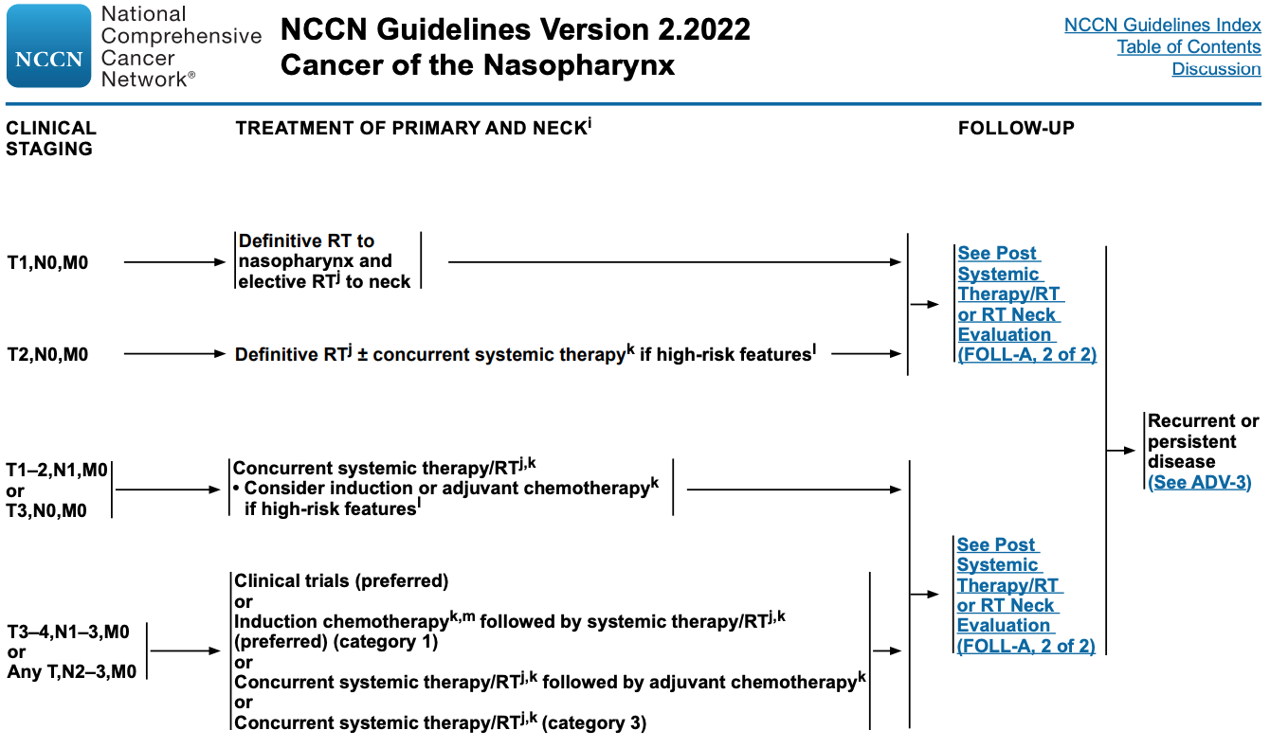
Notes:
One of the few H&N cancers where induction chemo is a standard of care – why? - risk of mets/patients die of metastatic disease

Slide 22
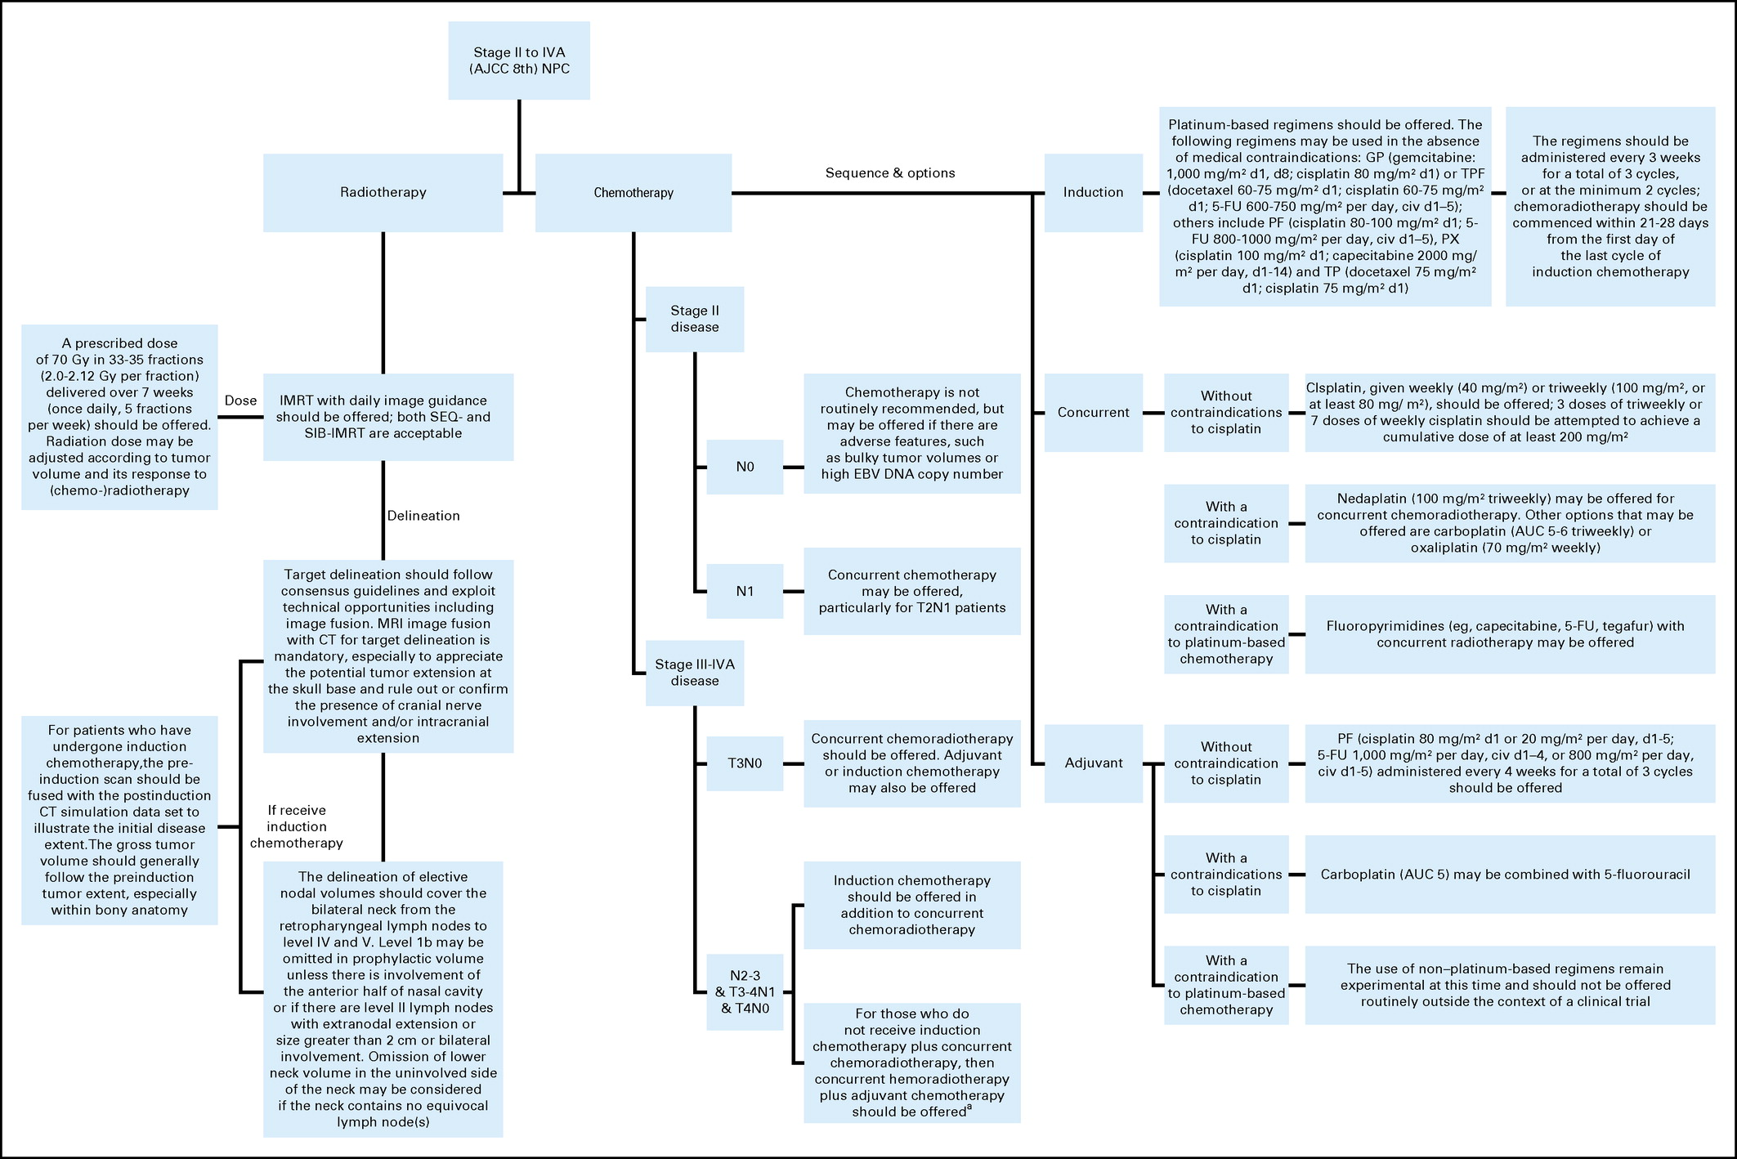
Notes:
These are the most clear guidelines in my opinion!
Chen et al, 2021, ASCO and CSCO guidelines
https://ascopubs.org/doi/figure/10.1200/JCO.20.03237

Slide 23
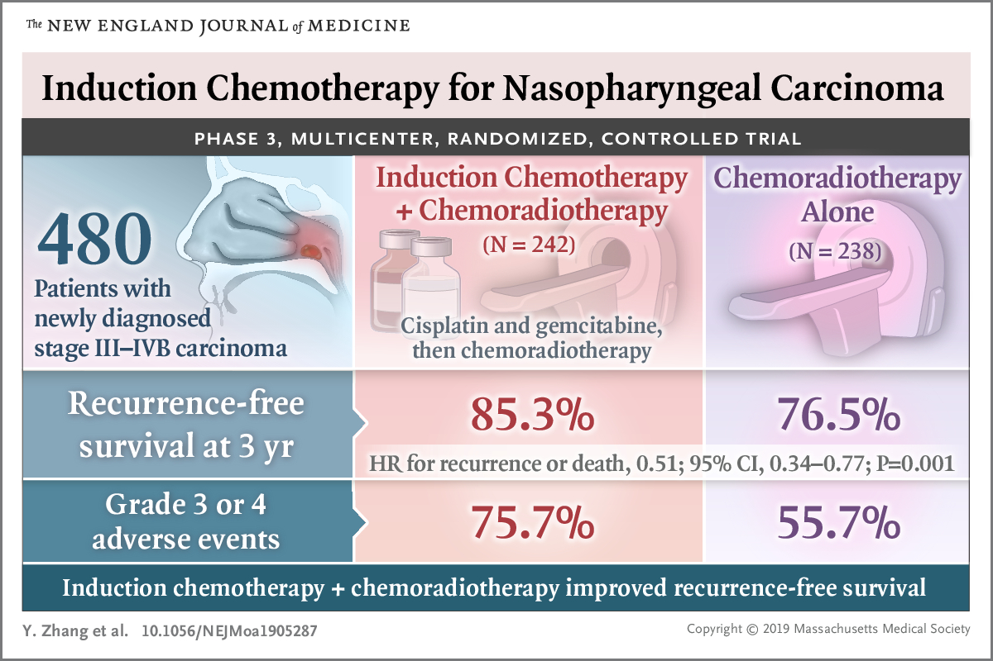

Slide 24
Case 1
68 yo M with CN VI palsy/sinus symptoms from nasopharyngeal carcinoma, non keratinzing, undifferentiated lymphoepithelial type, EBER positive, Stage IVA, cT4N2 Nasopharynx cancer, EBER positive
Induction chemo with 3 cycles cisplatin/gemcitabine
Cisplatin 100 mg/m2 q3 weeks for 3 cycles
Gemcitabine 1000 mg/m2
What toxicities would you watch for?
Notes:
What is next?
Restaging

Slide 25
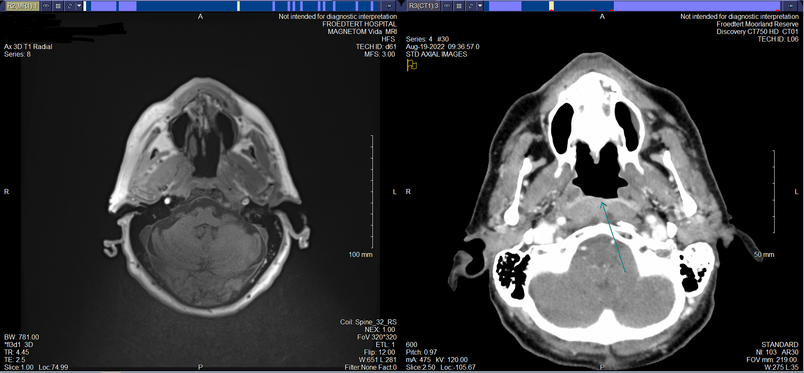
Case 1
Notes:
Near resolution of infiltrative mass
Interval reduced size of left level II lymph nodes
Whats next?

Slide 26
Case 1
68 yo M with CN VI palsy/sinus symptoms from nasopharyngeal carcinoma, non keratinzing, undifferentiated lymphoepithelial type, EBER positive, Stage IVA, cT4N2 Nasopharynx cancer, EBER positive
Induction chemo with 3 cycles cisplatin/gemcitabine
Cisplatin 100 mg/m2 q3 weeks for 3 cycles
Gemcitabine 1000 mg/m2
Completed Definitive chemoRT 66 Gy in 33 fx with concurrent cisplatin

Slide 27
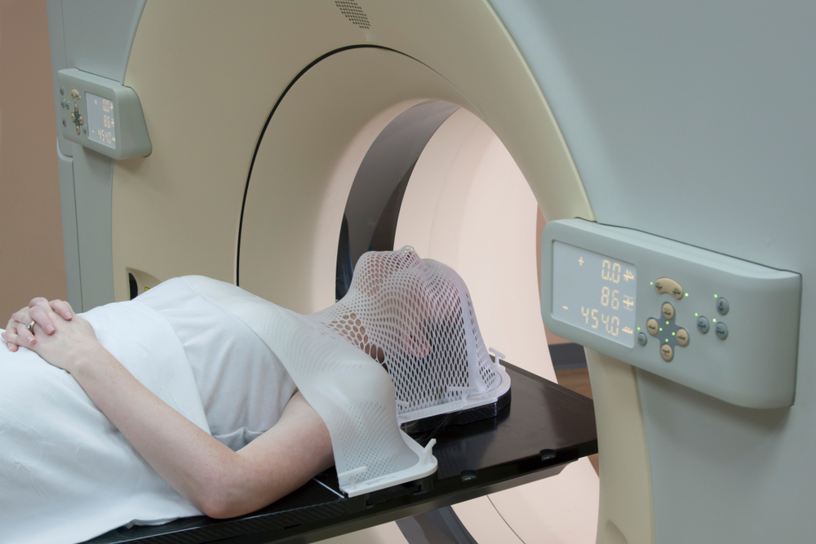
CT Simulation
Notes:
Mask
Fuse MR and PET

Slide 28
Contours
Notes:
Pull up plan in MIM or get pictures
Back up
https://econtour.org/cases/2

Slide 29
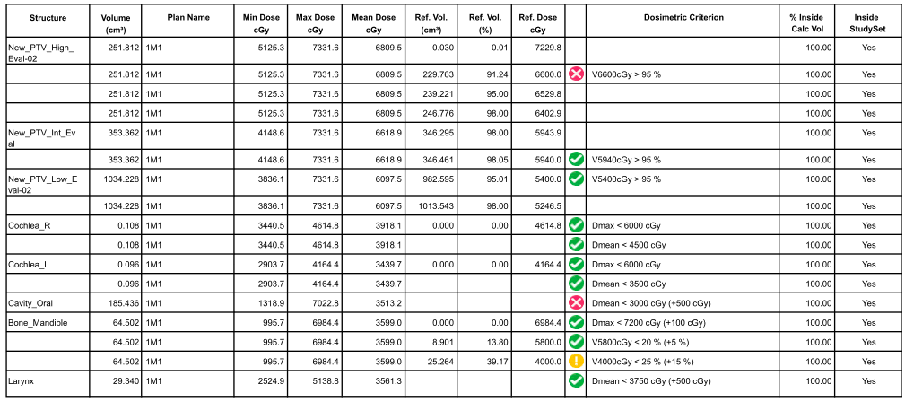
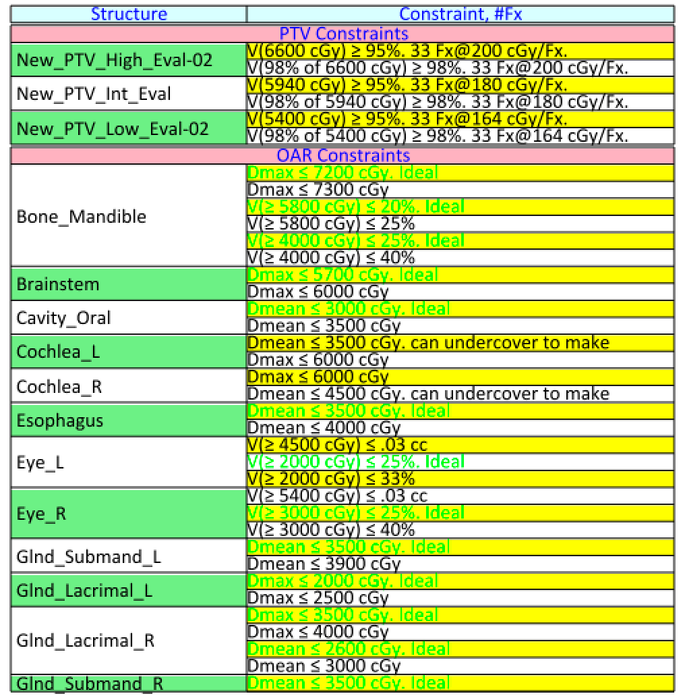
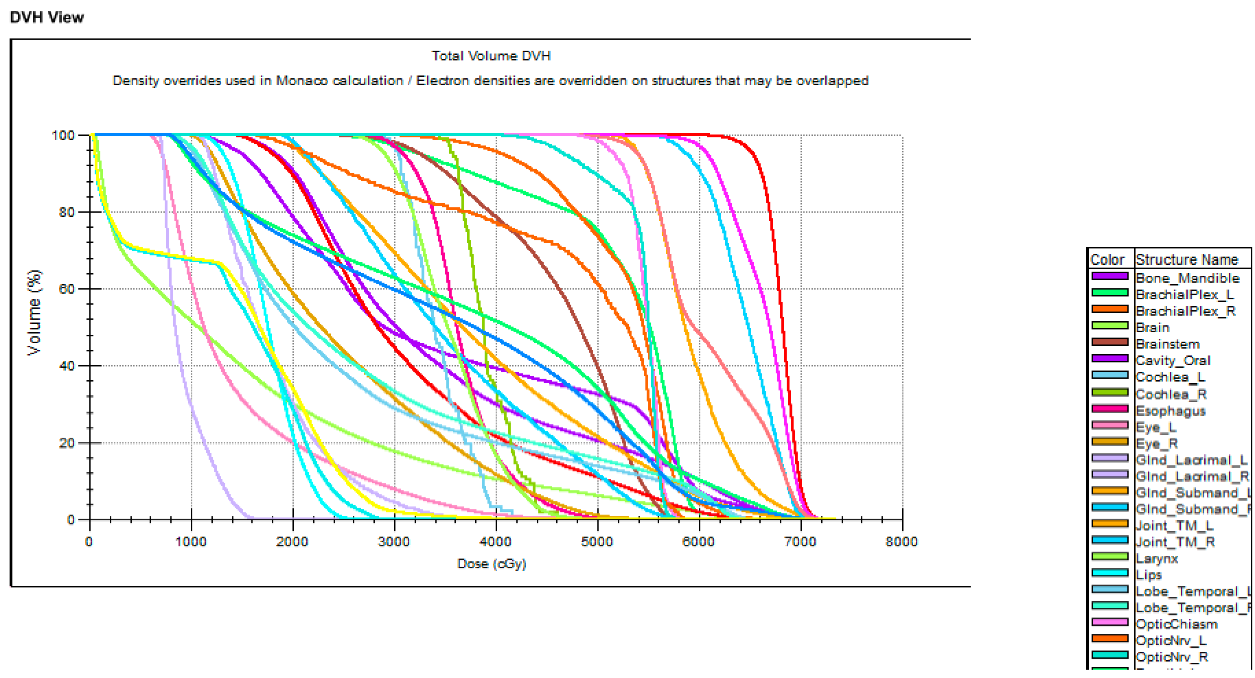
Plan Review

Slide 30
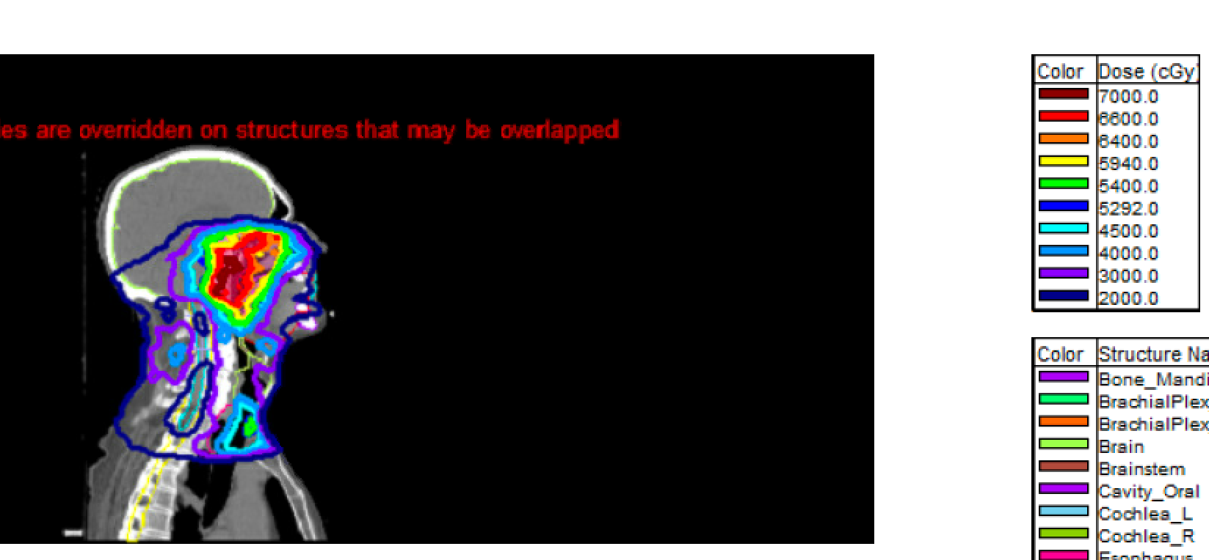
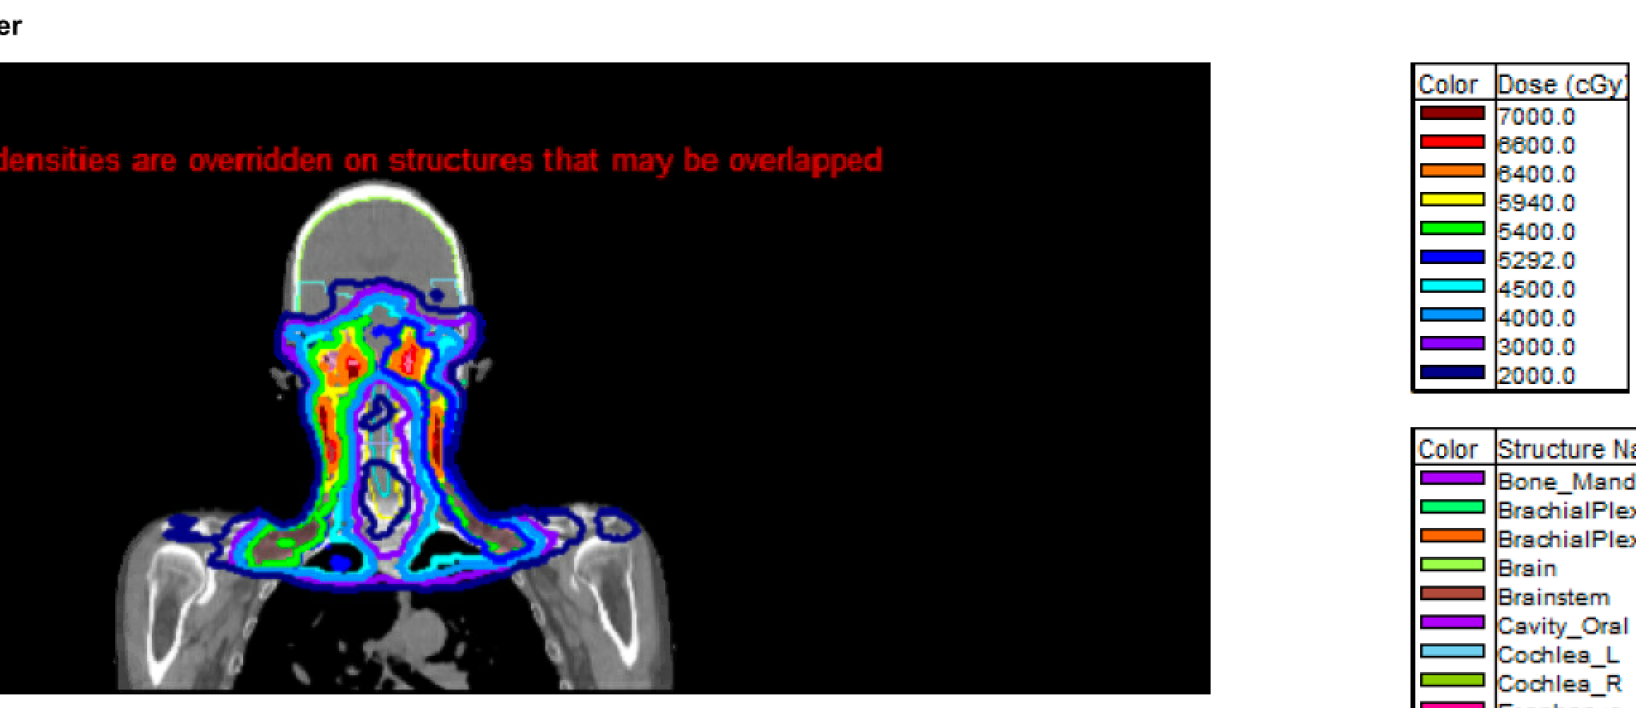
Plan Review

Slide 31
Toxicity
Notes:
Taste, smell, xerostomia, wt loss, nasal drainage/discharge, mucositis
Dental, swallow,

Slide 32
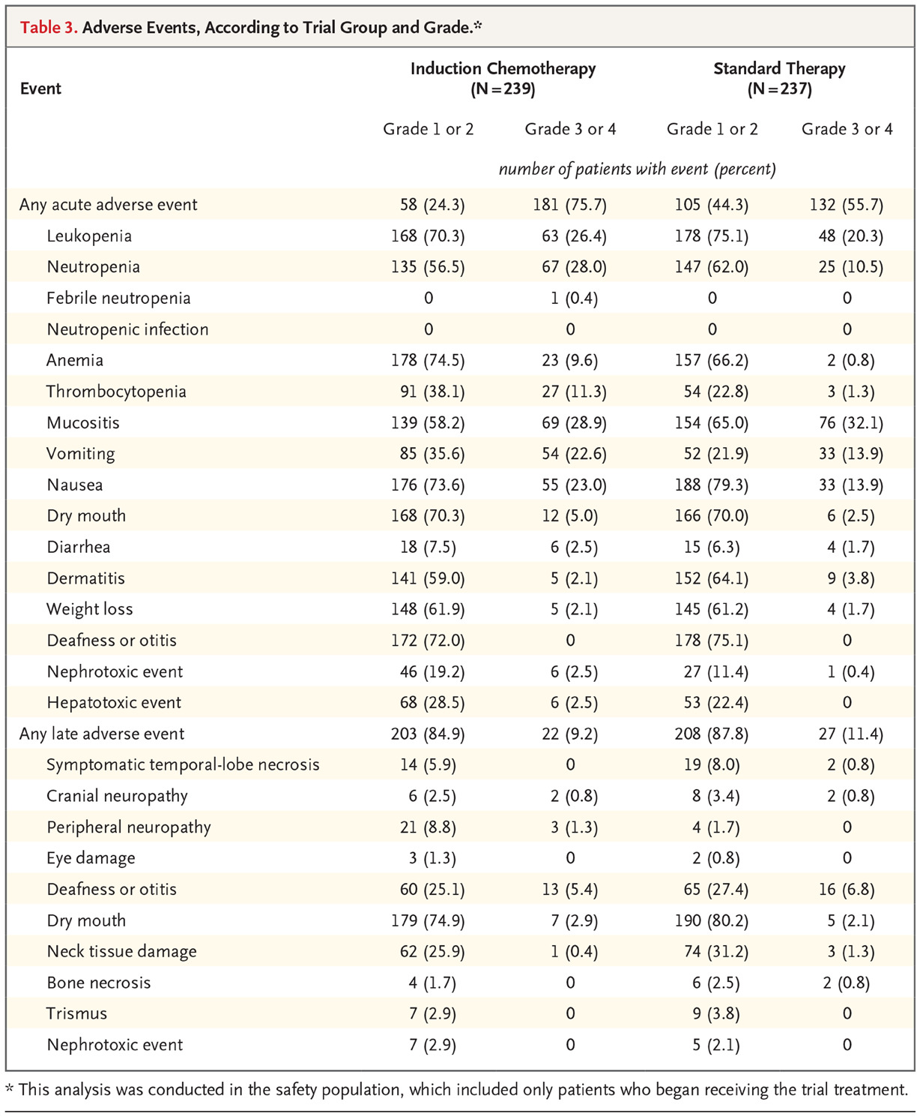

Slide 33
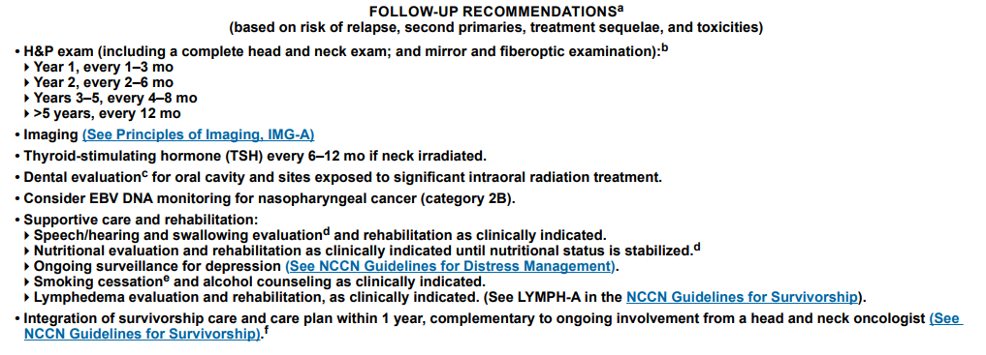
Follow up
Notes:
For reference

Slide 34
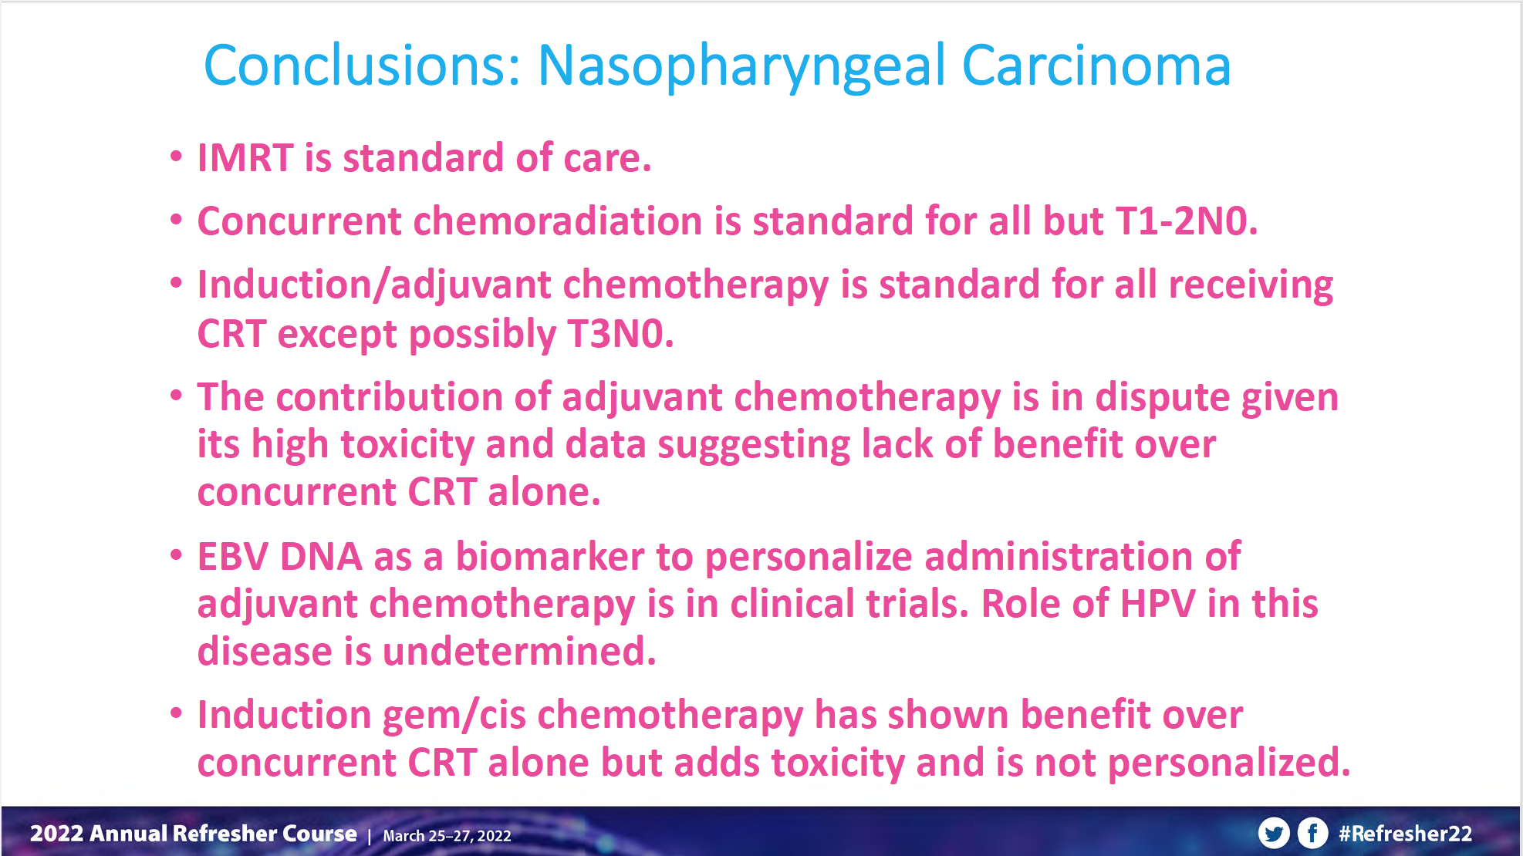
Notes:
Nice conclusions!

Slide 35
Case 1:
What if our patient had:
T1-2N0 – RT alone
T1-2, N1 – chemoRT alone (induction could be considered)
T3 or N2-3 – induction chemo f/b chemoRT
Notes:
Do we always treat bilateral necks? Probably..?

Slide 36
Questions?
Notes:
If we have time, let them practice contouring!

