Slide 1
Gynecologic Oncology
Careers in Clinical Oncology and Cancer Research Symposium
September 30, 2023

Slide 2
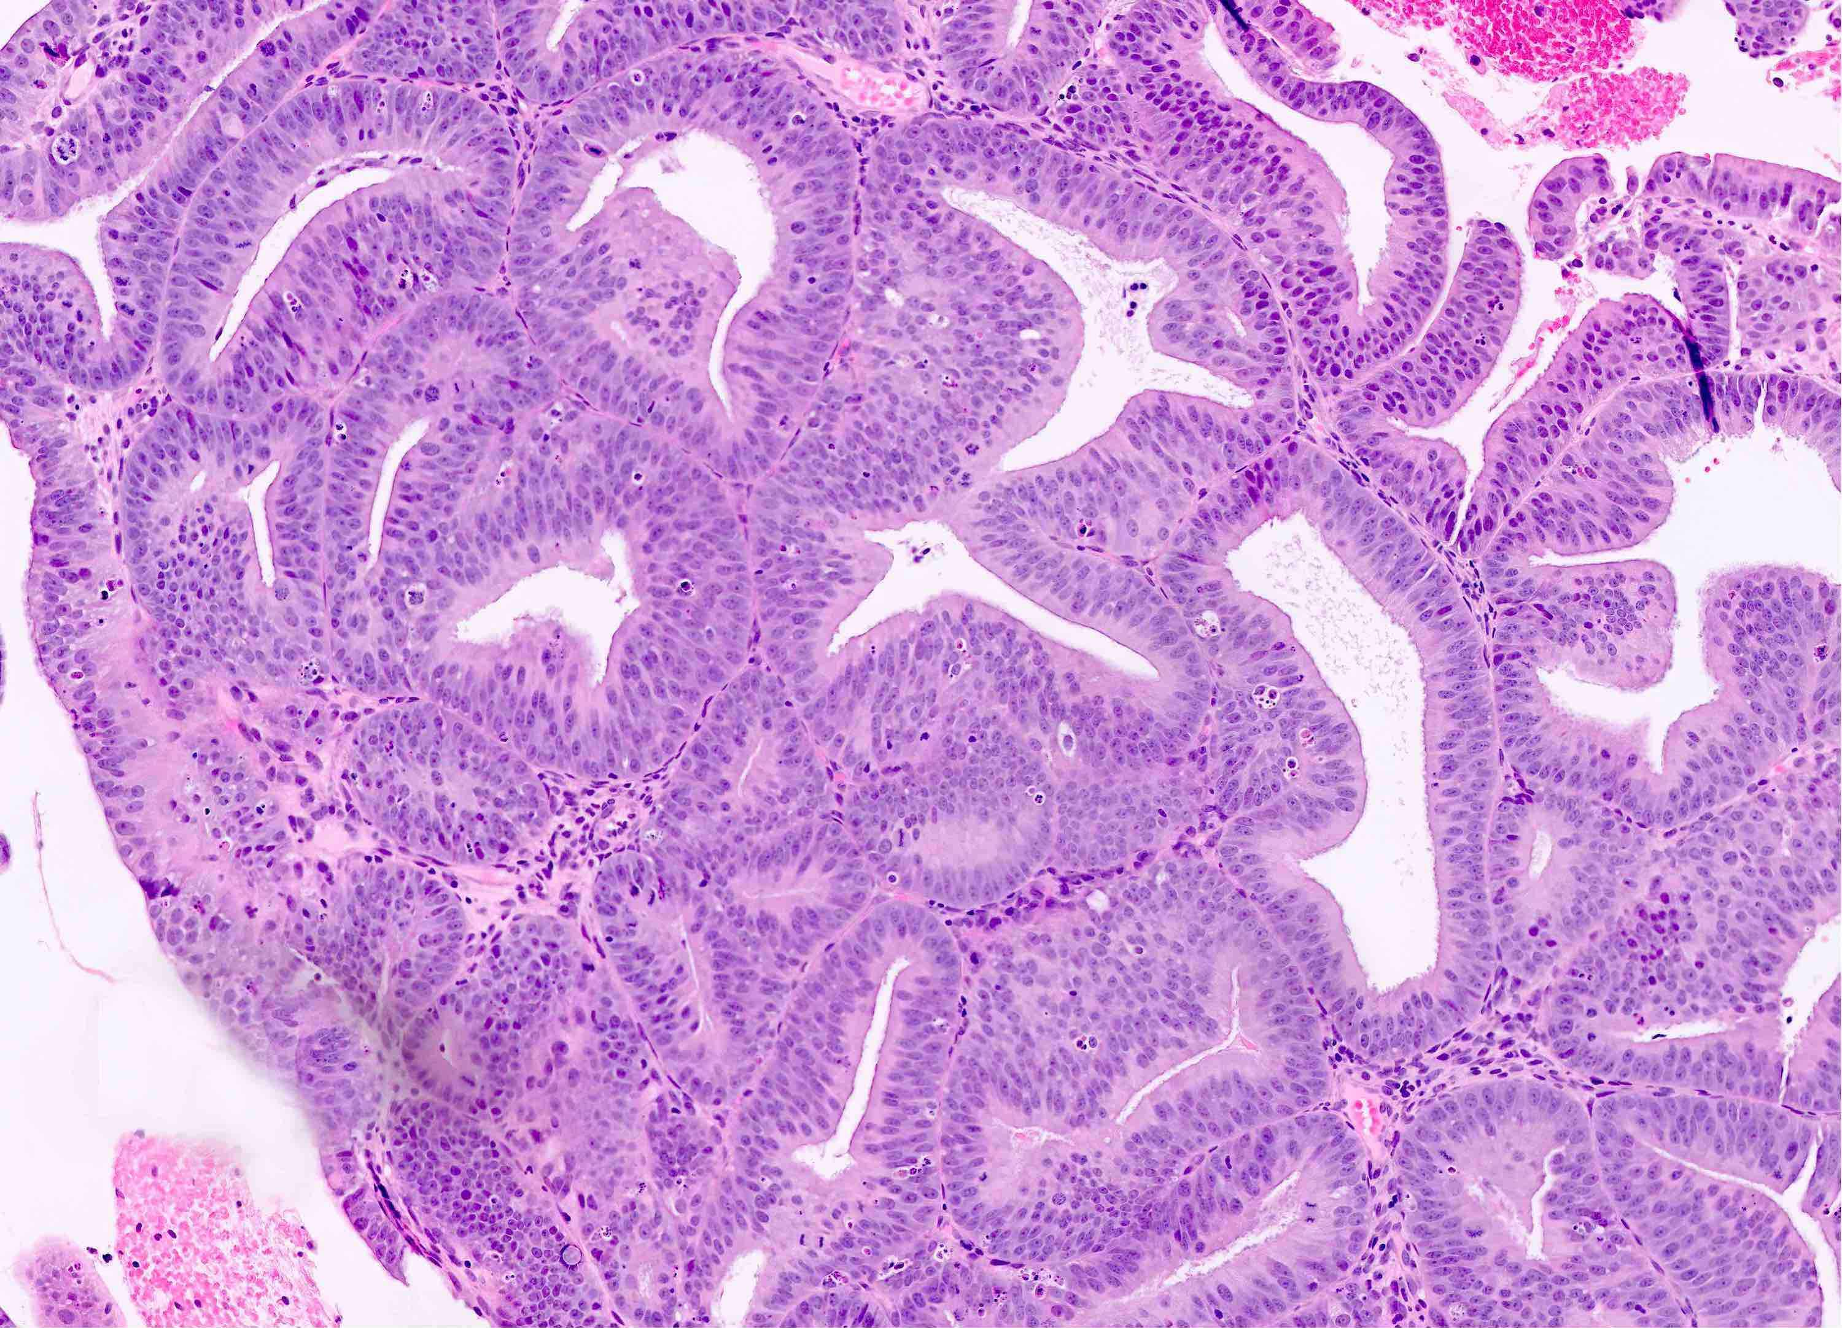
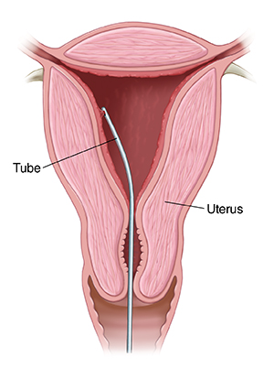
Clinical Case
A 40 year old woman, G0, with a history of PCOS presents to her gynecologist with heavy, irregular vaginal bleeding for several months. She also has a family history of colon cancer in her father at 50, and endometrial cancer in a paternal aunt at 47.
Her gynecologist obtains an endometrial biopsy…
The pathology shows endometrial intraepithelial neoplasia, cannot rule out endometrial cancer…

Slide 3
Clinical Case
Her gynecologist refers her to you – a Gyn Oncologist – for further management. During your consultation, you learn that she has struggled with infertility and strongly desires future pregnancy.
What next?
Need more tissue!
  Hysteroscopy, D&C in the OR
Imaging: US Pelvis, +/- MRI pelvis
Notes:
Break here for hands on D&C and bleeding management demo/hands on

Slide 4

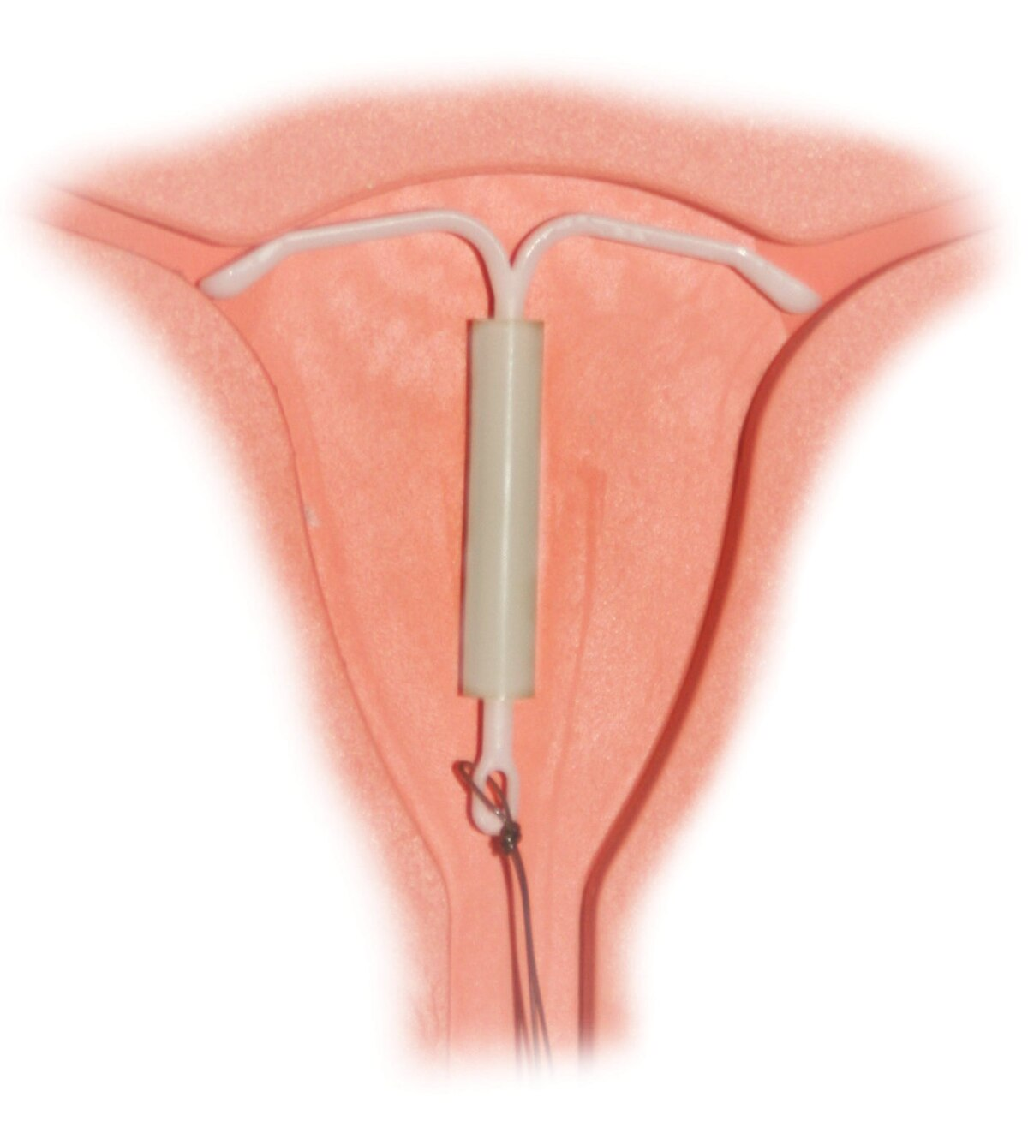
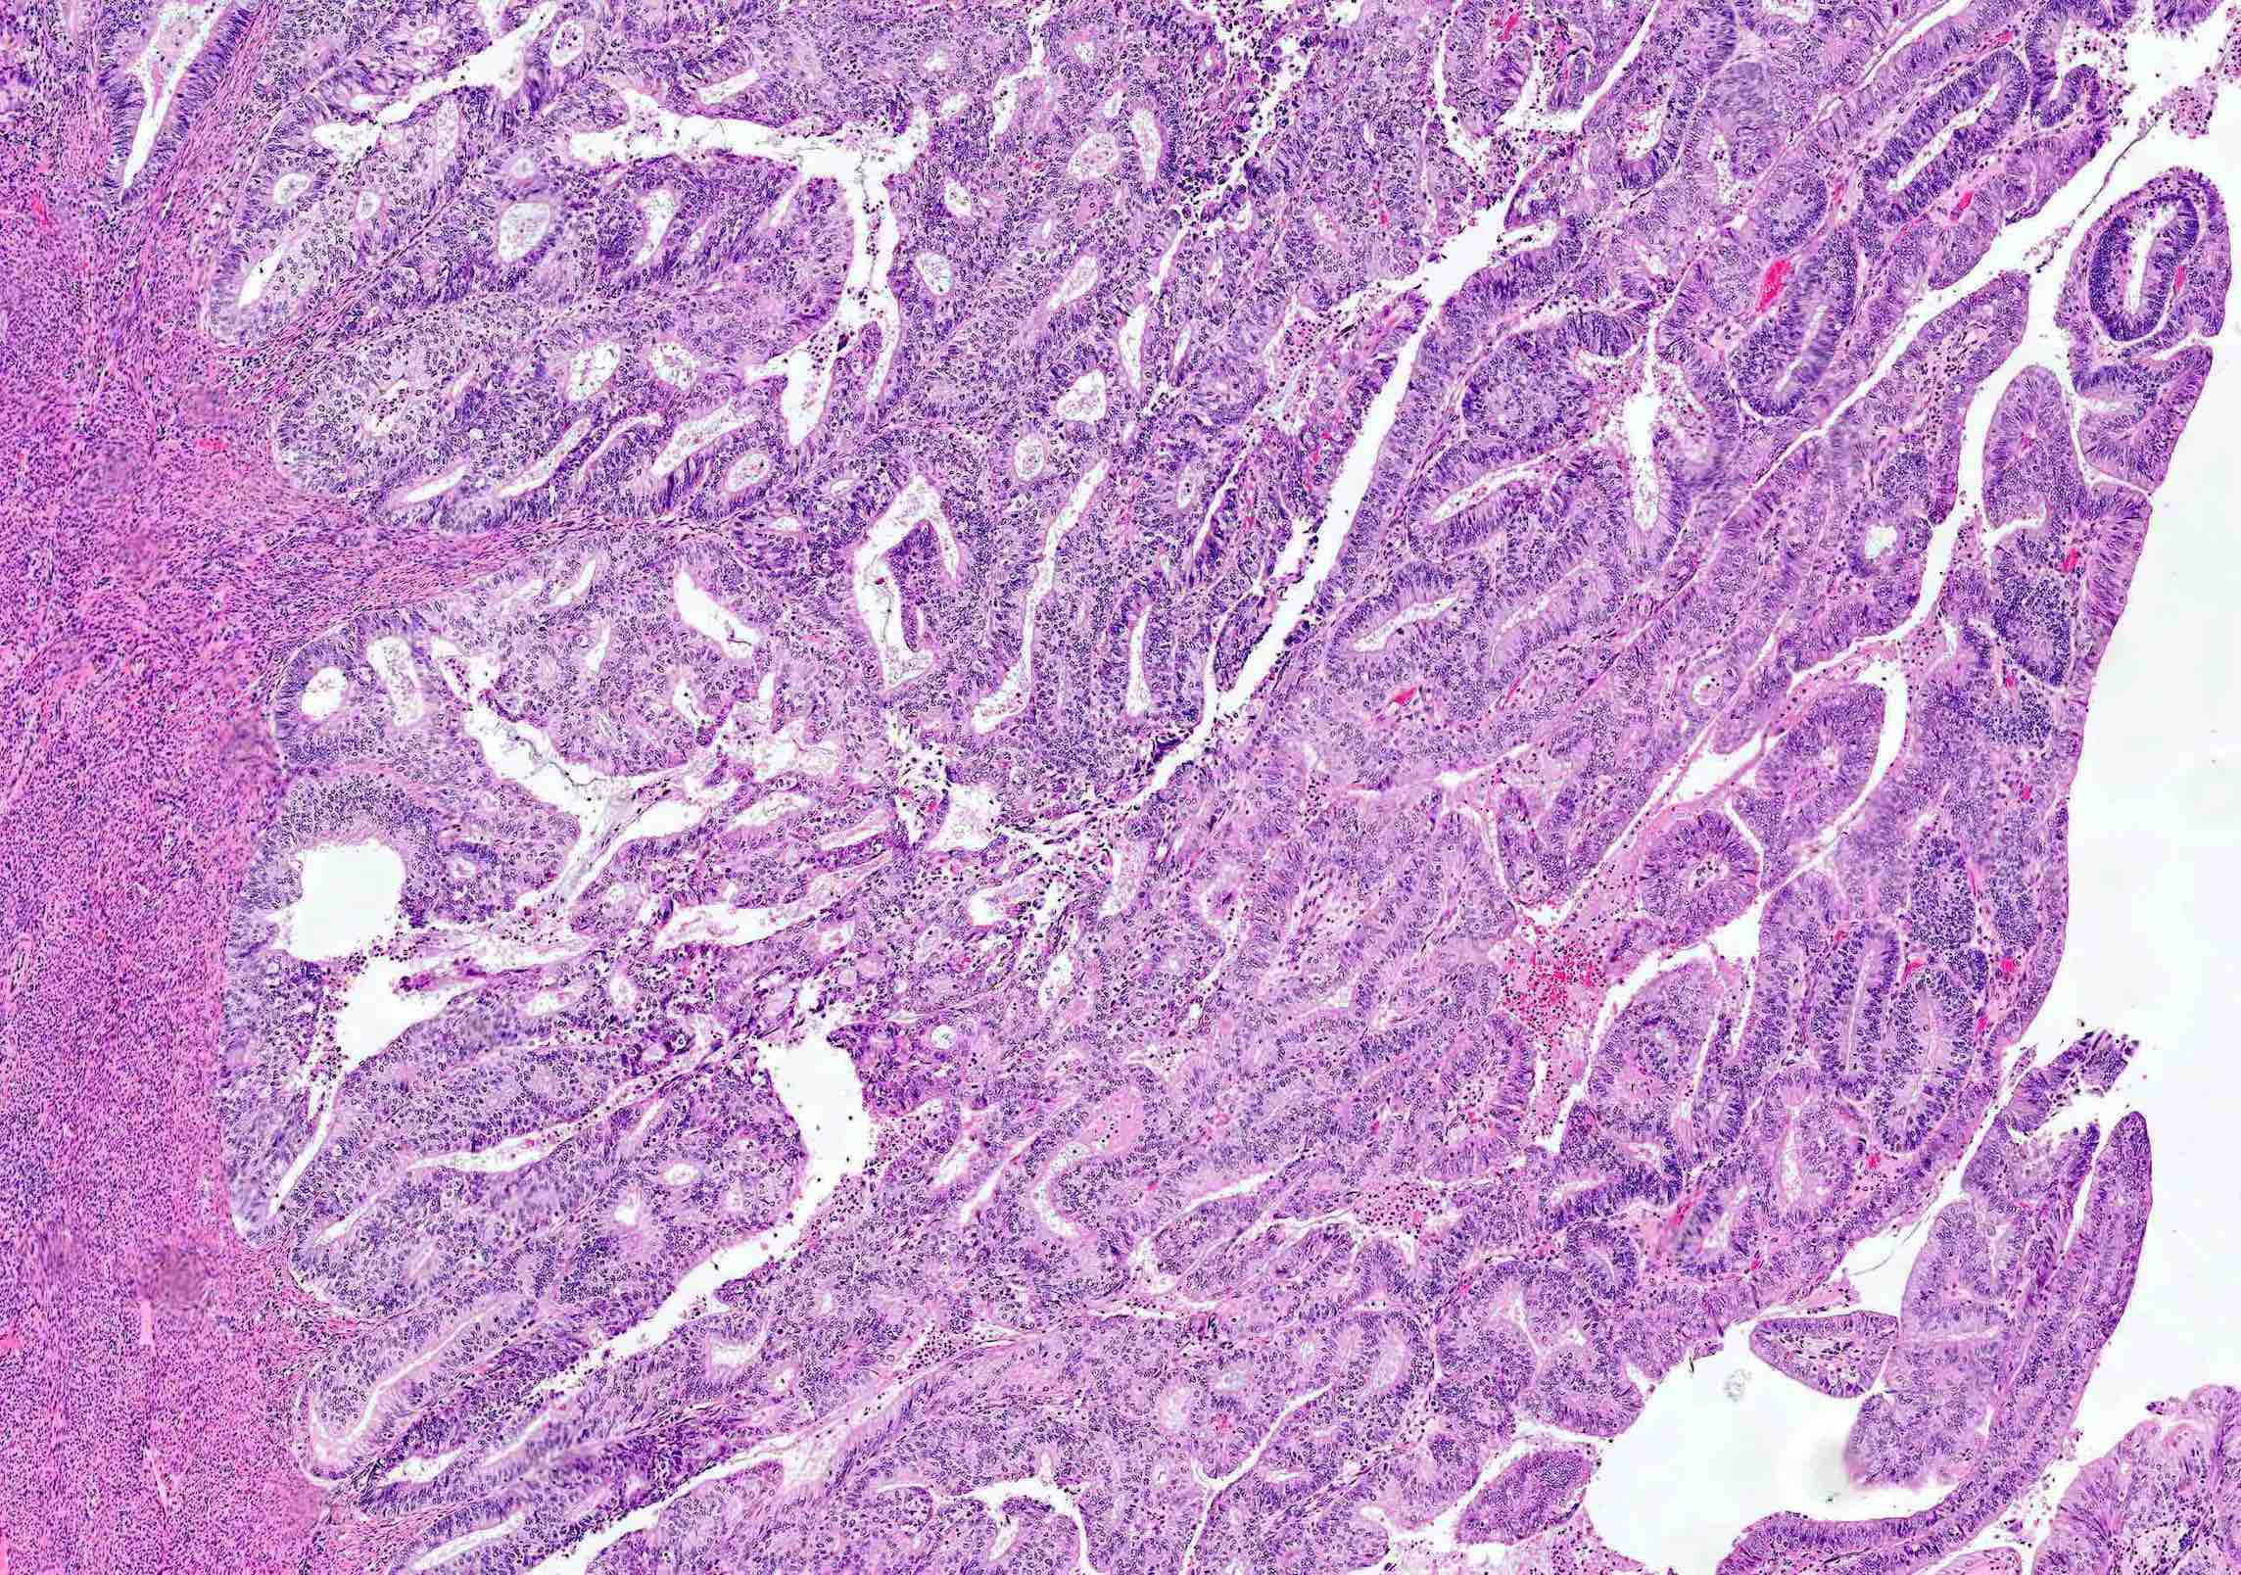
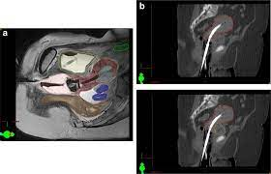
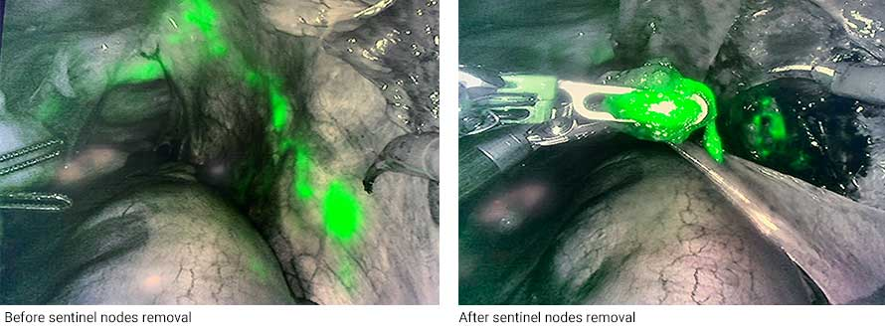


Clinical Case
Her final pathology comes back with FIGO grade 1 endometrioid endometrial adenocarcinoma…
You discuss the diagnosis and treatment options with her:
Surgery
Radiation
Medical Management
…In addition to referring her to Reproductive Endocrinology and Infertility and Genetics

Slide 5
Clinical Case
She expresses significant anxiety about her new diagnosis…
-Uncertainty
-Fertility
-Grief
-“Right choice?”
…You recommend she see your wonderful colleagues in Psycho-Oncology

Slide 7
Questions?

