Slide 1
Advancing Medicine through clinical research
-------------------, Clinical Research Coordinator, Cancer Center Clinical Trials Office
MCW Cancer Center Careers in Clinical Oncology and Cancer Research Symposium - September 30, 2023

Slide 2
Why is Clinical Research Important?
Clinical research uses clinical trials, which are experiments to determine the safety and effectiveness of medications, devices, diagnostic products and treatment regimens intended for human use.
It involves human participants and helps translate basic research into new treatments and information to benefit patients.
Clinical research is different from clinical practice. In clinical practice established treatments are used, while in clinical research evidence is collected while administering an experimental treatment.

Slide 3
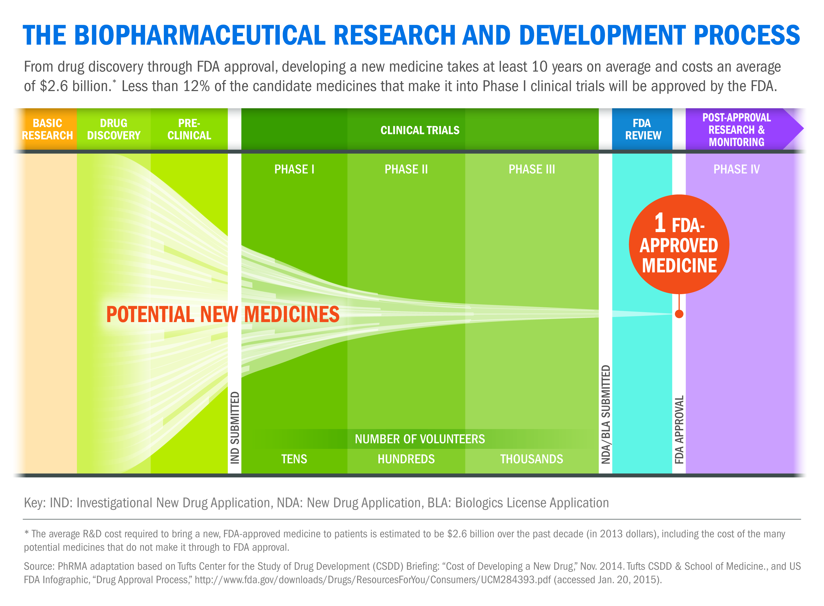
Notes:
Usually only 1 out of every 8 or 9 medications that make it into human testing get FDA approved (meaning they were better than the current standard). We currently run phase 1, 2, and 3 trials in our office.

Slide 4
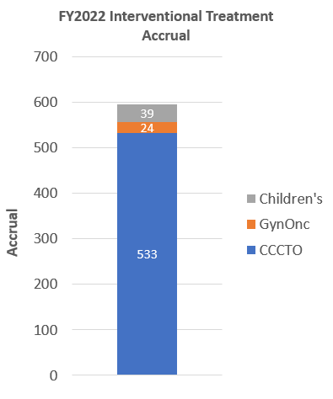
Cancer Center Clinical Trials Office Facts
140 FTEs and 6 disease teams (3 Solid Tumor teams, Hematology, BMT & Cell Therapy, Early Phase), plus Regulatory, Business Operations, Clinical Operations, Education & QA, and Multisite team
Gyn-Onc Staff still reside in the Ob-Gyn Department
Pediatric Oncology staff are in the Peds Department

Slide 5
How are Cancer Clinical Trials Different Than Standard Treatments?
Cancer clinical trials are conducted to test new cancer treatments or combinations or therapy (e.g. chemotherapy, immunotherapy, radiation therapy, surgical methods, etc.).
These trials do not involve normal, healthy volunteers like some other clinical trials use.
A cancer clinical trial is viewed as a treatment option for cancer patients.

Slide 6
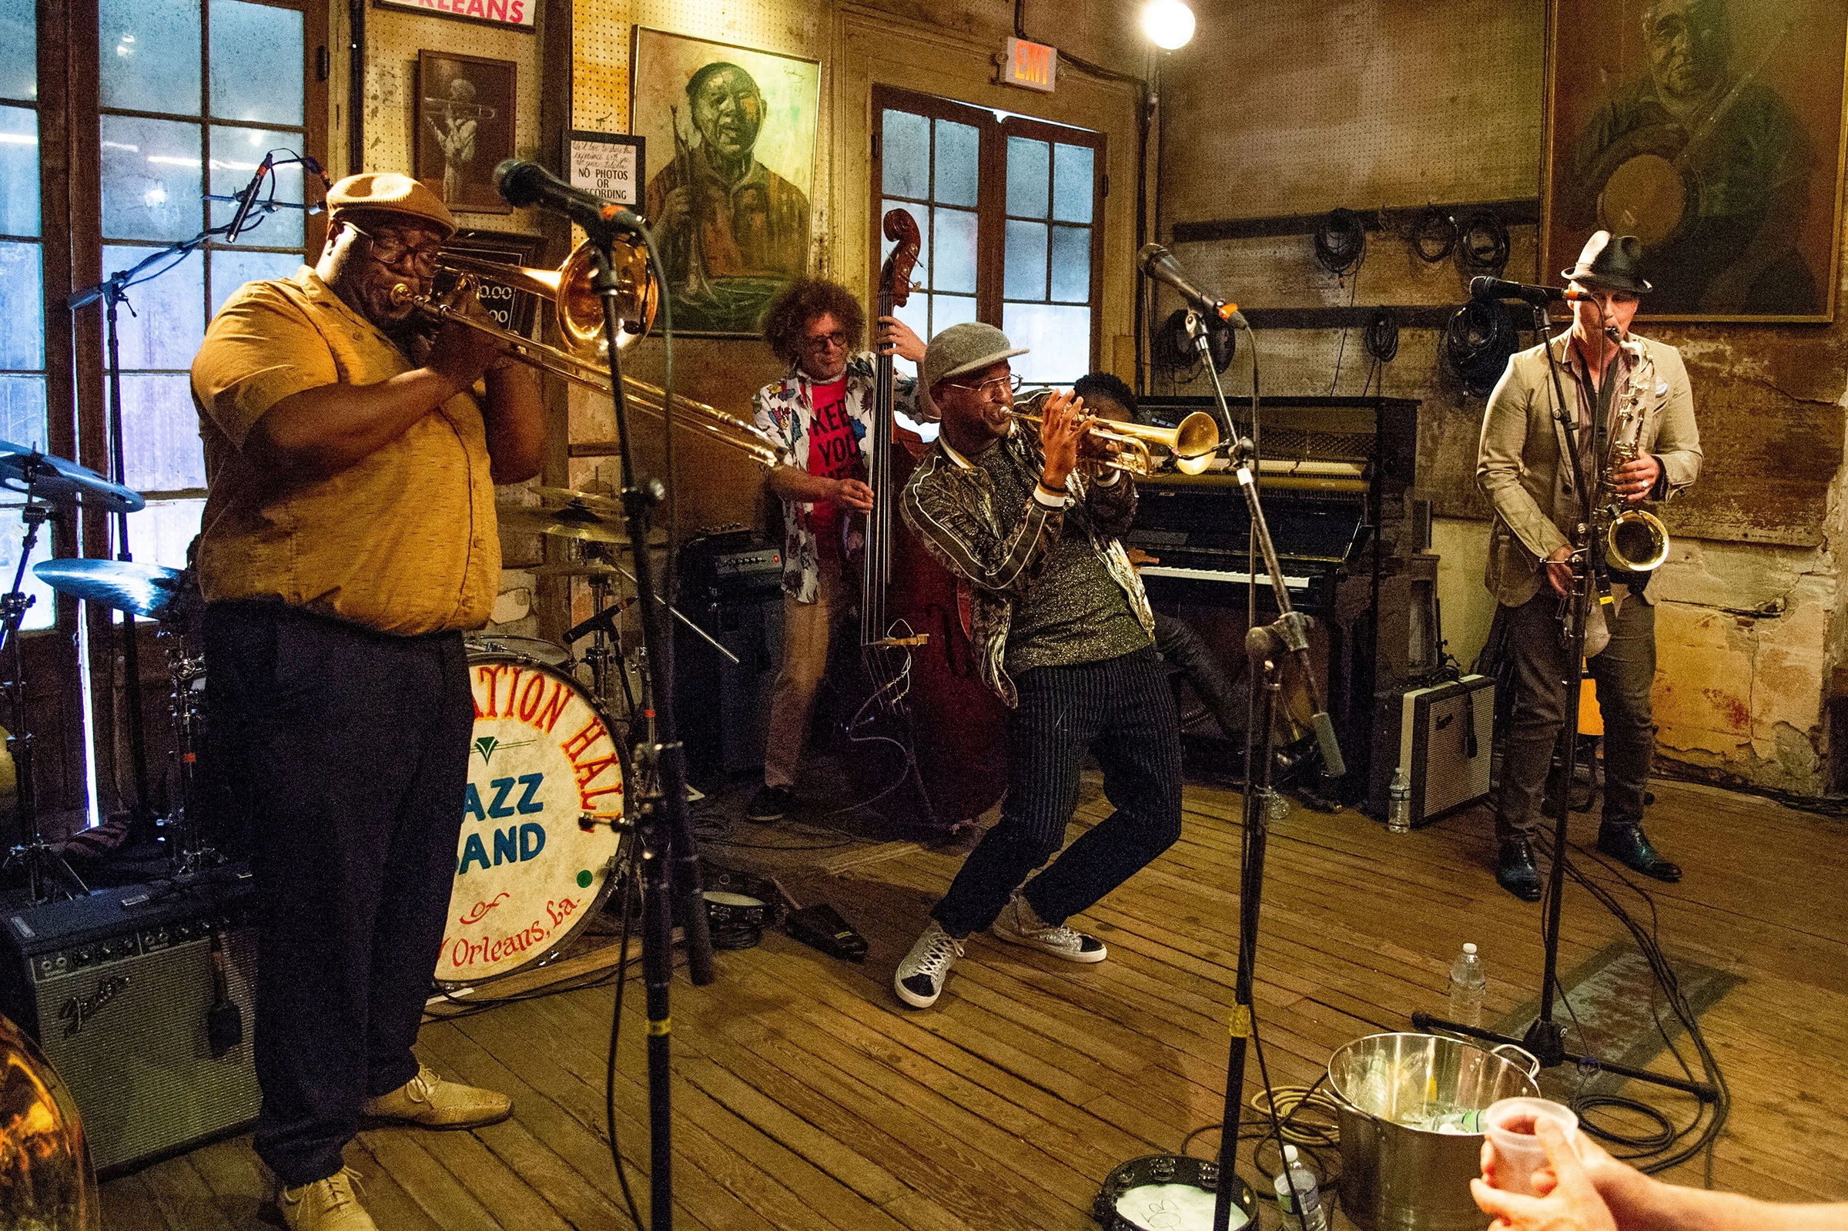

How are Cancer Clinical Trials Different Than Standard Treatments?
Standard Treatments are like Jazz Clinical Trials are like Classical Music
Notes:
Treating patients with conventional treatments is like Jazz Music. You can improvise and move treatment days around as needed. If the labs are close enough, the patient can be treated at the discretion of the physician. Clinical research is like classical music. There is no improvising. You must play the notes as they are written on the page.

Slide 7
Clinical Trials Aren’t for Everyone
Sometimes standard therapy is a better option for some patients based on their overall health, type of cancer, and medical history.
Sometimes the study requirements (extra visits, longer infusion times or observation times) are not possible for some patients.
Some patients are more comfortable getting an FDA-approved, commercially available treatment.
Not everyone who wants to participate in a clinical trial can participate. (Not all patients will be eligible.)

Slide 8
Eligibility is not a Suggestion
Each protocol has a strict eligibility checklist that must be followed. Enrolling an ineligible subject = major protocol devotion.
Inclusion criteria: patients must meet ALL of these to be eligible for the protocol
Ex.) age, type of cancer, prior treatments, performance status, adequate organ function, measurable disease
Exclusion criteria: list of conditions that would not allow a patient to enroll the protocol.
Ex.) certain comorbidities, performance status, pregnancy, brain metastasis, Hep B, C, HIV
Notes:
The clinical research coordinator would check this thoroughly to ensure an ineligible subject isn’t enrolled. The Investigator must sign off on every enrollment.

Slide 9
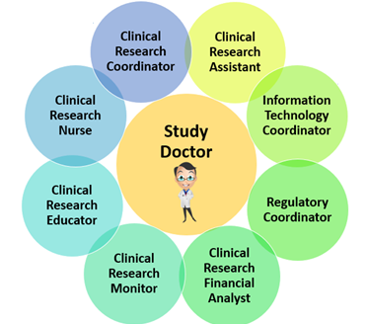
Physician Investigators and the Study Coordinator: We are a TEAM!
Study coordinators and physician investigators work together at every step of the process:
Building order sets in Epic (Beacon)
Screening potential subjects
Consenting subjects
Coordination of care in accordance with the protocol
Long term survival follow-ups

Slide 10
How do we keep patients safe?
Investigator oversight – review trends, accurate reporting of adverse events.
Disease Oriented Teams
Scientific Review Committee
Institutional Review Board
Ancillary committees (Radiation Safety, Biosafety, etc.)
Data & Safety Monitoring Committee
Notes:
The study team is responsible for the data entry and the accurate reporting of data. The PI is responsible for identifying trends and concerns. Various committees look over the studies and provide a checks and balance system for safety.

Slide 11
Clinical Research
Myths vs. Facts

Slide 12
Myth #1
Clinical trials are always a last resort and are for patients that have no other options.
Fact: There are many trials available for all different stages of cancer, from newly diagnosed to N^{th} line. There are also data collection studies, lifestyle and symptom management trials, and trials testing different surgical methods.

Slide 13
Myth #2
I will be treated like a guinea pig if I enroll in a clinical trial. Researchers only care about getting the data they need. They don’t care about the patients.
Fact: Recent research shows that participants of clinical research get the best care -- More brains and eyes on the patient. There are many committees that provide oversight to ensure patient safety. (But history is real.)
Notes:
The history of clinical research involves unethical and deceptive practices, immoral scientists, falsified data, and little to no requirements for any oversight to protect research participants. These stories have been passed down through generations and have lead to deep mistrust of the medical community. It’s an extremely different culture now, but it is important we acknowledge the truth of the past. Participant rights and safety are the top priorities in clinical research.

Slide 14
Myth #3
I might get a placebo if I enroll in a clinical trial, which means I’ll get no treatment at all.
Fact: Placebos are a research method, eliminating bias of researchers and patients. Patients will never receive less than a reasonable standard of care for their disease. Research studies involving placebos may be set up like this:
Group 1: Standard chemotherapy + an investigational drug Group 2: Standard chemotherapy + a placebo
Notes:
A placebo is a pill or liquid that looks like the medicine but is not active.

Slide 15
Myth #4
The experimental treatment is always better than the standard of care group.
Fact: If we knew this, we wouldn’t need to do the trial!
If we find out during the study that one group’s cancer is responding better, the study will be stopped, and everyone will be given the chance to transition to that group.
Notes:
Usually only 1 out of every 8 or 9 medications that make it into human testing get FDA approved (meaning they were better than the current standard).

Slide 16

Psycho-Oncology
-------------------, PsyD, ABPP
Associate Professor
MCW Cancer Center Careers in Clinical Oncology
and Cancer Research Symposium – September 30, 2023

Slide 17

Psycho-oncologists are:
Clinical Health Psychologists
Psychiatrists
Physician Assistants
Nurse Practitioners
Clinical Therapists
Licensed Social Workers
Licensed professional counselors

Slide 18
What is Psycho-oncology?
Psycho-oncology addresses two major psychological dimensions of cancer
The psychological responses of patients to cancer at all stages of disease, and that of their families and caretakers
The psychological, behavioral and social factors that may influence the disease process

Slide 19

Mission and Vision
Our Psycho-Oncology team aims to address the mental health aspects of individuals with cancer or who are touched by cancer in any way. Our providers deliver compassionate, effective, quality care to cancer patients and their families throughout diagnosis, treatment and recovery.

Slide 20

Who do we treat?
Newly diagnosed patients
Patients in active treatment (chemo, radiation, surgery)
Palliative patients
Patients well into survivorship
Couples
Families

Slide 21

What do we treat?
Adjustment to diagnosis, recurrence or survivorship
Education about anticipated and unexpected emotions and cancer
of worthlessness and uselessness since diagnoFeelings sis or recurrence
Symptoms of anxiety, panic or depression
Insomnia
Pain
Increase in frustration, anger or irritability
Family conflicts related to cancer
Grief and loss

Slide 22
Patient Encounters
Outpatient and inpatient
Consults
Group
Follow up

Slide 23
Psycho-Oncology Program
Medication evaluation and management for difficulties with mood, anxiety, sleep, fatigue, concentration, or mental status changes during or following cancer treatment
Psychotherapy, counseling, art therapy, mindfulness-based cancer recovery group
Individualized treatment that goes beyond surgery, chemotherapy, and radiation

Slide 24

Survivorship: What now?
Separation anxiety
Fatigue
Changes in body image
Managing others' expectations
Fear of recurrence
Cognitive changes
Financial stress

Slide 25
Multi-disciplinary Care
Anxiety with radiation
Anticipatory nausea/anxiety with chemotherapy
Co-treat oncology inpatients with occupational and physical therapists
Coordinate with providers both inpatient and outpatient regarding barriers to treatment, adherence and communication
Provide support and psychoeducation to providers and staff

Slide 26
Cancer genetics screening program
-------------------, MS, Genetic Counselor
MCW Cancer Center Careers in Clinical Oncology and Cancer Research Symposium - September 30, 2023

Slide 27
Am I at higher risk?

Slide 28
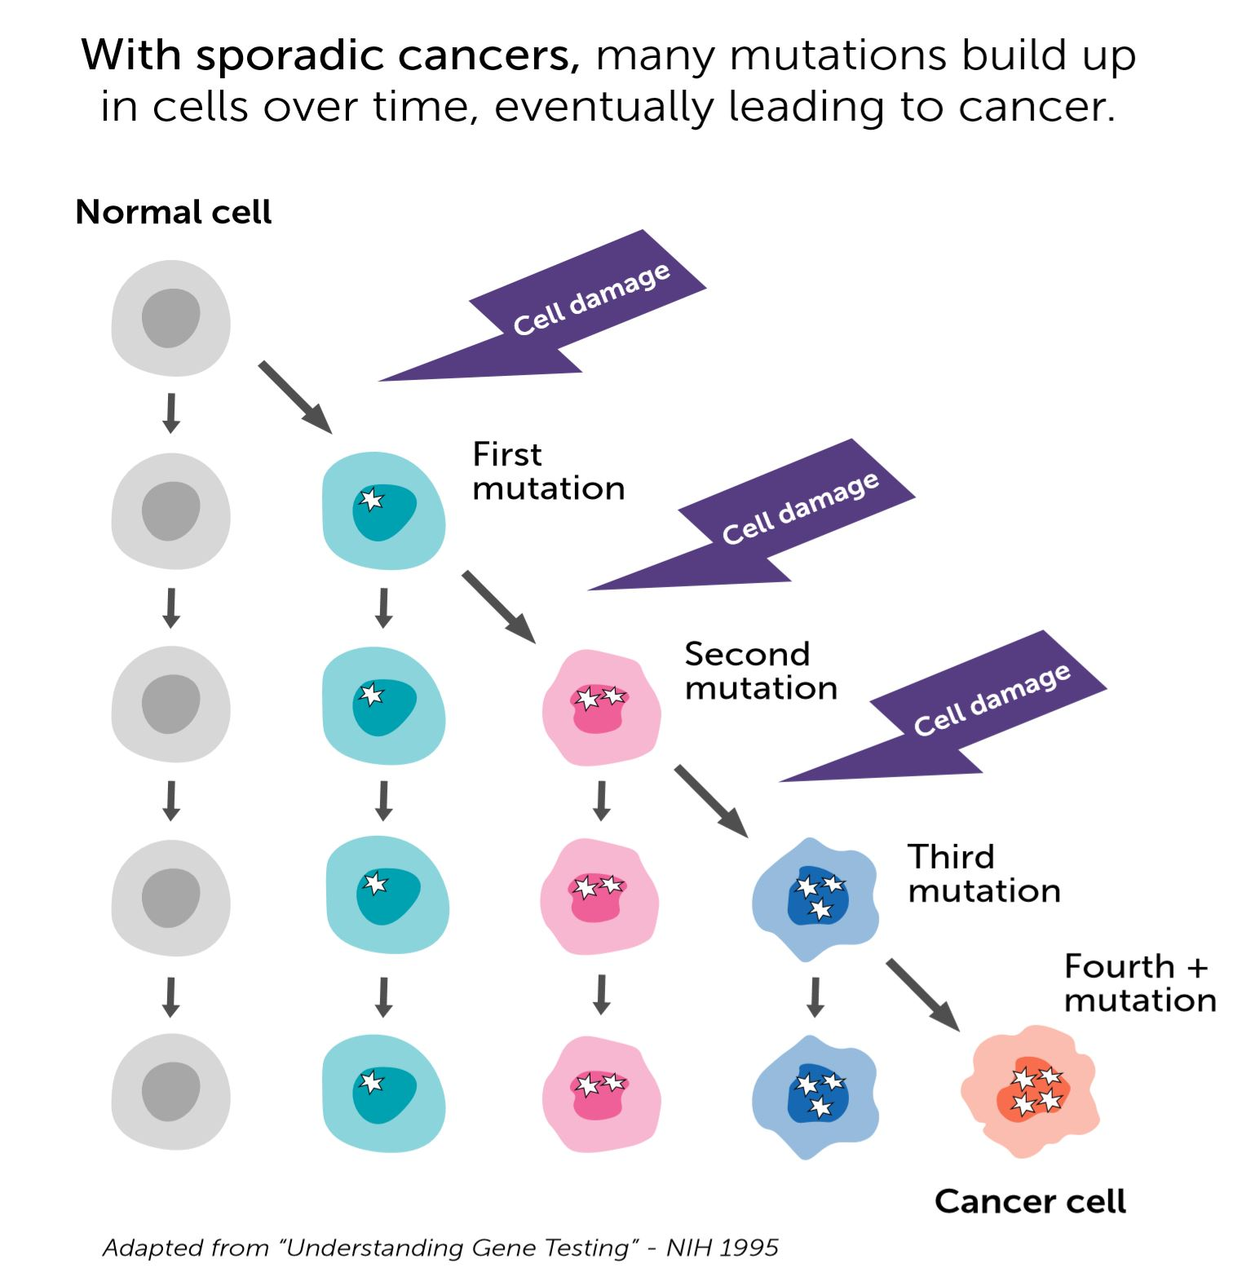
CANCER IS A GENTIC PROCESS
Lifestyle
Exposures
Internal Factors
Random Chance

Slide 29
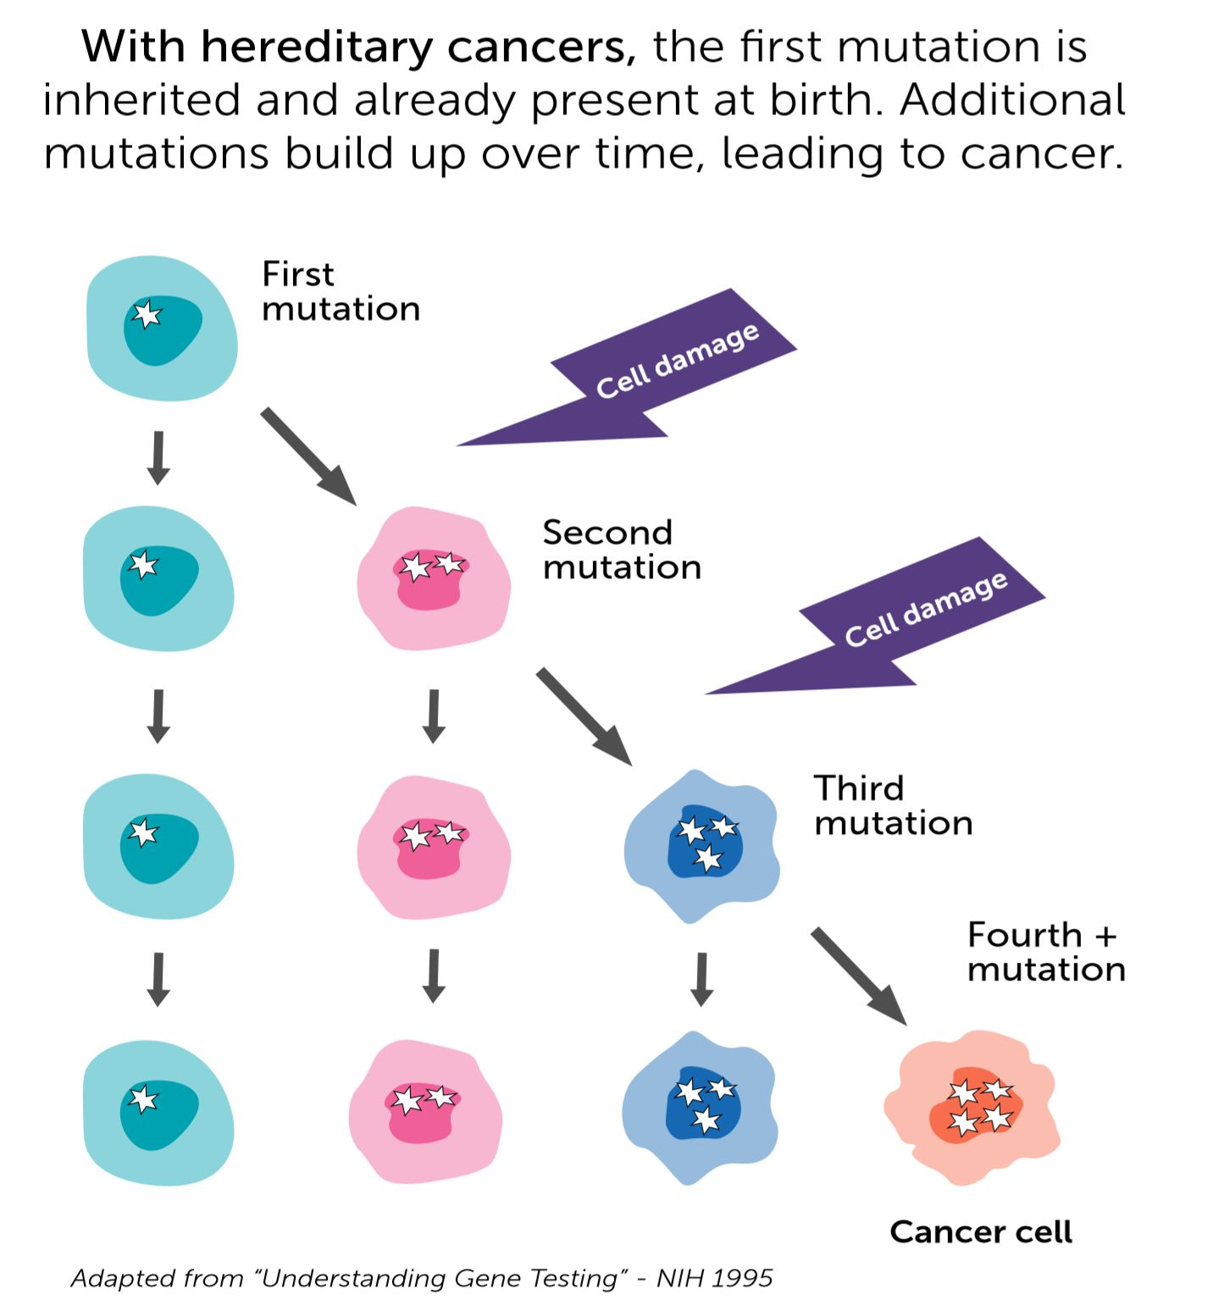
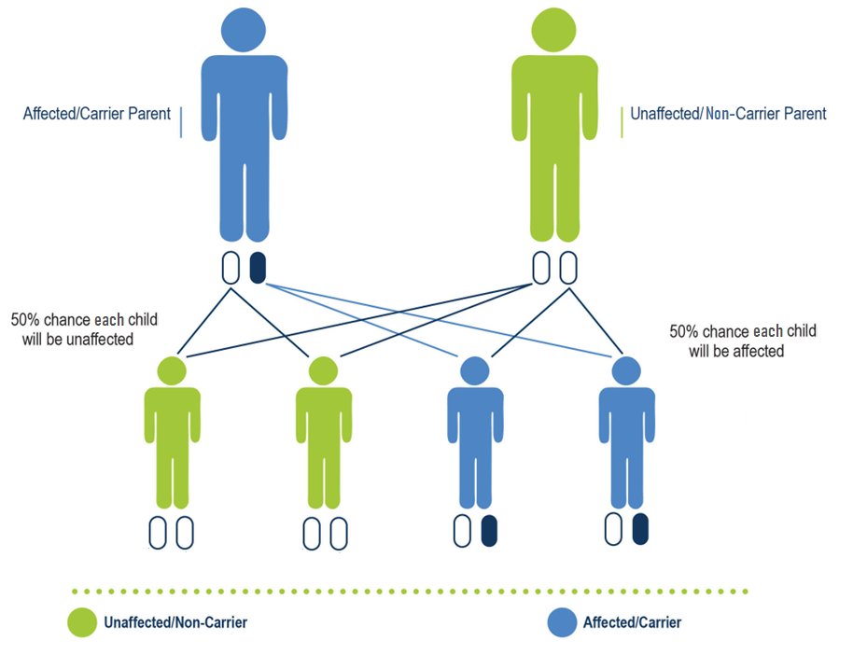
HEREDITARY CANCER RISK
Notes:
In most cases, autosomal dominant inheritance

Slide 30

RED FLAGS FOR HEREDITARY CANCER
Multiple relatives with the same or a related type of cancer
Younger age of diagnosis (<50 years of age)
Uncommon/specific types of cancers
Multiple primary cancers in one person
Bilateral or multifocal cancer
Male breast, pancreatic, ovarian, metastatic prostate, triple negative breast, etc.
Breast, ovarian, prostate & pancreatic cancers
Colon, endometrial, & ovarian

Slide 31
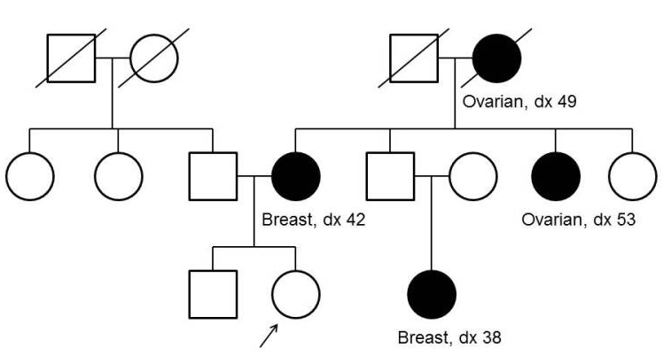
EVALUATION TOOLS
Personal & Family History
3 generation pedigree
Cancer pathology
Age of onset
Genetic Testing
Testing strategy
Gene panels
DNA banking
Genetic test reports

Slide 32
Genetic Counselors

Slide 33

GENETIC COUNSELING APPOINTMENT
Establish mutual goals, address patient’s expectations
Review medical history
Family history: Take a detailed 3 generation pedigree
Risk assessment: Analyze medical and family history, assess inheritance patterns
Discuss genetic testing options
Balancing discussion about what makes most sense medically, financially, etc.
Consider DNA banking
Obtain informed consent, review expectations
Address insurance concerns, review genetic discrimination laws
What will happen, possible results (positive, negative, inconclusive), turnaround time
Psychological impact of test for patient and other family members

Slide 34

GENETIC TESTING
Benefits​
Provides risk information for individuals and families​
Provides information useful for medical management​
May offer options of prevention, early detection or more effective treatment
May actually relieve anxiety/end uncertainty​
Risks​
Emotional (increased fear/anxiety)​
Strain on family relationships
Insurance Discrimination​
State and Federal Laws​
Limitations​
Genetic testing is not able to detect all causes of hereditary disease​
Continued risk for sporadic diseases​
Some management strategies not proven effective

