Slide 1
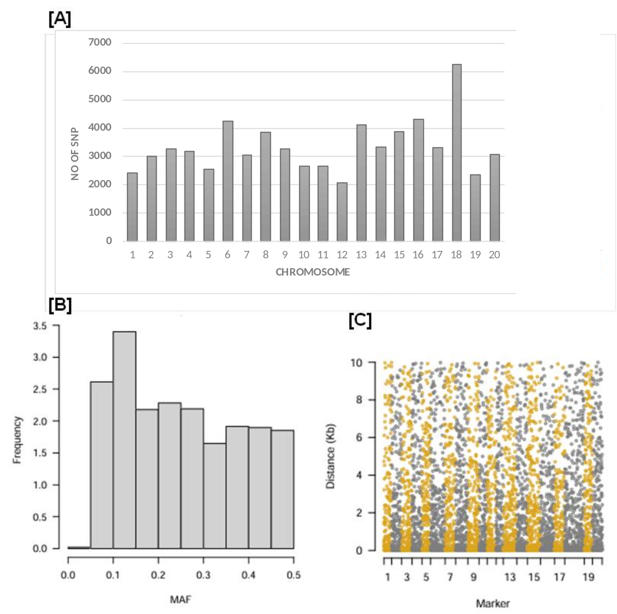
Supplementary figure S1. Distribution of Markers, MAF for 2 soybean germplasm lines. (A) Distribution of 66300 SNP across 20 chromosome of soybean data, (B) Distribution of minor allele frequencies (MAF), (C) Distribution of Markers

Slide 2
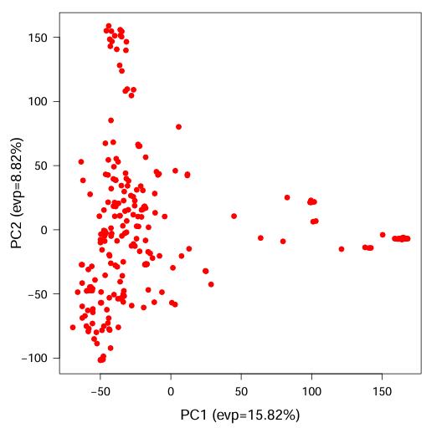
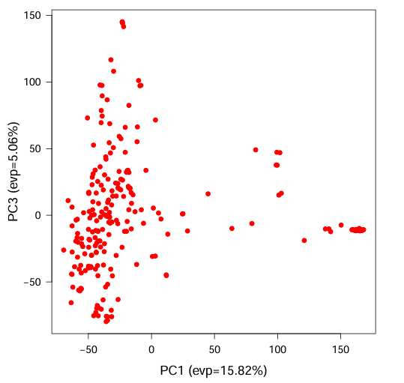
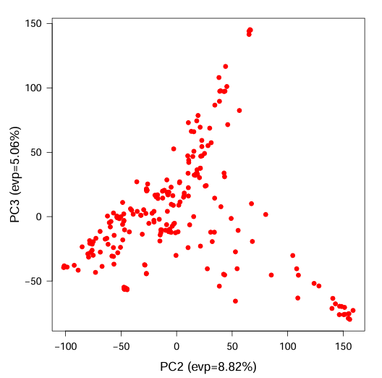
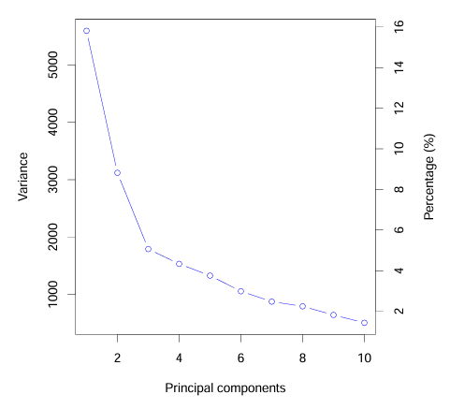
[A]
[B]
Supplementary figure S2. Principal component analysis (PCA) for the entire GWAS panel derived from SNP data. (A) Three different PCA plot derived from PC 1, 2 and 3, (B) Eigenvectors for PCA analysis

Slide 3
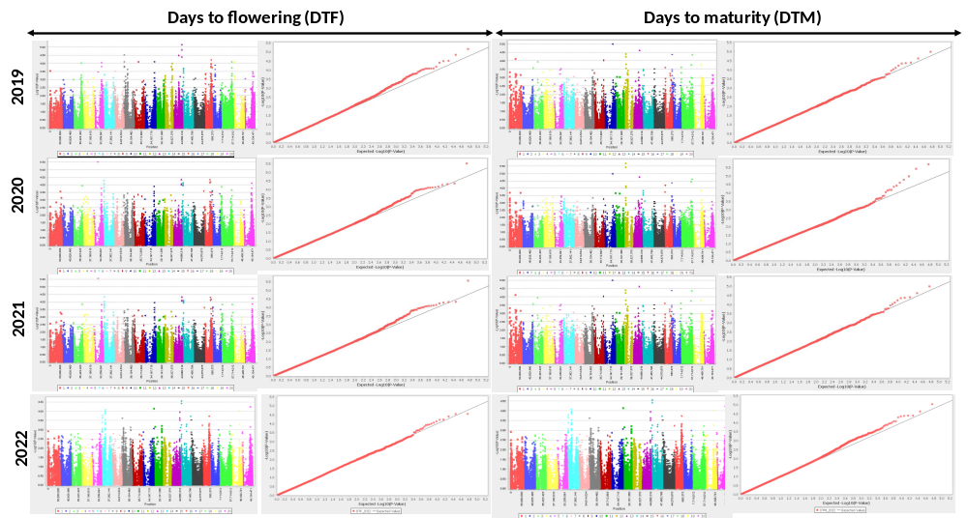
Supplementary figure S3. Association of SNPs with DTF and DTM in diverse soybean germplasm line. A total of 66300 SNPs was used for association study. GWAS was conducted by employing Mixed Linear Model (MLM) in TASSEL software (https://www.maizegenetics.net/tassel). Manhattan plot showing significant SNPs associated with DTF and DTM derived from FOUR consecutive year 2019 to 2022. (B&D) Quantile- quantile (QQ) Plots to show the distribution of SNPs with respect to traits.

Slide 4
Supplementary Figure S4a-S4g
Phylogenetic tree of key genes from different species

Slide 5
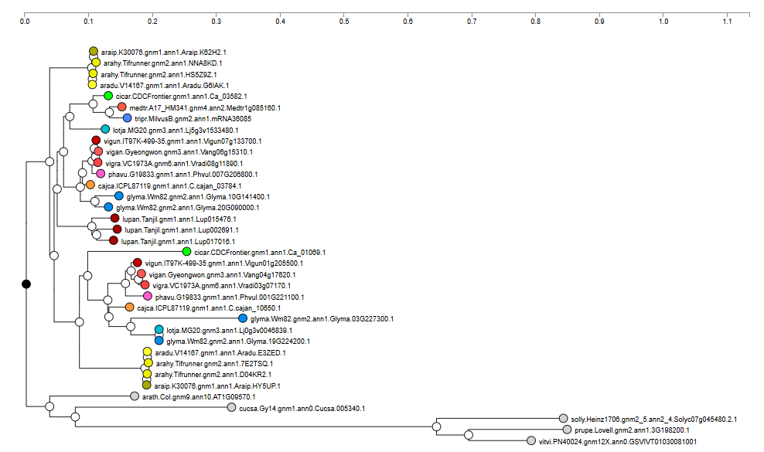
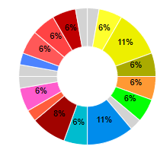
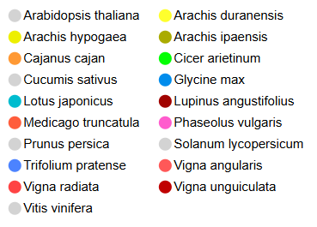
Function: Glyma.03G227300 : Phyotochrome; circadian rhythm;response to continuous far red light stimulus
Sup Figure S4a: Phylogenetic tree of Glyma.03G227300 homologs from different species

Slide 6
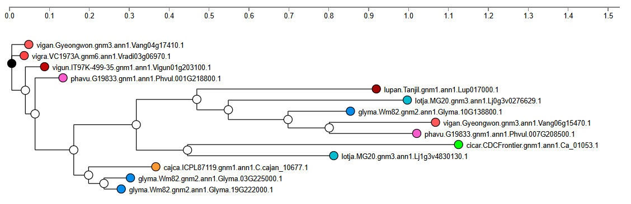
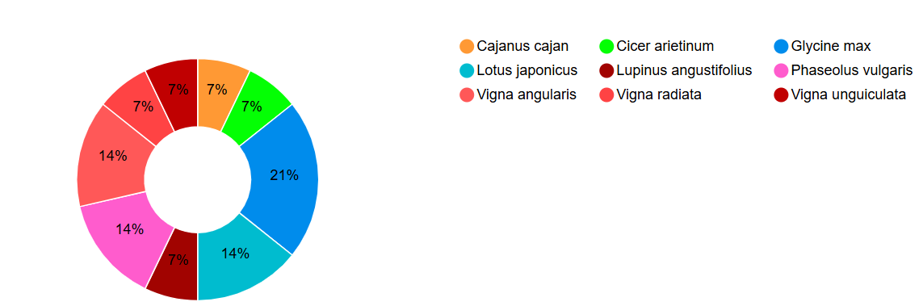
Glyma.03G225000; circadian rhythm; gibberellic acid mediated signaling pathway;
Sup Figure S4b: Phylogenetic tree of Glyma.03G225000 homologs from different species

Slide 7
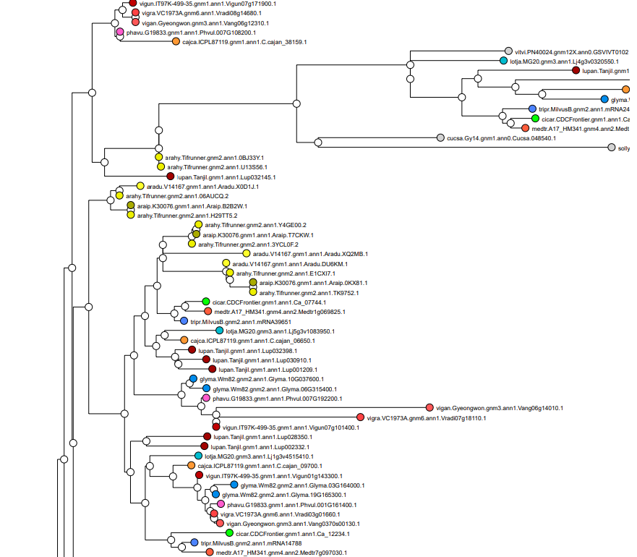
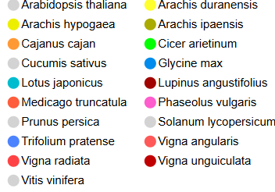
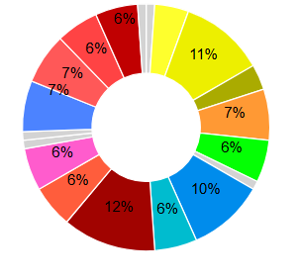
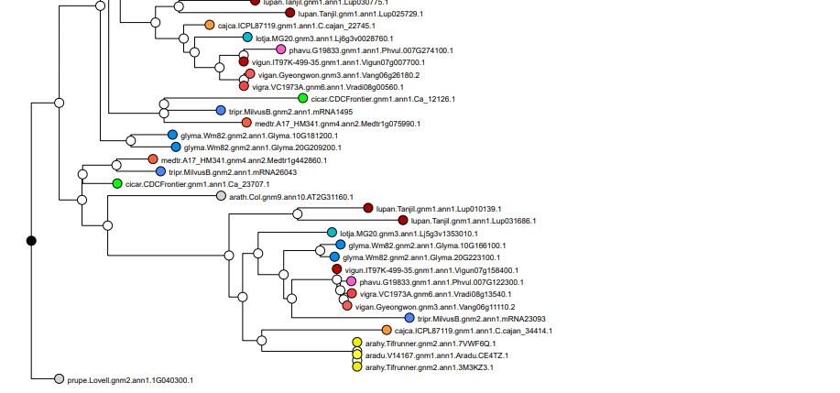
Glyma.03G164000:DUF640; post-embryonic plant morphogenesis
Sup Figure S4c: Phylogenetic tree of Glyma.03G164000 homologs from different species

Slide 8
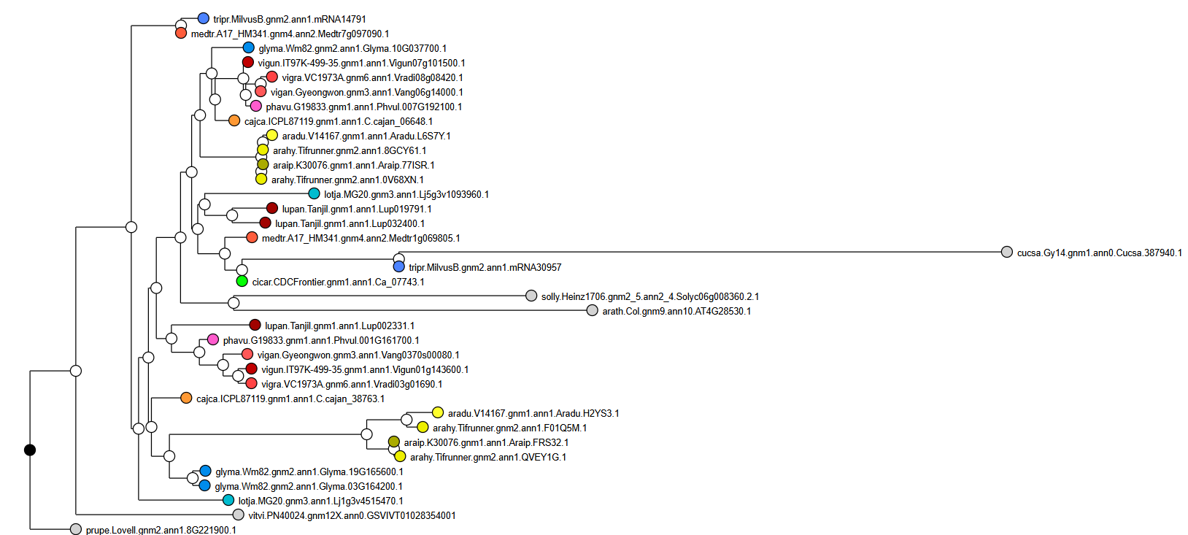
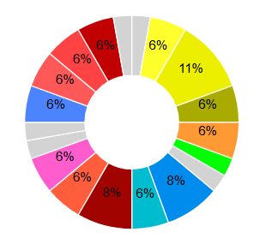
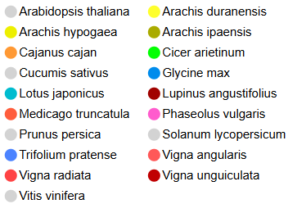
Glyma.03G164200:NAM; floral organ senescence
Sup Figure S4d: Phylogenetic tree of Glyma.03G164200 homologs from different species

Slide 9
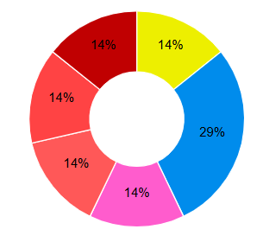

Glyma.03G166000:male meiosis II
Sup Figure S4e: Phylogenetic tree of Glyma.03G166000 homologs from different species

Slide 10
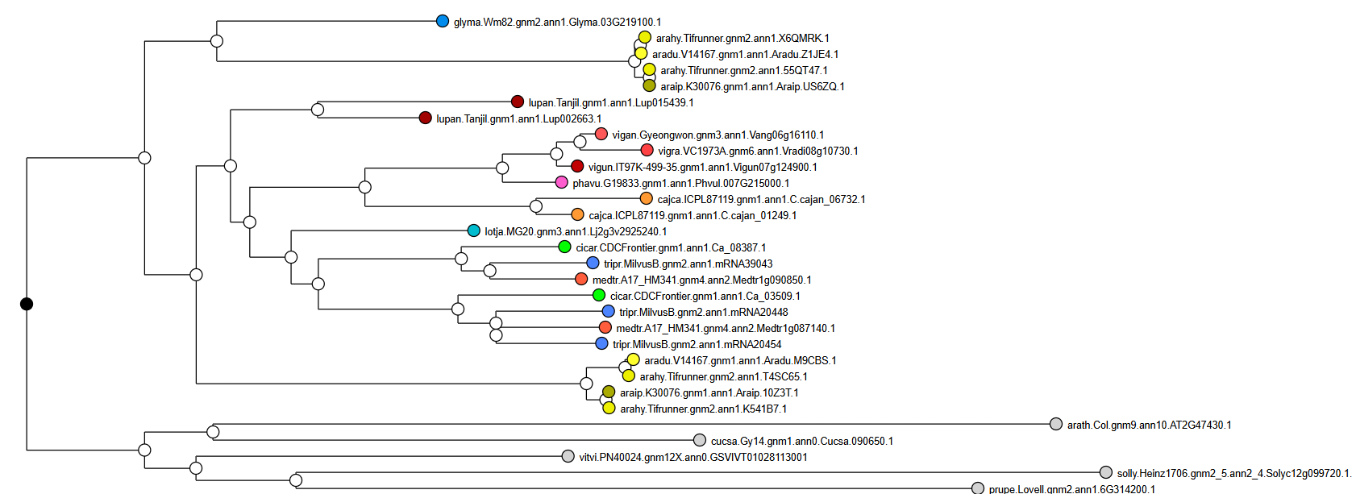
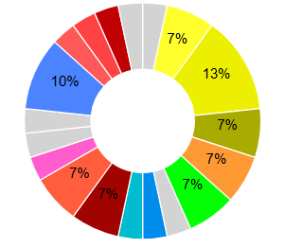
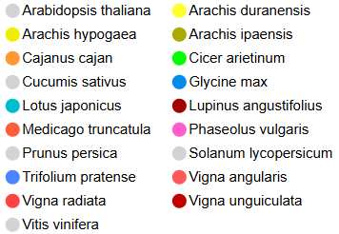
Glyma.03G219100:Response regulator receiver domain; cytokinin mediated signaling pathway; embryo sac development
Sup Figure S4f: Phylogenetic tree of Glyma.03G219100: homologs from different species

Slide 11
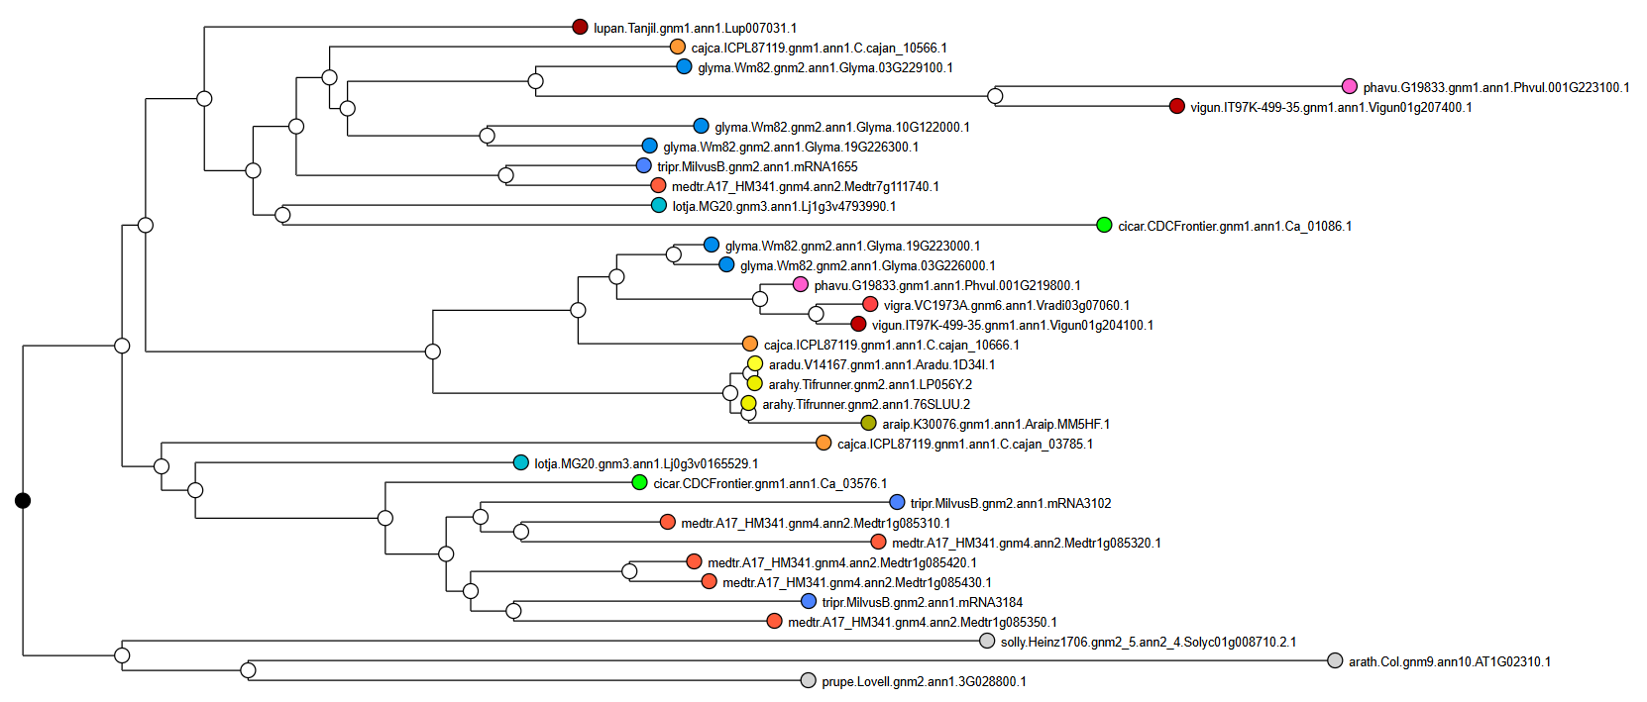
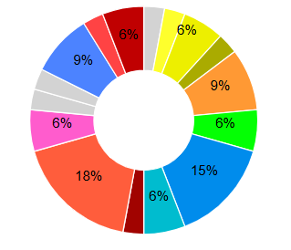
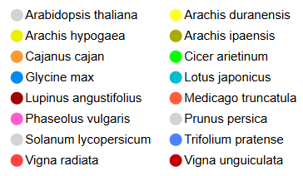
Glyma.03G226000:Cellulase; determination of bilateral symmetry; meristem initiation
Sup Figure S4g: Phylogenetic tree of Glyma.03G226000: homologs from different species

