Slide 1
Supplementary fig.
Chromosome-scale assembly of European flax (Linum usitatissimum L.) genotypes and pangenomic analysis provide genomic tools to improve breeding
Demenou et al.

Slide 2
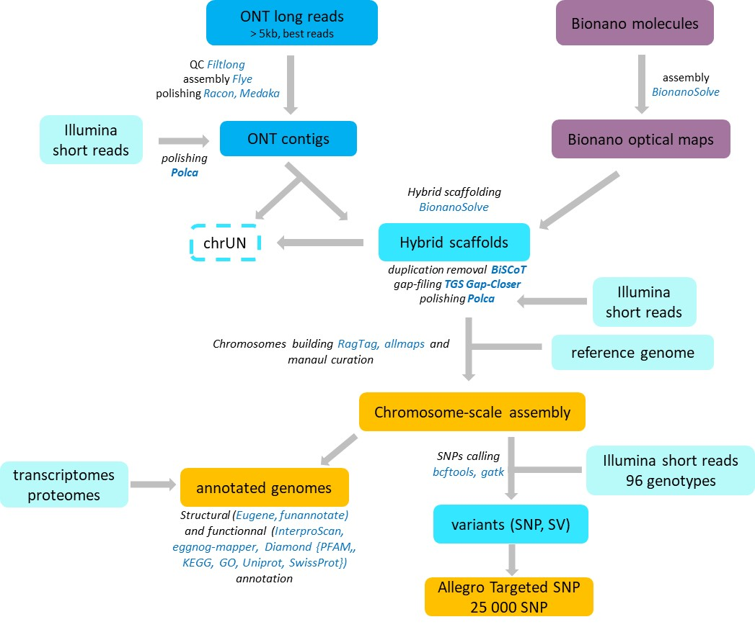
Supplementary Fig. S1 : Pipeline of analysis and tools used for the assembly and annotation in this study
EDTA

Slide 3
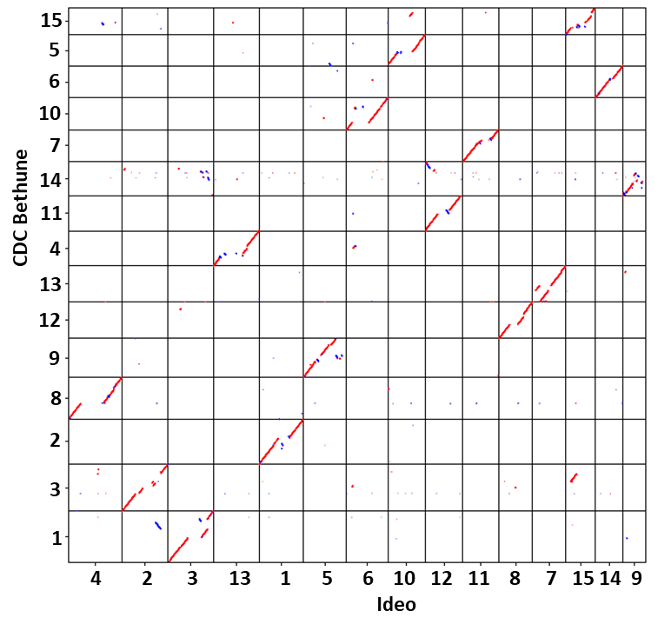
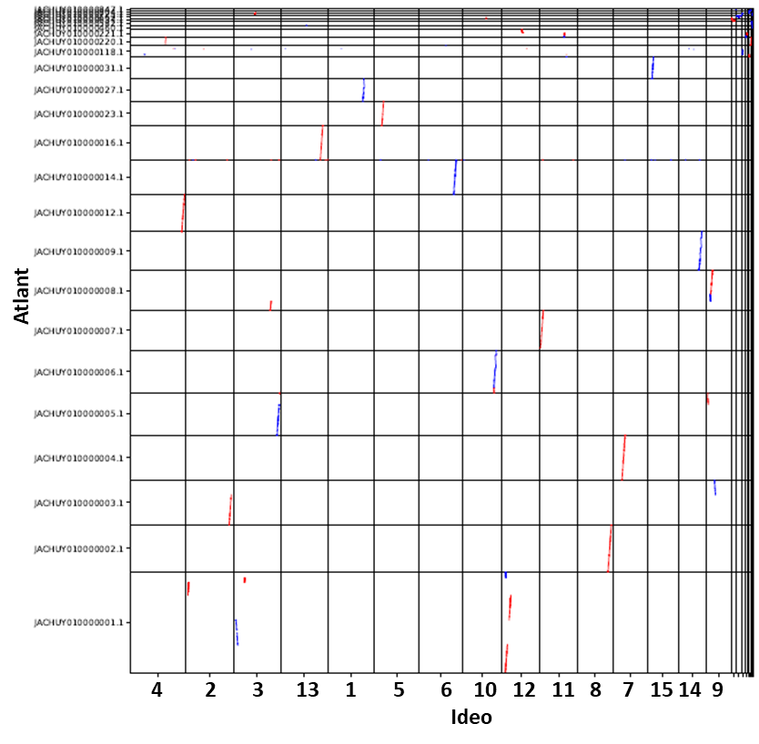
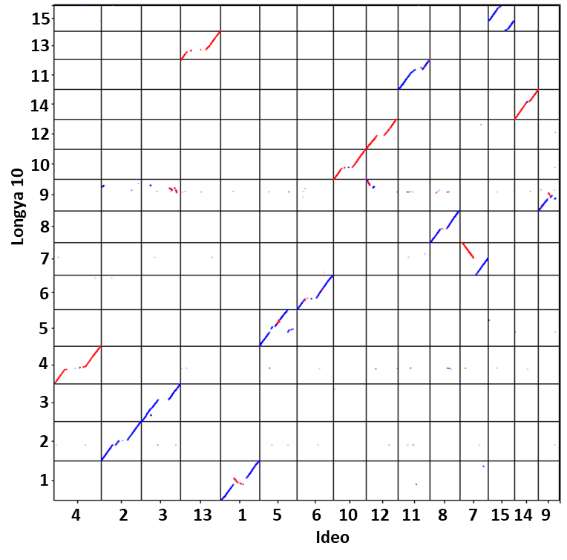
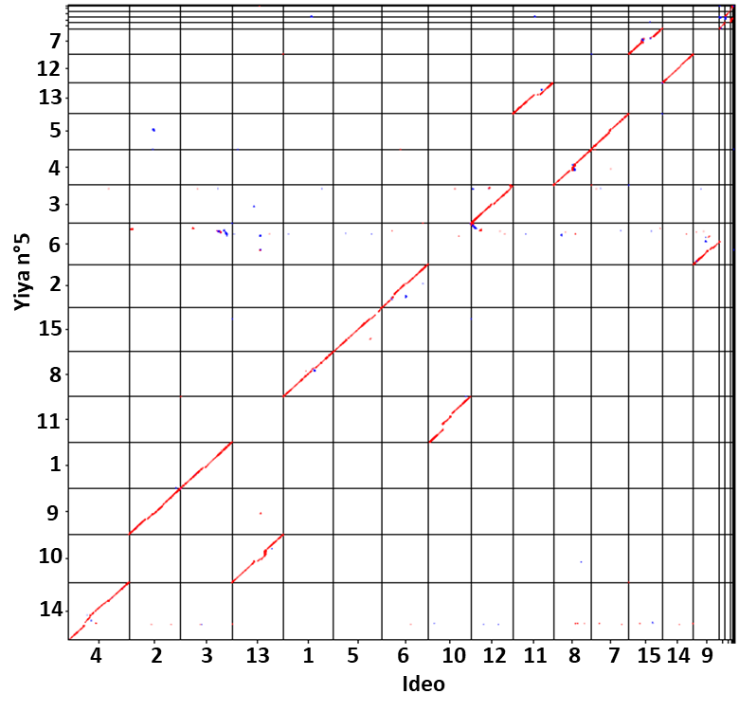



Supplementary Fig. S2 :Dotplots showing synteny between ideo and existing assemblies CDC Bethune, Atlant, Longya 10 and Yiya n°5.

