Slide 1
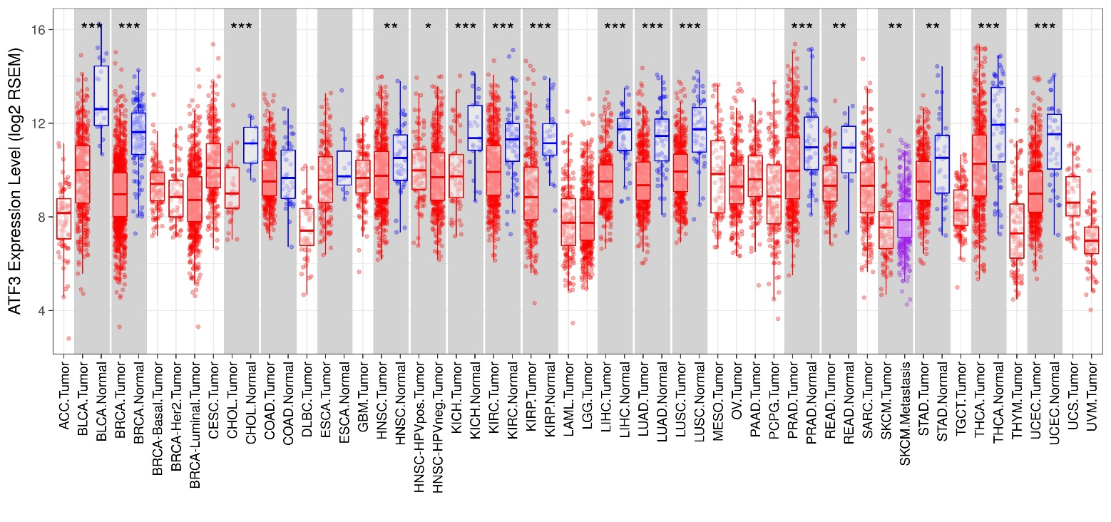
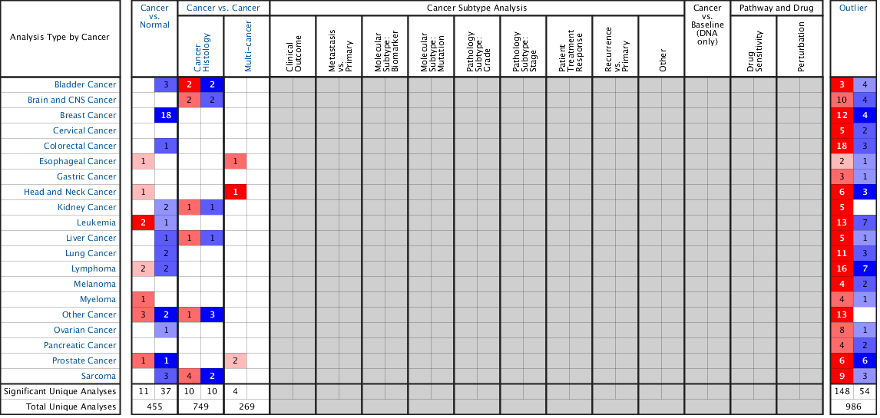
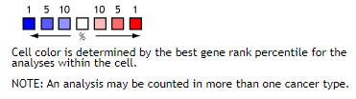
A
B
Supplementary Figure 1
(A) Human ATF3 expression levels in different tumor types from TCGA database were determined by TIMER (*P < 0.05, **P <0.01, ***P < 0.001). (B) ATF3 mRNA levels in different human cancers.
Notes: The figure was generated from ONCOMINE with the following thresholds: P-value: 1E-04; fold change: 2; gene rank: top 10%.

Slide 2
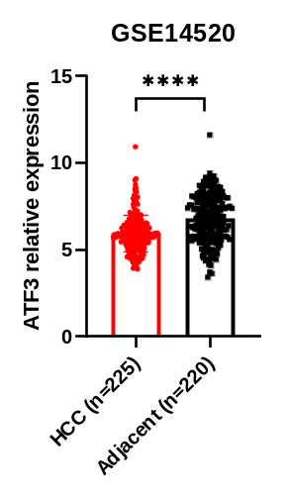
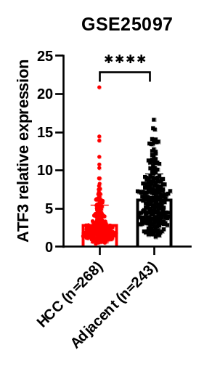
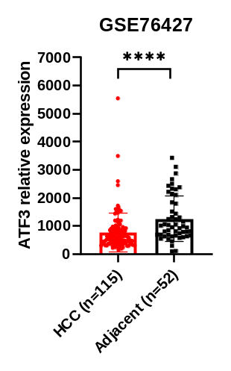
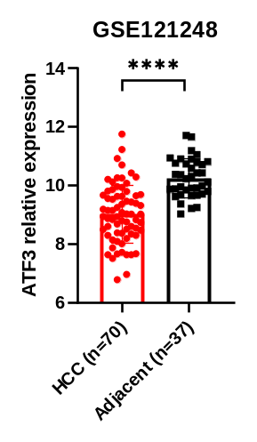
Supplementary Figure 2. TCGA verification.

Slide 3
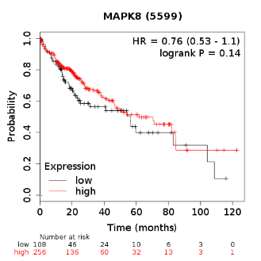
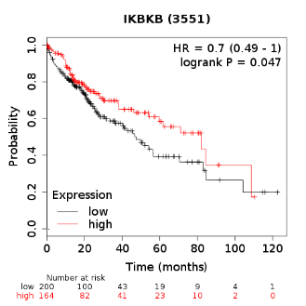
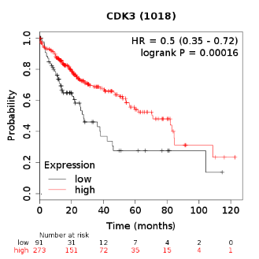
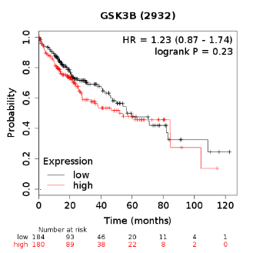
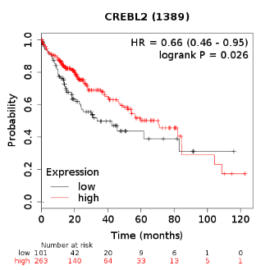
A
B
CREBP1
Supplementary Figure 3 Expression and OS survival outcome of ATF3-related regulators.
(A) Top kinase regulators of ATF3 coexpressed genes. (B) CREBP1 regulators of ATF3 co-expressed genes.

