Slide 1
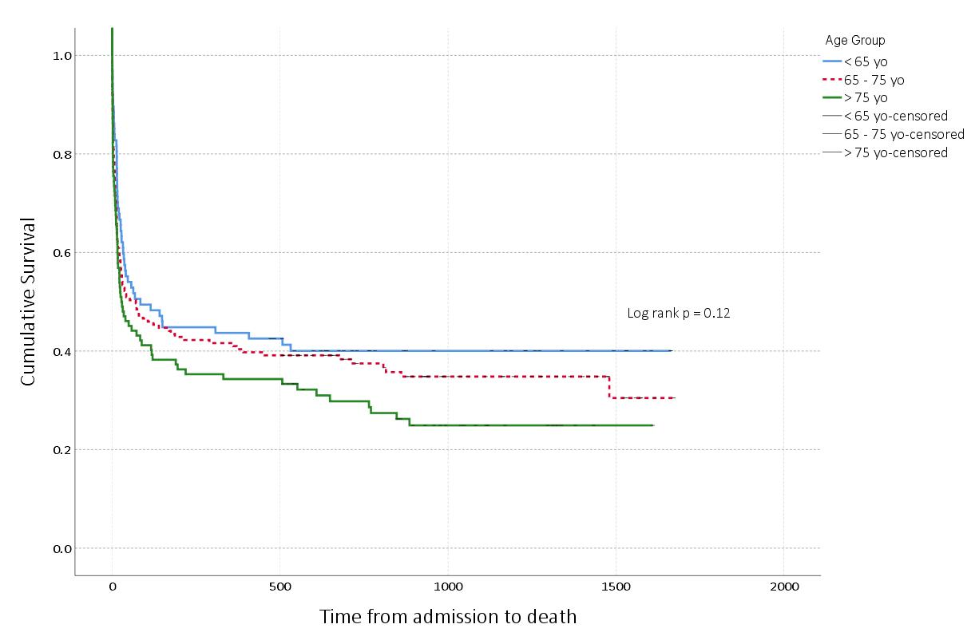

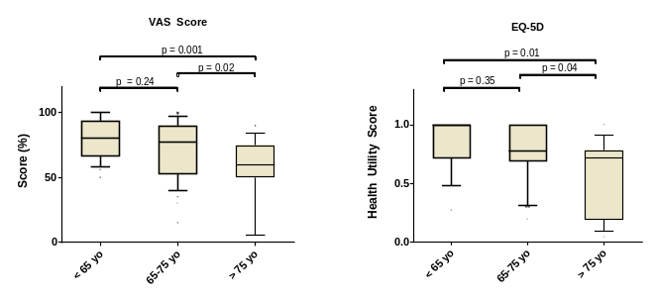
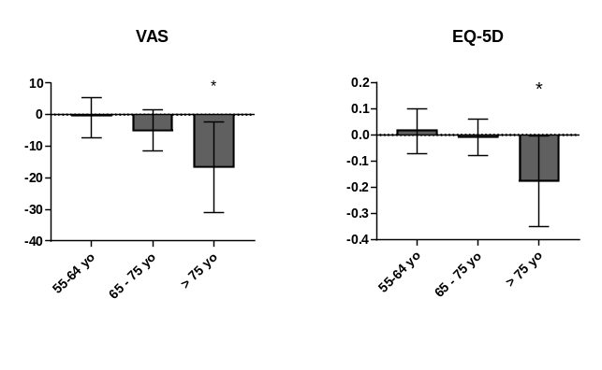

Epidemiology and Outcome of Elderly Patients Requiring Renal Replacement Therapy in the ICU:
an Observational Study
Long term survival?
Quality of life?
EQ-5D survey to 85.7% of survivors
Elderly survivors have a low dialysis dependence rate (13.3%), similar to younger patients (resp. 9% and 0%, p=0.23).
They have a lower QOL than younger patients
They have a lower than predicted QOL (reference normal local population)
The need for RRT is associated with a very high mortality. The majority of deaths occur in ICU. Elderlies (>75 yo) have a similar mortality than younger patients.
VAS
EQ-5D
Single Centre Observational Study
352
32.7
Conclusions: the need for RRT identifies a population at very high risk of mortality. Among survivors, the rate of RRT dependence is low. Patients >75 yo who survived ICU had a lower quality of life than younger patients. This QOL was also lower than predicted according to age and sex.
RRT patients
Months Follow-up

Slide 2
