Slide 1
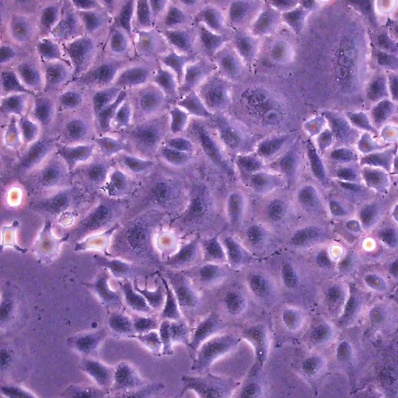
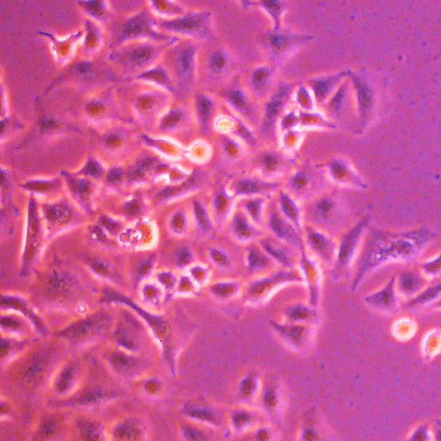
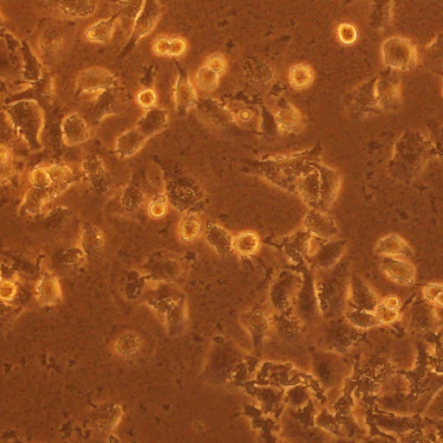
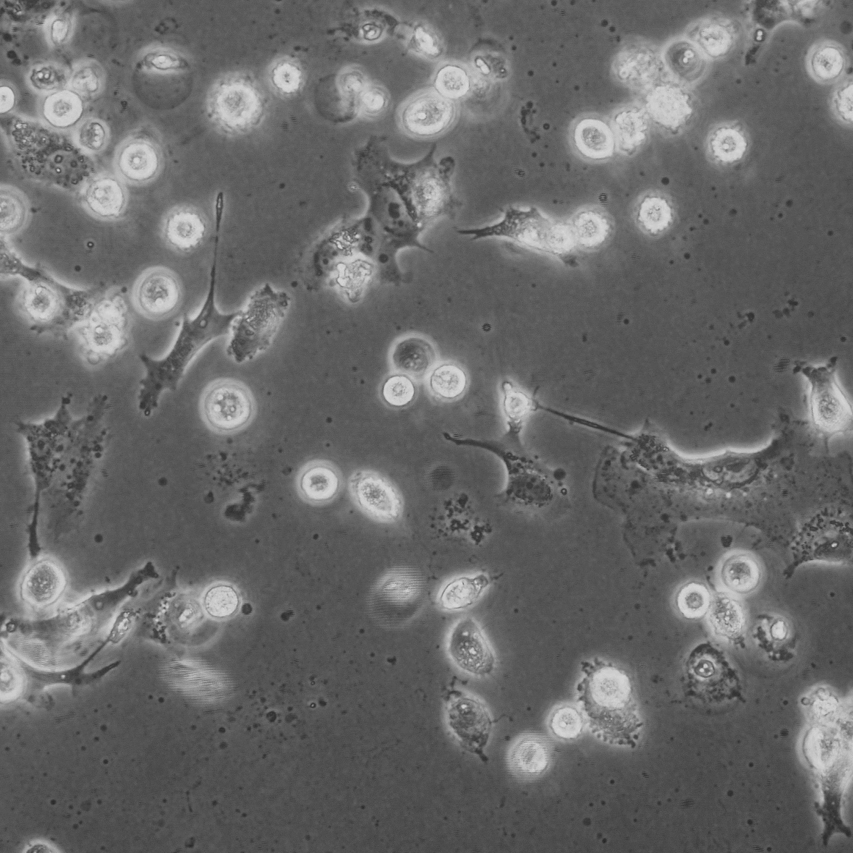
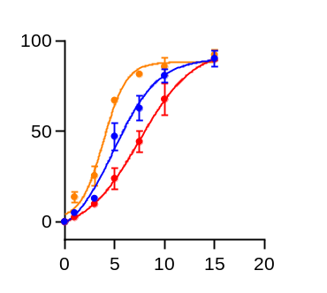
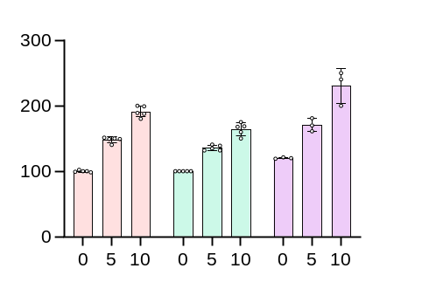
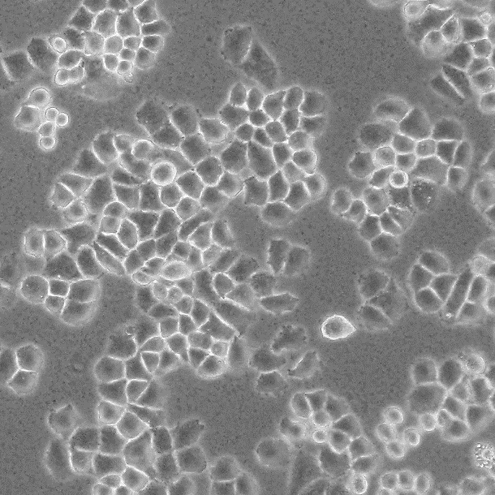
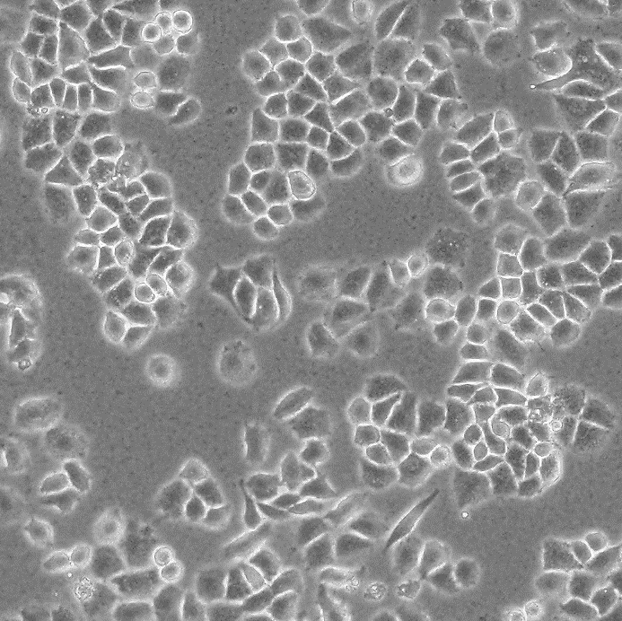
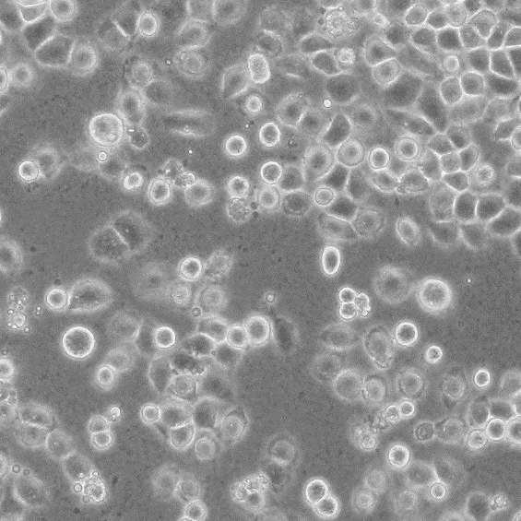
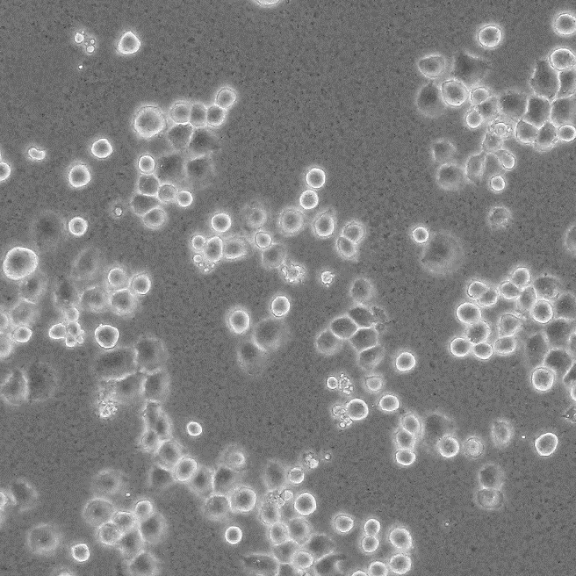
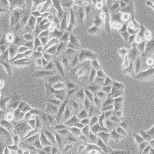
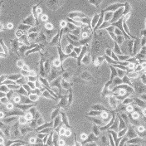
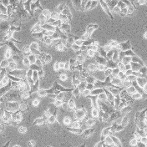
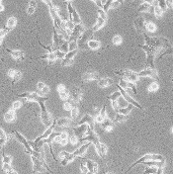
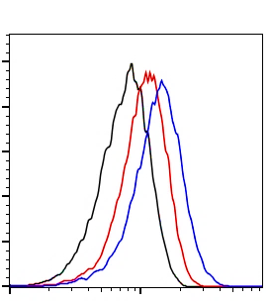
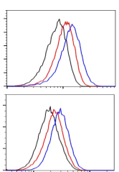
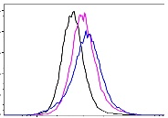
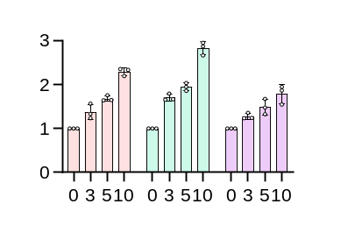
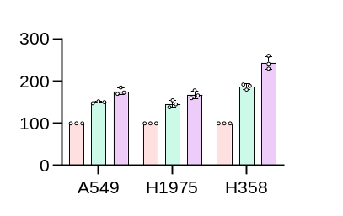
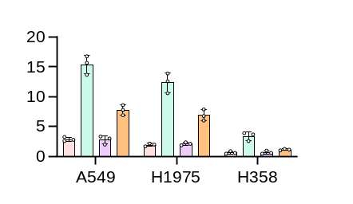
Fig S1 Huaier Induces Ferroptosis in NSCLC Cells
a
b
c
Huaier 0 2.5 5 10 (mg/ml)
A549 H1975 H358
A549 H1975 H358
A549
***
**
100 μm
Mean flurocescence
of FerroOrange
(% control)
***
***
Inhibition ratio(%)
**
***
H358 H1975
100 μm
(mg/ml)
100 μm
Huaier
Huaier (mg/ml)
d
e
Huaier 0 5 10 (mg/ml) 0 5 10 (mg/ml)
A549
H1975
A549
H1975
H358
0
5
10
100 μm
100 μm
Count
H358
Liperfluo
(mg/ml)
100 μm
Liperfluo
f
A549 H1975 H358
g
0 5 10(mg/ml)
h
0 5 Fer-1+0 Fer-1+ 5 (mg/ml)
***
***
***
**
Relative
fluorescence
Intensity of
DCFH(%)
**
**
***
**
***
**
Relative LDH
levels
**
***
***
**
*
*
**
**
MDA (μM/mg)
**
**
**
Huaier (mg/ml)

Slide 2
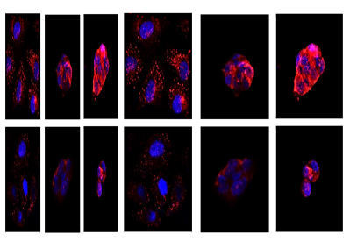
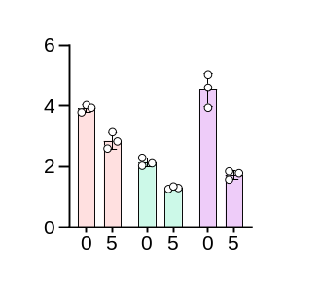
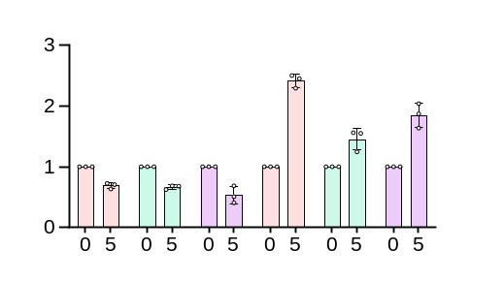
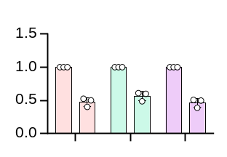
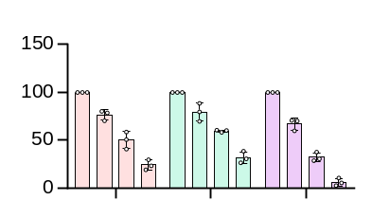
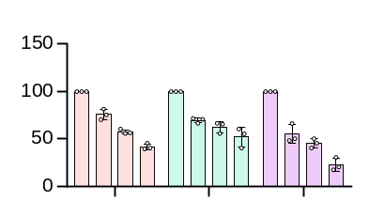
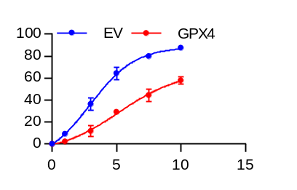
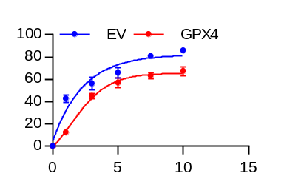
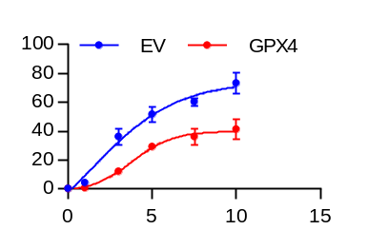
Fig S2 Huaier Induces Ferroptosis of NSCLC cells via SLC7A11/GPX4 Axle
20 μm
a
GPX4/DAPI
c
b
A549
H1975
H358
A549
H1975
H358
Intracellular
**
***
***
**
A549 H1975 H358
Cystine uptake
***
Concentration of
Glutamate (mmol/l)
Cell supernatant
*
*
*
*
Huaier(mg/ml)
Huaier (mg/ml)
d
A549
H1975
e
siGPX4 - + - + - +
f
H358
A549
H1975
H358
0
5 mg/ml
KDa
**
***
*
**
**
**
**
GPX4
20
**
**
Relative level of
GPX4
Cell Viability (%)
β-actin
45
100 μm
- + - +
- + - +
- + - +
siGPX4 - + - + - +
A549 H1975 H358
siGPX4
Huaier(mg/ml)
0 0 5 5
0 0 5 5
0 0 5 5
g
h
A549
H1975
H358
i
SLC7A11
SLC7A11
SLC7A11
RSL3 0 5 0 5 0 5 (μM)
***
*
EV
EV
EV
***
***
***
KDa
***
KDa
GPX4
20
SLC7A11
Cell Viability (%)
35
β-actin
45
β-actin
45
- + - +
- + - +
- + - +
A549 H1975 H358
A549 H1975 H358
siGPX4
(mg/ml)
Huaier
0 0 5 5
0 0 5 5
0 0 5 5
j
EV
EV
EV
k
0
5 mg/ml
GPX4
GPX4
GPX4
KDa
EV
GPX4
20
β-actin
45
GPX4
Liperfluo
100 μm
A549 H1975 H358
A549 H1975 H358
A549 H1975 H358
l
Inhibition ratio(%)
Inhibition ratio(%)
Inhibition ratio(%)
A549
(mg/ml)
(mg/ml)
(mg/ml)
Huaier
Huaier
H1975
Huaier
H358

Slide 3
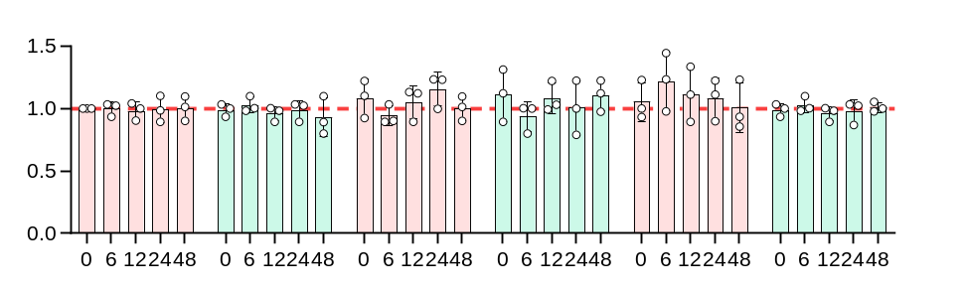
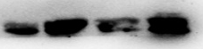

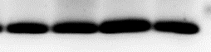
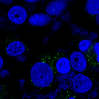



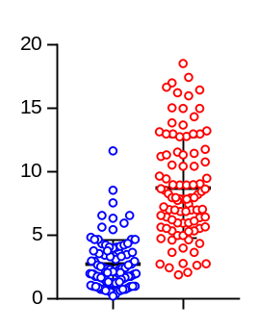

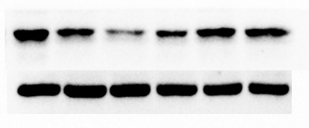

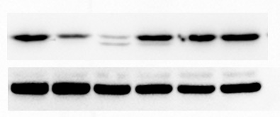
Fig S3 Huaier Induces Ferritinophagy in NSCLC Cells
a
b
FTH1
FTL
H1975
H358
(mg/ml)
Huaier
0 5 0 5
A549
KDa
NCOA4
80
FTH1
Relative
mRNA level
21
β-actin
45
H1975 H358
Hours
c
FTH1 LC3 Merge
d
FTH1 LAMP1 Merge
e
LC3 NCOA4 Merge
0
0
0
DAPI
DAPI
DAPI
5 mg/ml
5 mg/ml
5 mg/ml
10 μm
10 μm
20 μm
f
FerroOrange LysoTracker Merge
g
h
BafA1 - - - + + +
0
5 mg/ml
Huaier 0 5 10 0 5 10
KDa
***
NCOA4
80
0
Nuc
FTH1
21
Fluorescence of
FerroOrange colocalizing
with LysoTracker（1*10⁶）
β-actin
45
3-MA - - - + + +
Huaier 0 5 10 0 5 10
KDa
5 mg/ml
NCOA4
80
Nuc
FTH1
21
5 μm
β-actin
(mg/ml)
45

Slide 4
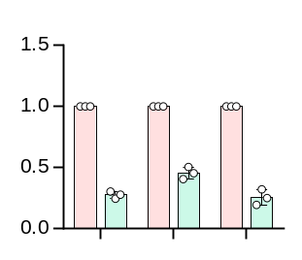
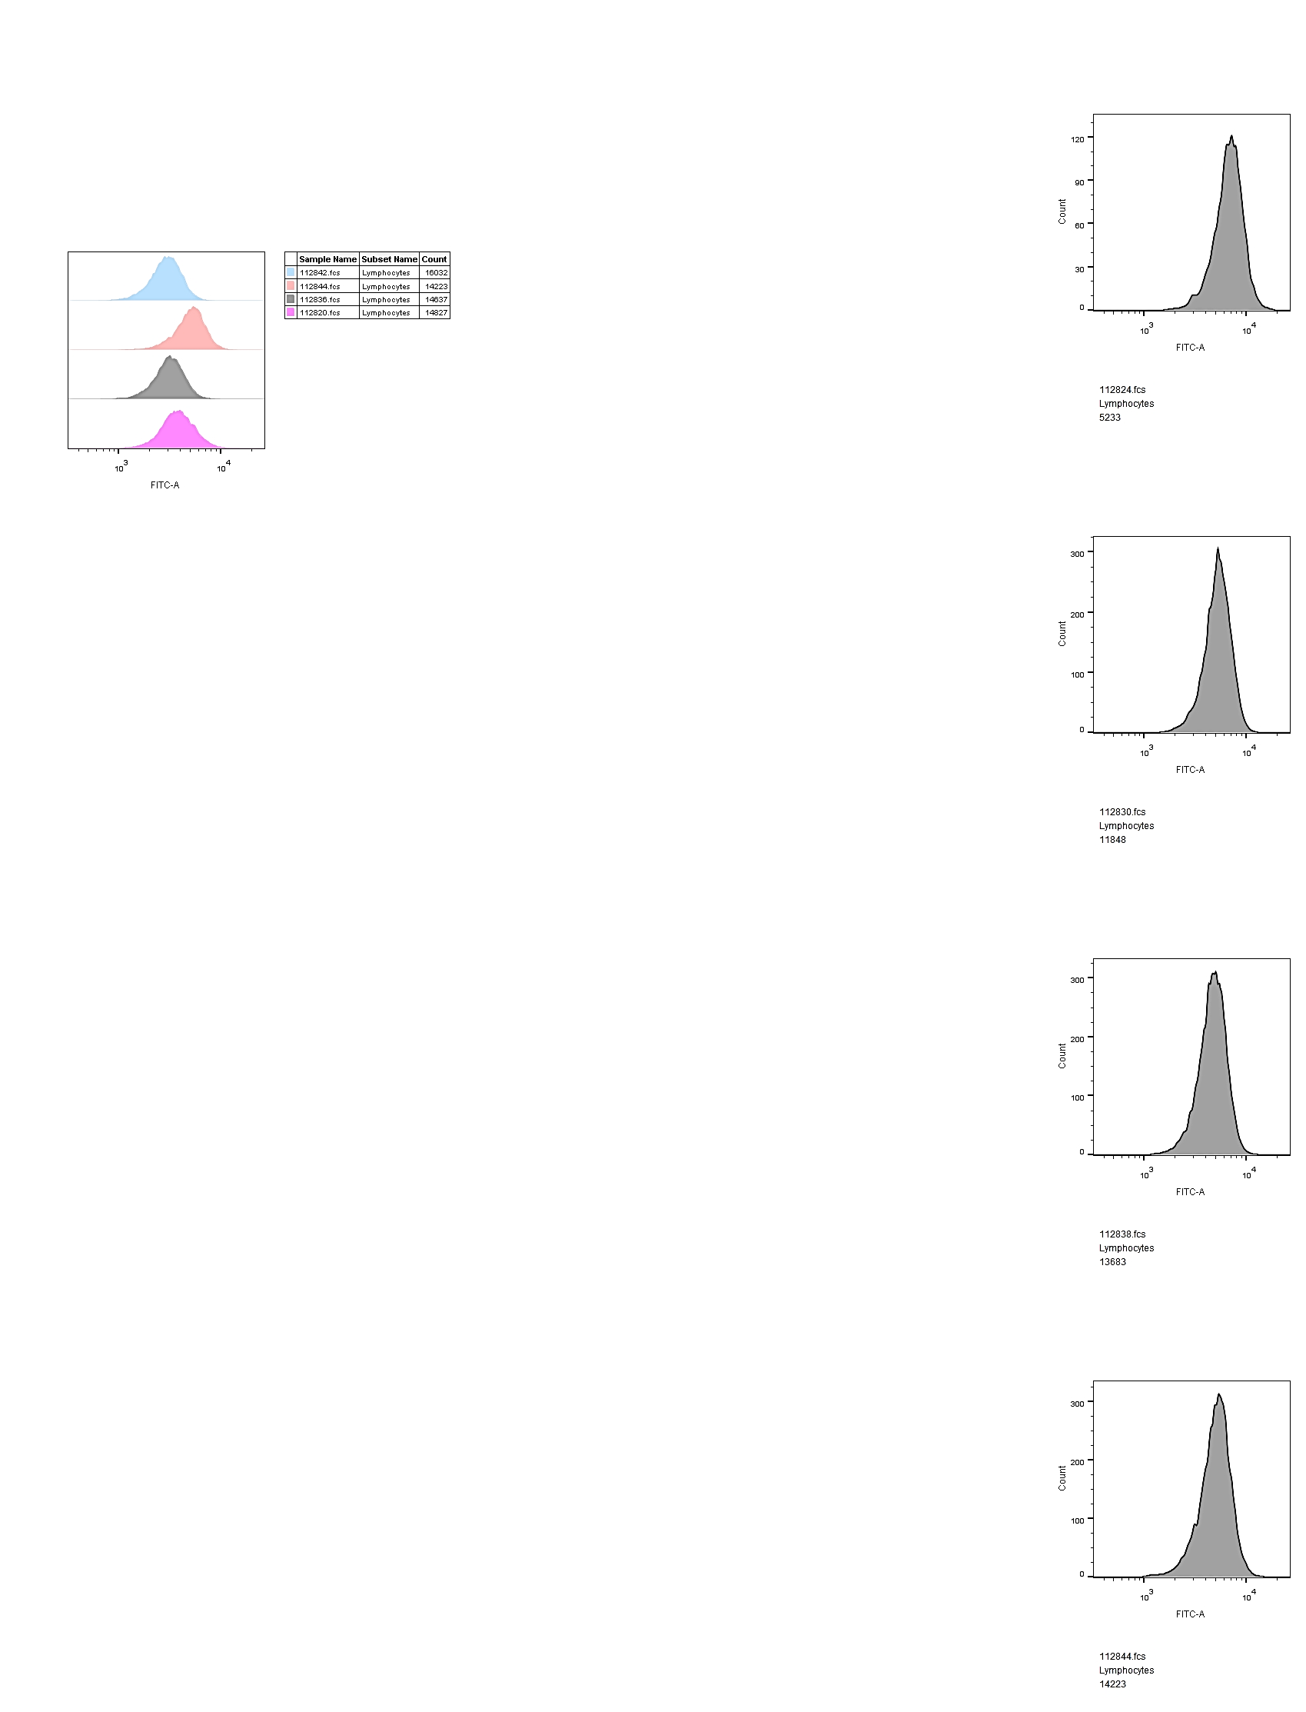
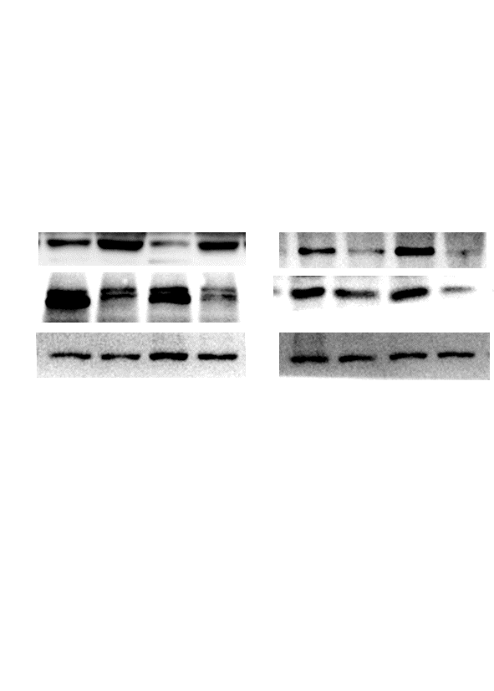
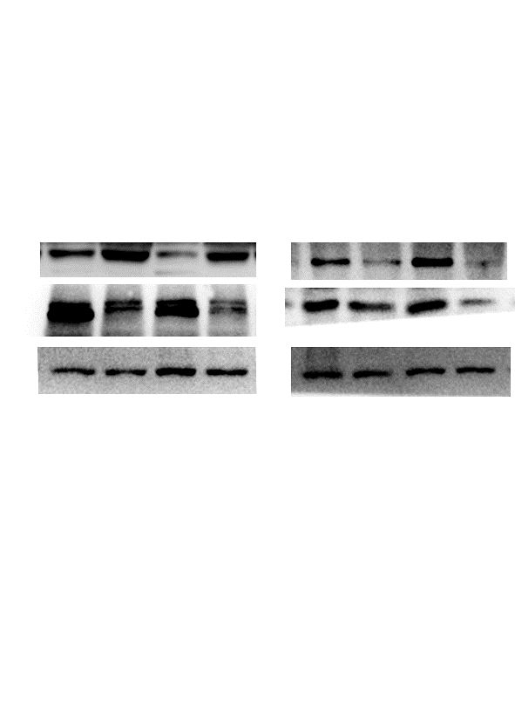
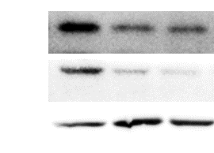
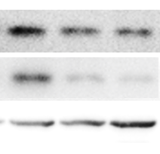
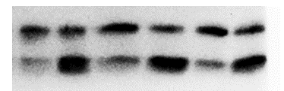
Fig S4 Huaier Simultaneously and Independently Downregulates the SLC7A11/GPX4 Axis and Upregulates Ferritinophagy
a
siNC
siNCOA4
b
siNC
siNCOA4
c
DMSO 3-MA
**
***
***
0
0
46.5%
Relative level
of NCOA4
5
Huaier(mg/ml)
Count
3
Huaier(mg/ml)
5
Liperfluo
0
23.8%
100 μm
5
Liperfluo
A549 H1975 H358
A549 H1975 H358 A549 H1975 H358
d
EV SLC7A11
e
siNC siNCOA4
f
Ctr BafA1(50nM)
Huaier
KDa
Huaier
0 5 0 5
0 5 0 5
Huaier
NCOA4
80
SLC7A11
KDa
0 3 5
0 3 5
KDa
21
35
SLC7A11
35
FTH1
GPX4
20
GPX4
20
LC3Ⅰ
LC3 Ⅱ
16
β-actin
45
β-actin
45
14
A549(mg/ml)
A549(mg/ml)
β-actin
45
A549(mg/ml)

