Slide 1
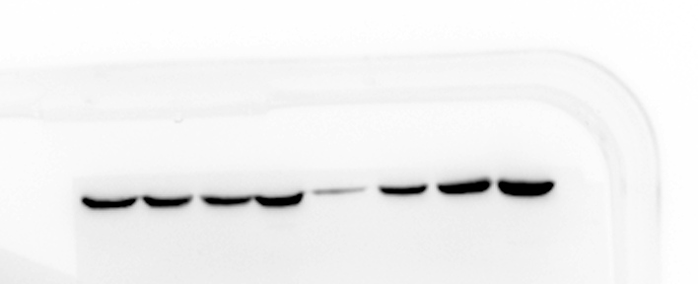
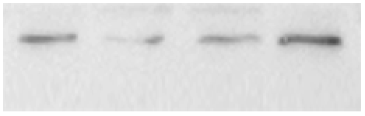
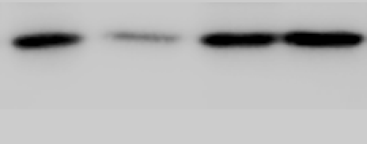
Fig.3b
Fig.3c
SLC7A11
-35KDa
GPX4
-20KDa
β-actin
-45KDa
β-actin
-45KDa
GPX4
-20KDa
Fig.3g
GPX4
-20KDa
GPX4
-20KDa
β-actin
-45KDa
SLC7A11
-35KDa
SLC7A11
-35KDa
GPX4
-20KDa
β-actin
-45KDa
β-actin
-45KDa
β-actin
-45KDa

Slide 2

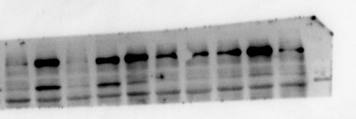
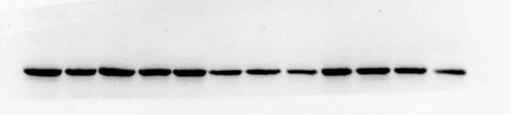
Fig.4b
NCOA4
-80KDa
Fig.4a
FTH1
-21KDa
NCOA4
-80KDa
β-actin
-45KDa
FTH1
-21KDa
Fig.4c
β-actin
-45KDa
NCOA4
-80KDa
FTH1
-21KDa
β-actin
-45KDa

Slide 3
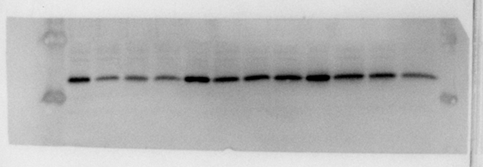
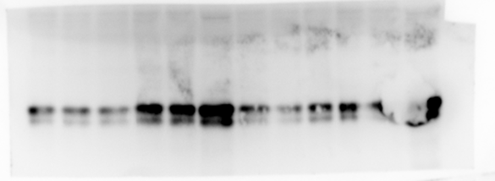
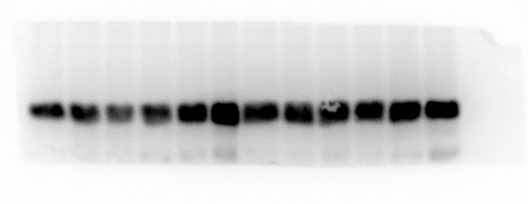
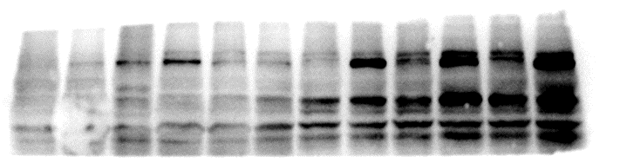
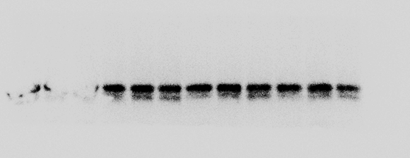
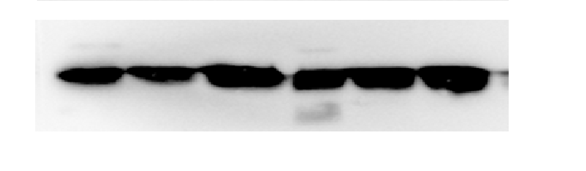
Fig.5f
Fig.5g
GPX4
-20KDa
FTH1
-21KDa
SLC7A11
-35KDa
NCOA4
-80KDa
β-actin
-45KDa
β-actin
-45KDa

Slide 4
Fig.S2e
Fig.S2e
GPX4
-35KDa
Fig.S2g
β-actin
-45KDa
GPX4
-20KDa
β-actin
-45KDa
Fig.S2j
Fig.S2i
GPX4
-20KDa
SLC7A11
-35KDa
β-actin
-45KDa
-45KDa
GPX4
-20KDa
β-actin
β-actin
-45KDa

Slide 5
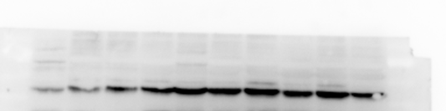

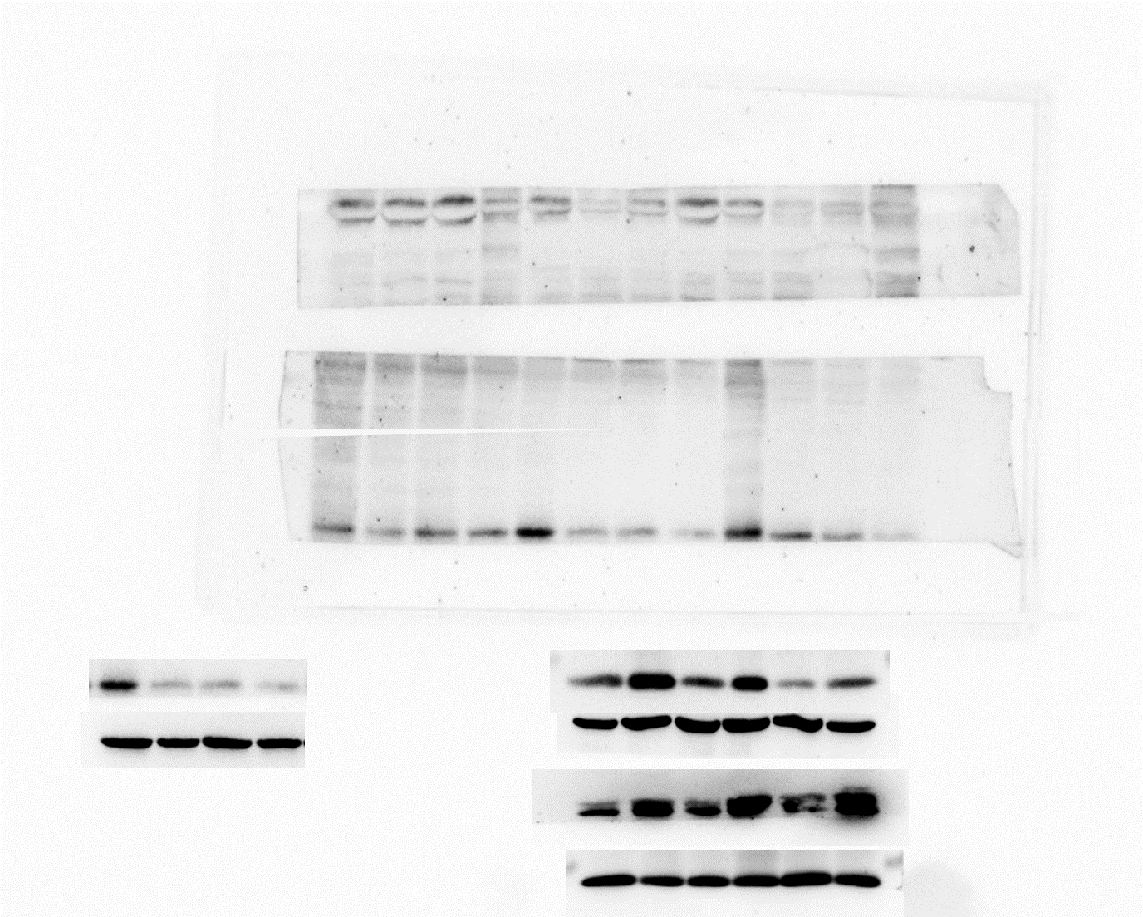
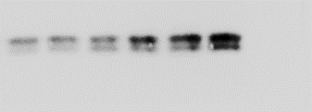

Fig.S3h
NCOA4
-80KDa
FTH1
-21KDa
Fig.S3a
β-actin
-45KDa
NCOA4
-80KDa
FTH1
-21KDa
NCOA4
-80KDa
β-actin
-45KDa
-21KDa
FTH1
β-actin
-45KDa

Slide 6


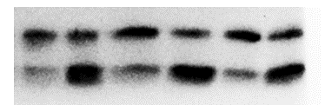
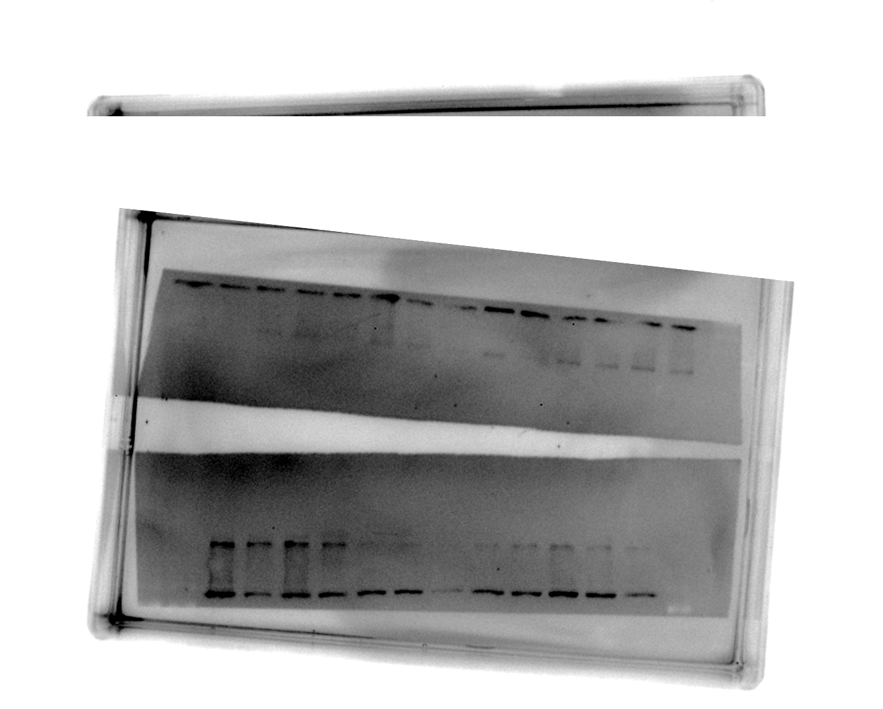
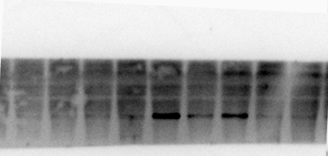

Fig.S4d
NCOA4
-80KDa
Fig.S4f
SLC7A11
-35KDa
FTH1
-21KDa
LC3Ⅰ
LC3 Ⅱ
-16KDa
GPX4
-20KDa
-14KDa
β-actin
-45KDa
-45KDa
β-actin
Fig.S4e
SLC7A11
-35KDa
SLC7A11
-35KDa
GPX4
-20KDa
GPX4
-20KDa
β-actin
-45KDa
β-actin
-45KDa

