Slide 1
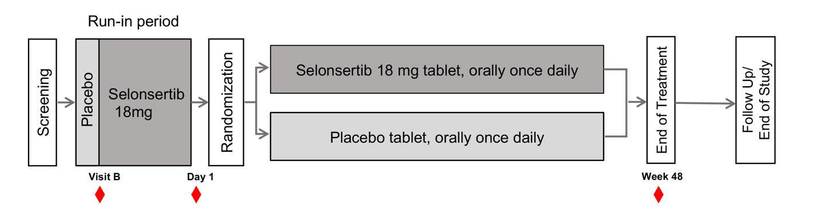
Supplemental Figure 1
Supplemental figure S1. Schematic representation of the MOSAIC clinical study setup. The timepoints at which the patient samples were collected are marked in red.

Slide 2
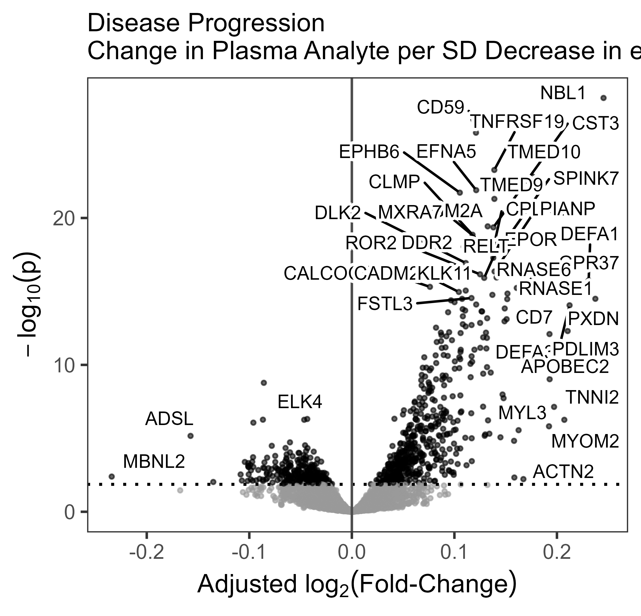
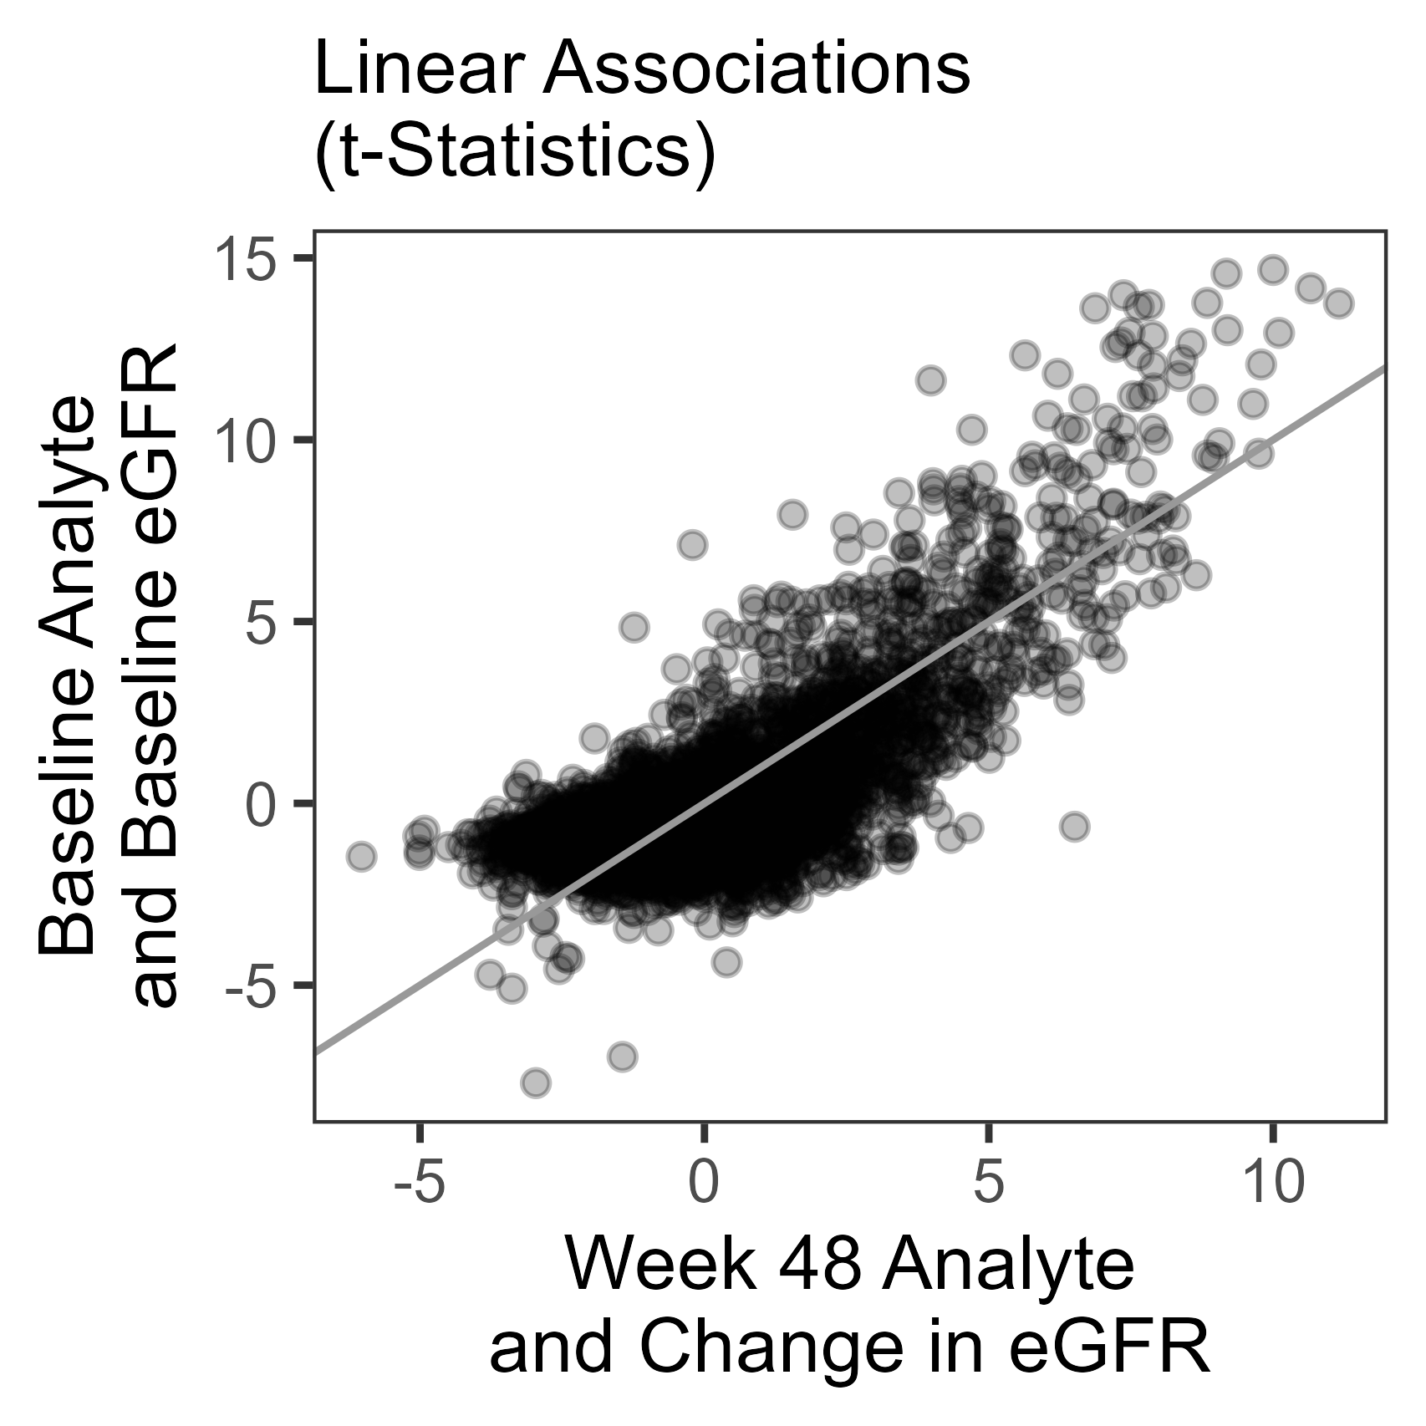
A
B
Supplemental figure S2
Change in plasma analytes per SD decrease in eGFR during the 48-week study
Association between analytes that showed correlation with baseline eGFR (y-axis), and analytes whose change correlated with the change in eGFR during the 48-week treatment (x-axis)

Slide 3
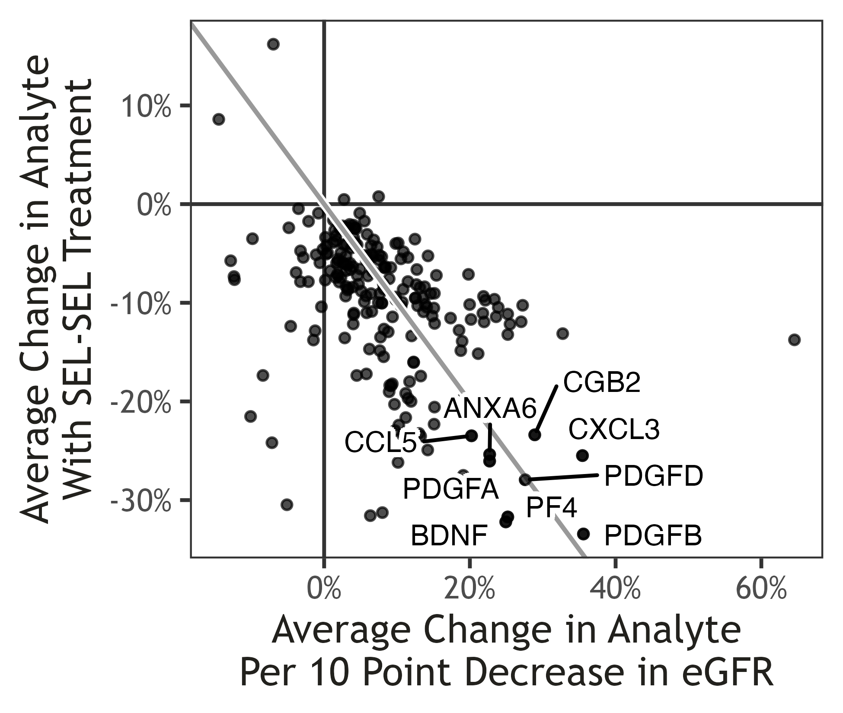
Supplemental figure S3
The change in SAS biomarkers with selonsertib treatment in the Severe eGFR group (X-axis) plotted against the change in analyte per 10-point decrease in eGF R

