Slide 1
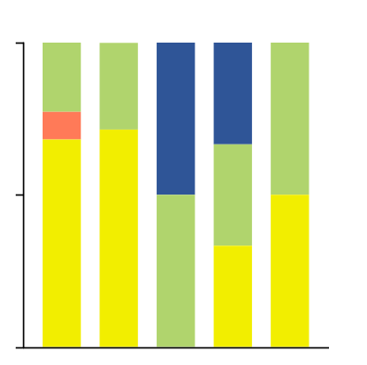
Supplementary Figure S1
(%)
p < 0.0326
100
5
2
2
2
1
1
BRAF
RAS
50
2
NF1
15
5
Triple WT
1
1
2
0
Acral
Mucosal
High-CSD
Low-CSD
Unknown

Slide 2


Supplementary Figure S2
KM041
FM017
KI007
FM009
FM011
JT002
JT013
FM003
NS002
NS003
SB004
FM013
JT009
FM014
KF002
KF004
KF005
KM011
KM034
SG005
JT004
Before ICI
During ICI
CDKN2A
After ICI
BRAF
Truncation
TERT
Missense SNV
KDR
LOH
CCND1
Amplification
APC
Homozygous Deletion
EP300
PDGFRA
KIT
RAC1
NF1
KRAS
TP53
SLC44A4
PTPRD
PTEN
STK19
PIK3CA
NRAS
CDK4
ADGRF5
Clinical Response
CR
PR
LS
SD
PD
NE

Slide 3
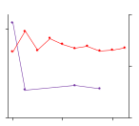
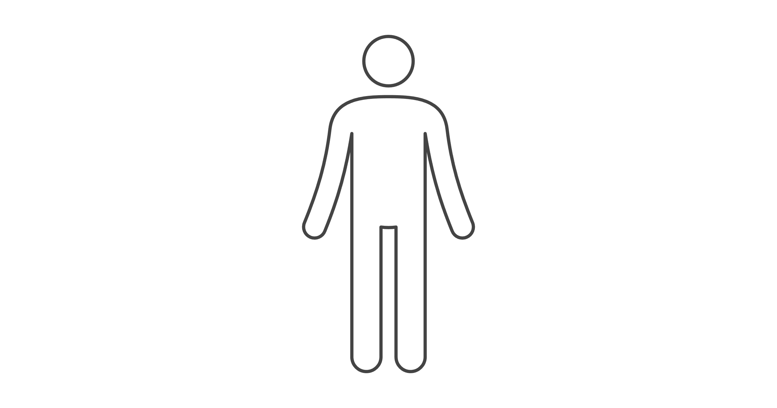
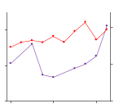
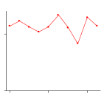
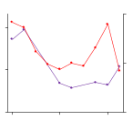
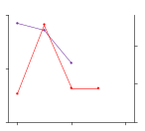
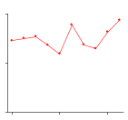
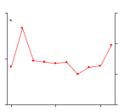
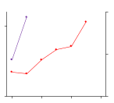
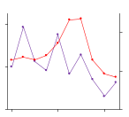
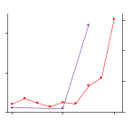
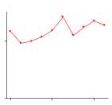
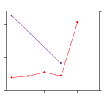
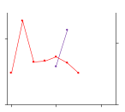
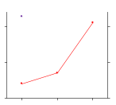
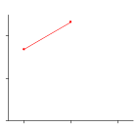
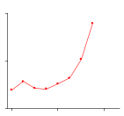
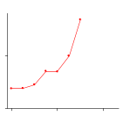
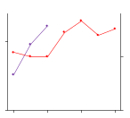
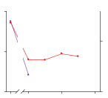
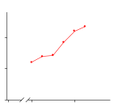
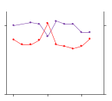
Supplementary Figure S3
KM041
10
FM017
KI007
300
D
200
10
B
250
D1
D1
B
5
B
100
D
5
D
B
D2
D
B
B
D2
0
0
24
48
0
0
0
24
48
0
0
0
24
48
CR
PR
FM009
30
800
FM011
400
JT002
JT013
30
D
300
B
10
B
300
B
B
D
15
400
B
200
D1
D2
15
D
A
5
A
B
B
D
LDH
0
0
0
B
0
0
D1
D2
0
0
5-S-CD
0
24
48
0
12
24
0
24
48
0
24
48
LS
CR
FM003
200
NS002
30
NS003
SB004
30
PR
750
D
300
D
2000
75
B
300
B
B
50
A
B
D
D
SD
100
B
D
15
B
1000
B
A
25
15
PD
B
D
0
0
12
24
36
0
0
0
24
48
0
0
0
24
48
0
0
0
24
48
0
LS
Nivolumab
FM0013
JT009
Ipilimumab
1000
10
300
30
Nivolumab + Ipilimumab
5
D
15
B
Pembrolizumab
500
B
D
B
D
Dabrafenib/Trametinib
0
B
D
Vemurafenib
0
12
24
0
0
0
24
48
0
Encorafenib/Binimetinib
SD
DTIC
FM014
KF002
KF004
KF005
RT
1000
10
D
400
B
300
B
D2
B
*
HF10 (TBI-1401)
B
D
B
A
A
D
A
D
500
D2
D1
500
5
B
200
B
B
D2
0
0
6
12
0
0
0
6
12
0
0
24
48
A
0
0
D1
24
48
PD
KM011
30
400
KM034
SG005
B2
JT004
300
B
B2
500
B2
250
5
B1 - 3
D1
15
D1
200
B1
10
B1
D
B1
B3
B4
B
D2
D2
250
D
B1
B4
0
0
B2
B1
B2
0
12
*
24
36
0
-18
0
12
24
0
0
-40
0
24
0
0
24
48
0
PD
NE

Slide 4
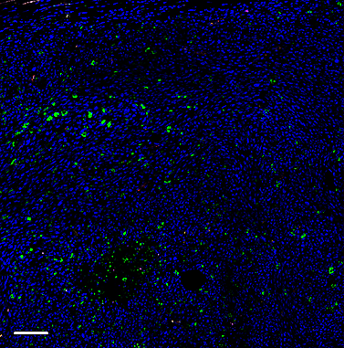
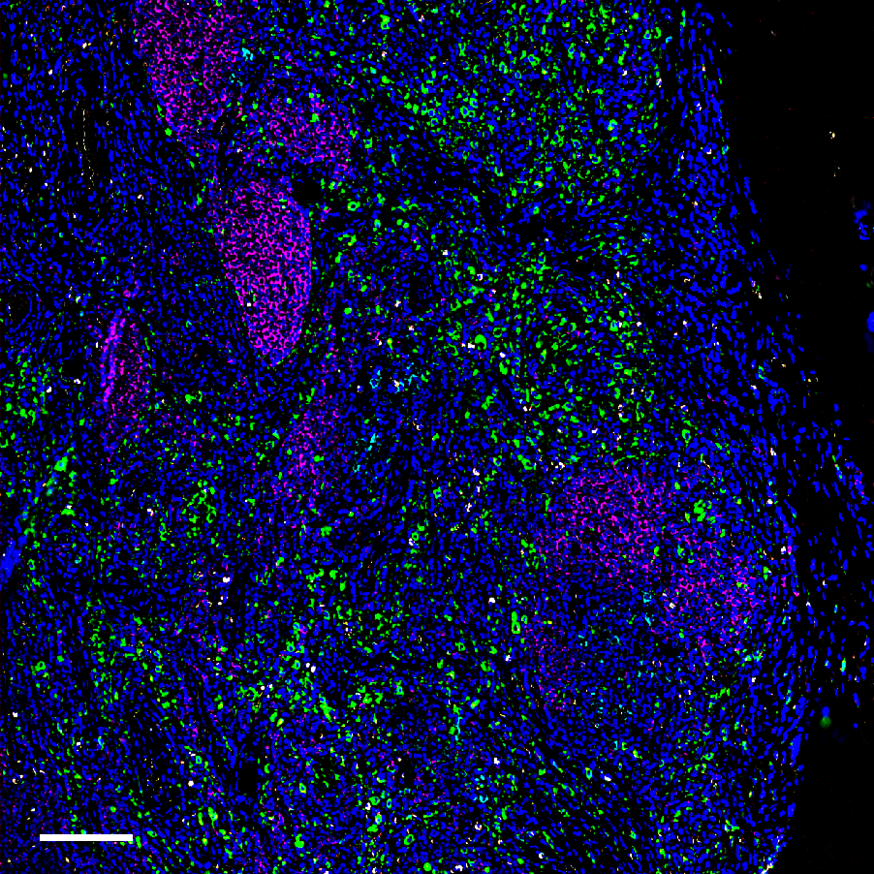
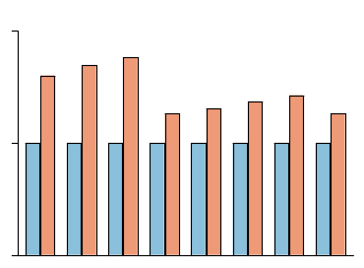
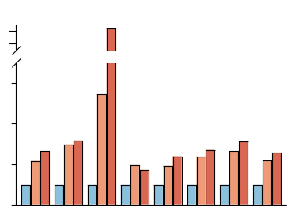
Supplementary Figure S4
A
B
Before ICI
After ICI
Before ICI
After ICI
2
3
Region Number
2
1
1
C
D
Before ICI
After ICI
Before ICI
After ICI
Region
1.2
Region
2.0
CD4
0.767 | 1.233
0.741 | 1.259
0.723 | 1.278
0.883 | 1.117
0.864 | 1.136
0.842 | 1.158
0.823 | 1.177
0.883 | 1.117
50.41 | 49.59
1.2
CD4
0.513 | 1.118 | 1.369
0.418 | 1.251 | 1.331
0.097 | 0.532 | 2.371
0.637 | 1.257 | 1.106
0.561 | 1.088 | 1.352
0.490 | 1.173 | 1.337
0.441 | 1.174 | 1.385
0.520 | 1.138 | 1.342
42.3 | 45.27 | 12.43
2.0
CD4
CD4
CD8
CD8
CD8
1.0
CD8
1.6
CD20
1.1
CD20
1.5
CD20
0.8
CD20
1.2
CD68
CD68
CD68
CD68
Fold Change
MARCO
1.0
MARCO
1.0
MARCO
0.6
MARCO
Fold Change
0.4
0.8
PD1
0.9
PD1
0.5
PD1
PD1
0.4
PDL1
PDL1
PDL1
0.2
PDL1
MelanA
0.8
MelanA
0.0
MelanA
0.0
MelanA
0.0
Area (%)
Area (%)
1
2
1
2
3
Region
Region
E
Before ICI
After ICI
2
24
Region 1 / Region 1
22
Region 2 / Region 1
6
Region 3 / Region 1
Relative Density
1
4
2
0
CD4
CD8
CD20
CD68
PD1
PDL1
0
CD4
CD8
CD20
CD68
PD1
PDL1
MARCO
MelanA
MARCO
MelanA

