Slide 1
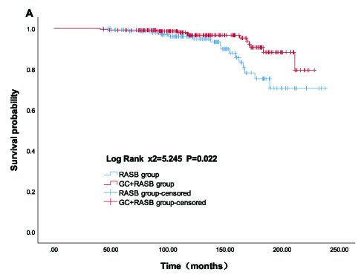
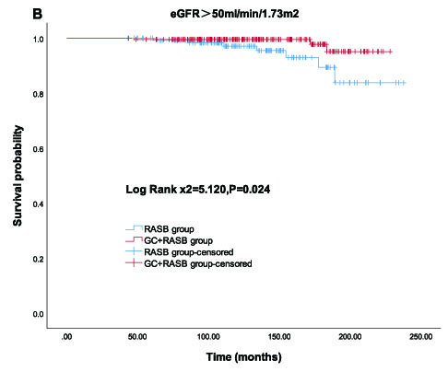
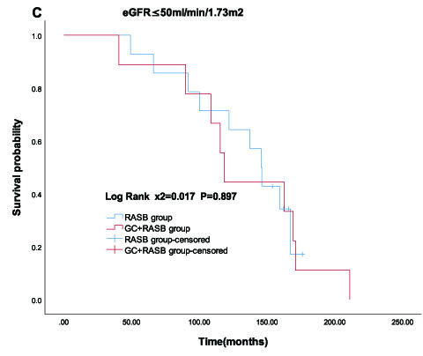
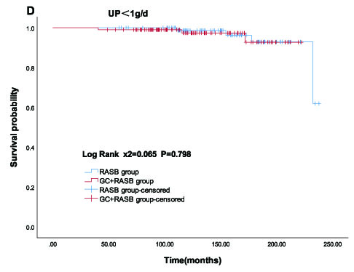
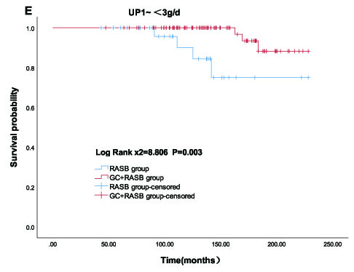
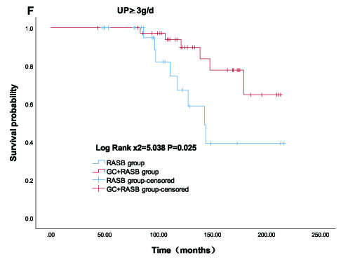
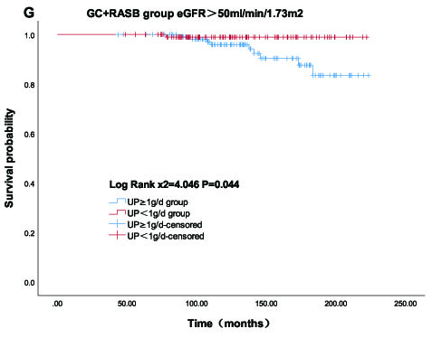
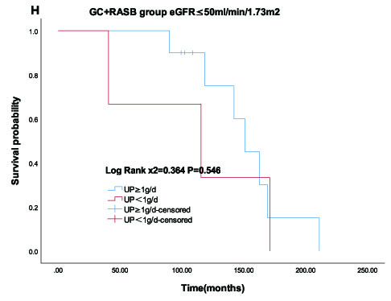
[Retrospective Analysis of Glucocorticoid Therapy in Pediatric immunoglobulin A Nephropathy: Kidney Outcomes and Efficacy]
AIM: The study was conducted to analyze the efficacy and kidney outcomes of GC in the treatment of pediatric IgAN.
OUTCOMES
DESIGN
Inclusion criteria
-biopsy –proven IgA Nephropathy
-treatment with RAS blocker alone or glucocorticoid combined with RAS blocker 6 months
Endpoints
-a composite of 40% eGFR decrease of the baseline, kidney failure, and death caused by kidney disease
Kaplan-Meier survival curves comparing GC+RASB with RASB alone in pediatric IgA nephropathy.(A) Entire cohort. B) Stratified by initial eGFR＞50ml/min/1.73m2. (C) Stratified by initial eGFR ≤50ml/min/1.73m2. (D) Stratified by initial UP ＜1g/d. (E) Stratified by initial UP 1~＜3g/d. (F) Stratified by initial UP ≥3g/d. (G) GC+RASB group with initial eGFR > 50ml/min/1.73m², stratified by UP. (G) GC+RASB group with initial eGFR ≤50ml/min/1.73m², stratified by UP.
CONCLUSION: GC therapy reduced the risk of progression to kidney failure in children with initial eGFR >50 ml/min/1.73 m² and proteinuria ≥1 g/d. No additional kidney survival benefit was observed in children with eGFR ≤50 ml/min/1.73 m² or proteinuria <1 g/d.
-----
Wu et al. 2025

