Slide 1
Supplementary Figure S1
A
0.1% mutant
NM_000546.6(TP53): c.844C>A
A
0.002233
Measured ratio
T T C C G T
B
Ratio of DNA added (mutant : wild type)
added DNA | measured DNA
100.00% | 0.994981
10.00% | 0.117648
1.00% | 0.013485
0.10% | 0.003177
Measured ratio
(mutant : wild type)
R² = 0.9997
Deep sequencing performance for the reference variant NM_000546.6(TP53): c.844C>A. (A) Each bar indicates the frequency of correct and erroneous nucleotides from sequencing within the region of the reference variant. The mean background error per base was 9.2 × 10⁻⁴, and the upper limit of the 99% confidence interval of the background error was 2.23 × 10⁻³ (dotted plane). A variant was considered correct when the frequency of variants was more than 2.23 × 10⁻³. The measured frequency of the 0.1% reference variant was 3.17 × 10⁻³, which was higher than upper limit of background errors, showing that the variant was detected. (B) High degree of linearity between the added and measured ratio of variants.

Slide 2
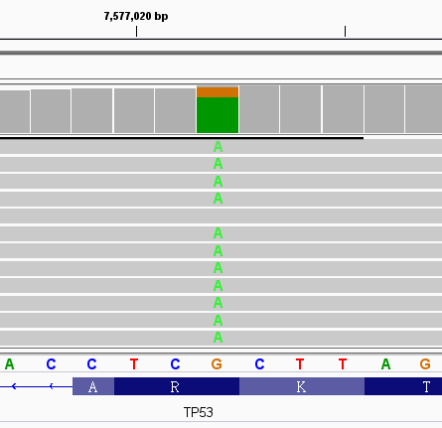
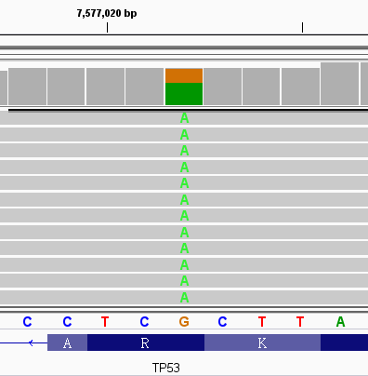
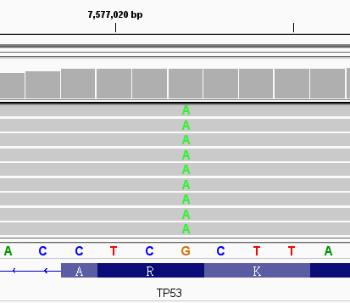
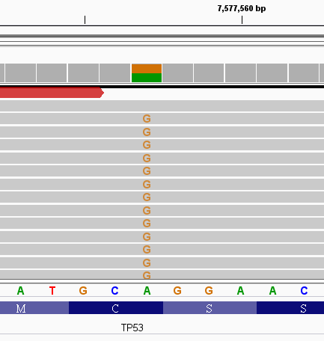
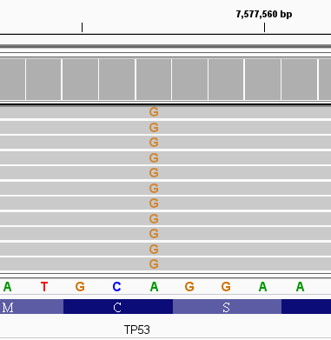
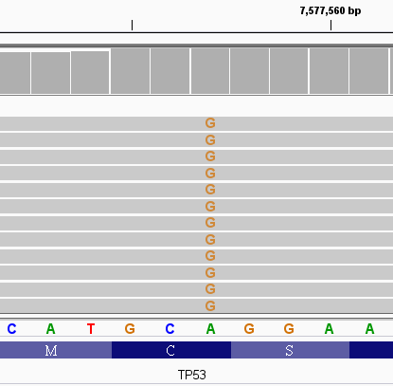
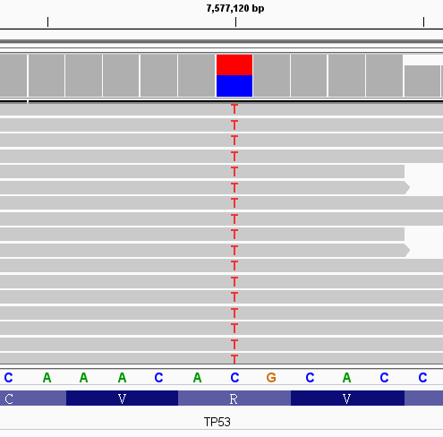
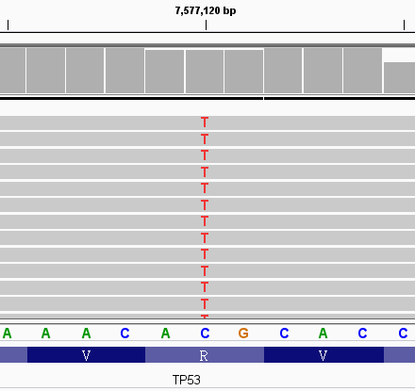
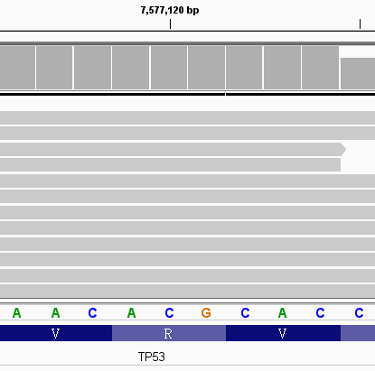
Supplementary Figure S2
Tumor
Before NAT
After NAT
Patient #8 : TP53:NM_000546: c.916C>T, p.Arg306* (NC_000017.10:g.7577022G>A)
Patient #91: TP53:NM_000546: c.724T>C,p.Cys242Arg (NC_000017.10:g.7577557A>G)
Patient #45: TP53:NM_000546: c.818G>A, p.Arg273His (NC_000017.10:g. g.7577120C>T)

Slide 3
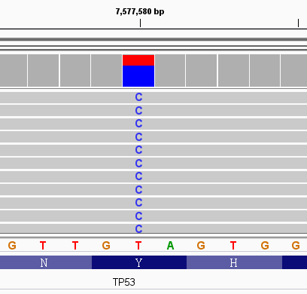
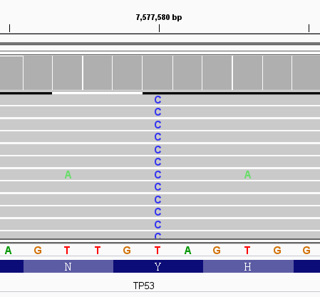
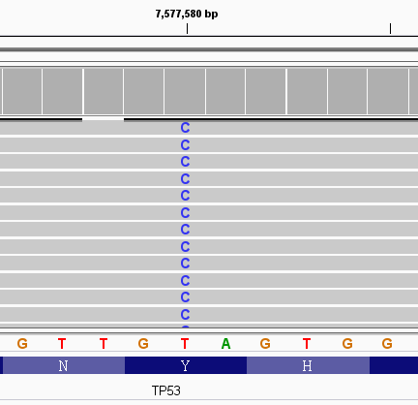
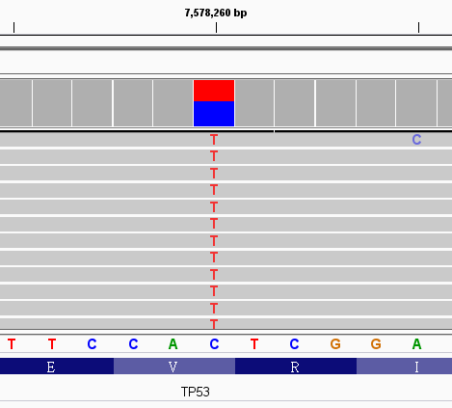
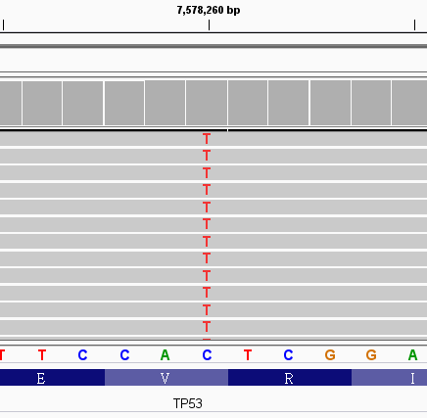
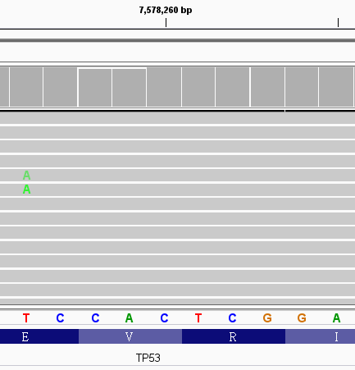
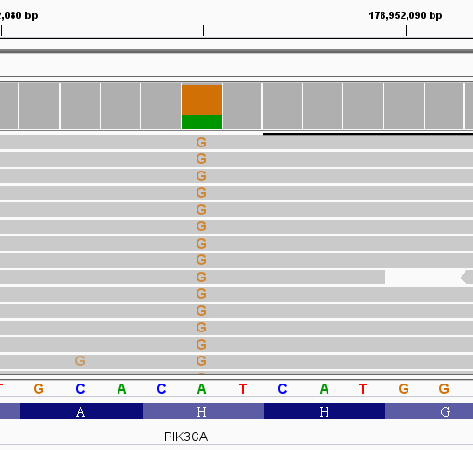
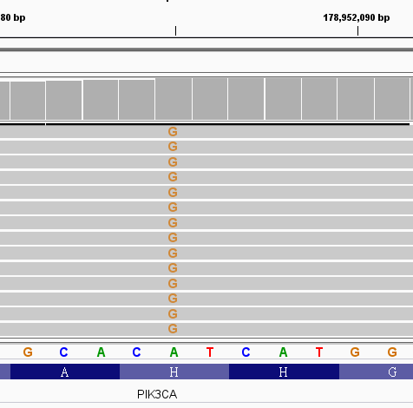
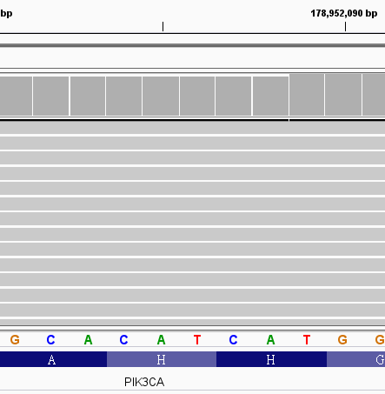
Supplementary Figure S2 (continued)
Tumor
Before NAT
After NAT
Patient #27: Her2 and c-MYC amplification
c-Myc
Her2
c-Myc
c-Myc
Copy number
Her2
Her2
Patient #27: TP53:NM_000546: c.701A>G, p.Tyr234Cys (NC_000017.10:g. 7577580T>C)
Patient #83: TP53:NM_000546: c.589G>A, p.Val197Met (NC_000017.10:g. 7578260C>T)
Patient #83: PIK3CA:c.3140A>G, p.His1047Arg (NC_000003.11:g.178952085A>G)

Slide 4
Supplementary Figure S2 (continued)
Illustration of the genetic alterations in DNA of breast tumor, ctDNA before NAT and ctDNA after NAT. We selected 5 patients who had TP53 variants in their ctDNA and their biopsy tumors were available for DNA extraction. We performed NGS on the DNA of the biopsy tumor to check whether the TP53 variants that were detected in ctDNA existed in the DNA of breast tumors. If the TP53 variant could be parallel identified in the DNA of the breast tumor and ctDNA, we could confirm that the source of the genetic variants detected in the ctDNA originated from breast tumors.
The TP53 gene variants of patients #8 and #91 were detected in DNA of breast tumors, ctDNA before and after NAT. These results suggest that the TP53 variants in the ctDNA came from breast cancer cells. The presence of ctDNA after NAT was related to a high risk of recurrence; accordingly, both patients experienced recurrence.
For patient #45, the source of the TP53 variant (TP53:NM_000546: c.818G>A) was detected both in DNA of breast tumors and the ctDNA before NAT, suggesting the variants of ctDNA originating from breast tumor. The variant was not identified in the ctDNA after NAT. She did not experience recurrence.
Patients #27 and #83 had more than one genetic alteration in their tumors; these mutations have the potential to be biomarkers for the presence of ctDNA. Patient #27 had Her2 and c-MYC amplification in the breast tumor, ctDNA before and after NAT. The tumor DNA also contained the mutation TP53:NM_000546: c.701A>G, and this variant also observed in ctDNA before and after NAT. Patient #27 experienced recurrence. Patient #83 had variants in the TP53 and PIK3CA genes in tumor cells. Both variants were identified in ctDNA before NAT but not after NAT. Patient #83 did not experience recurrence. The data show good concordance between TP53 variants and other genetic alterations in ctDNA.

Slide 5
Supplementary Figure S3
p = 0.104
Tumor size, cm
The difference of tumor size in patients with or without ctDNA before NAT.

Slide 6
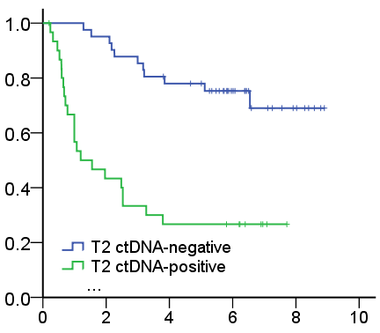
Supplementary Figure S4
Recurrence-free survival
p < 0.001
Years
ctDNA positivity after NAT was significantly associated with RFS among 72 patients with detectable genetic variants before and after NAT, p < 0.001.

Slide 7
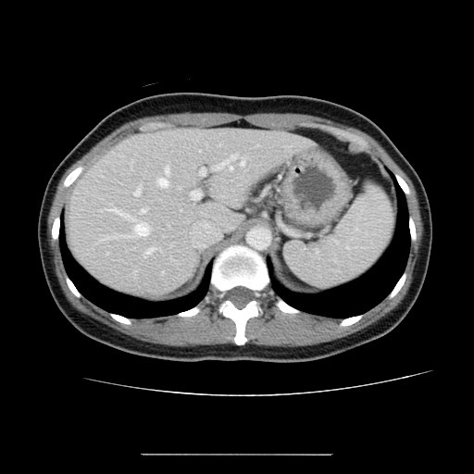
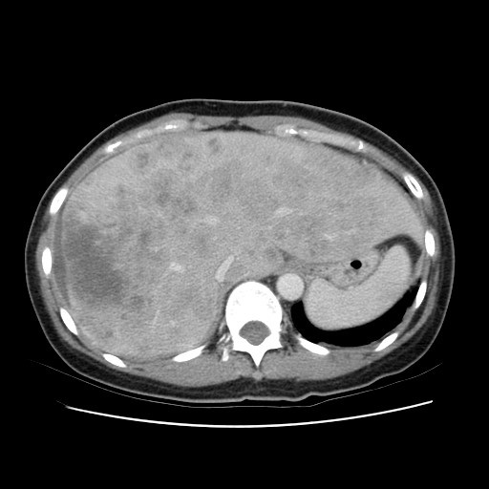
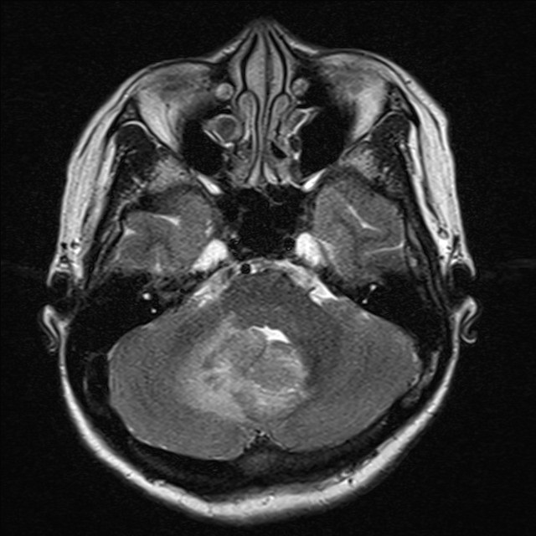
Supplementary Figure S5
A
Before NAT
After NAT
case #50
B
case #5
For case #50, staging computed tomography (CT) showed no hepatic metastasis before NAT; however, follow-up CT revealed multiple hepatic metastases 6 months after NAT. Case #5 did not have neurologic symptoms before NAT. However, unsteady gait occurred 13 months after NAT, and magnetic resonance imaging found cerebellar metastasis.

