Slide 1
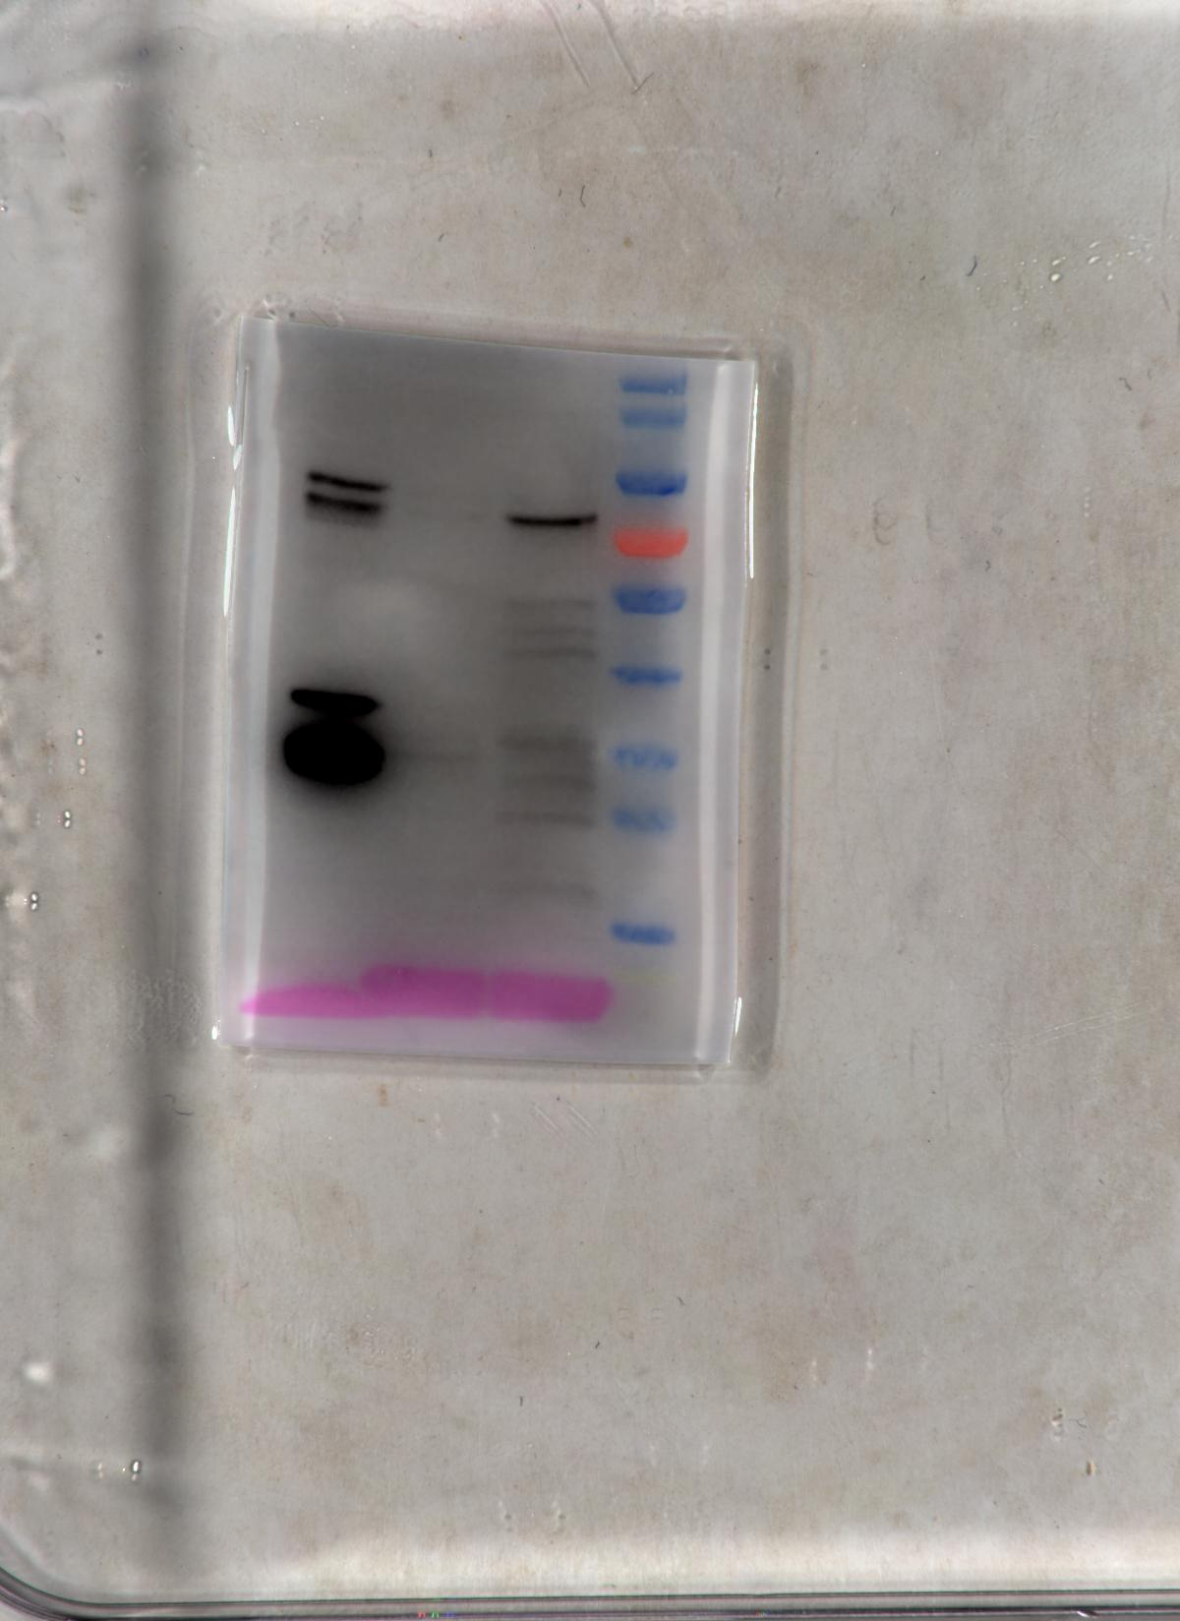
Figure 1
1b
Total protein
Cytosol
ER
MoSur2-GFP
70 KDa
GFP
26 KDa

Slide 2
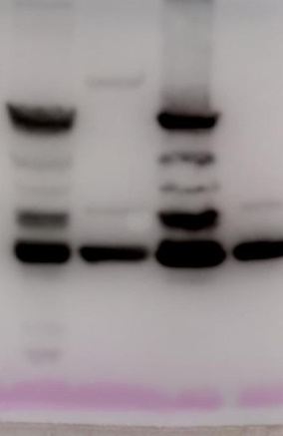
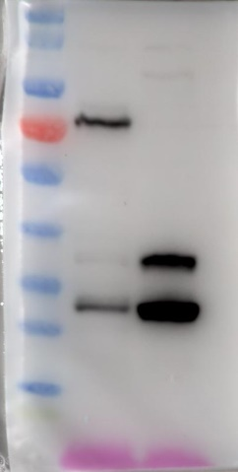
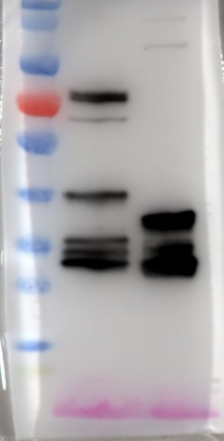
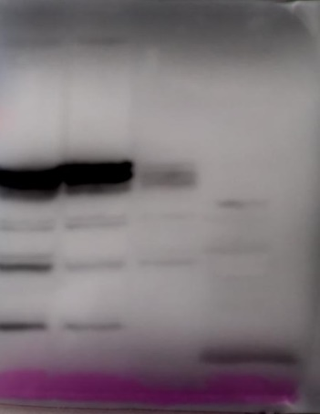
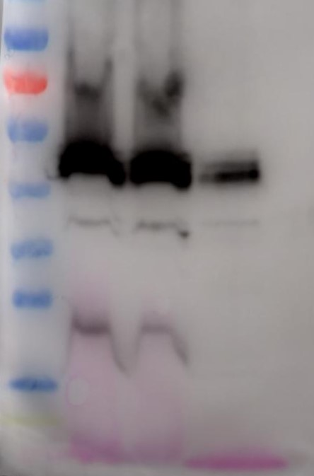
Figure 2
a
IP:GFP
Input
b
GFP
−
+
−
+
Input
IP:GFP
+
+
GFP
−
+
−
+
MoTsc10-GFP
−
−
+
+
MoSpt2-GFP
−
−
+
+
+
+
MoSur2-Flag
+
+
+
+
MoSur2-Flag
65KDa−
MoSpt2-GFP
47 KDa−
MoTsc10-GFP
26 KDa−
GFP
27 KDa−
GFP
26 KDa−
MoSur2-Flag
26 KDa−
MoSur2-Flag

Slide 3
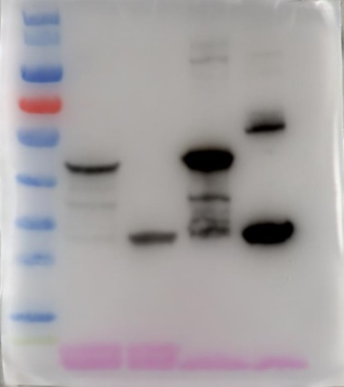
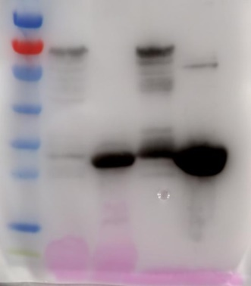
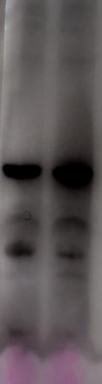
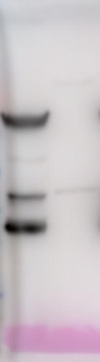
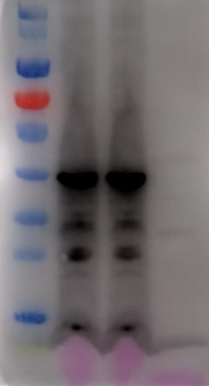
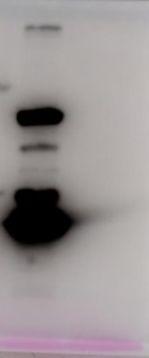
Figure 2
e
f
Input
Output
Input
Output
GST
−
+
−
+
GST
−
+
−
+
+
+
−
MoSpt2-GST
+
−
+
−
MoTsc10-GST
−
MoSur2-His
+
+
+
+
MoSur2-His
+
+
+
+
65 KDa−
MoSpt2-GST
47 KDa−
MoTsc10-GST
26 KDa−
GST
26 KDa−
GST
47 KDa−
MoSur2-His
47 KDa−
MoSur2-His

Slide 4
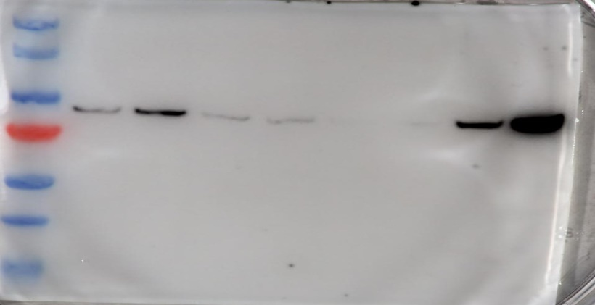
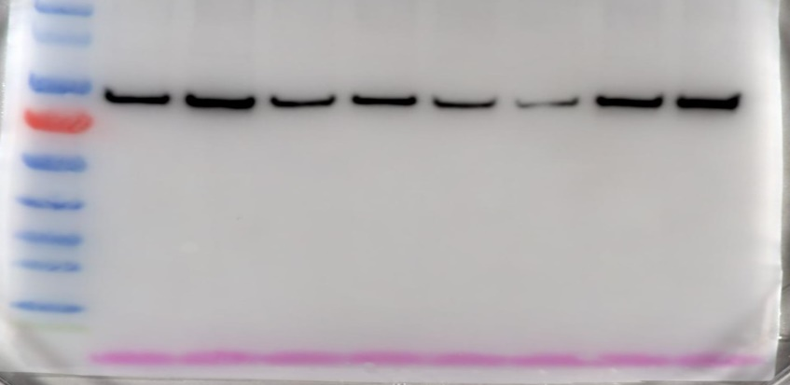
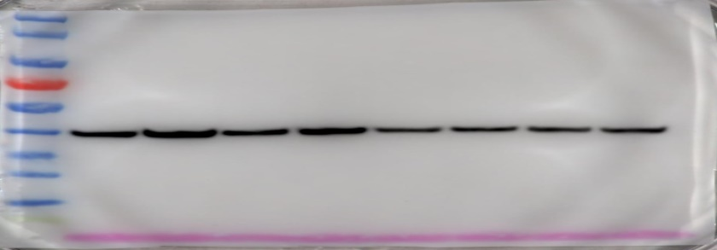
Figure 5 f
Guy11
∆Mosur2
Myr
0
30
60
90
0
30
60
90
(min)
95KDa
p-MoYpk1
95KDa
MoYpk1
40KDa
GAPDH

Slide 5
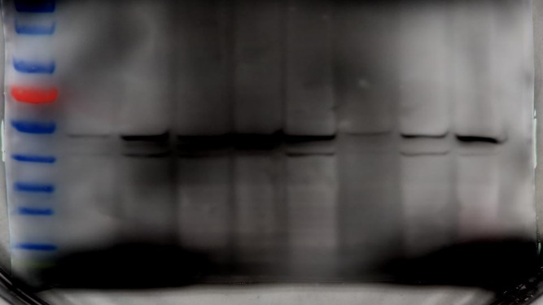
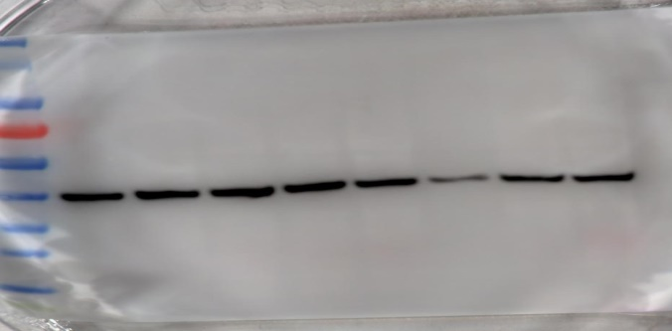
Figure 7 c
Guy11
∆Mosur2
CR
60
0
60
90
0
30
90
30
(min)
47 KDa
p-MoMps1
47 KDa
MoMps1
GAPDH
40 KDa

Slide 6
Figure S5 b
2.4 kbp
Recombinational DNA
1.0 kbp
Tubulin
0.5 kbp
Target gene
Marker
Guy11
∆Mosur2
Marker
Guy11
∆Mosur2

