Slide 1
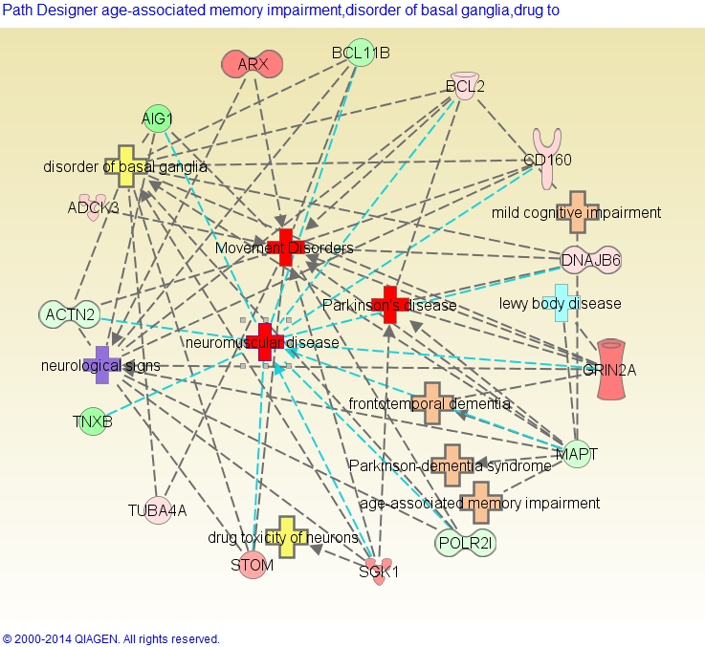
Figure S1. IPA® gene and function interconnection network of 15 genes with blood DML (P<0.0001) that are associated with PD and other similar disorders, as derived from the comparison of PD cases with Plantation Work 10+ vs 0 years.
Footnote: The DML genes are shown in capitals and either red (for hypermethylation) or green (for hypomethylation) icons. The shade of the filled color reflects the level of methylation (darker differing more from the average).

Slide 2
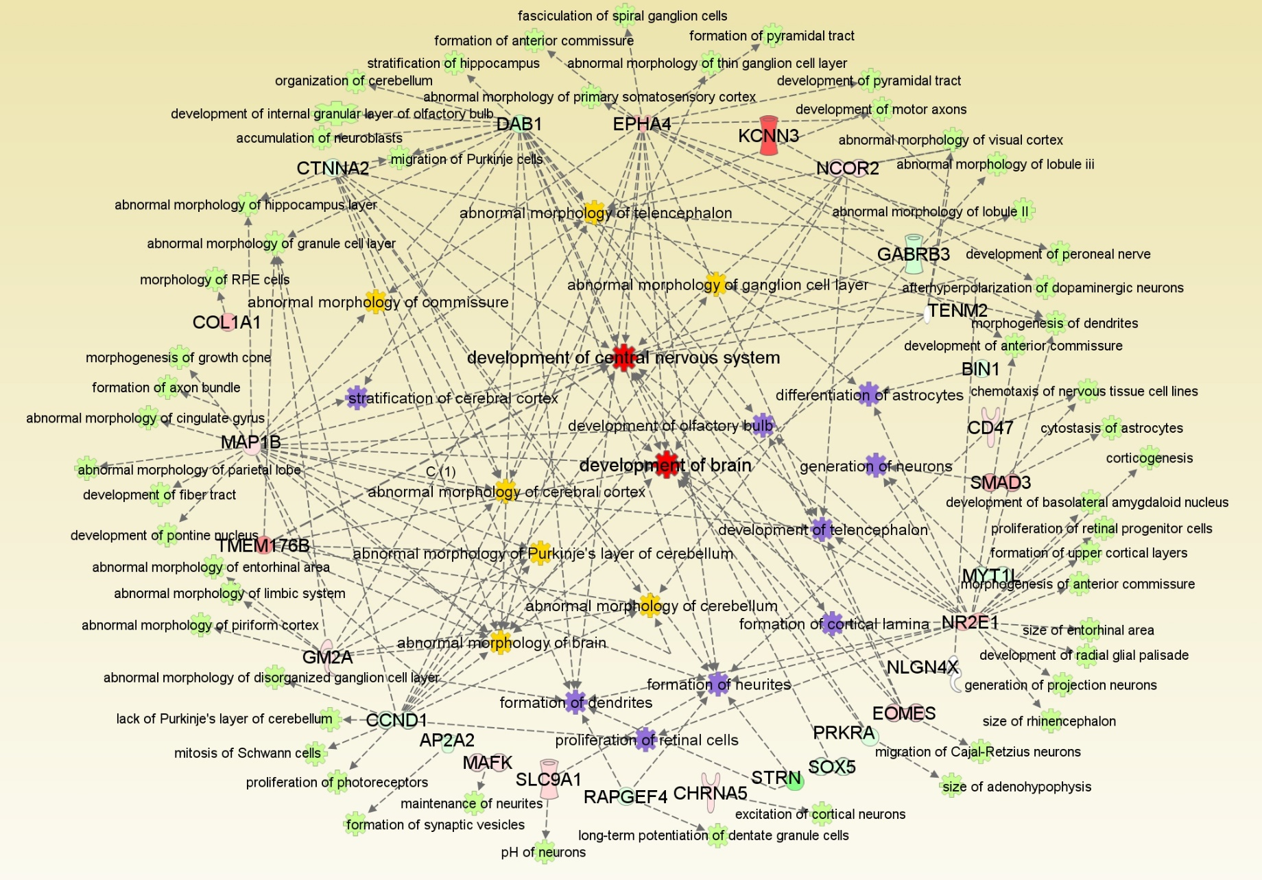
Figure S2. IPA® gene and function interconnection network of 27 genes with blood DML (p<0.001) that are associated with neurological development and abnormal brain morphology ,as derived from the comparison of PD cases with 4+ OGCs and vs 0-2 OGCs.
Footnote: The DML genes are shown in capitals and either red (for hypermethylation) or green (for hypomethylation) icons. The shade of the filled color reflects the level of methylation (darker differing more from the average).

