Slide 1
Supplementary Figure S1
MCF-7
ADSC #3
ADSC #4
NDUFS1
R0 R50
R0 R50
GAPDH
1.00 1.84 1.00 1.77

Slide 2

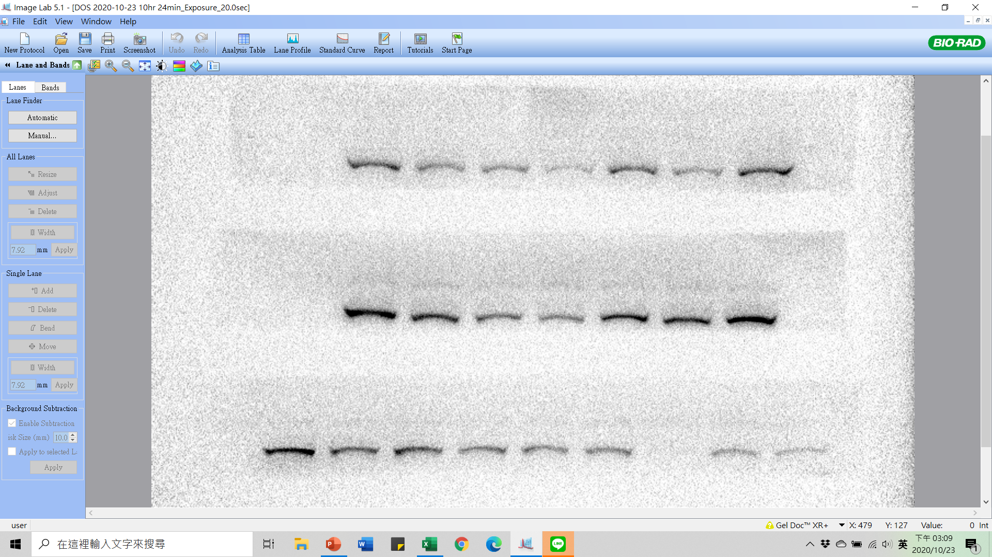
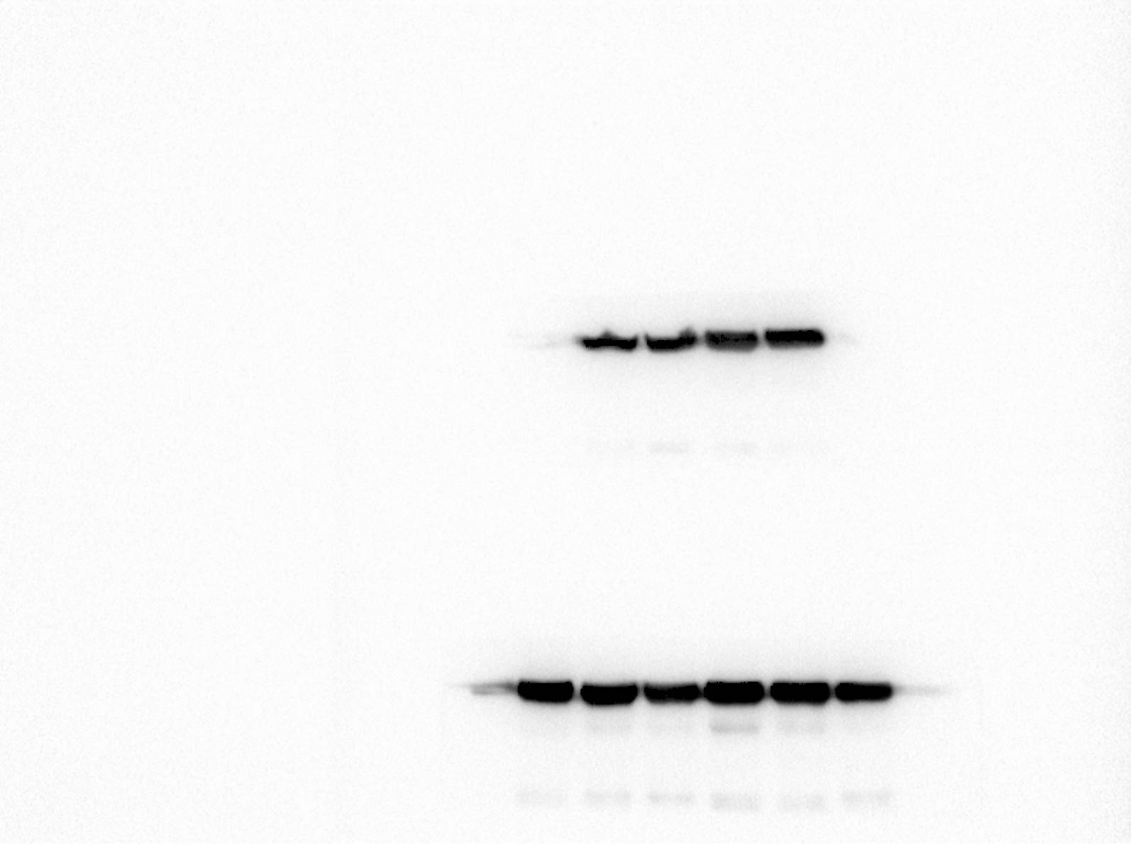
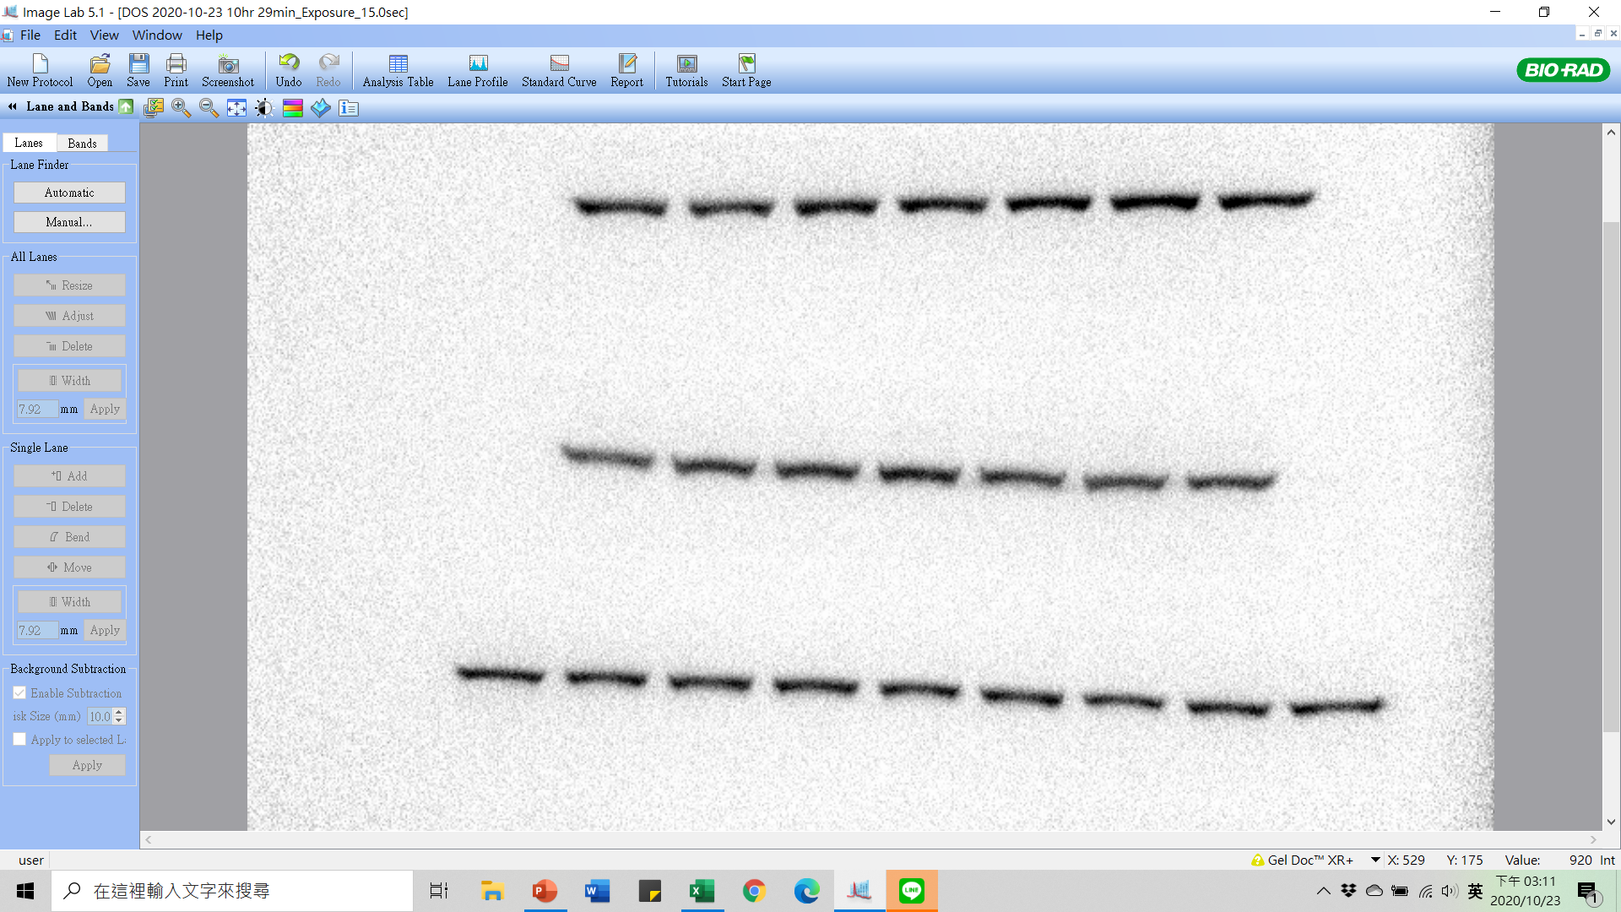
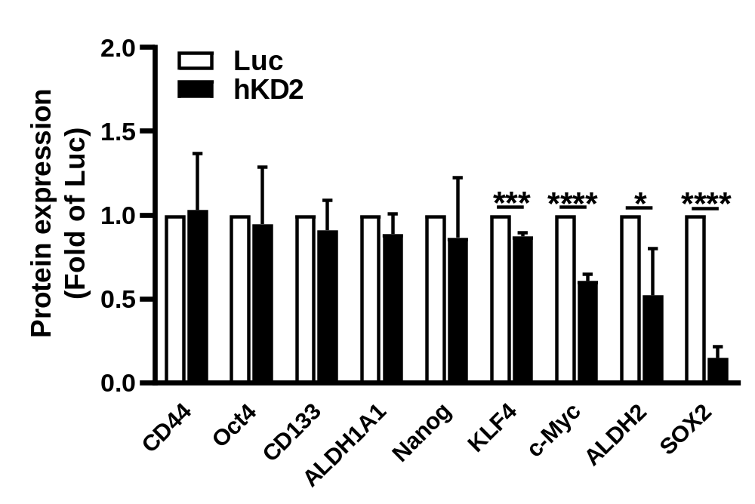
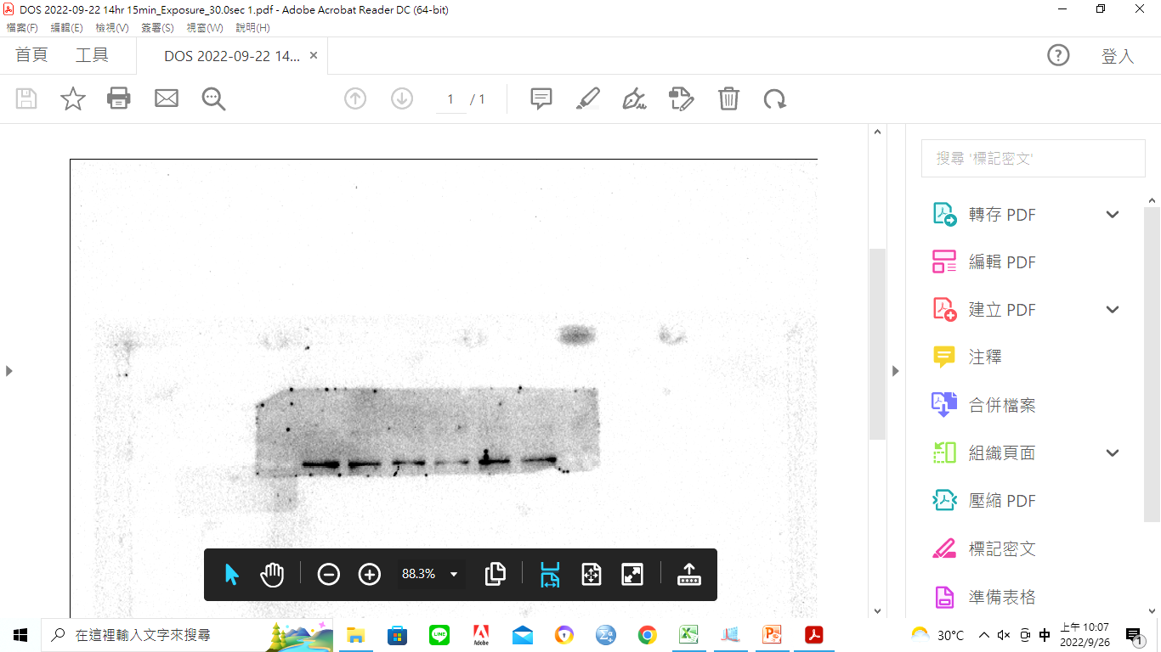
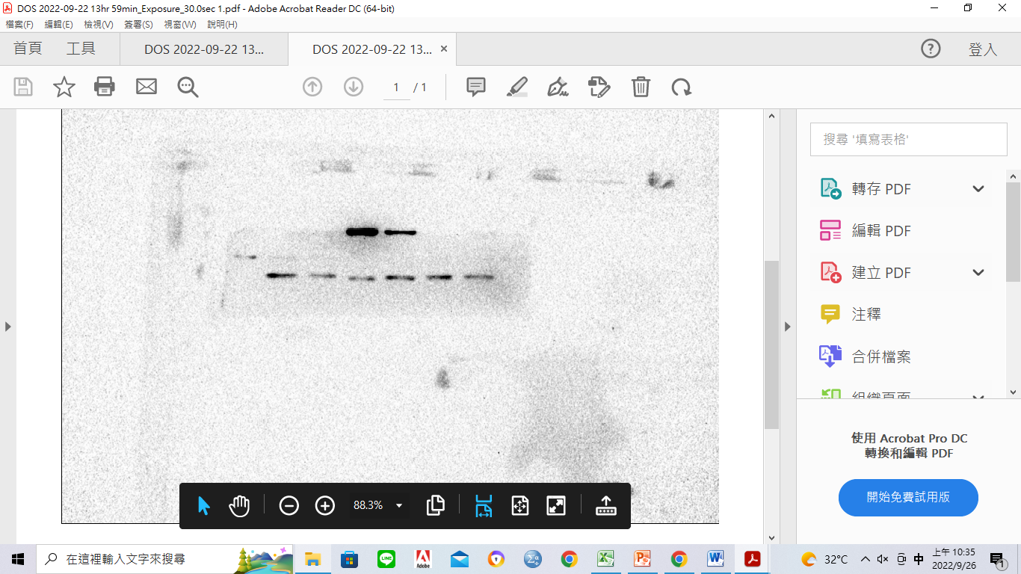
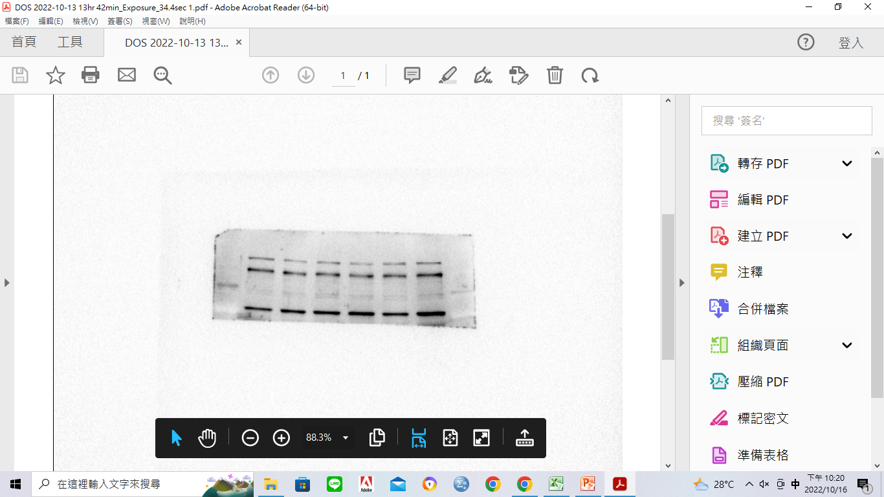
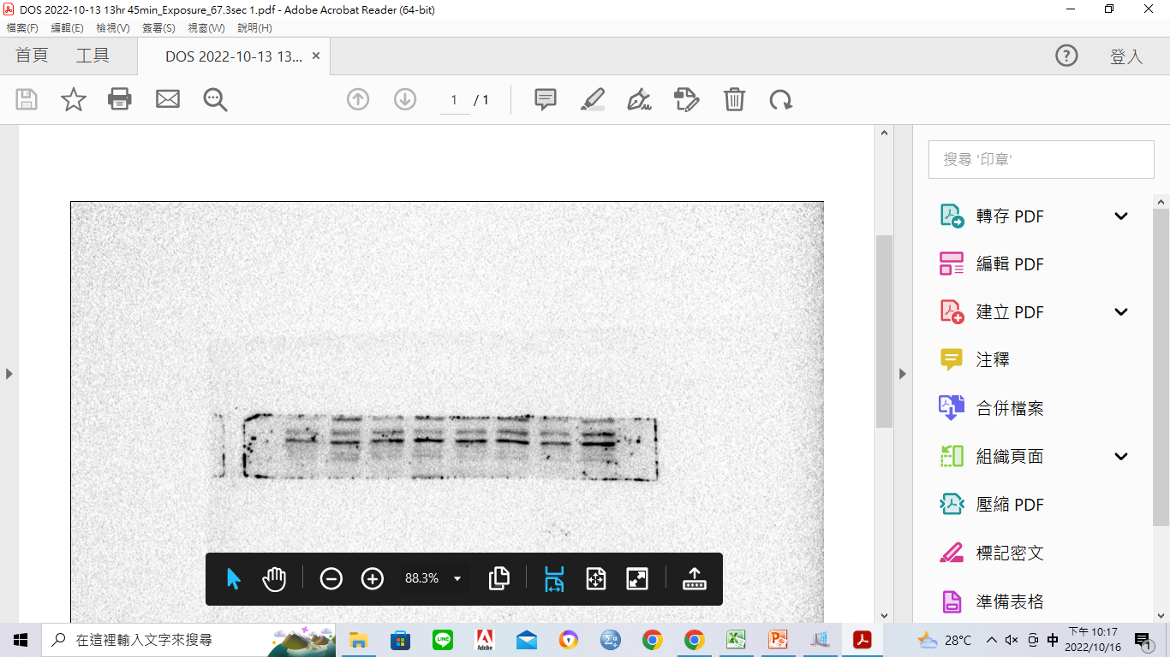
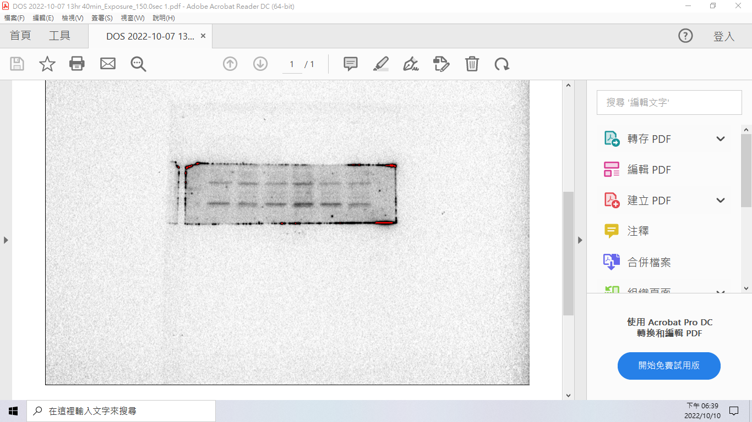
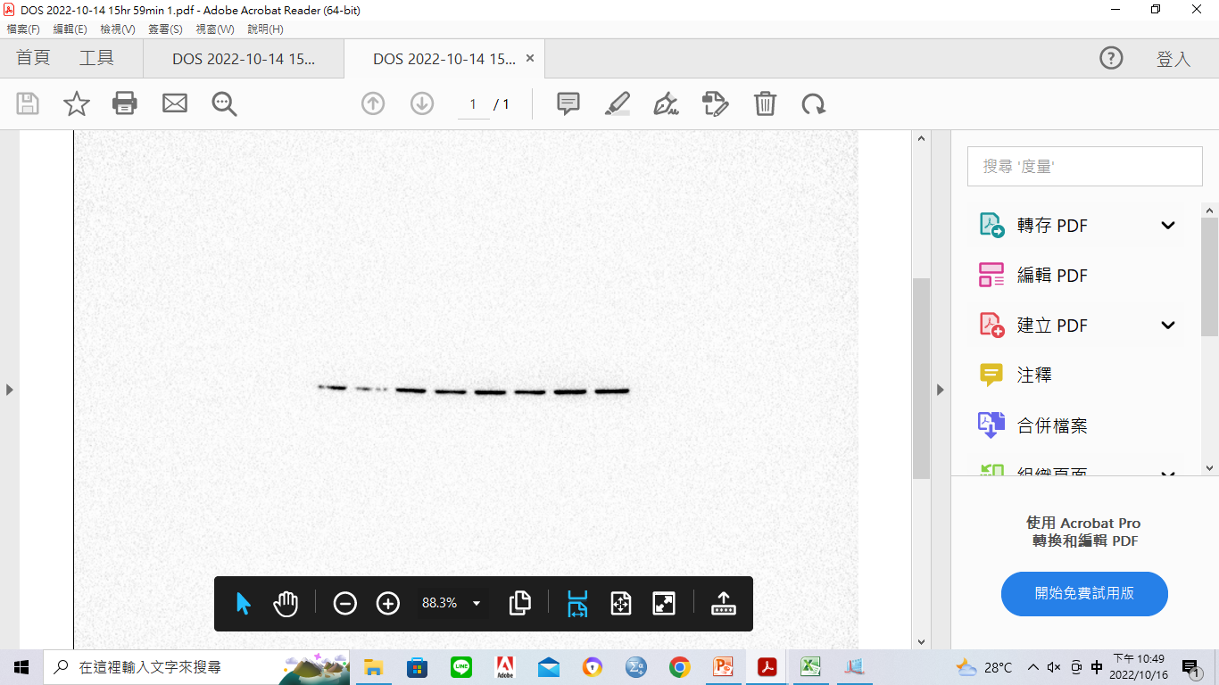
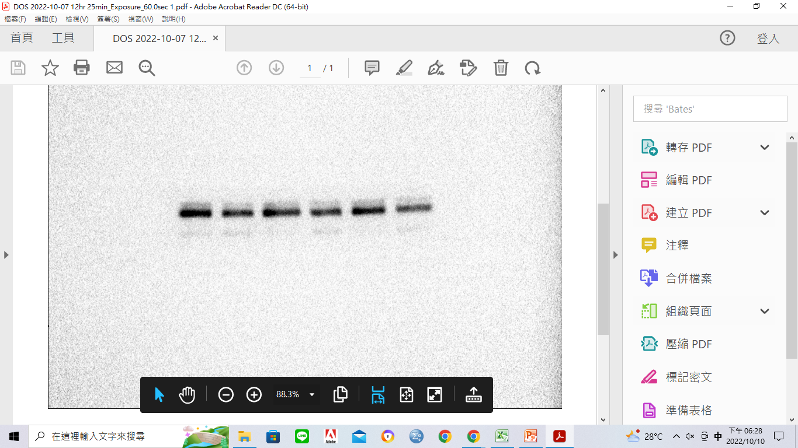
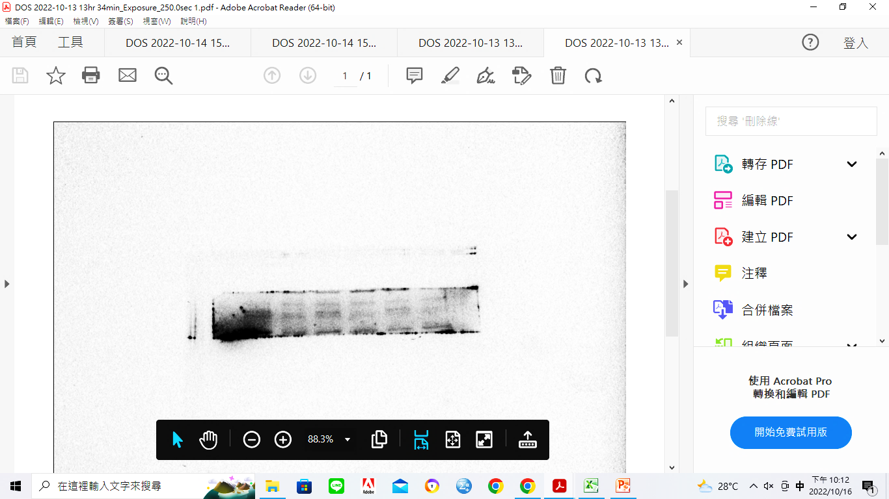
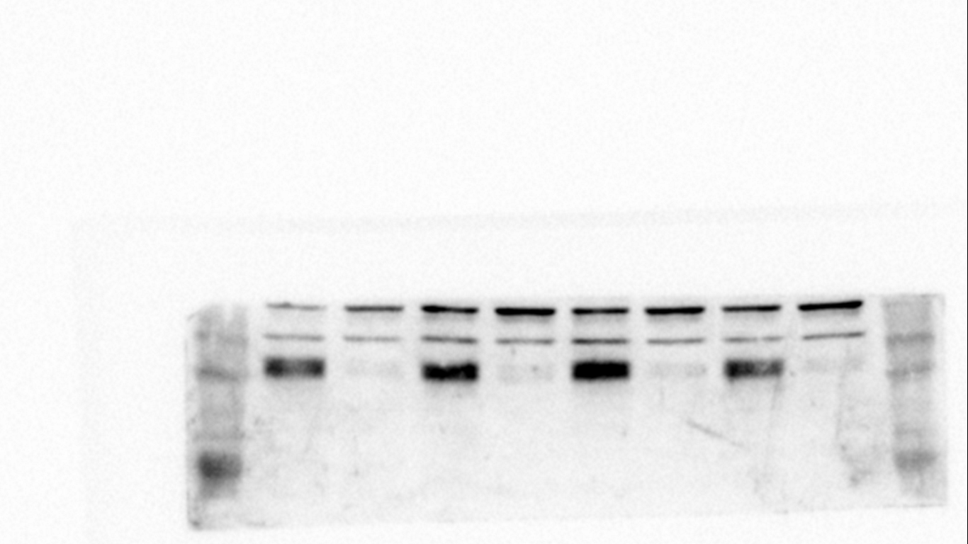
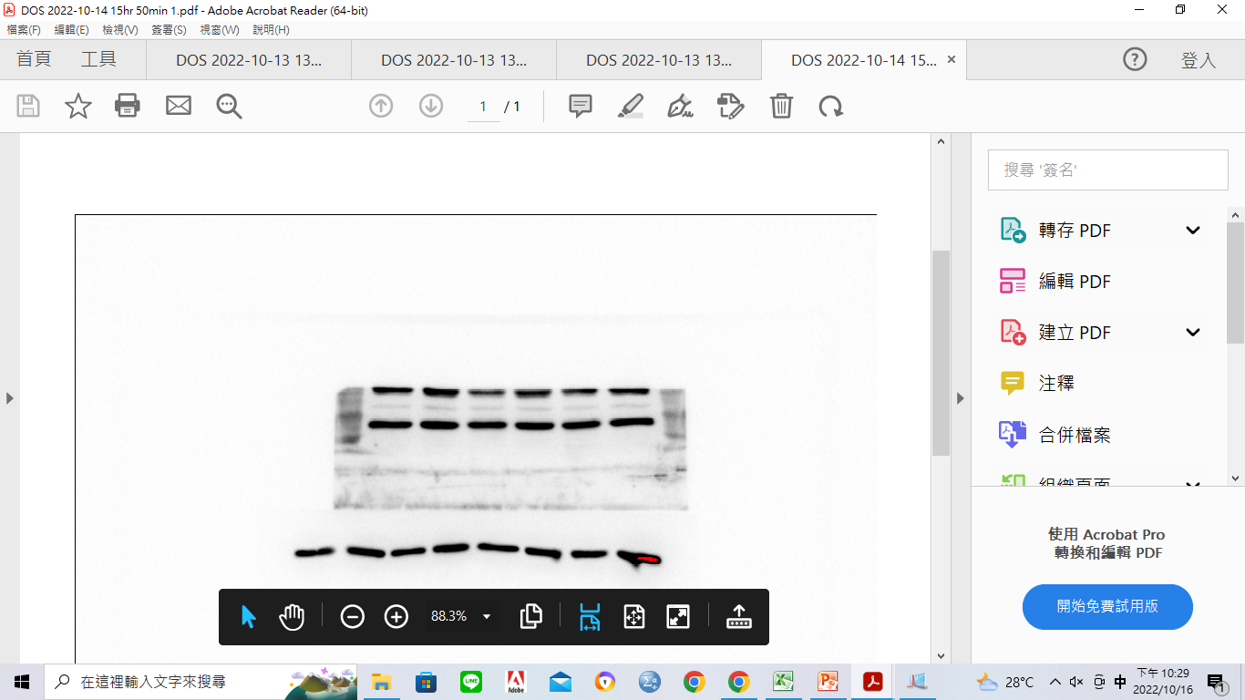
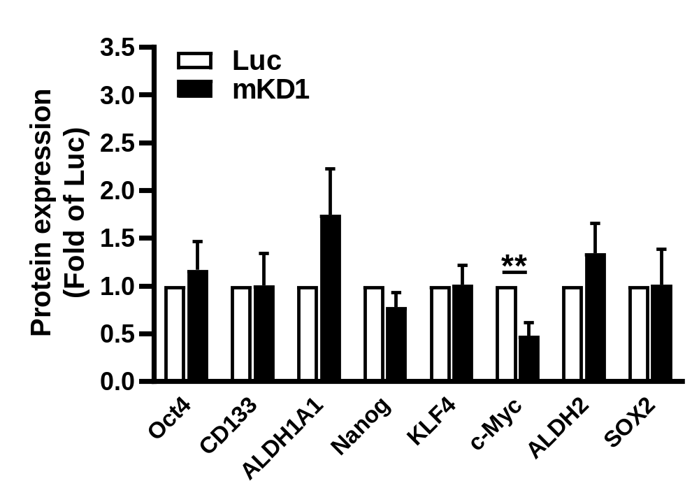
Supplementary Figure S2
A
B
MDA-MB-231
MCF-7
MDA-MB-231
H3 (hKD2)
H3 (hKD2)
ZR-75-1
T-47D
MCF-7
BT-549
Hs 578T
Luc
G3 (hKD1)
G3’
Luc
G3 (hKD1)
G3’
A4
E3
F3
A4
E3
F3
NDUFS1
1.00
0.51
0.40
0.40
0.17
0.25
NDUFS1
1.00 0.70 0.37 0.36 0.79 0.55 0.95
1.00 0.58 0.30 0.23 0.57 0.57 0.97
α-Tubulin
α-Tubulin
C
MCF-7
NDUFS1
Luc hKD2
CD44
Oct4
CD133
ALDH1A1
Nanog
KLF4
c-Myc
ALDH2
SOX2
GAPDH
D
4T1
NDUFS1
Luc mKD1
Oct4
CD133
ALDH1A1
Nanog
KLF4
c-Myc
ALDH2
SOX2
GAPDH

Slide 3
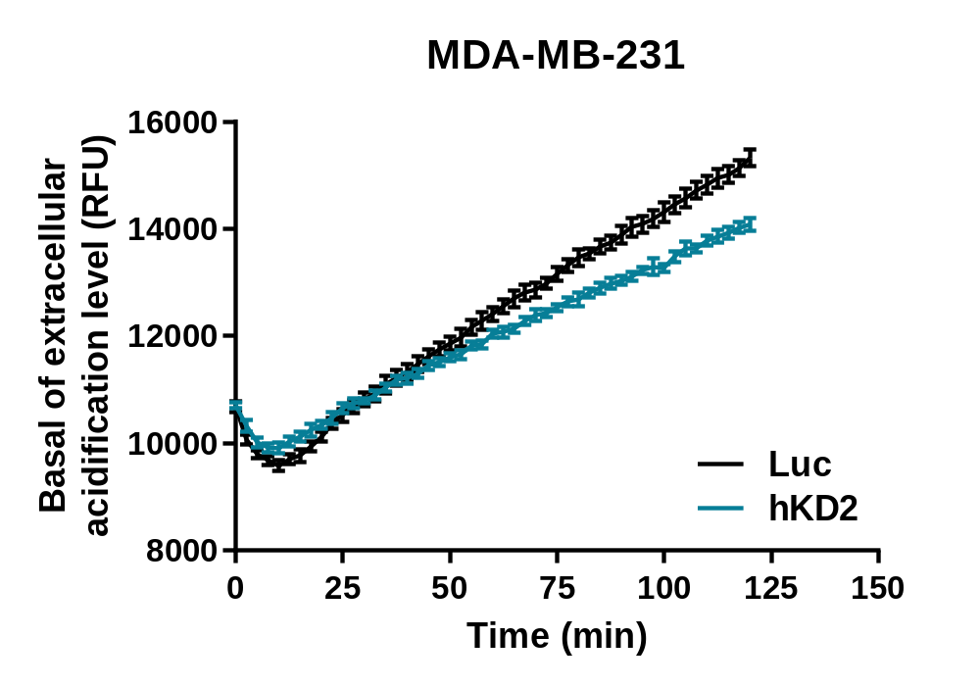
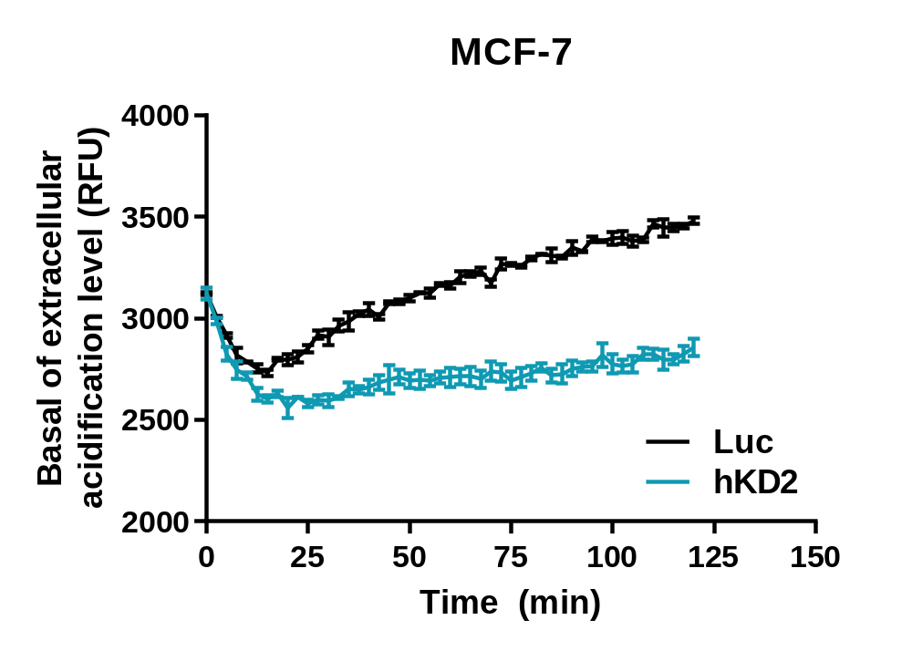
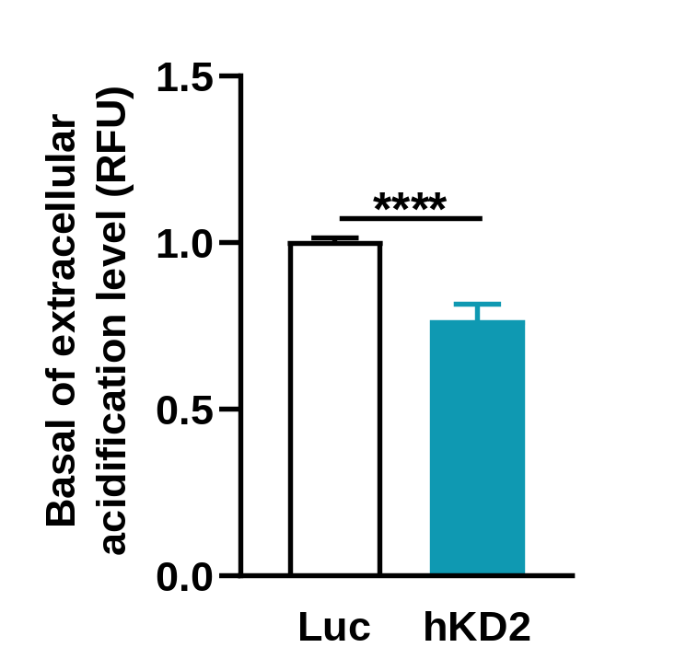
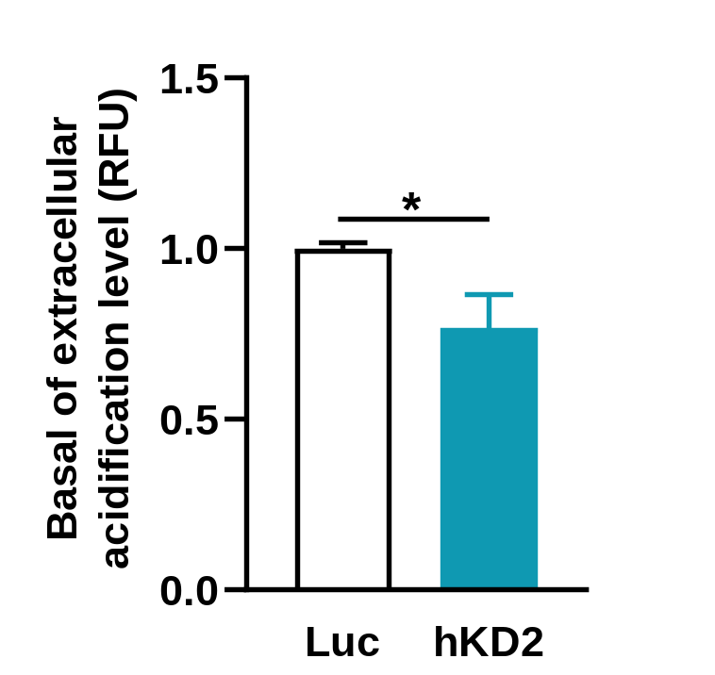
Supplementary Figure S3
Notes:
ECAR

Slide 4
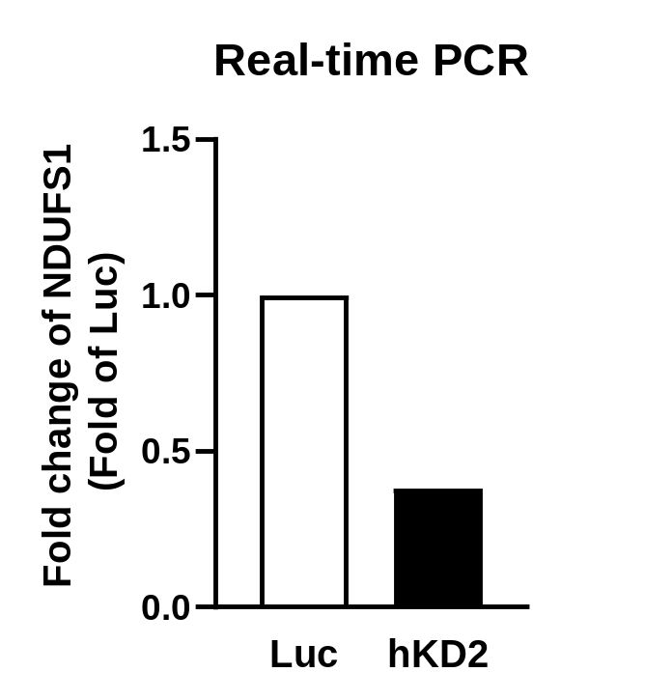
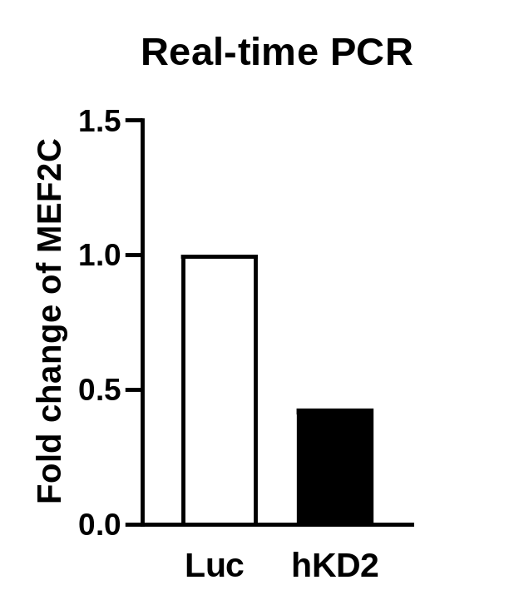
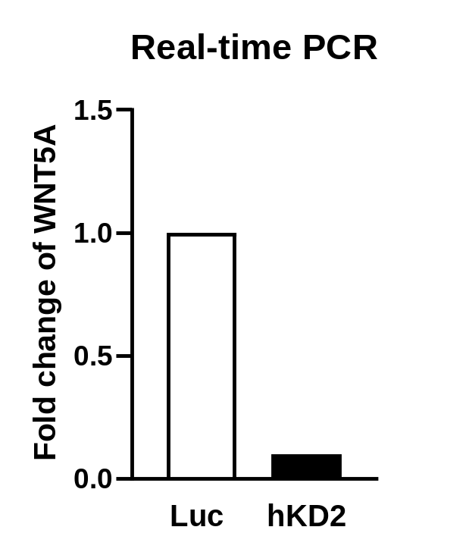
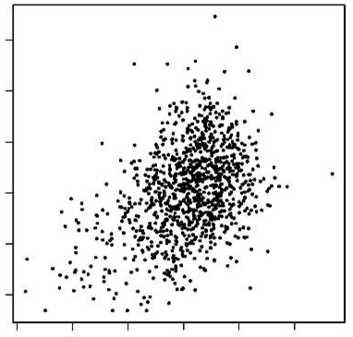
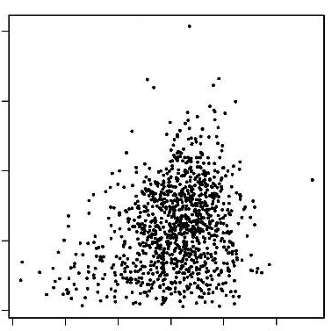
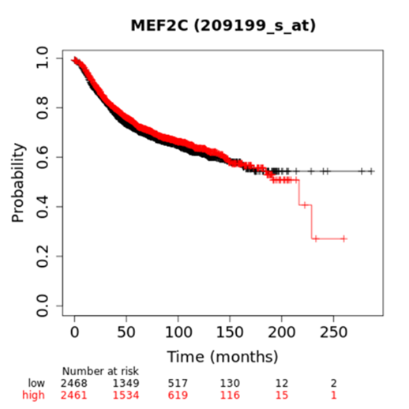
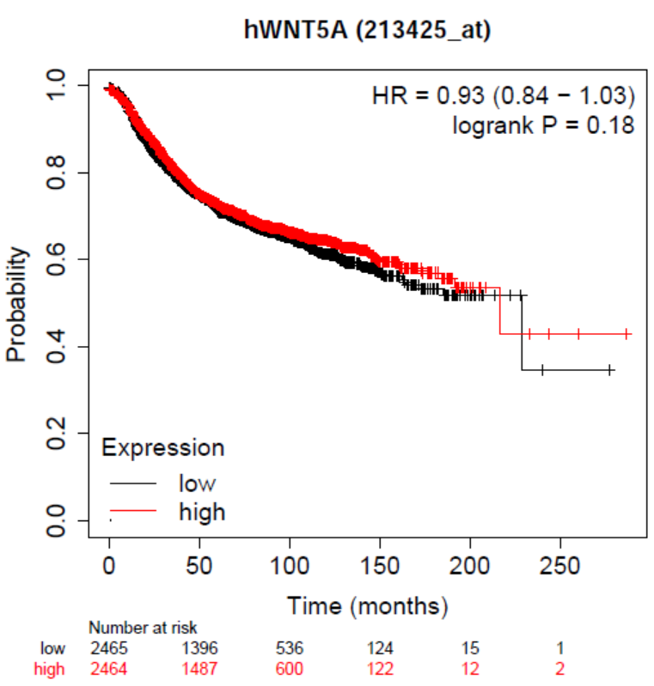
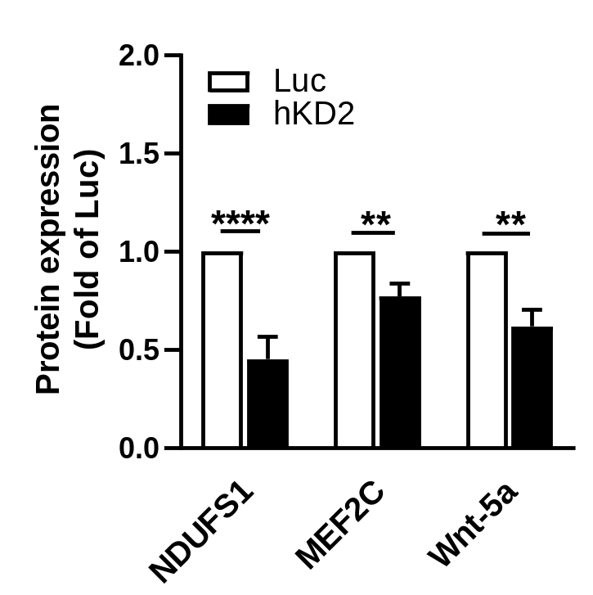
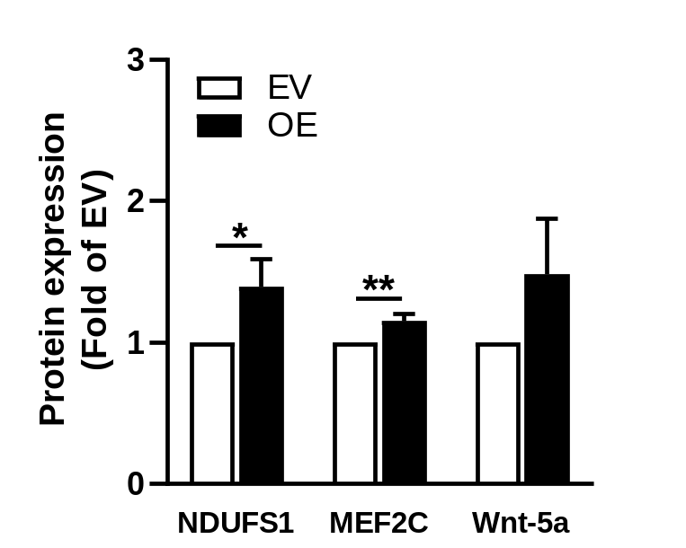
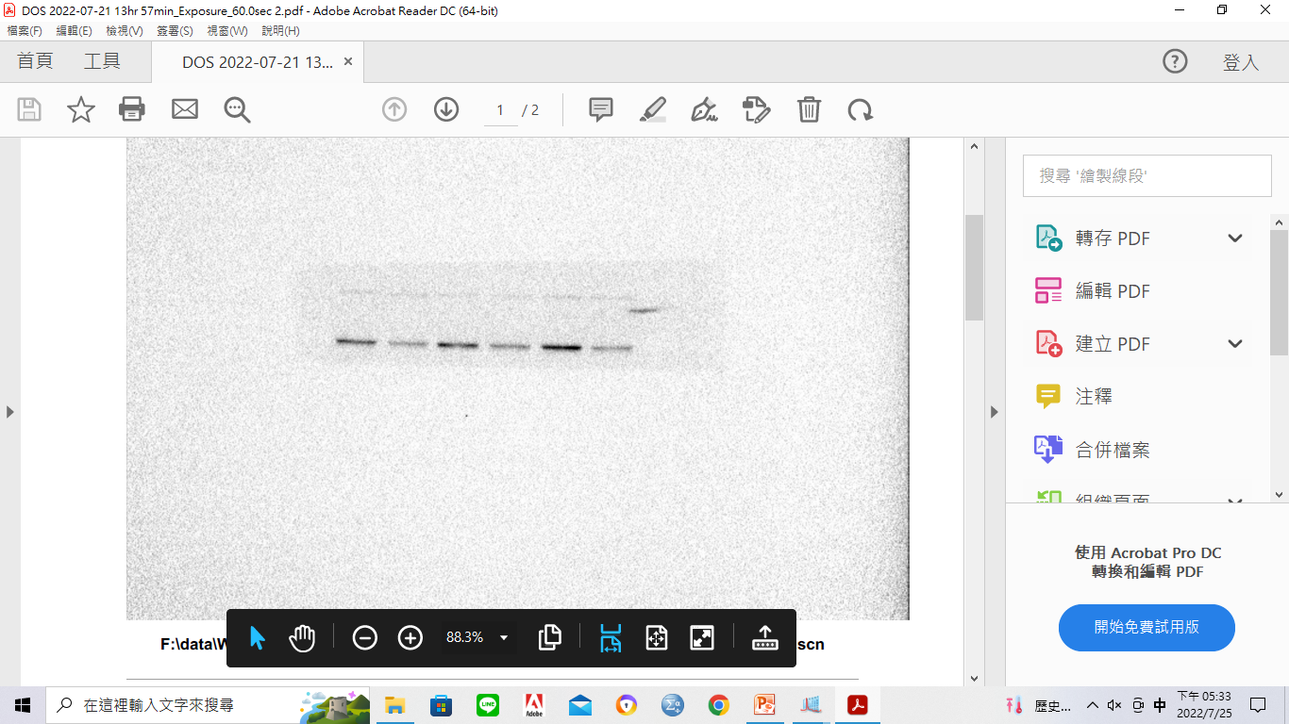
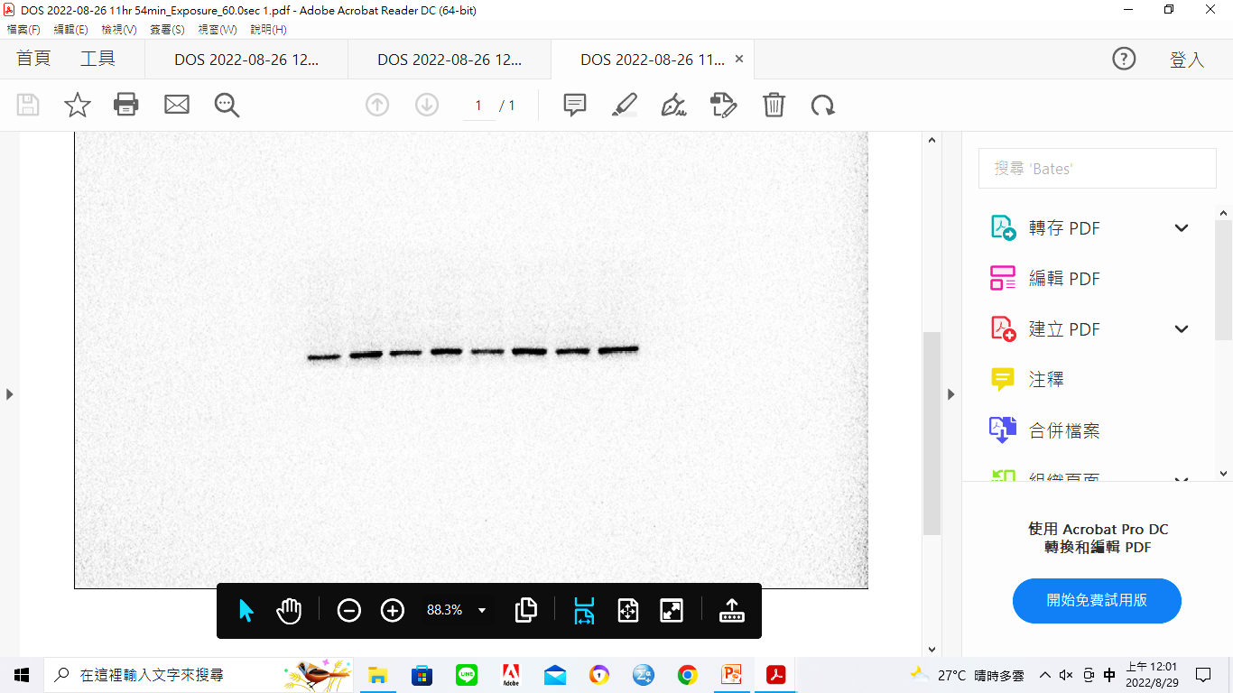
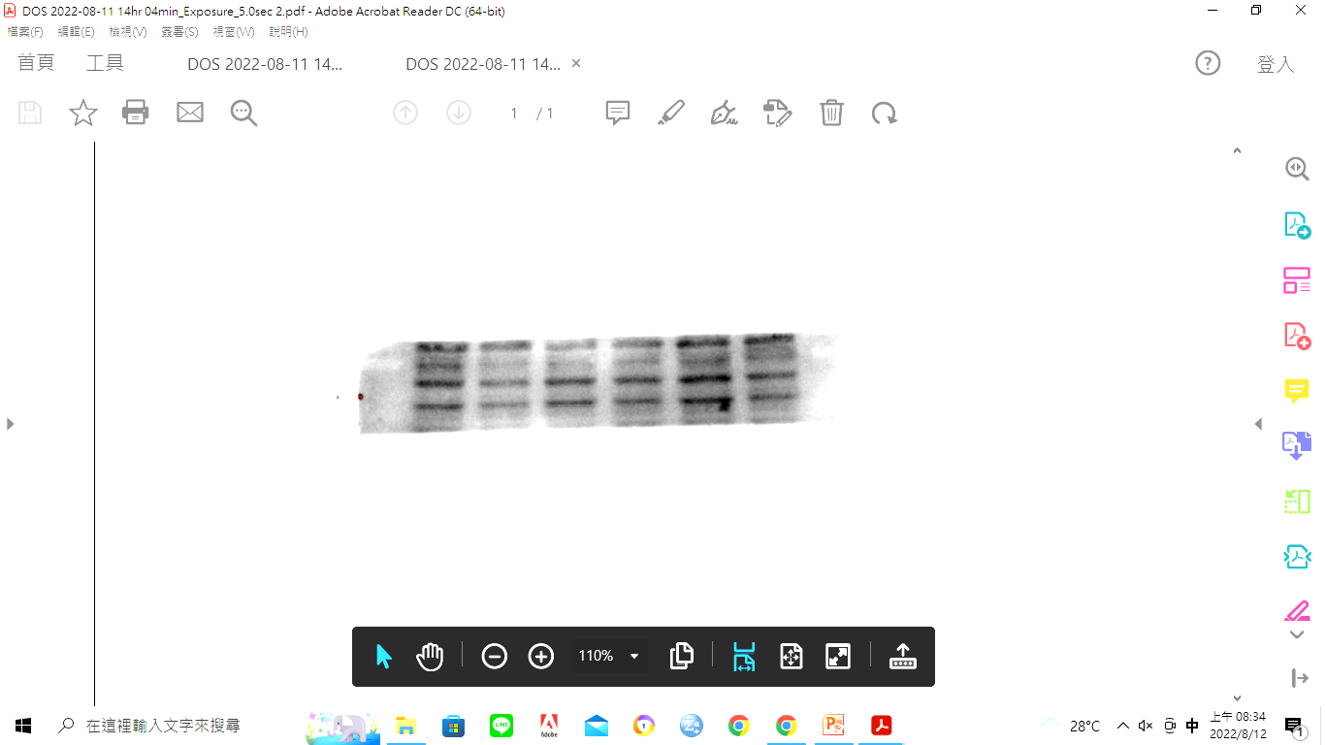
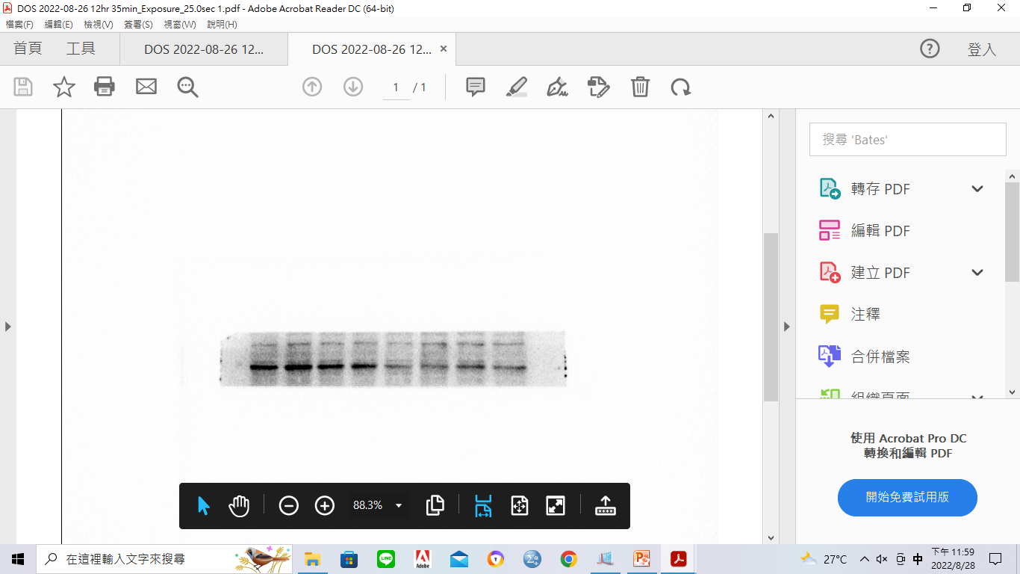
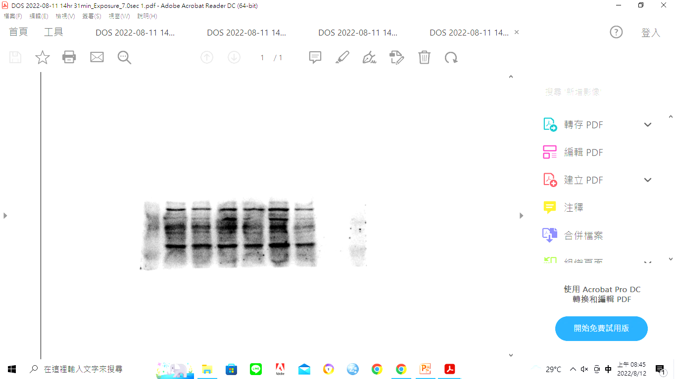
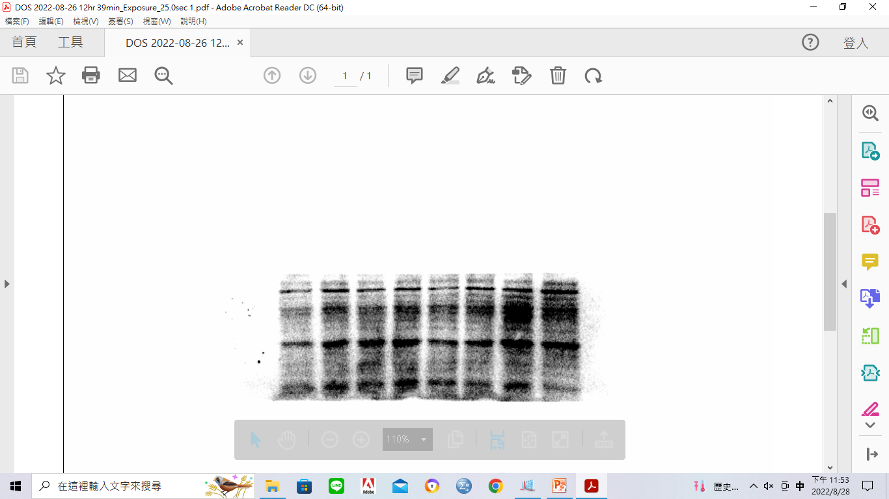
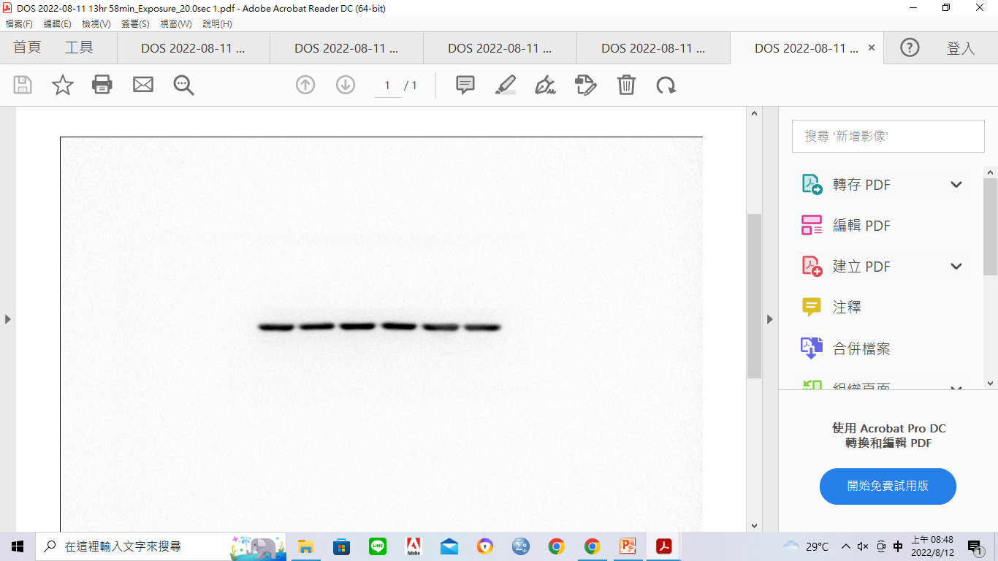
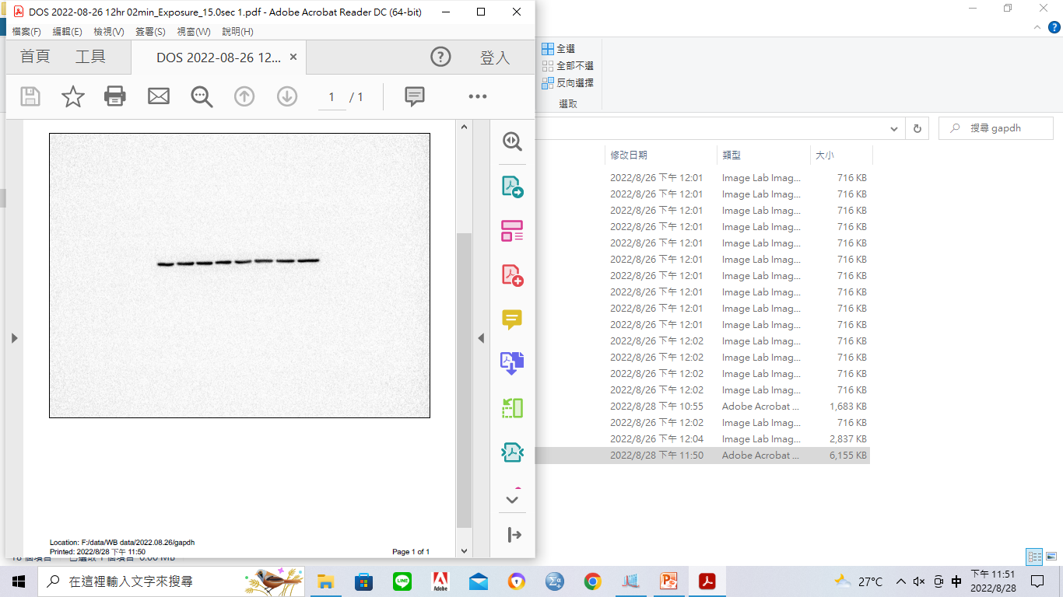
Supplementary Figure S4
A
B
C
TCGA-BRCA
TCGA-BRCA
MEF2C (209199_s_at)
hWNT5A (213425_at)
p=5.4e-13
R=0.22
p=5.4E-13
p=0.0011
R=0.099
p = 0.17
p = 0.18
1 2 3 4 5 6
Probability
Probability
Log2 (MEF2C TPM)
0 2 4 6 8
0.0 0.2 0.4 0.6 0.8 1.0
0.0 0.2 0.4 0.6 0.8 1.0
Log2 (WNT5A TPM)
Low MEF2C expression
Low hWNT5A expression
High MEF2C expression
High hWNT5A expression
0 50 100 150 200 250
0 50 100 150 200 250
2 3 4 5 6 7
2 3 4 5 6 7
Months
Months
Log2 (NDUFS1 TPM)
Log2 (NDUFS1 TPM)
No. of patient at risk
Low 2468 1349 517 130 12 2
High 2461 1534 619 116 15 1
No. of patient at risk
Low 2465 1396 536 124 15 1
High 2464 1487 600 122 12 2
D
MDA-MB-231
MDA-MB-231
NDUFS1
Lu c hKD2
EV OE
NDUFS1
MEF2C
Wnt-5a
GAPDH

Slide 5
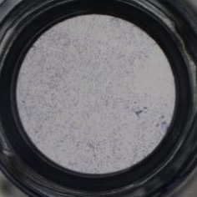
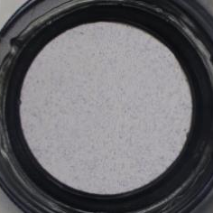
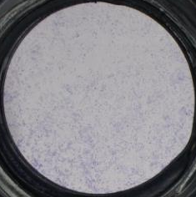
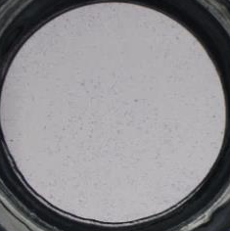
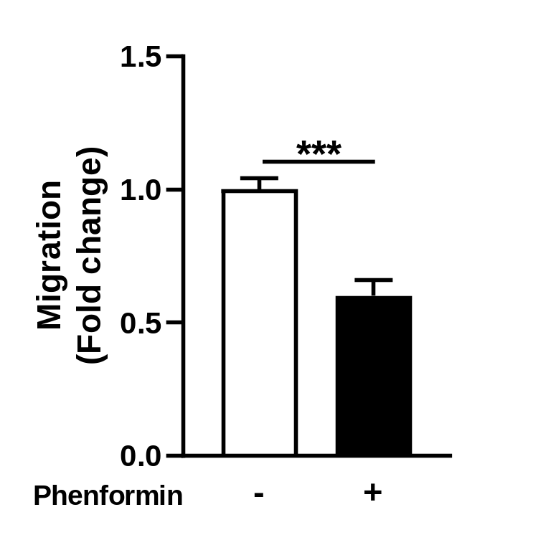
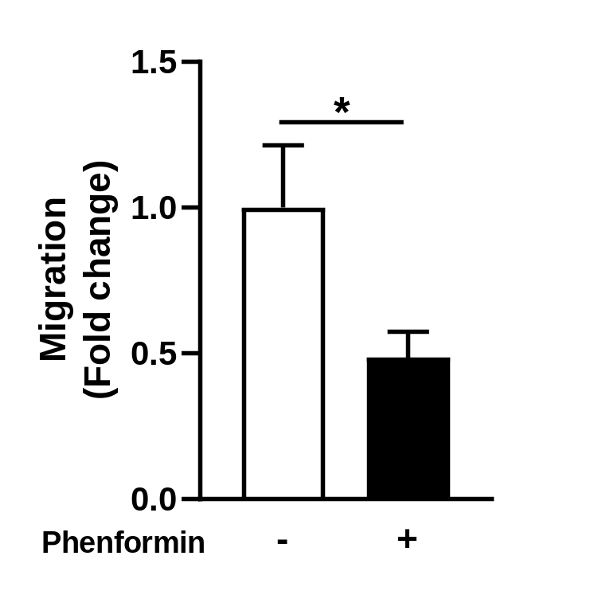
Supplementary Figure S5
MDA-MB-231
NDUFS1 OE
MCF-7 NDUFS1 OE
Phenformin
-
+
Phenformin
-
+

Slide 6
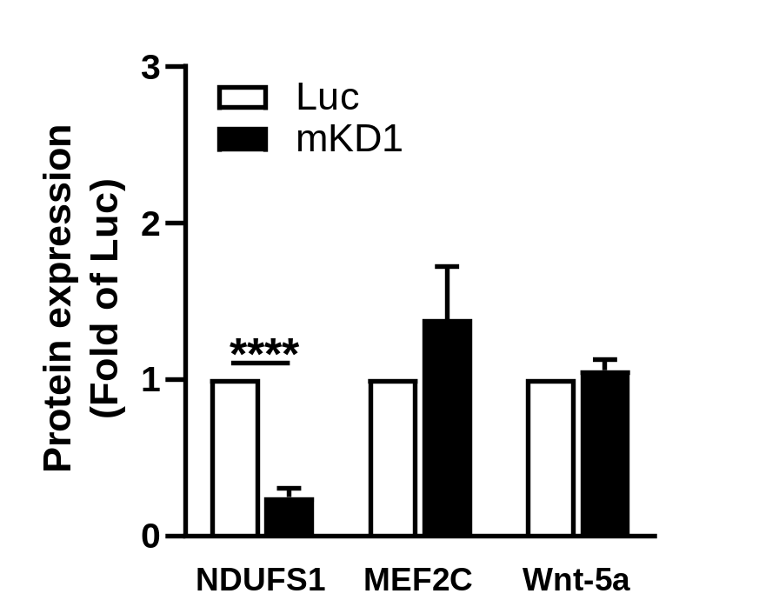
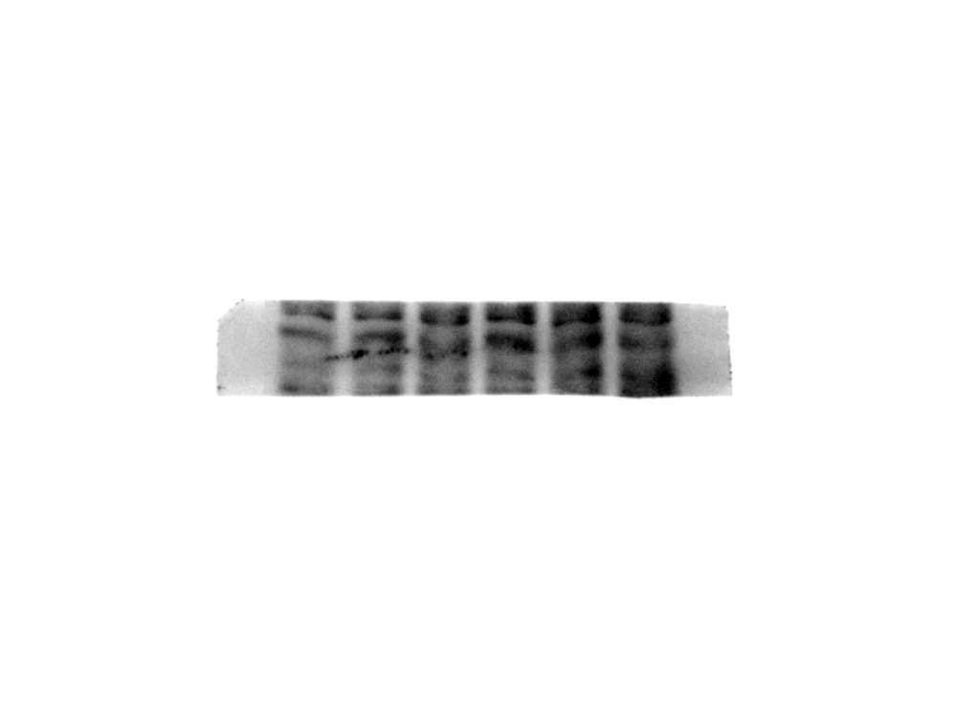
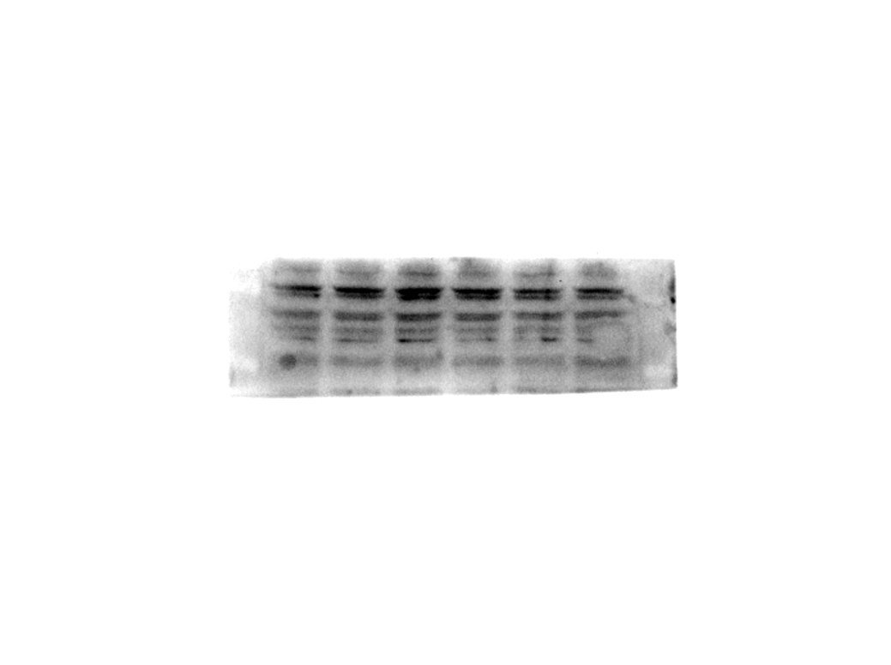
Supplementary Figure S6
A
4T1
Luc
A3
B3
C3
D3’
H2
D3
(mKD1)
E3
F3
NDUFS1
1.00 0.74 0.65 0.40 0.36 0.41 0.05 0.26 0.17
α- Tubulin
B
4T1
NDUFS1
Luc mKD1
NDUFS1
MEF2C
Wnt-5a
GAPDH

