Slide 1
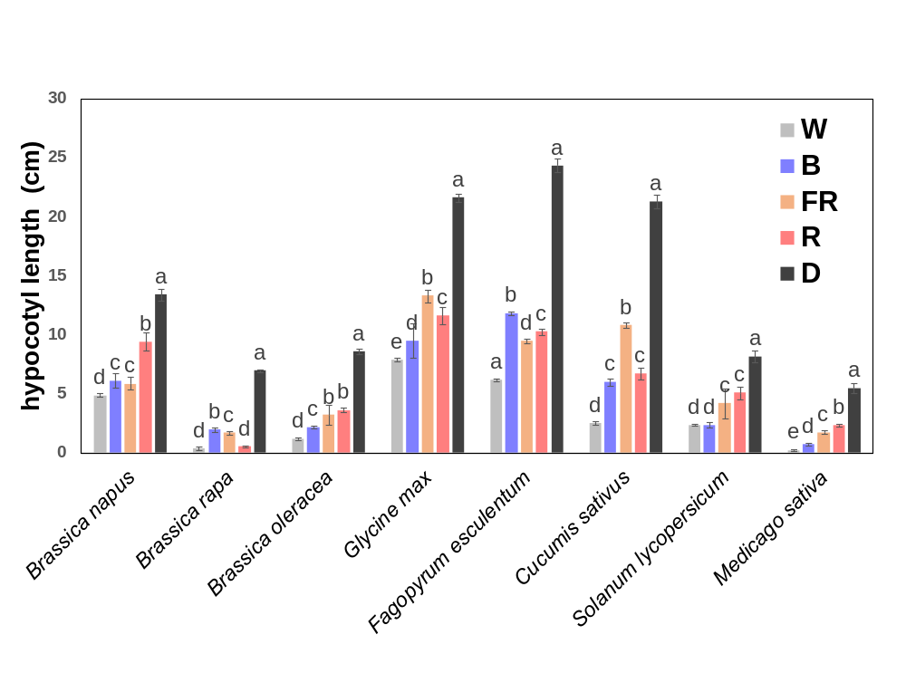
Fig. S1 Hypocotyl length in eight eudicot species treated with diverse light conditions (W, B, FR, R, D).

Slide 2
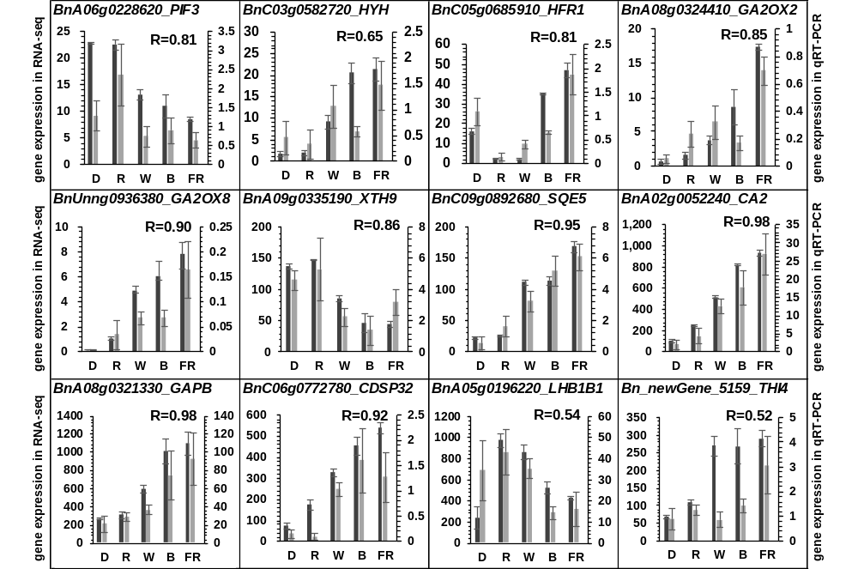
Gene expression in RNA-seq
Gene expression in qRT-PCR
Fig. S2 Comparison of gene expression results in RNA-seq and qRT-PCR.

Slide 3
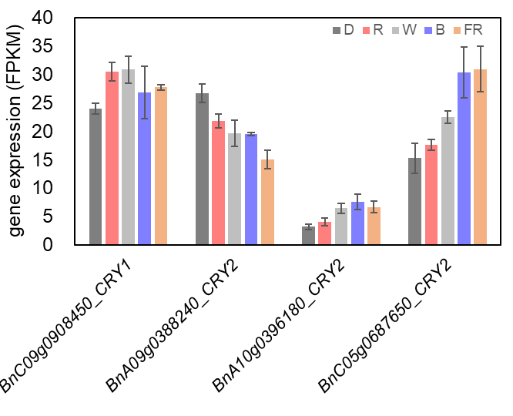
Fig. S3 CRY1 and CRY2 gene expression in Brassica napus under different light quality（D, R, W, B, FR).

Slide 4
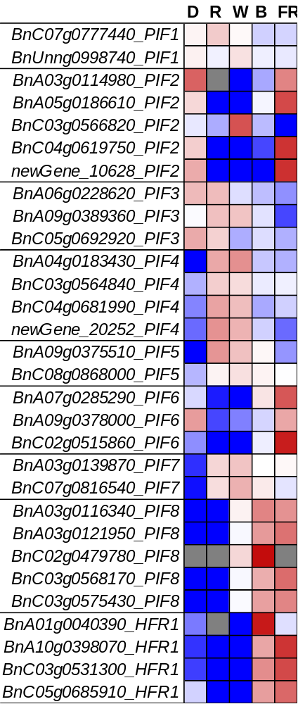

-2
2
Fig. S4 Gene expression of PIFs gene family in Brassica napus upon various light conditions. The scale bar represents the log₂ of the ratio.

