Slide 1
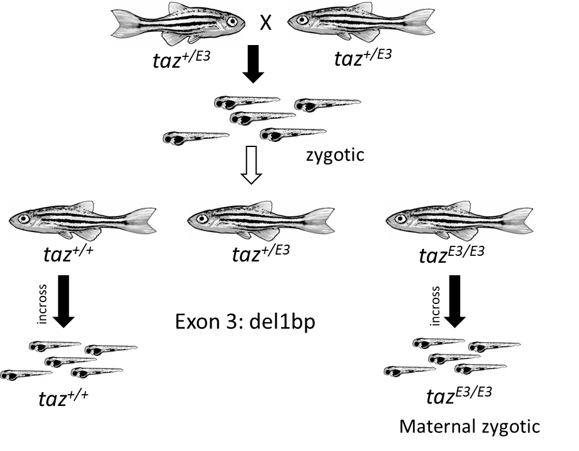
Figure S1

Slide 2
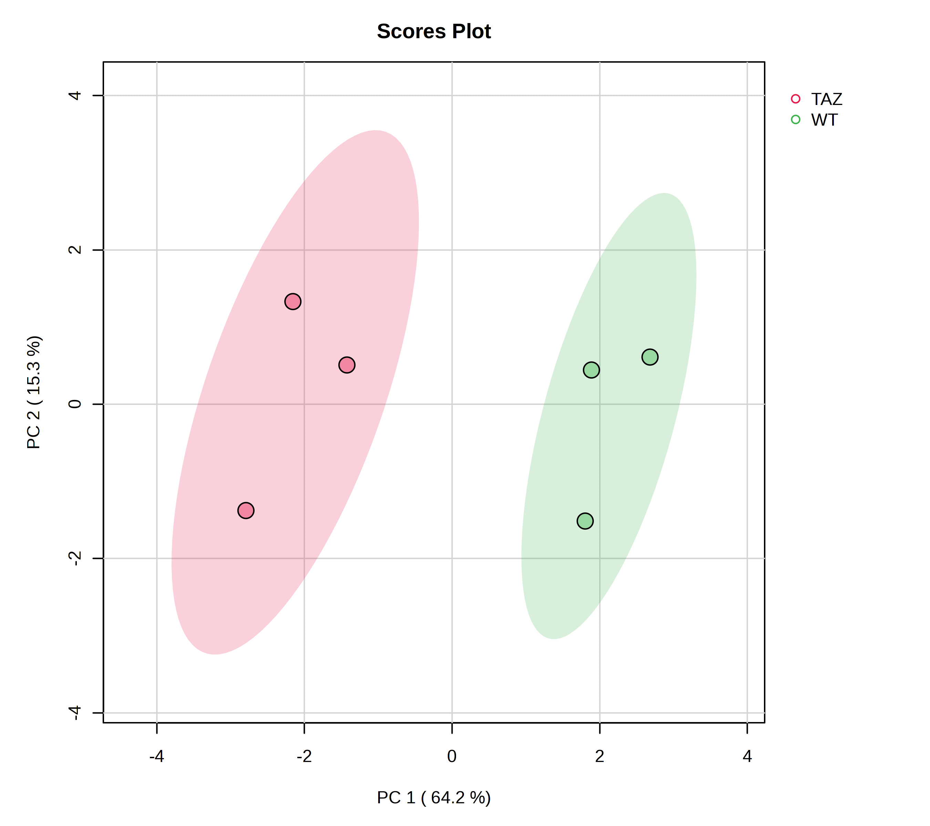
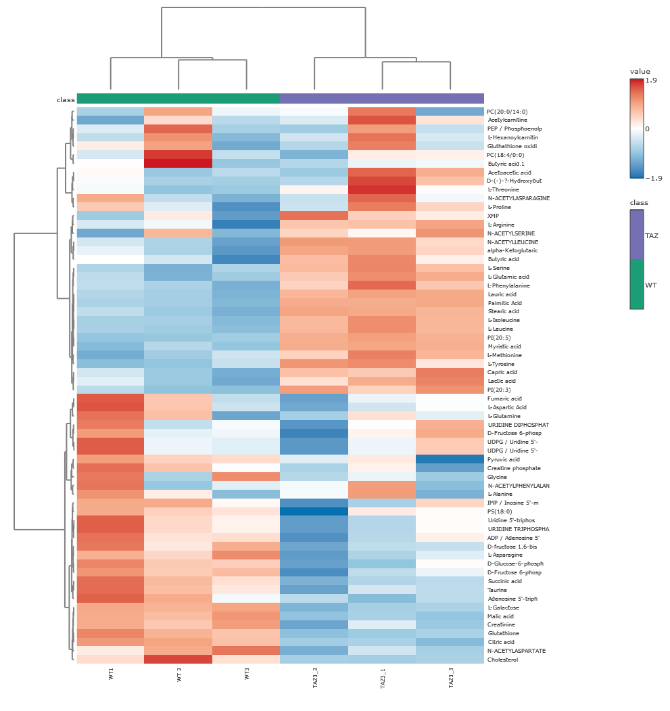
Figure 2S
A
B

Slide 3
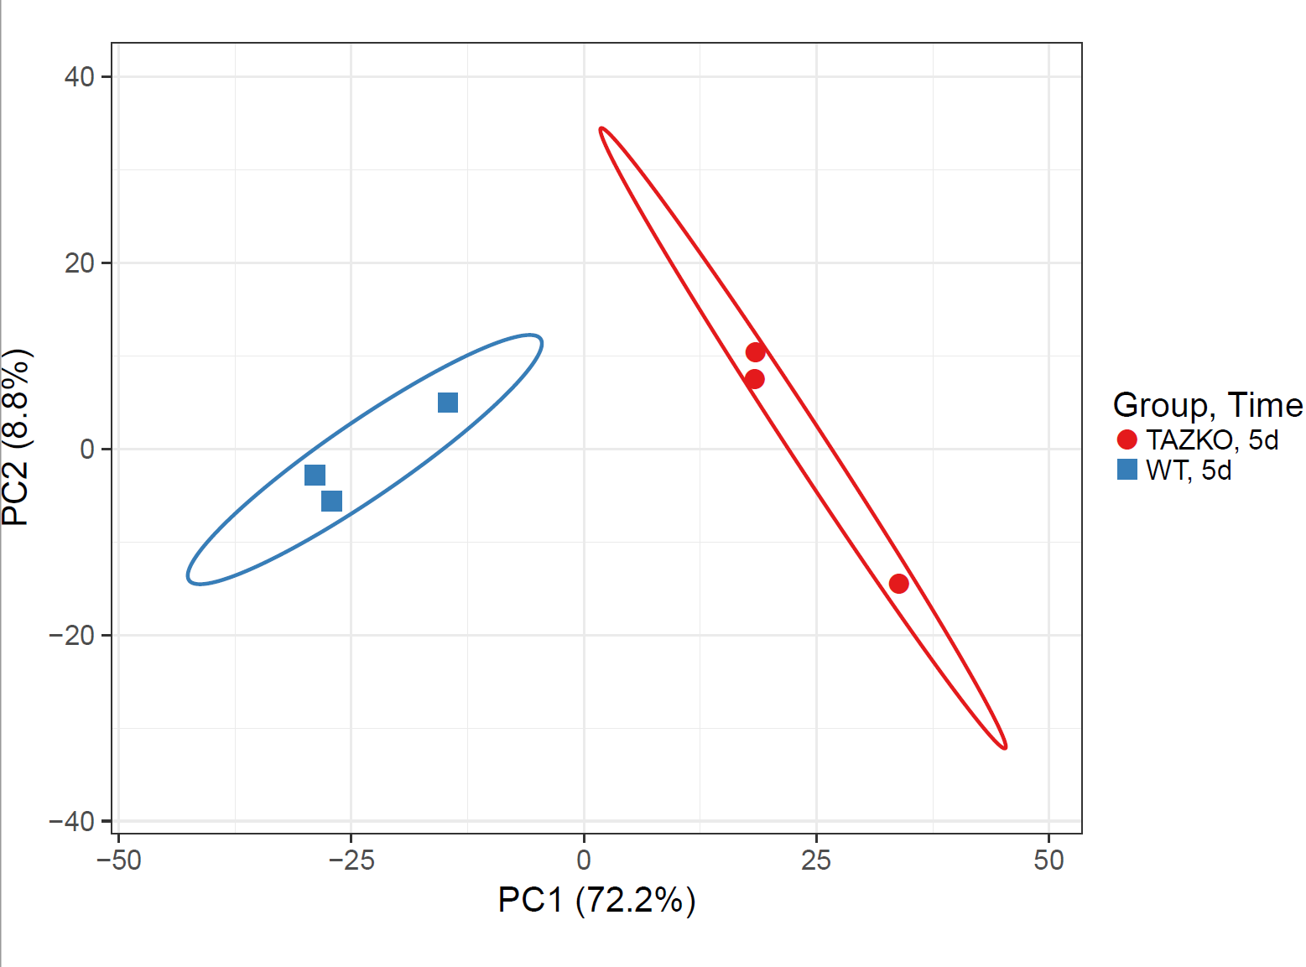
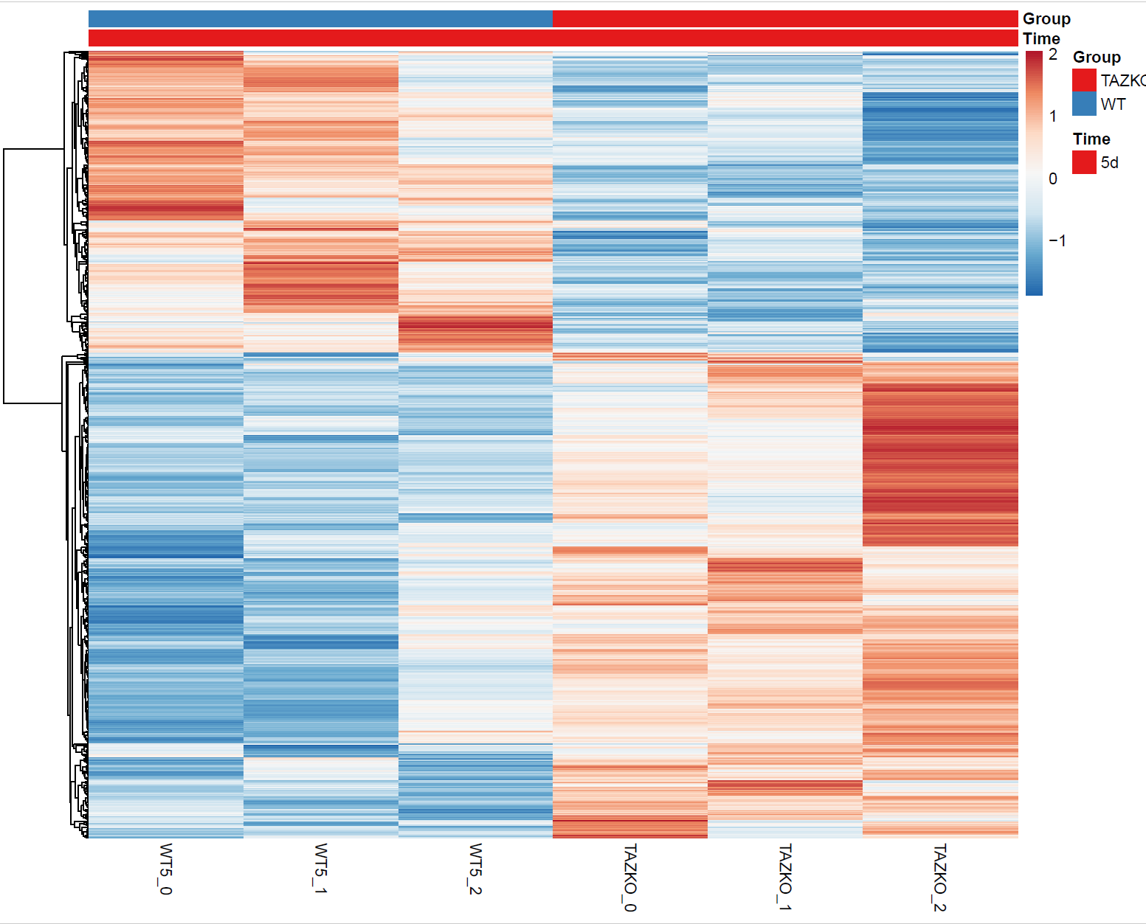
Figure 3S
A
B
C

Slide 4

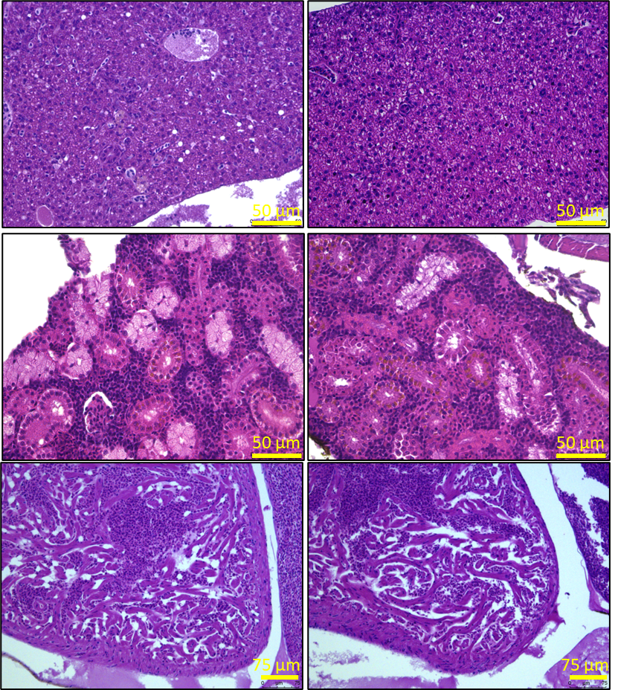
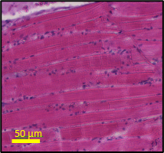
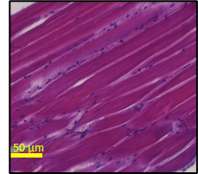
Figure 4S
A
C
Standard Length
HEART
taz^{+/+}
1 year
5000 μm
taz^{+/+}
B
MZ taz^{E3/E3}
5000 μm
MZ taz^{E3/E3}
D
2 year
taz^{+/+}
MZ taz^{E3/E3}
E
taz^{+/+}
taz^{E3/E3}
taz^{+/+}
taz^{E3/E3}
LIVER
HEART
KIDNEY
MUSCLE

