Slide 1
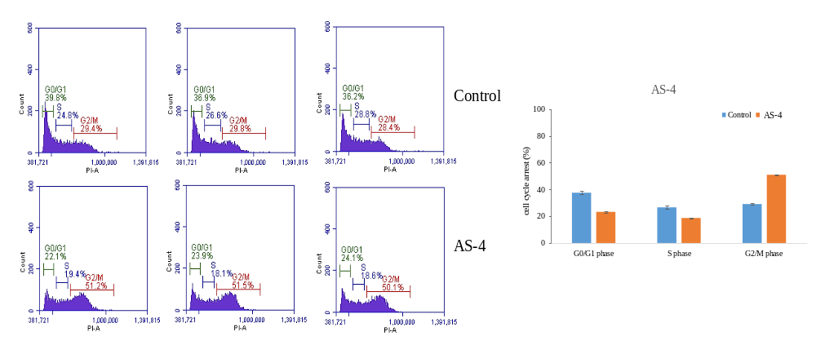
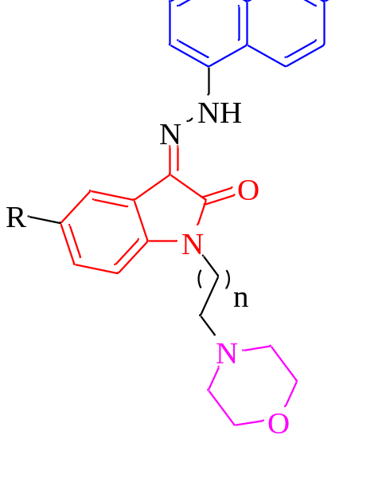
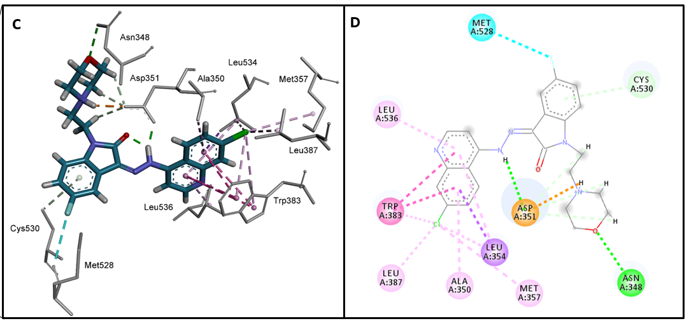
Morpholinated isatin-quinoline hybrids
F > Cl > Br > OCH₃ > CH₃ > H
Cell cycle arrest at G2/M Phase
n = 1 > 2> 3
Selective inhibition against hormone positive breast cancer cells (MCF-7)
over hormone negative cells (MDA-MB-231)
Higher selectivity toward MCF-7 cells over L929 cells (noncancerous skin fibroblast)
Molecular interactions with Human estrogen receptor alpha (ERα)

