Slide 1
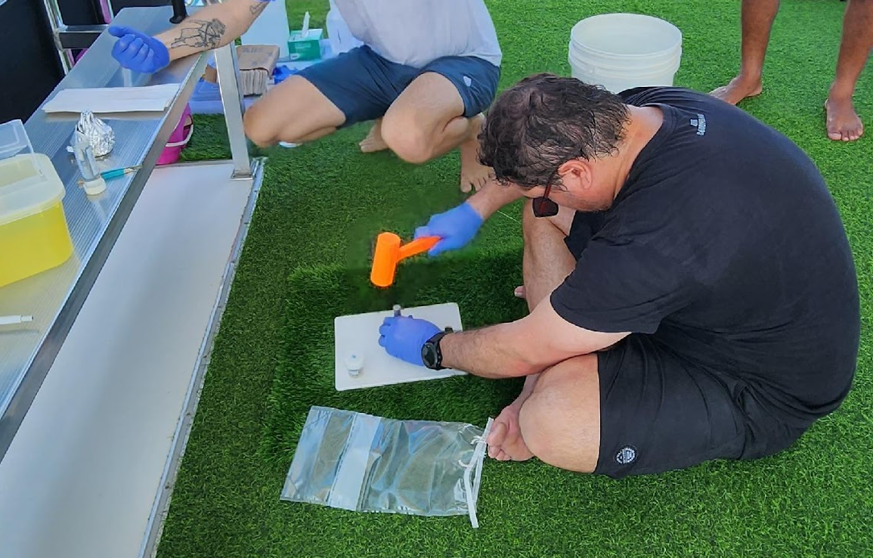
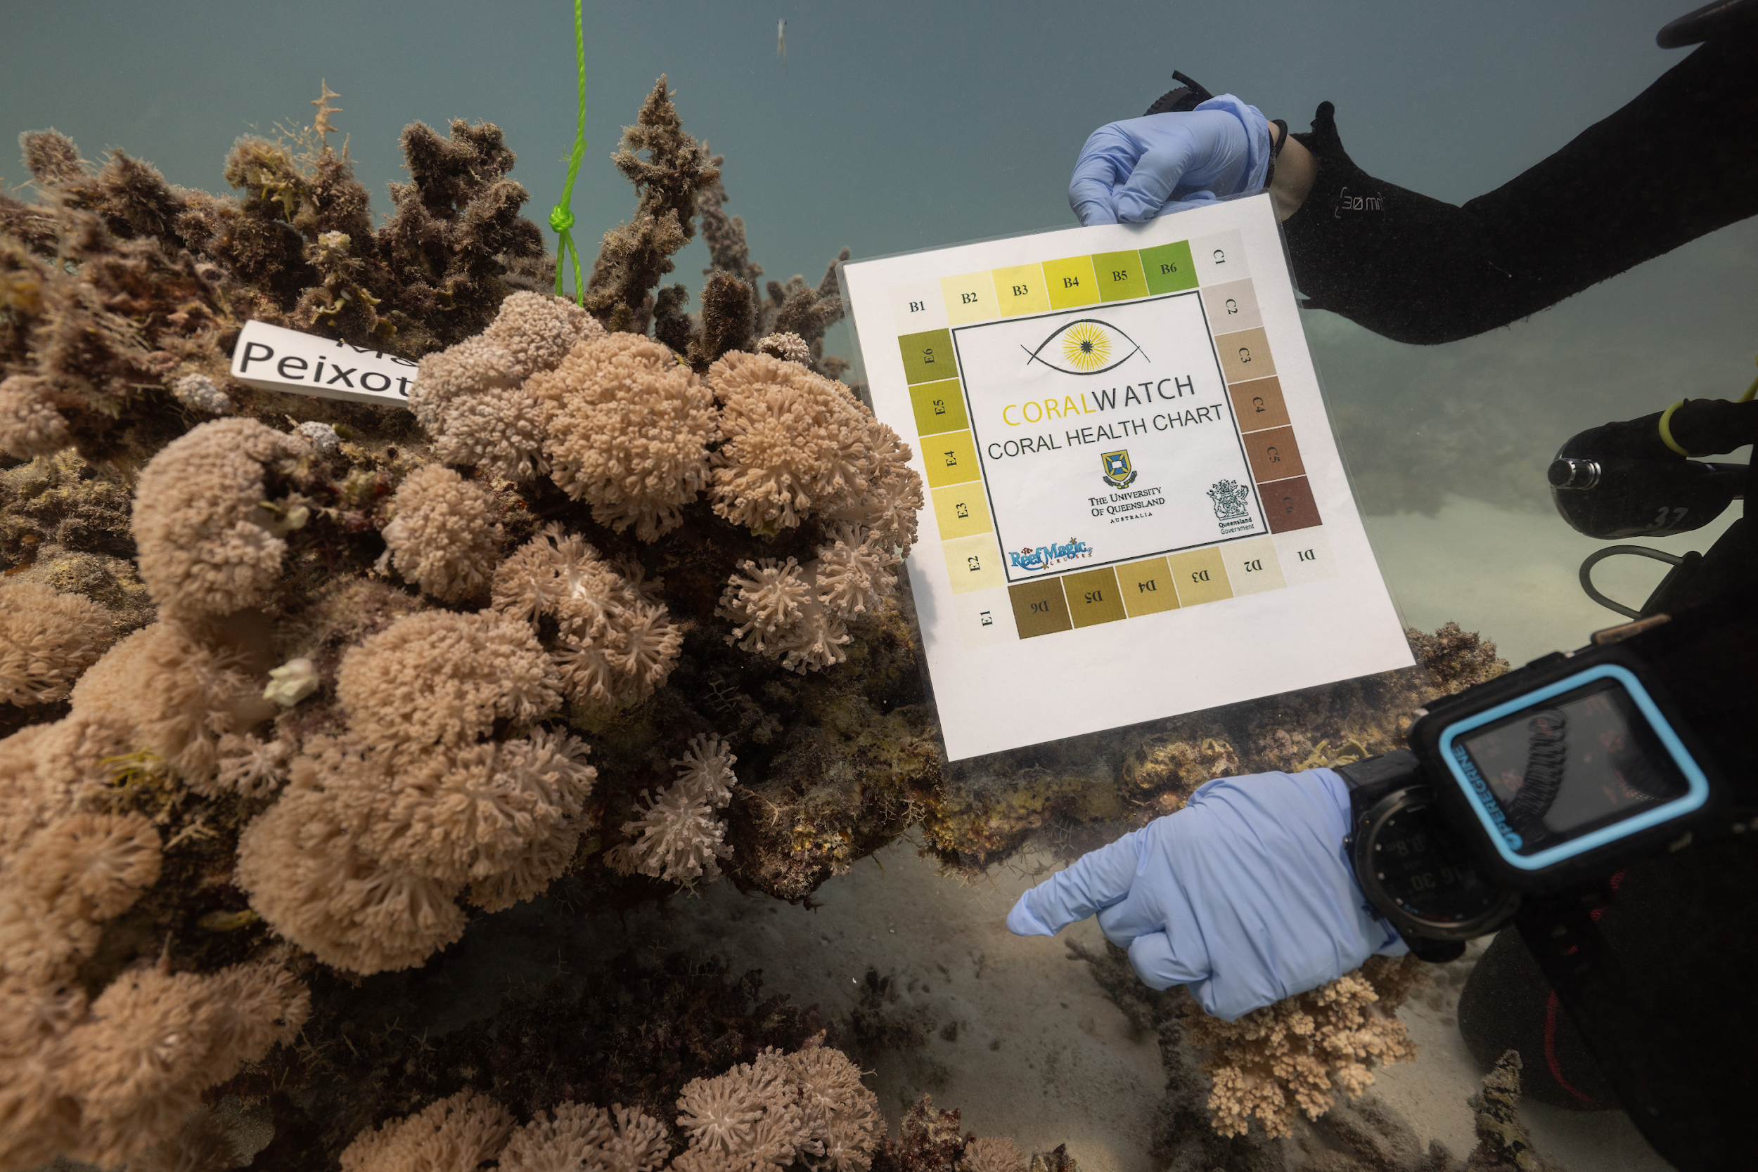
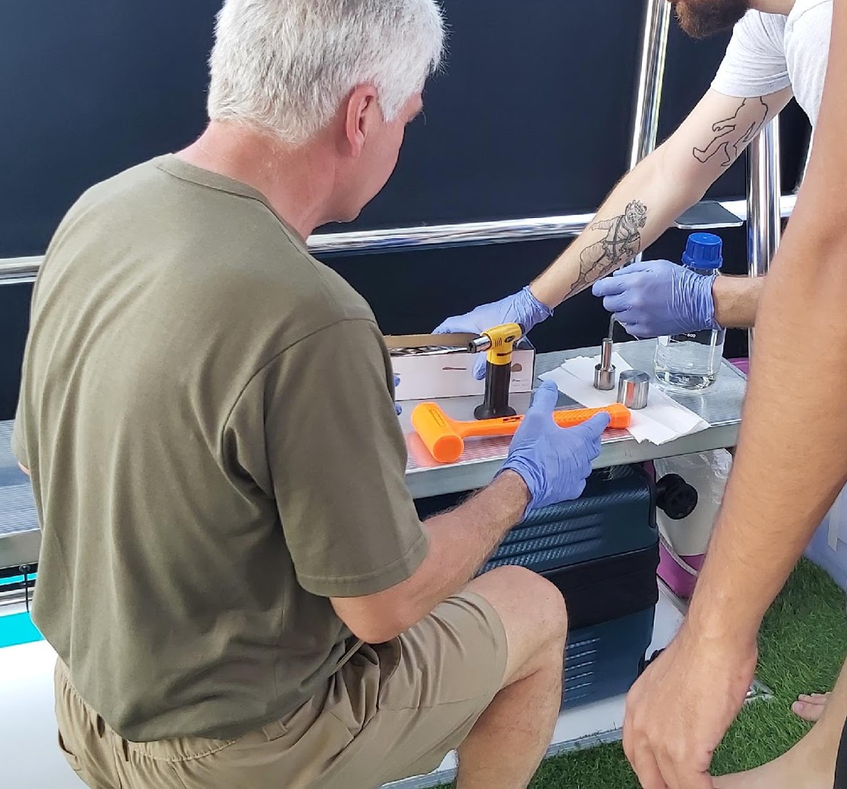
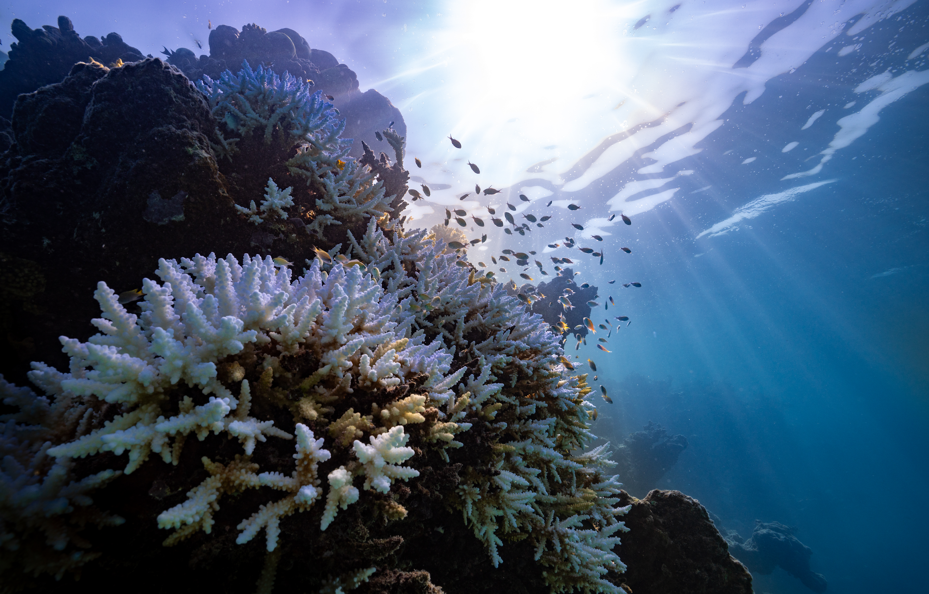
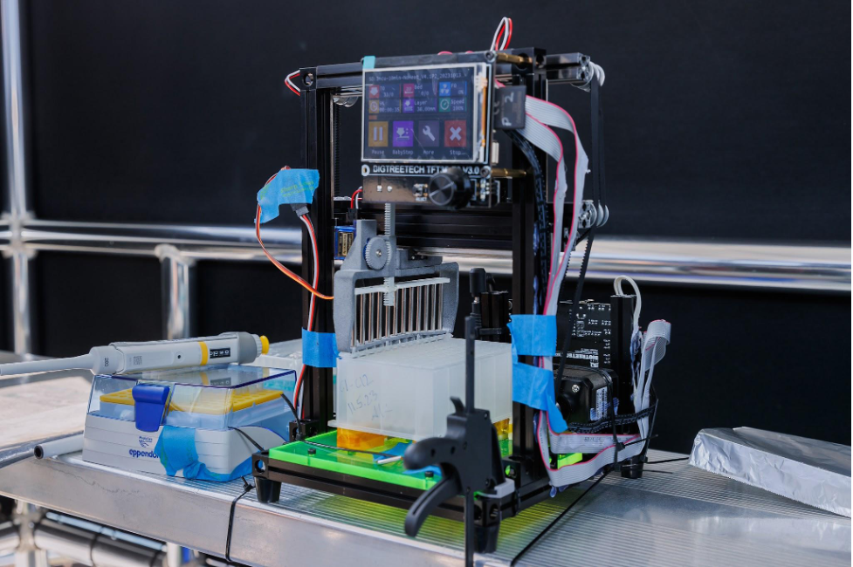
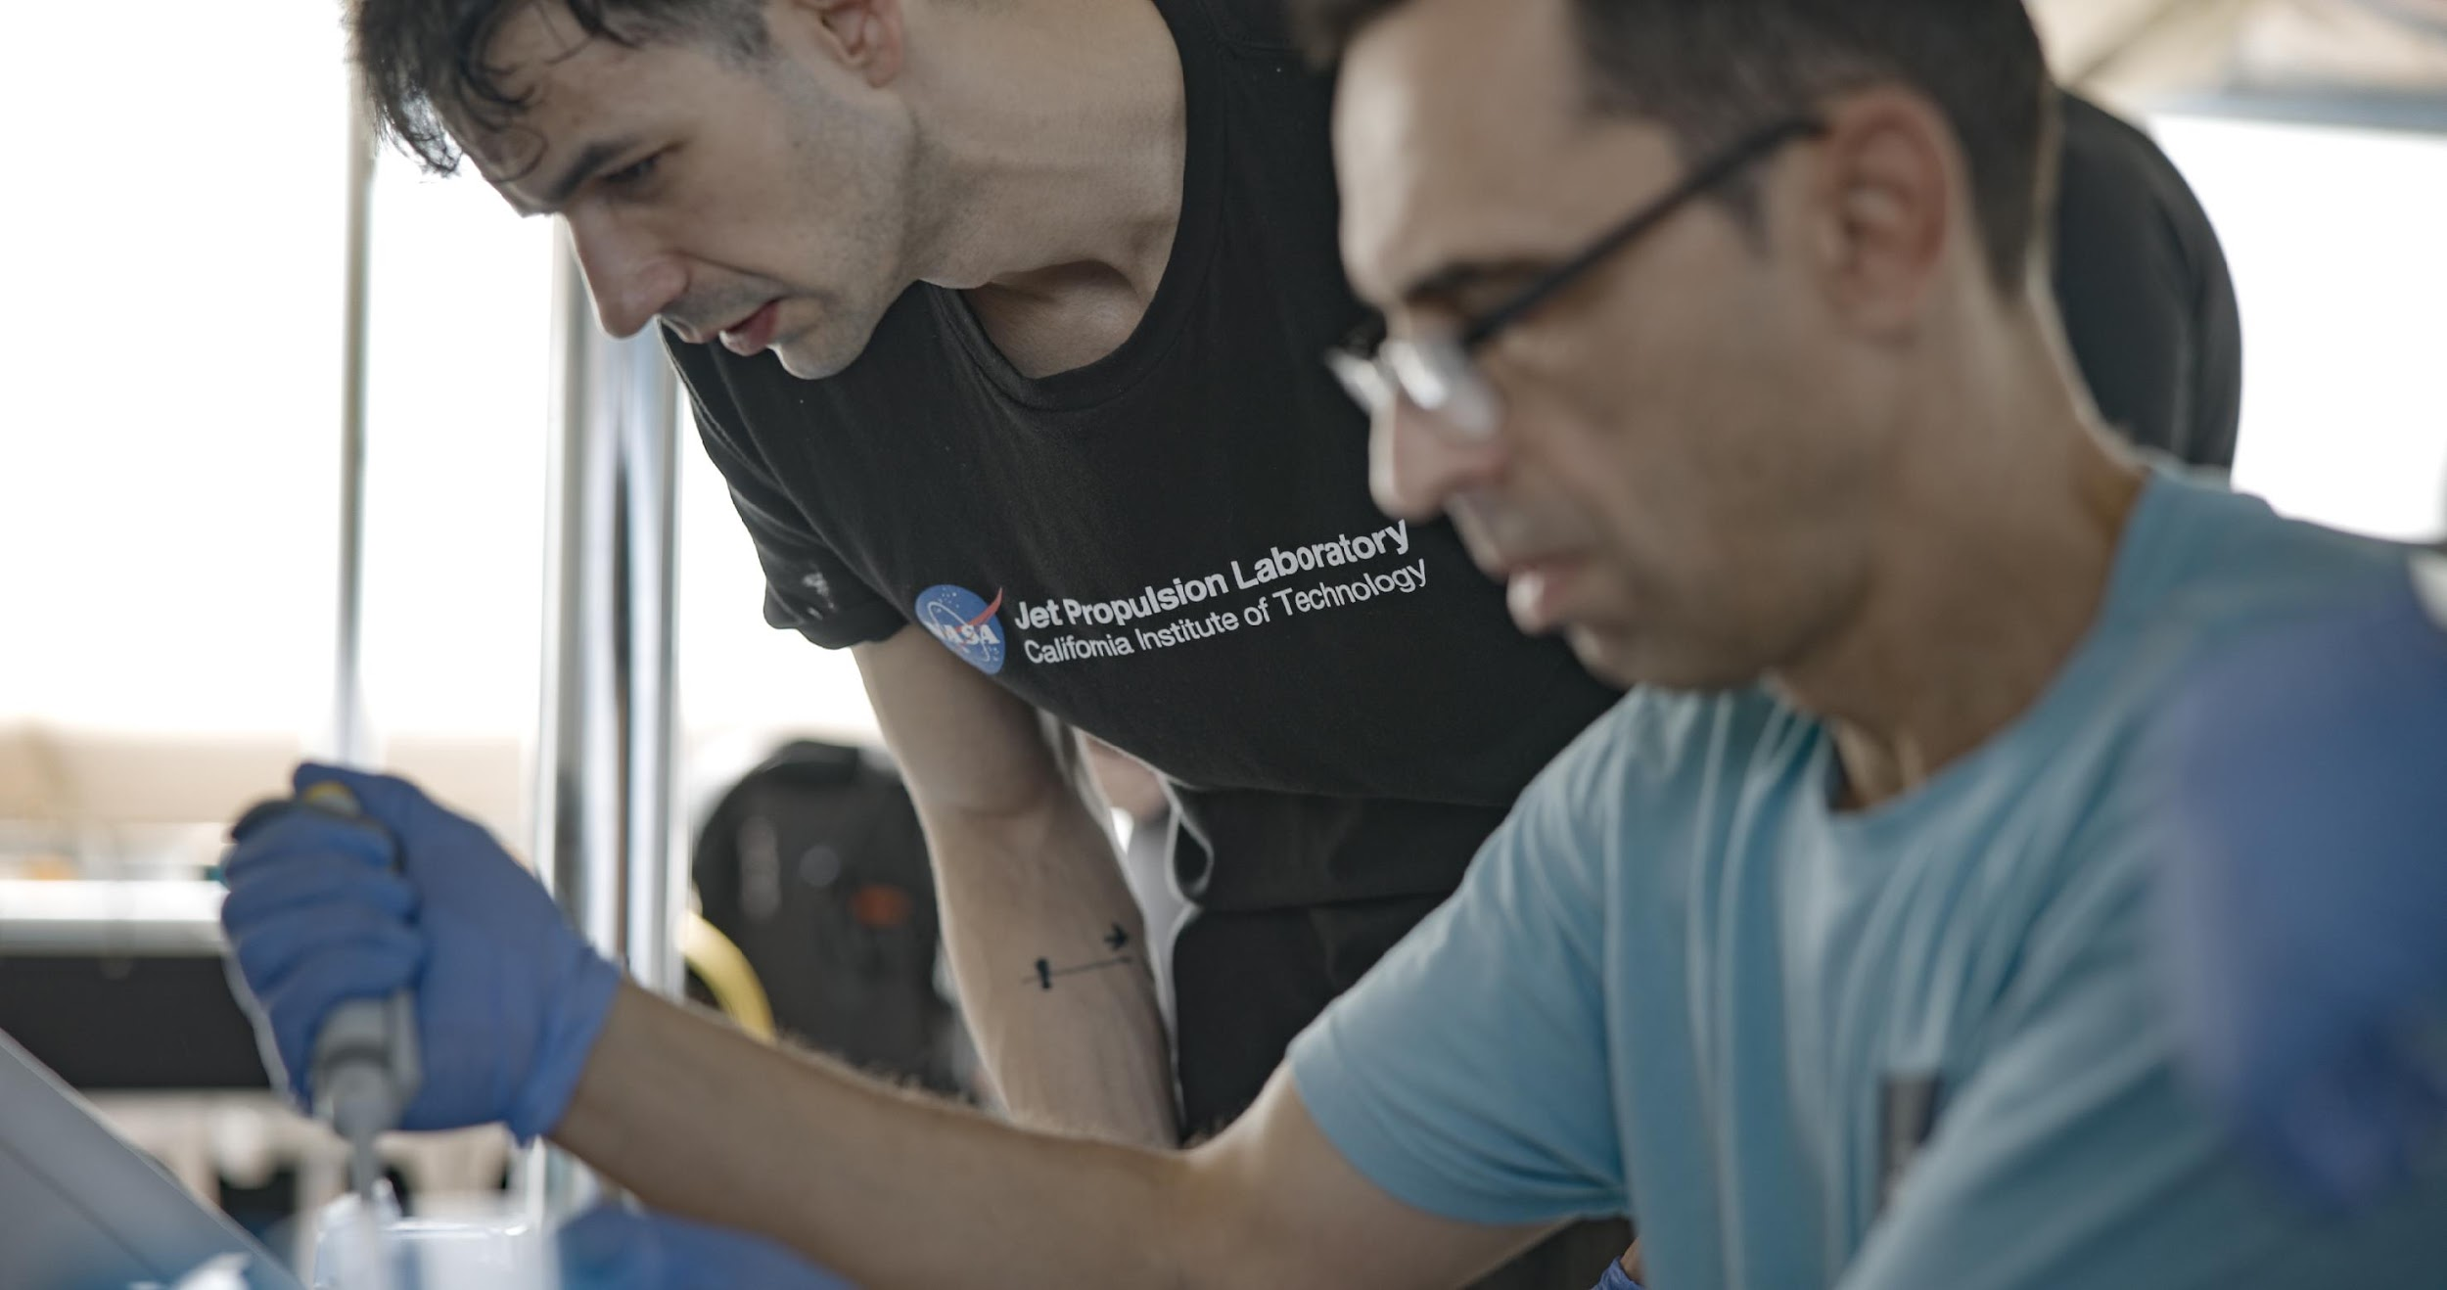
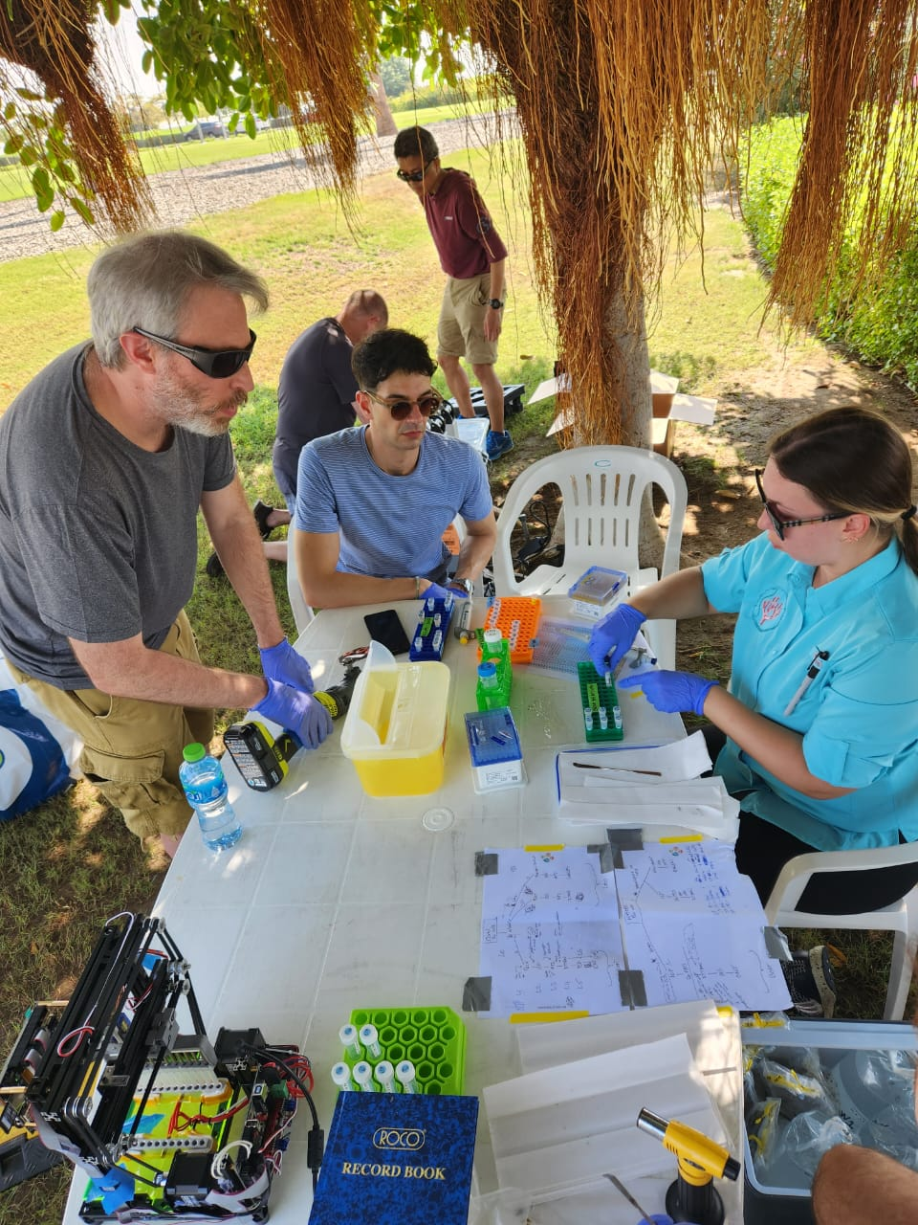
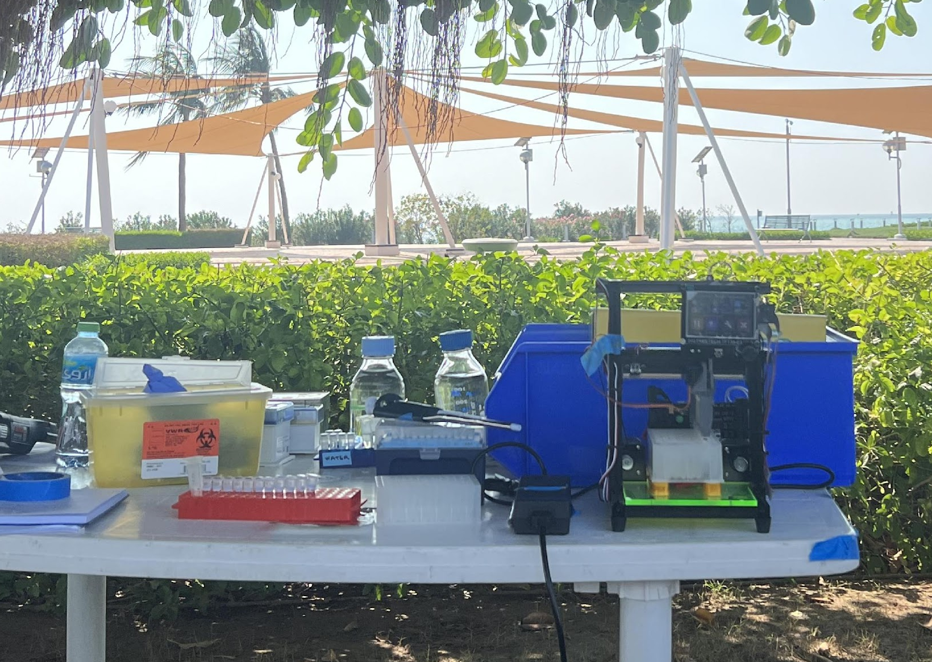
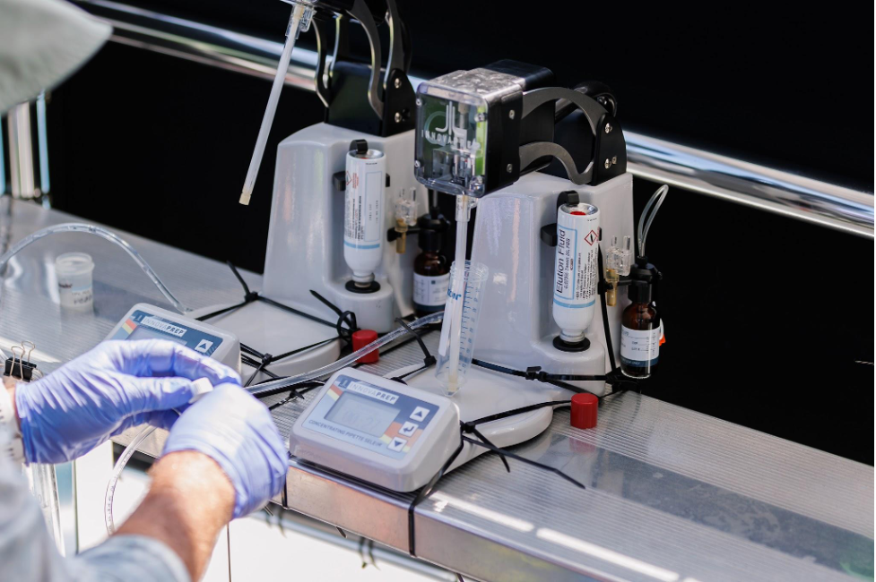
Supplementary Figure 1

Slide 2
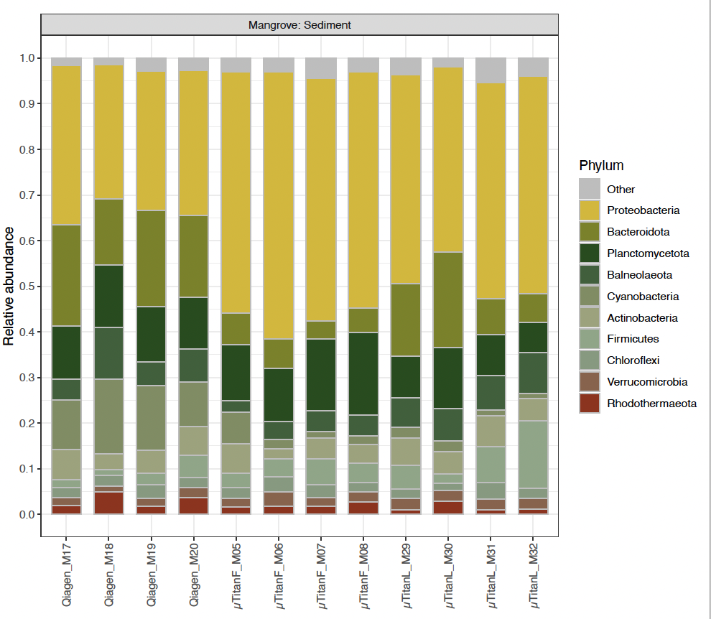
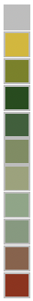
Mangrove sediments
1
0.8
Other
Pseudomonadota
Bacteroidota
Planctomycetota
Balneolaeota
Cyanobacteria
Actinomycetota
Bacillota
Chloroflexi
Verrumicrobia
Rhodothermaeota
0.6
Relative abundance
0.4
0.2
0
Qiagen
xTitan (F)
xTitan (L)
Supplementary Figure 2

Slide 3
A)
1
0.8
Other
Endozoicomonadaceae
Fulvivirgaceae
Spiroplasmataceae
Prochlorococcaceae
Flavobacteriaceae
Pelagibacteraceae
Francisellaceae
Oxalobacteraceae
Pseudomonadaceae
Sphigomonadaceae
0.6
Relative abundance
0.4
0.2
0
B)
1
0.8
Other
Endozoicomonas
Fulvivirga
Spiroplasma
Parasynechococcus
Candidatus Pelagibacter
Allofrancisella
Herbaspirillum
Janthinobacterium
Pseudomonas
Sphigomonas
0.6
Relative abundance
0.4
0.2
0
Qiagen
xTitan (F)
xTitan (L)
Qiagen
xTitan (F)
xTitan (L)
Supplementary Figure 3

Slide 4
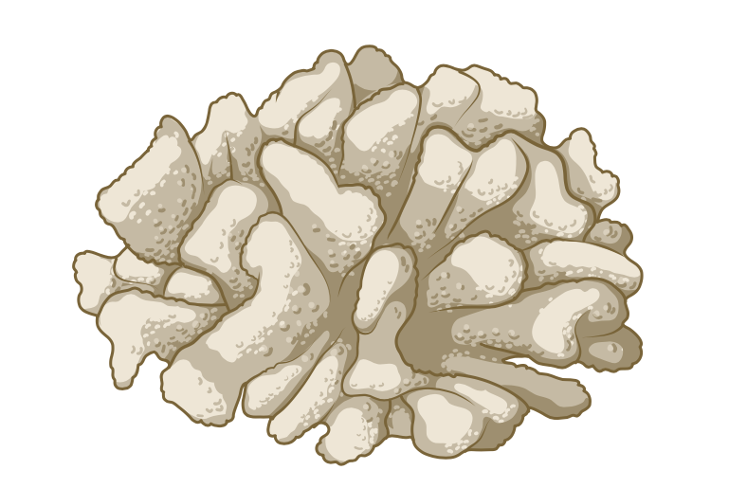

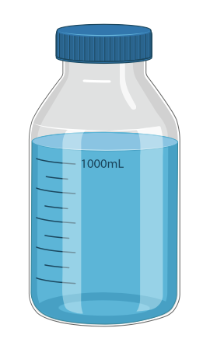

A)
B)
15
100
Archaea
75
Bacteria
10
Eukaryota
Relative abundance
Qiagen
Unclassified
Qiagen
50
Number of sequences (M)
5
25
Viruses
0
0
15
100
75
10
xTitan (F)
Relative abundance
xTitan (F)
50
Number of sequences (M)
5
25
0
0
100
15
75
10
Relative abundance
xTitan (L)
Number of sequences (M)
50
xTitan (L)
5
25
0
0
Coral 1
Coral 2
Sediments
Sea water
Coral 1
Coral 2
Sediments
Sea water
Supplementary Figure 4

