Slide 1
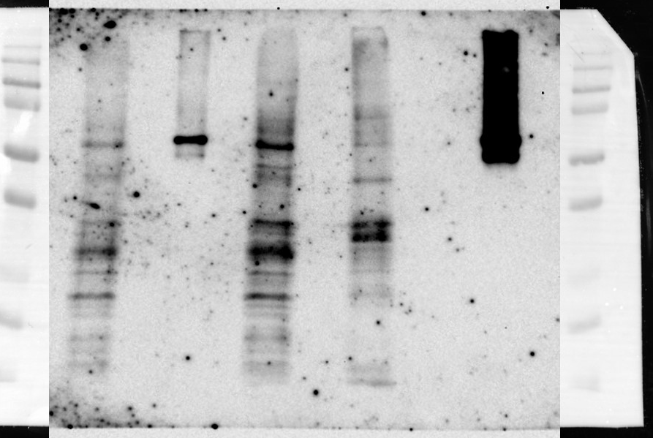
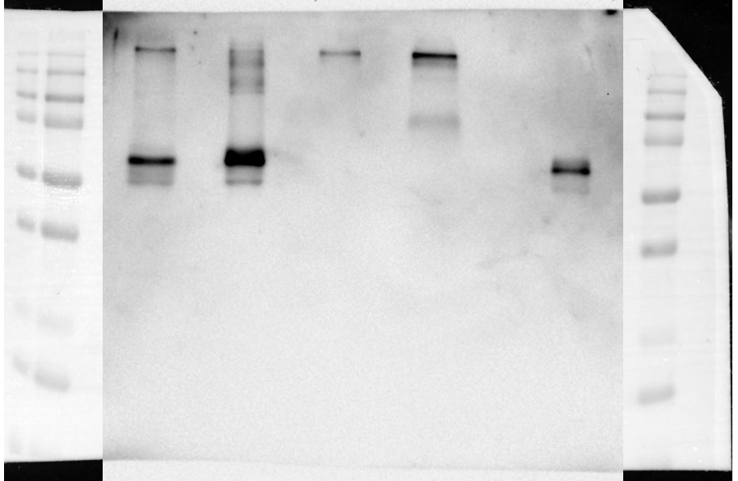
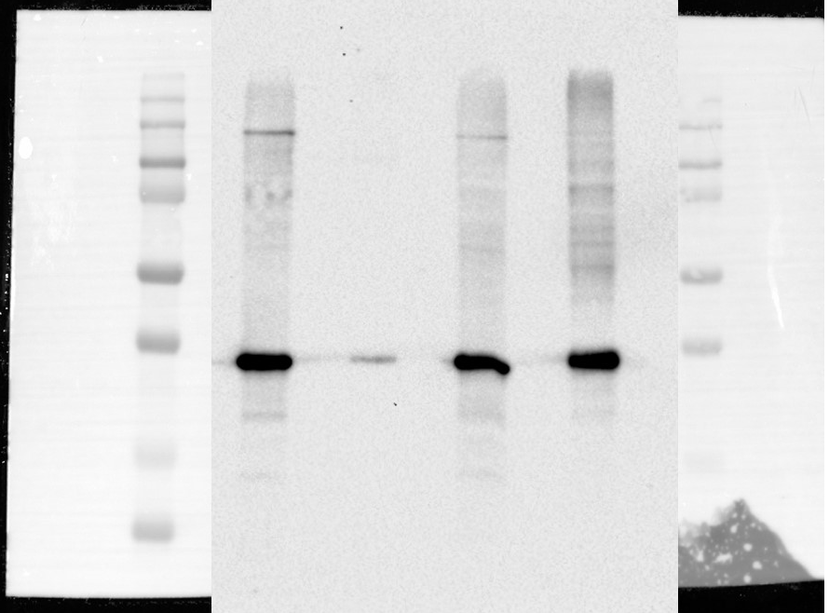
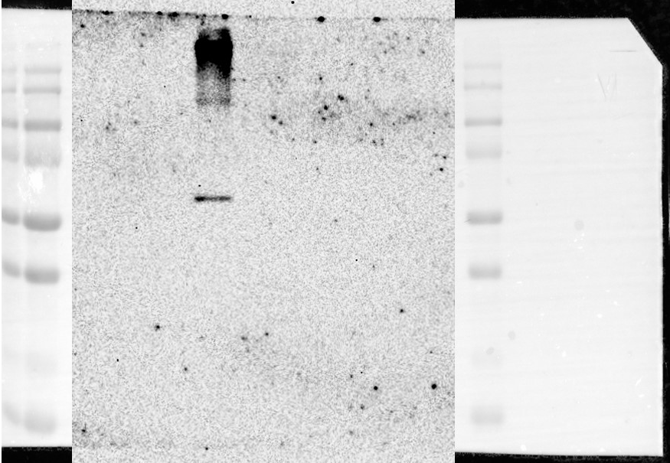
Supplementary figure 1
Uncropped pictures of western blotting in Figure 1
Figure 1(c)
Cell lysate
Supernatant
WB:FLAG
WB:E protein
WB: GAPDH
WB:FLAG

Slide 2
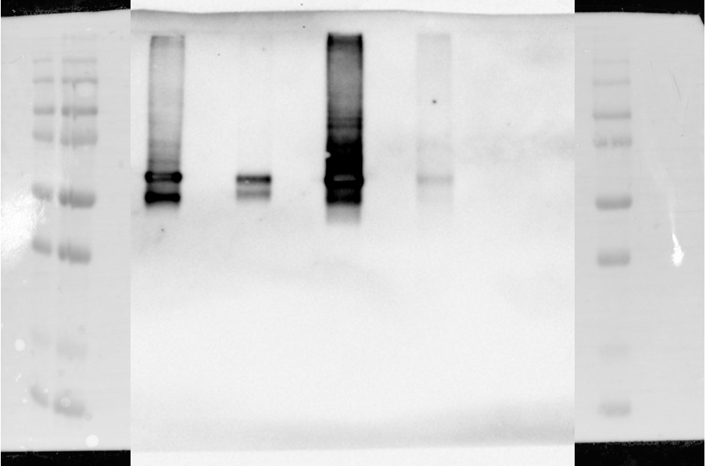
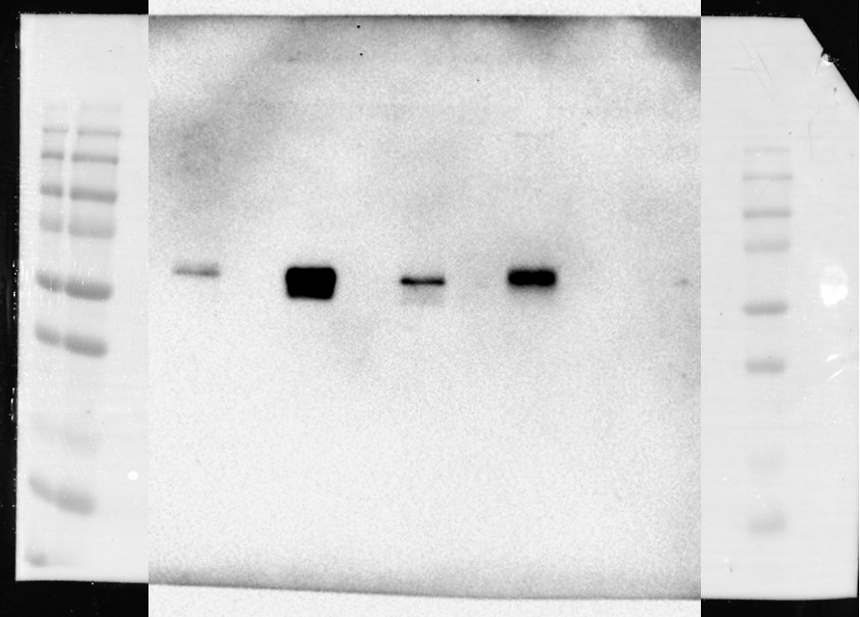
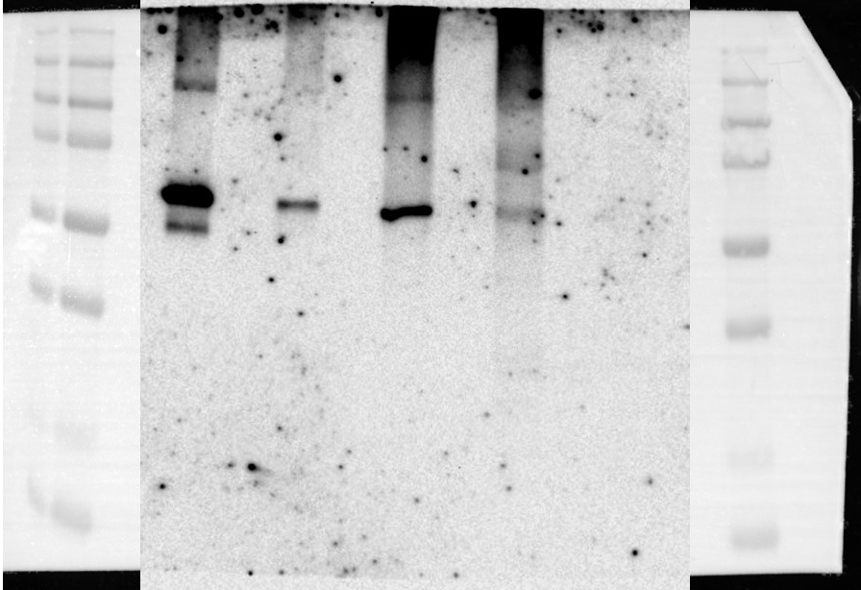
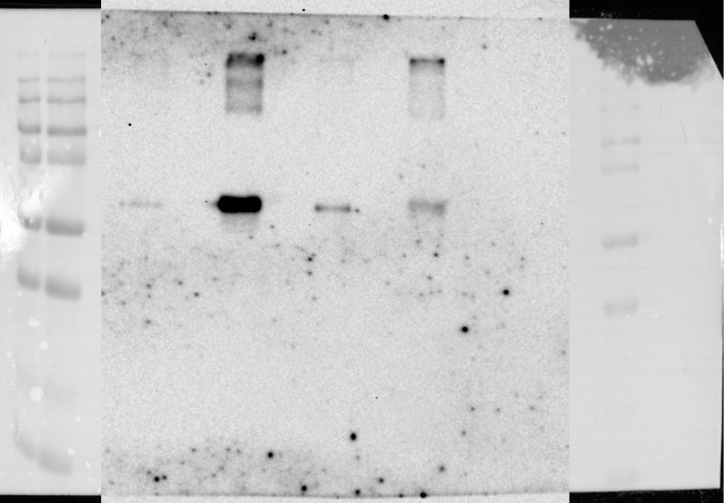
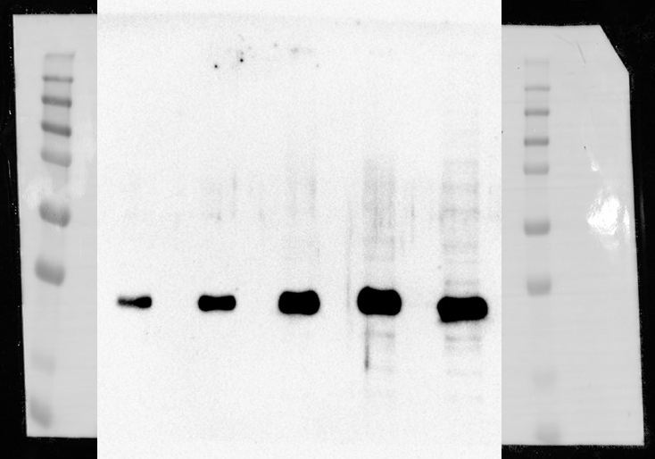
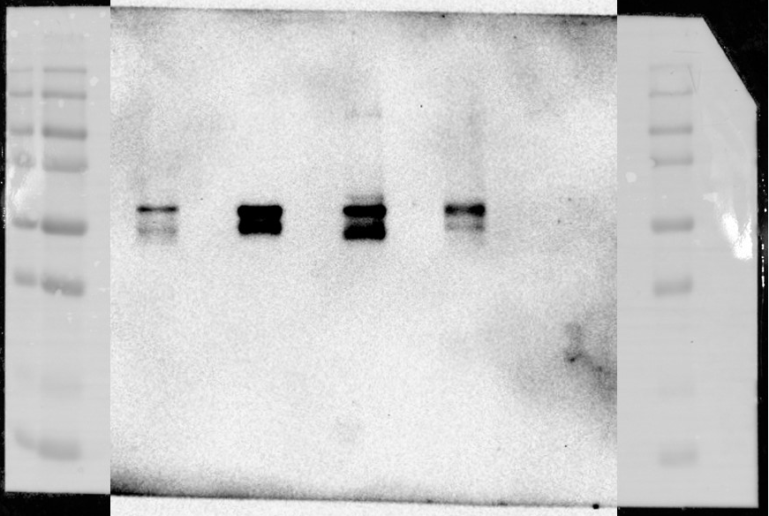
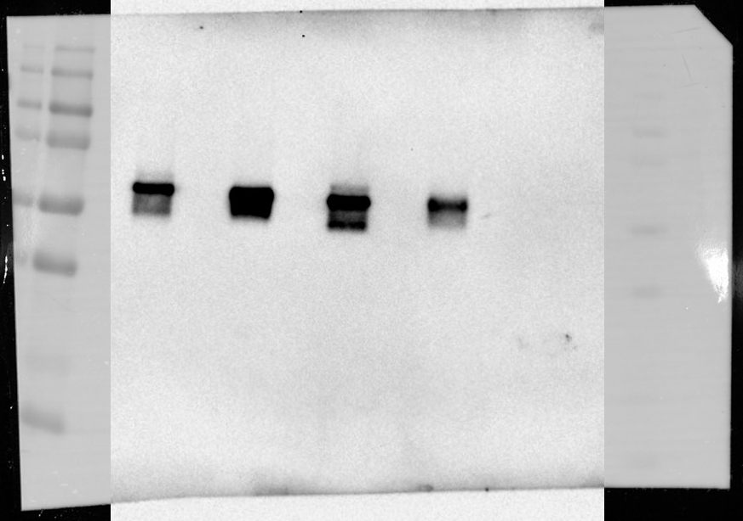
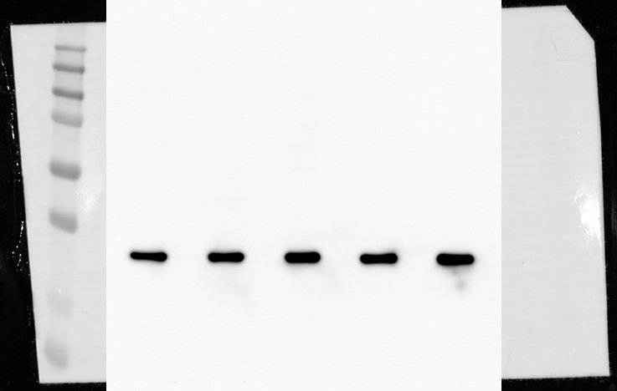
Supplementary figure 2
Uncropped pictures of western blotting in Figure 2
Figure 2(b)
Cell lysate
Supernatant
WB:E protein
WB:E protein
WB:FLAG
WB:FLAG
WB: GAPDH
Figure 2(c)
Cell lysate
Supernatant
WB:E protein
WB:E protein
WB: GAPDH

Slide 3
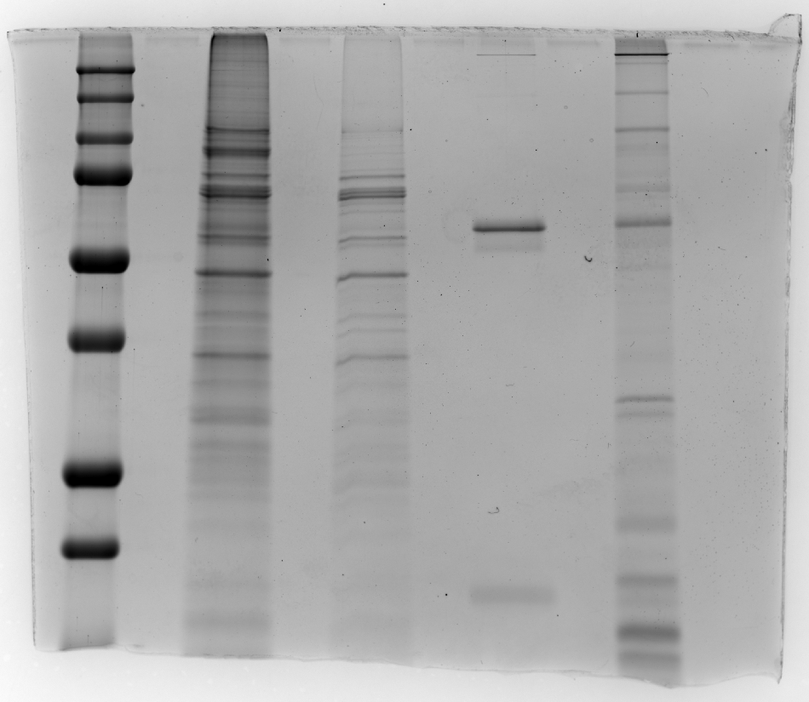
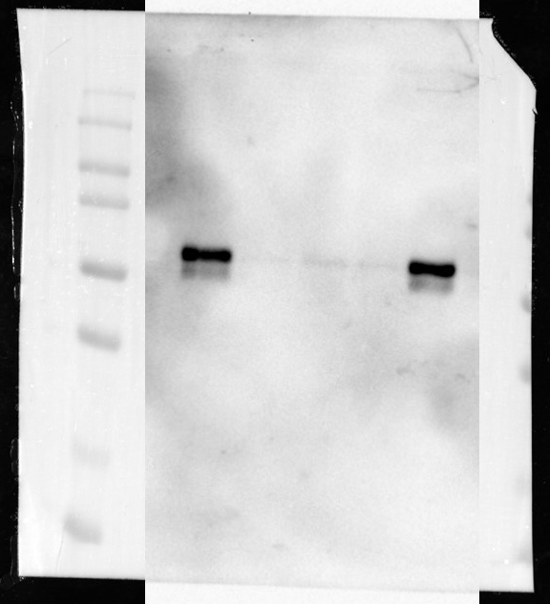
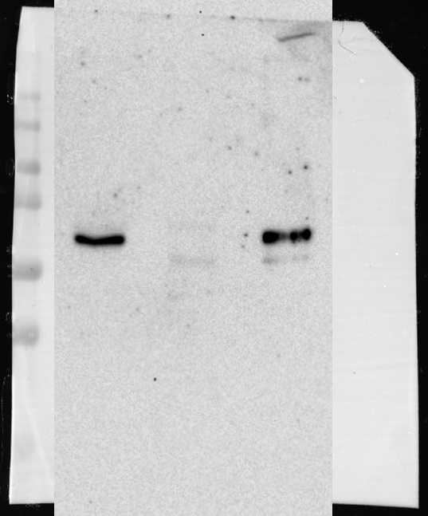
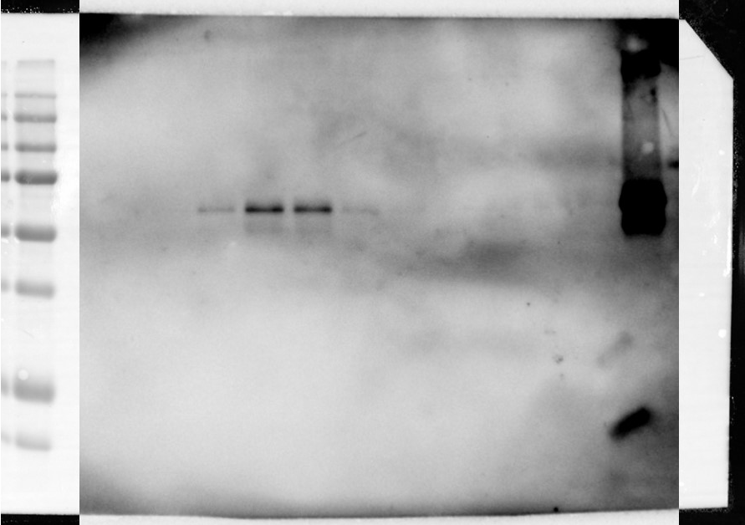
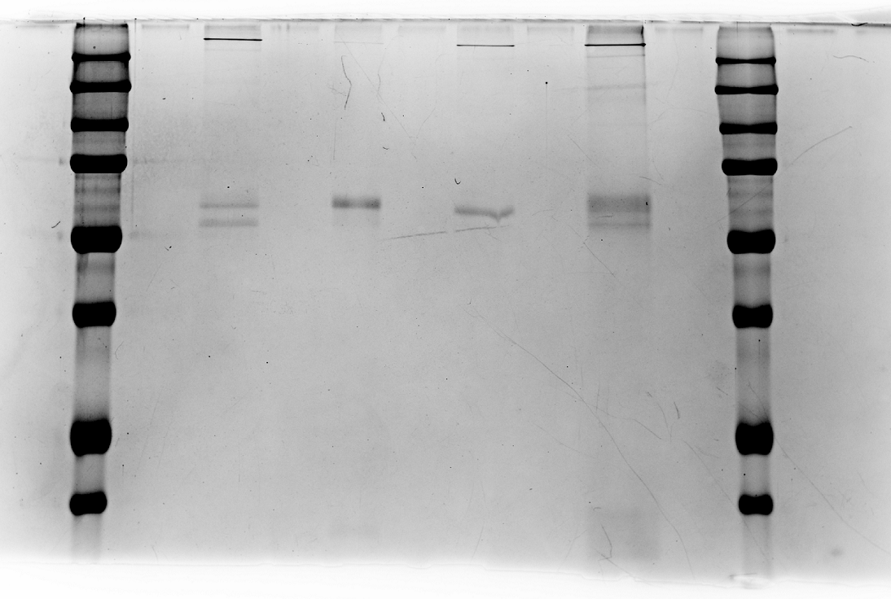
Supplementary figure 3
Uncropped pictures of western blotting and CBB staining in Figure 3
Figure 3(a)
WB: E protein
CBB staining
WB: FLAG
Figure 3(b)
Figure 3(c)
WB: E protein
CBB staining

