Slide 1
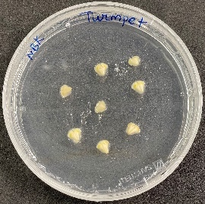
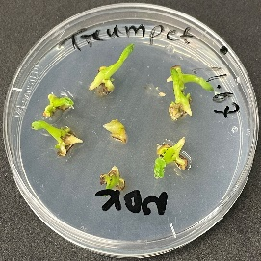
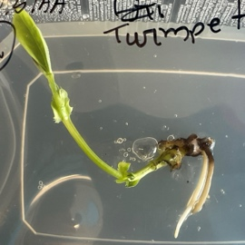
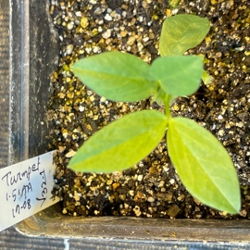
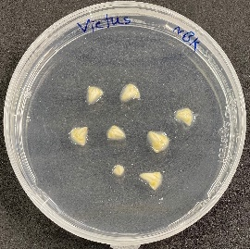
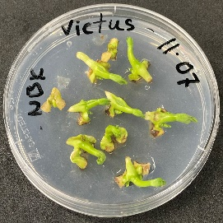
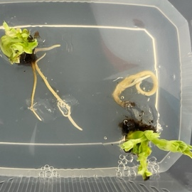
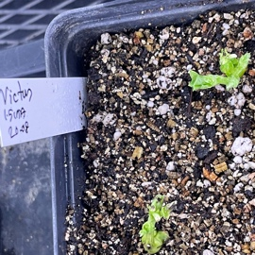
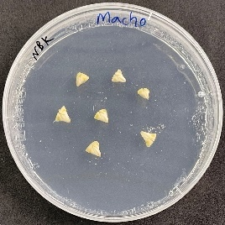
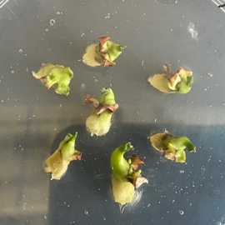
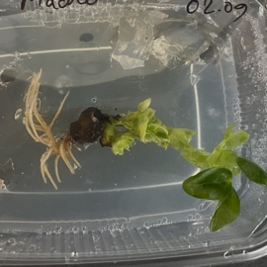
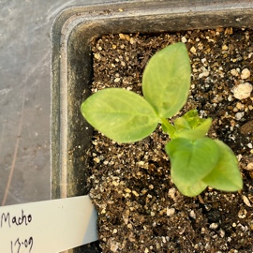
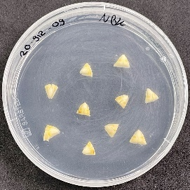
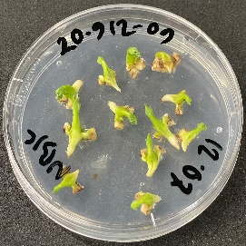
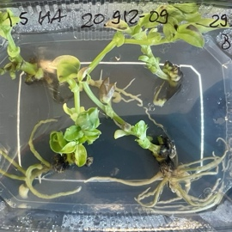
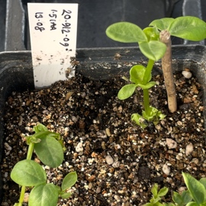
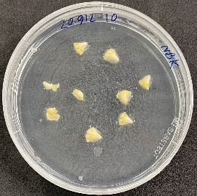
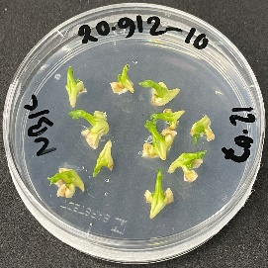
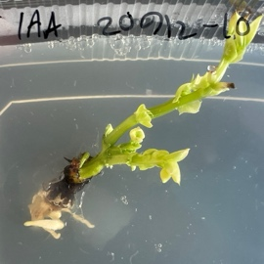
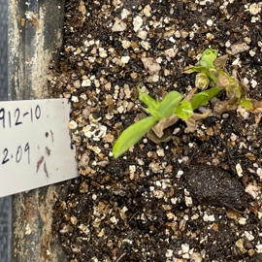
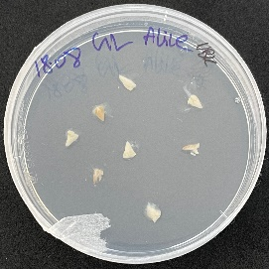
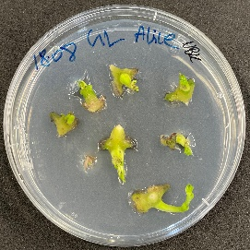
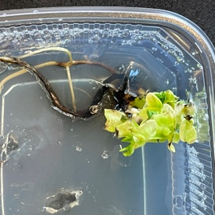
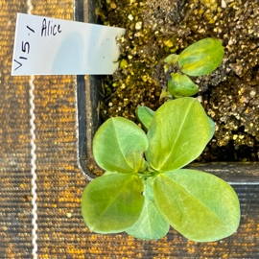
Extracted embryo
Early growth stage
Root formation
Plants in soil
a
b
c
d
e
f
Supplementary Fig. 1 Various growth stages of faba bean cultivars (a) Trumpet, (b) Victus, (c) Macho, (d) 20.912-09, (e) 20.912-10 and (f) GL-Alice, showing sequential stages of development from initial culture to advanced growth with root formation.

Slide 2
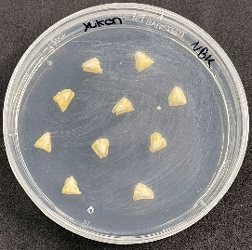
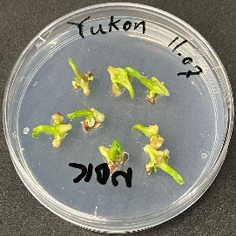
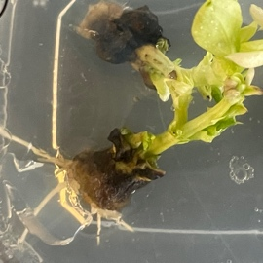
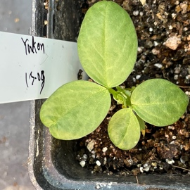
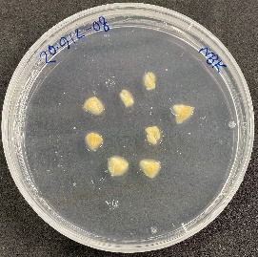
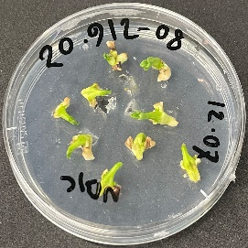
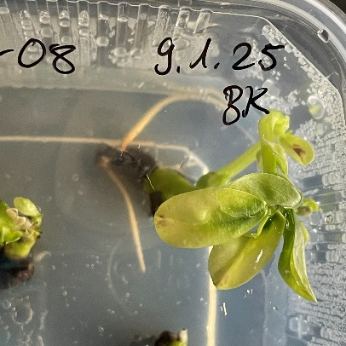
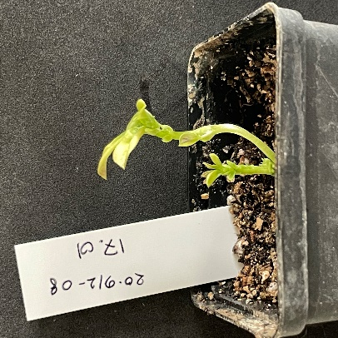
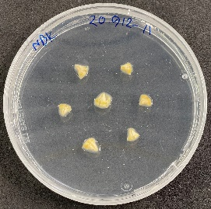
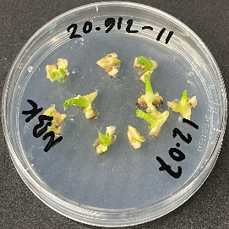
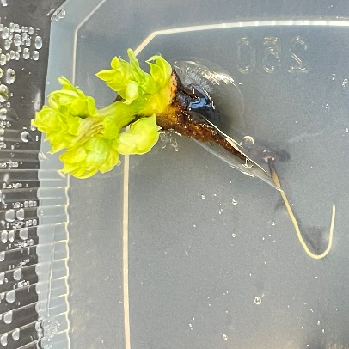
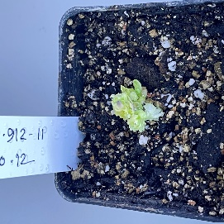
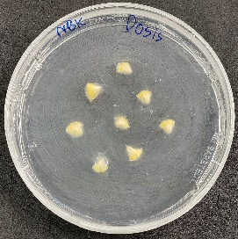
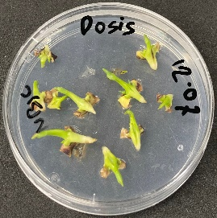
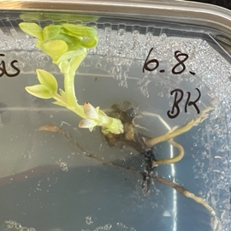
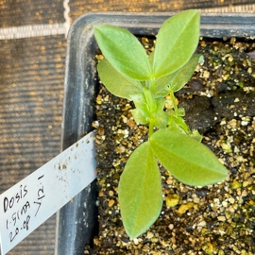
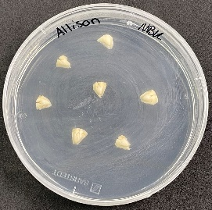
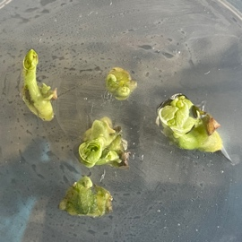
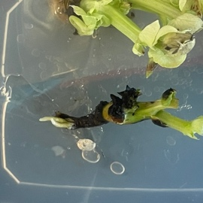
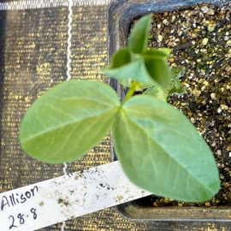
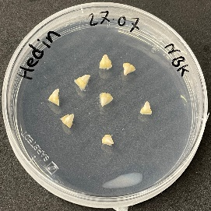
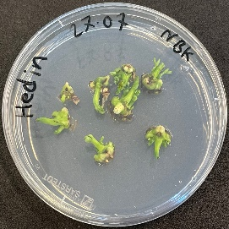
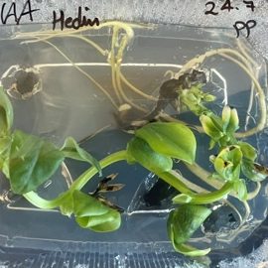
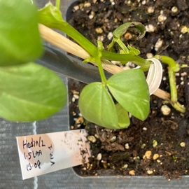
Extracted embryo
Early growth stage
Root formation
Plants in soil
a
b
c
d
e
f
Supplementary Fig. 2 Various growth stages of faba bean cultivars (a) Yukon, (b) 20.912-08, (c) 20.912-11, (d) Dosis, (e) Allison and (f) Hedin/2, respectively, showing sequential stages of development from initial culture to advanced growth with root formation.

Slide 3
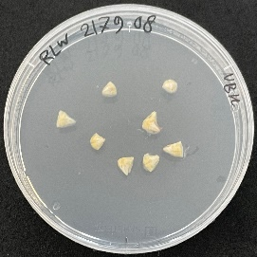
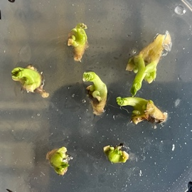






















Extracted embryo
Early growth stage
Root formation
Plants in soil
a
b
c
d
e
f
Supplementary Fig. 3 Various growth stages of faba bean cultivars (a) RLW 2179.08, (b) Lynx, (c) Expresso, (d) Alfaed, (e) Loki and (f) Zahra, respectively, showing sequential stages of development from initial culture to advanced growth with root formation.

Slide 4
























Extracted embryo
Early growth stage
Root formation
Plants in soil
a
b
c
d
e
f
Supplementary Fig. 4 Various growth stages of faba bean cultivars (a) Vespa, (b) Stella, (c) DL-Nevado, (d) Hiverna-Sublinie, (e) Louhi, and (f) Kristal, respectively, showing sequential stages of development from initial culture to advanced growth with root formation.

Slide 5
























Extracted embryo
Early growth stage
Root formation
Plants in soil
a
b
c
d
e
f
Supplementary Fig. 5 Various growth stages of faba bean cultivars (a) GL-Lucia, (b) Vincent, (c) Pantani, (d) Mallory, (e) Scirocco and (f) 19.7203, respectively, showing sequential stages of development from initial culture to advanced growth with root formation.

Slide 6




Extracted embryo
Early growth stage
Root formation
Plants in soil
a
Supplementary Fig. 6 . Various growth stages of faba bean cultivar Nejma, showing sequential stages of development from initial culture to advanced growth with root formation.

