Slide 1
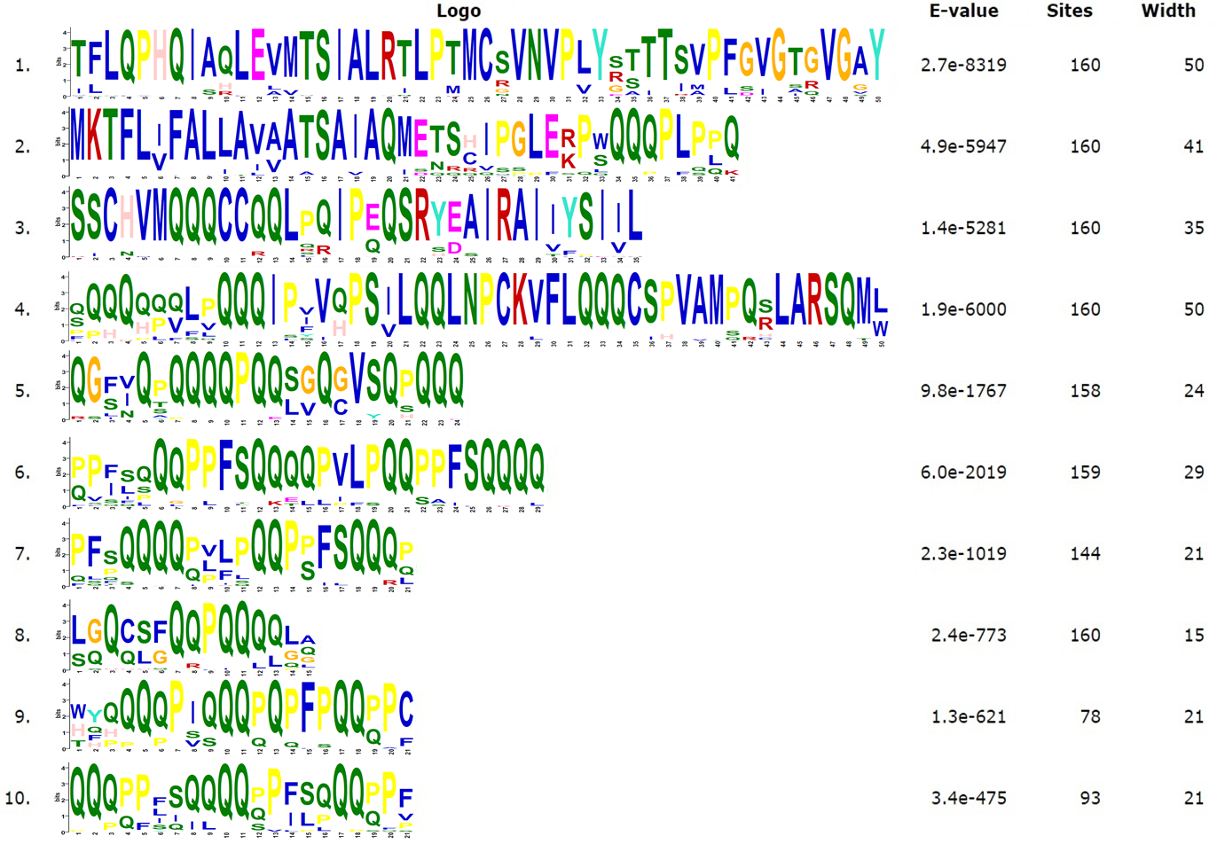
A
B
Fig. S12 Phylogenetic relationships and conserved amino acid motif composition of LMW-GS genes identified in this study. (A) Phylogenetic tree (left) conducted in MEGA11 using the Neighbor-Joining method, with dashed boxes in green, blue, and purple respectively enclosing the i-, s-, and m-type LMW-GS genes, and conserved amino acid motifs (right) identified by MEME; (B) Amino acid composition of the conserved motifs in LMW-GS proteins.

