Slide 1
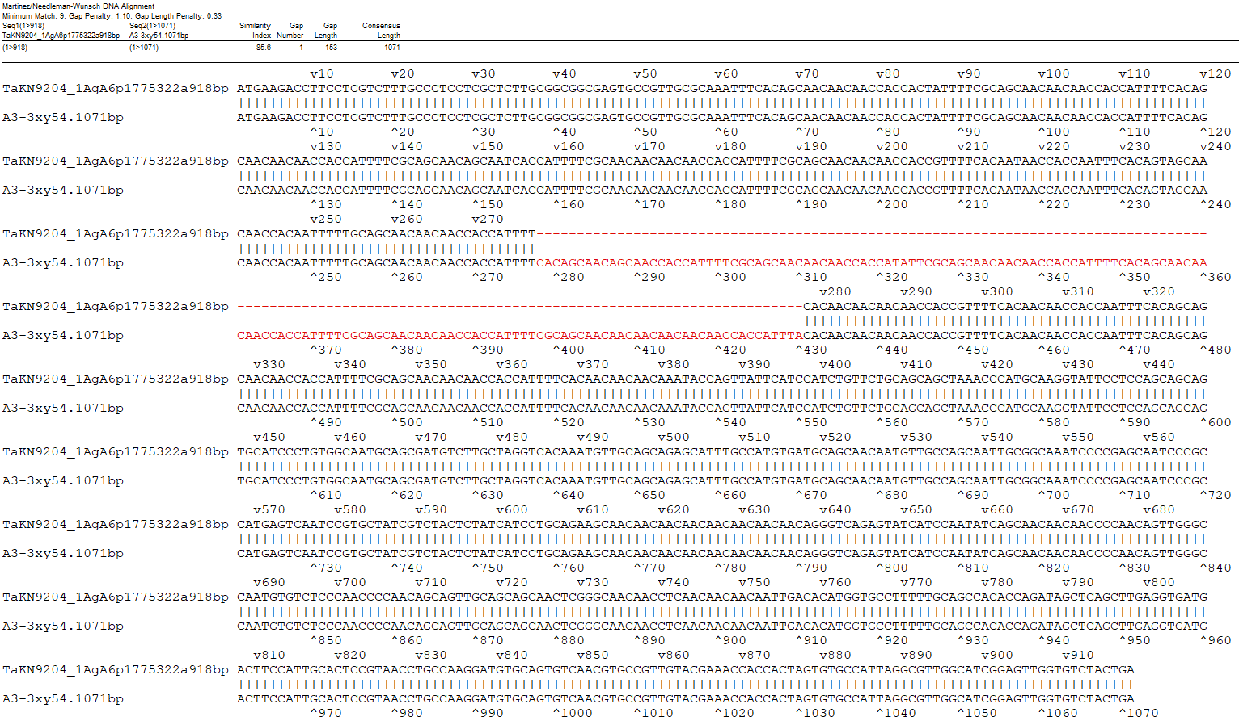
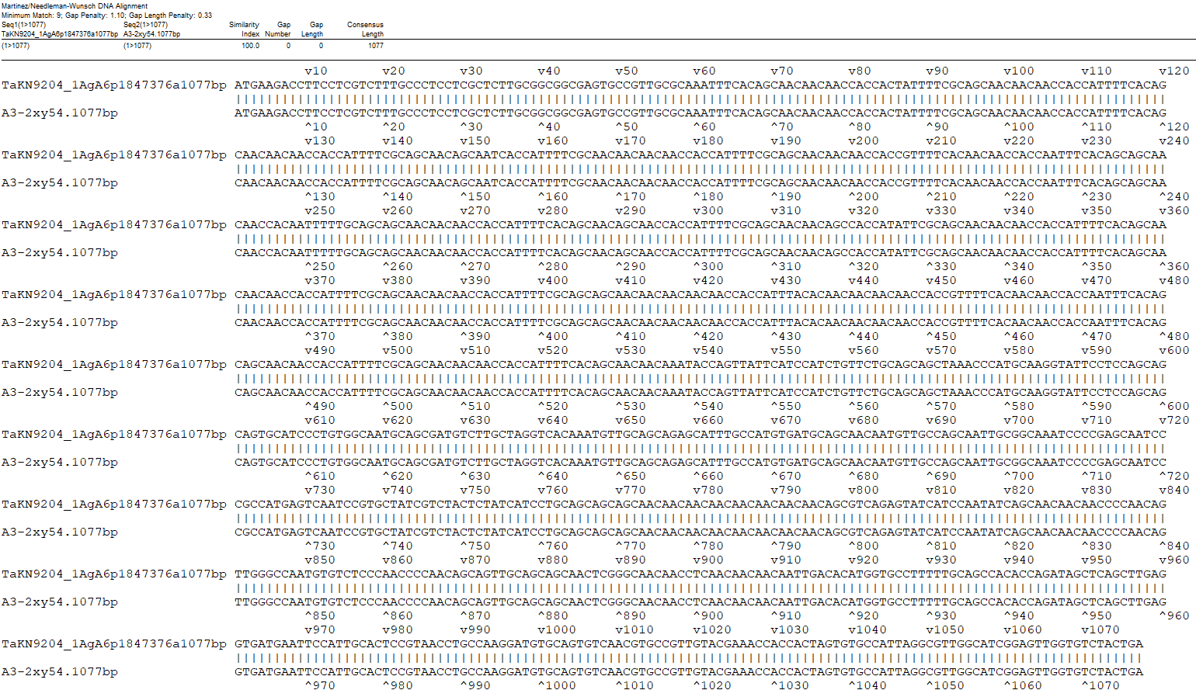
A
B
Fig. S8 Annotation comparison of TaKN9204_A6-I vs. A3-3xy54 (85.6%, A) and TaKN9204_A6-II vs. A3-2xy54 (100%, B) identified in TaKN9204 and Xiaoyan54.

