Slide 1
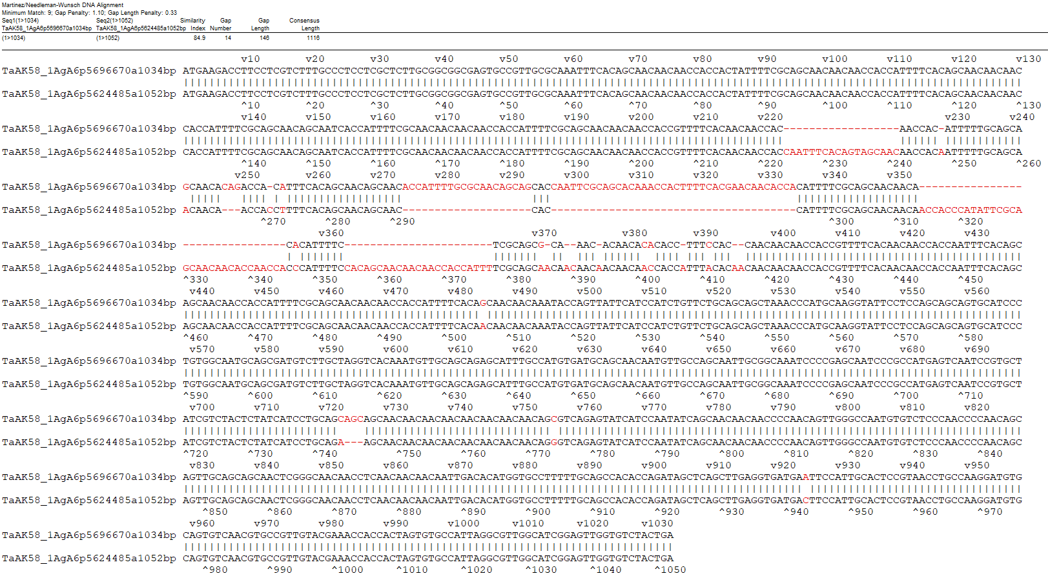
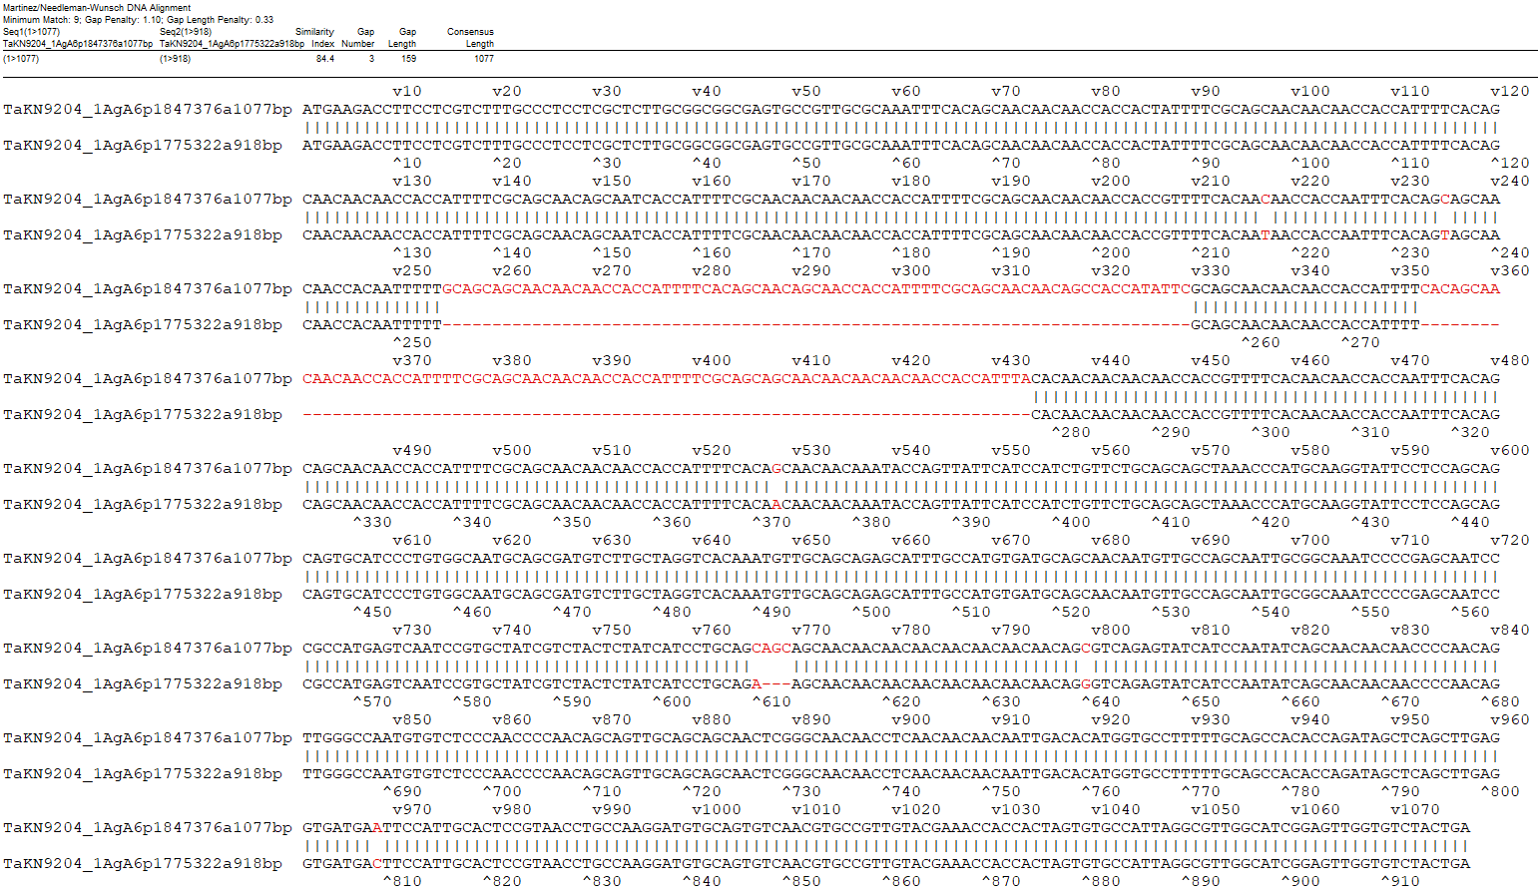
A
B
Fig. S6 Annotation comparison of A6-I and A6-II identified in TaAK58 (A) and TaKN9204 (B) by LMWgsFinder.

