Slide 1
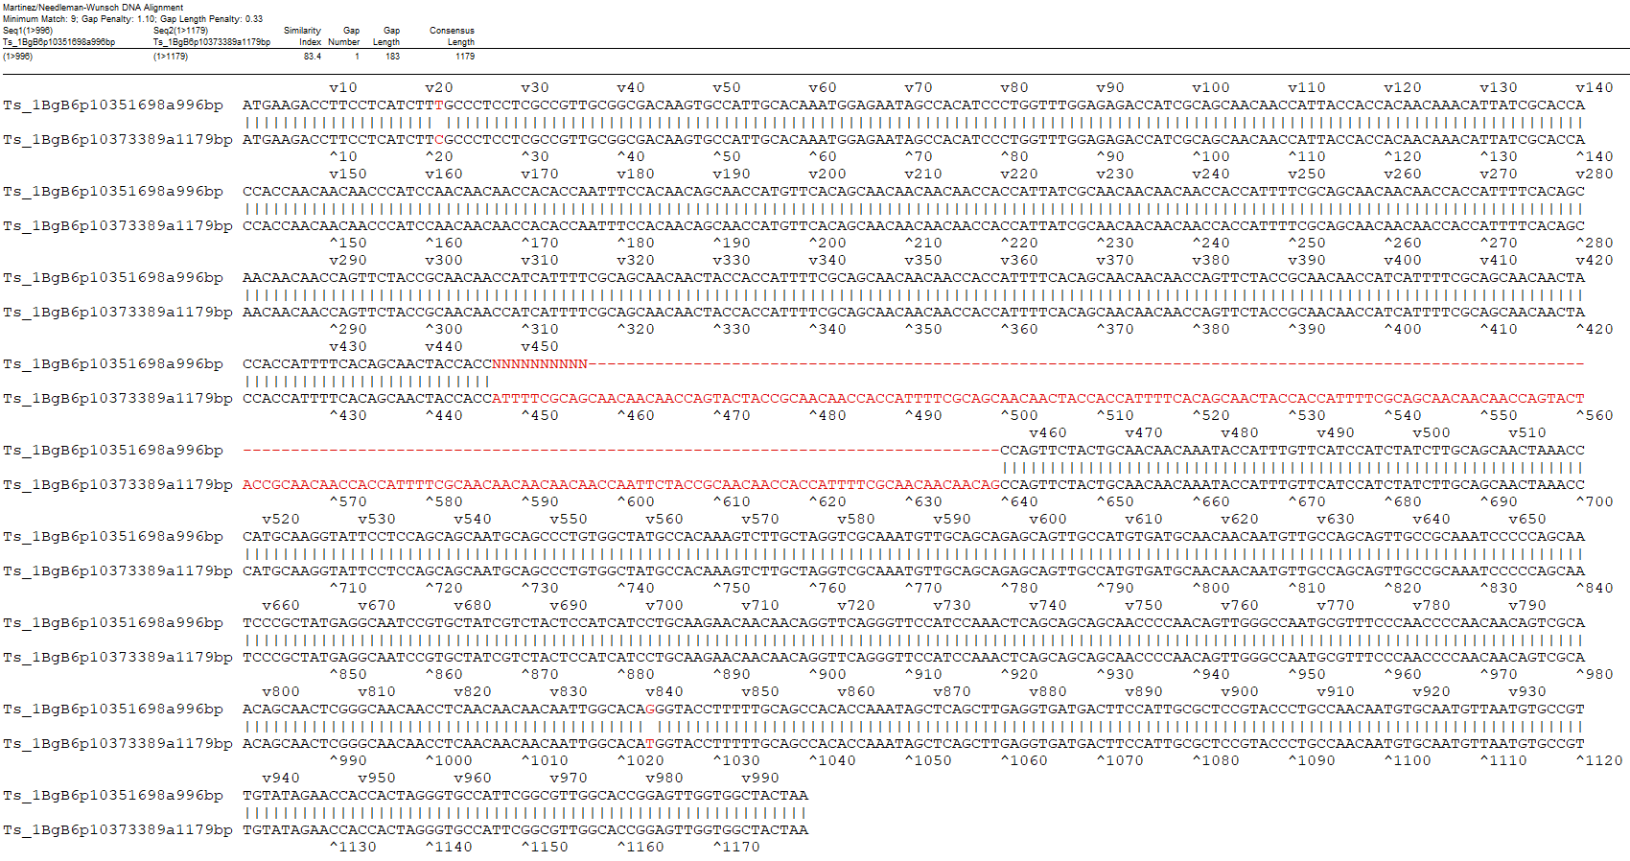
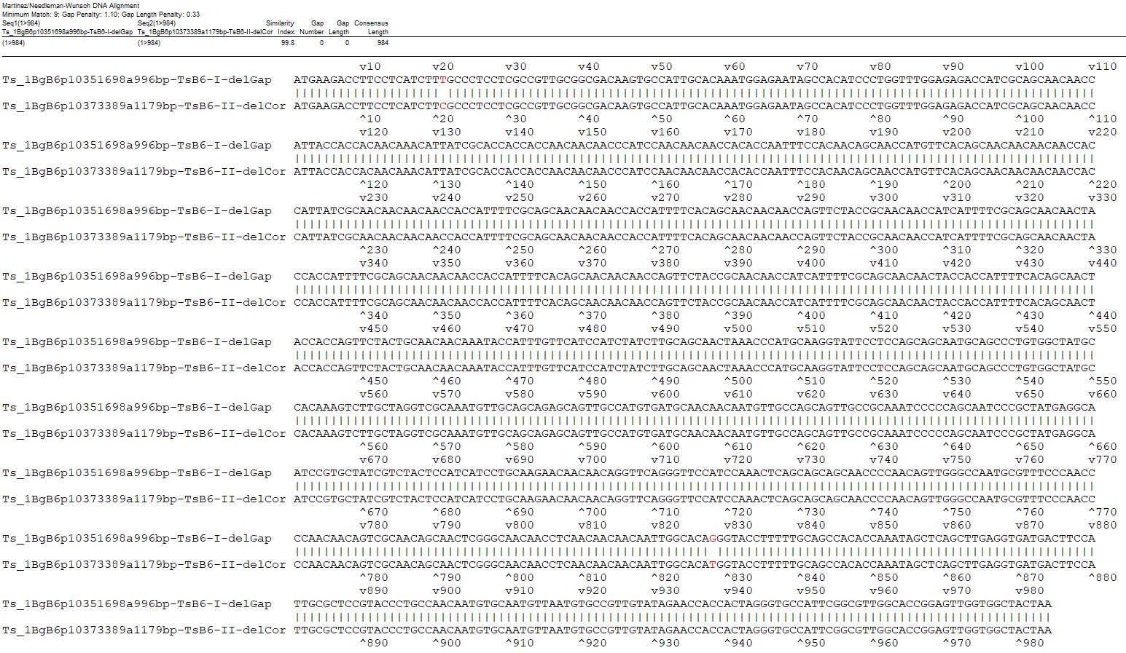
A
B
Fig. S9 DNA sequence alignment of Ts_B6-I (Ts_1BgB6p10351698a996bp) and Ts_B6-II (Ts_1BgB6p10373389a1179bp) before (A) and after (B) gap/corresponding-part deletion.

