Slide 1
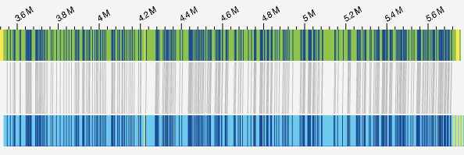
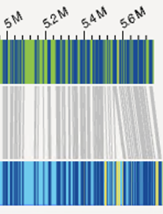
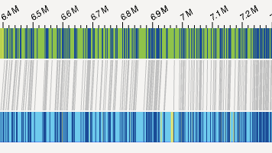
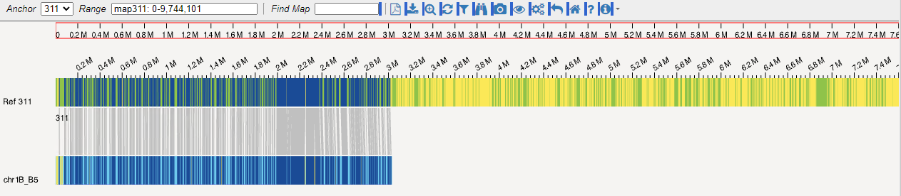
A
CSv2.1_Ref398
chr1B_Glu3-B2_region in CSv2.1
B2
B
CSv2.1_Ref398
chr1B_Glu3-B2 region in Fielder
B2
B2
C
CSv2.1_Ref181
chr1A_Glu3-A3 region in CS2.1
A3
D
CSv2.1_Ref311
chr1A_Glu3-B5 region in CS2.1
B5
Fig. S19 BioNano genome map alignments with the sequence of genomic regions harboring the Glu3 loci of wheat 1A and 1B subgenome. The optical maps were constructed using the restriction profiles produced by Bionano’s DLE-1 enzyme, which recognizes the sequence CTTAAG. The assembled sequences were digested in silicon with the same recognition sequences to generate cmaps, which were then aligned with the whole genome optical maps of Chinese Spring. The connected black lines indicate matching recognition sites, while the yellow bars show the mismatches. The red arrow indicates the location of the LMW-GS gene.

