Slide 1
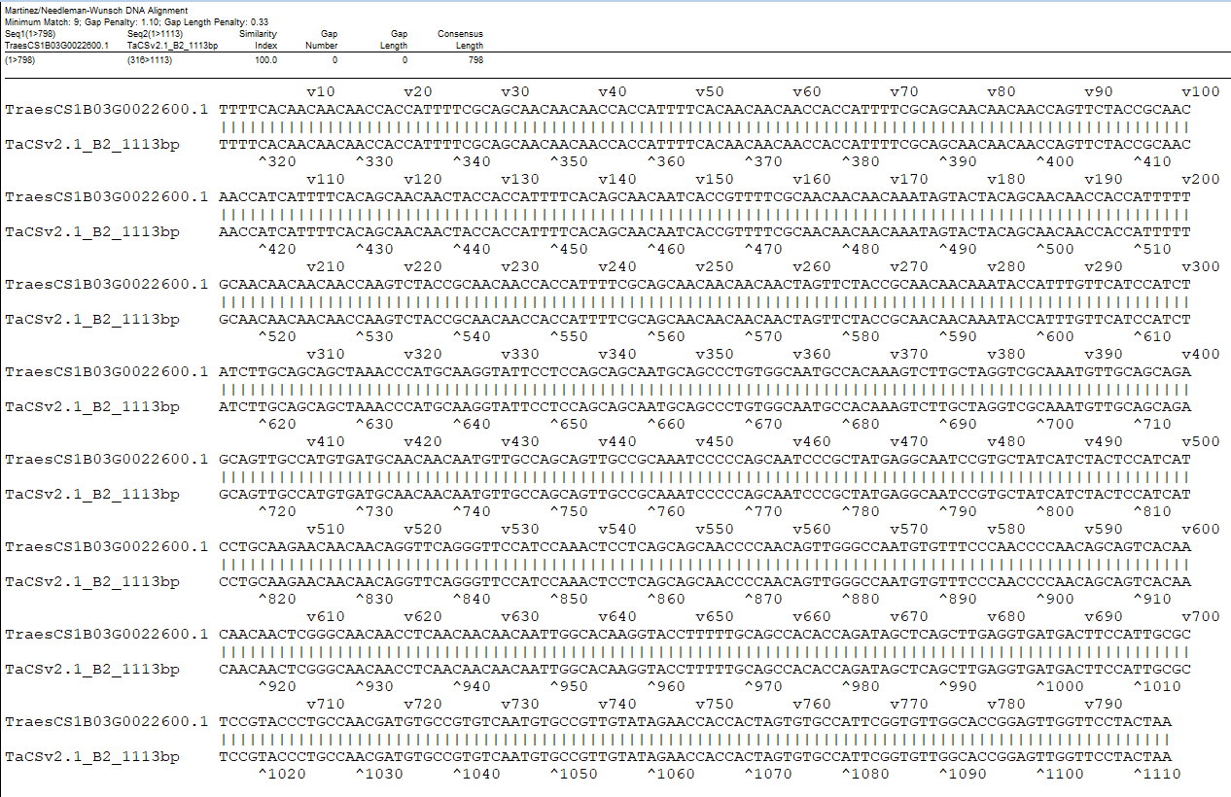
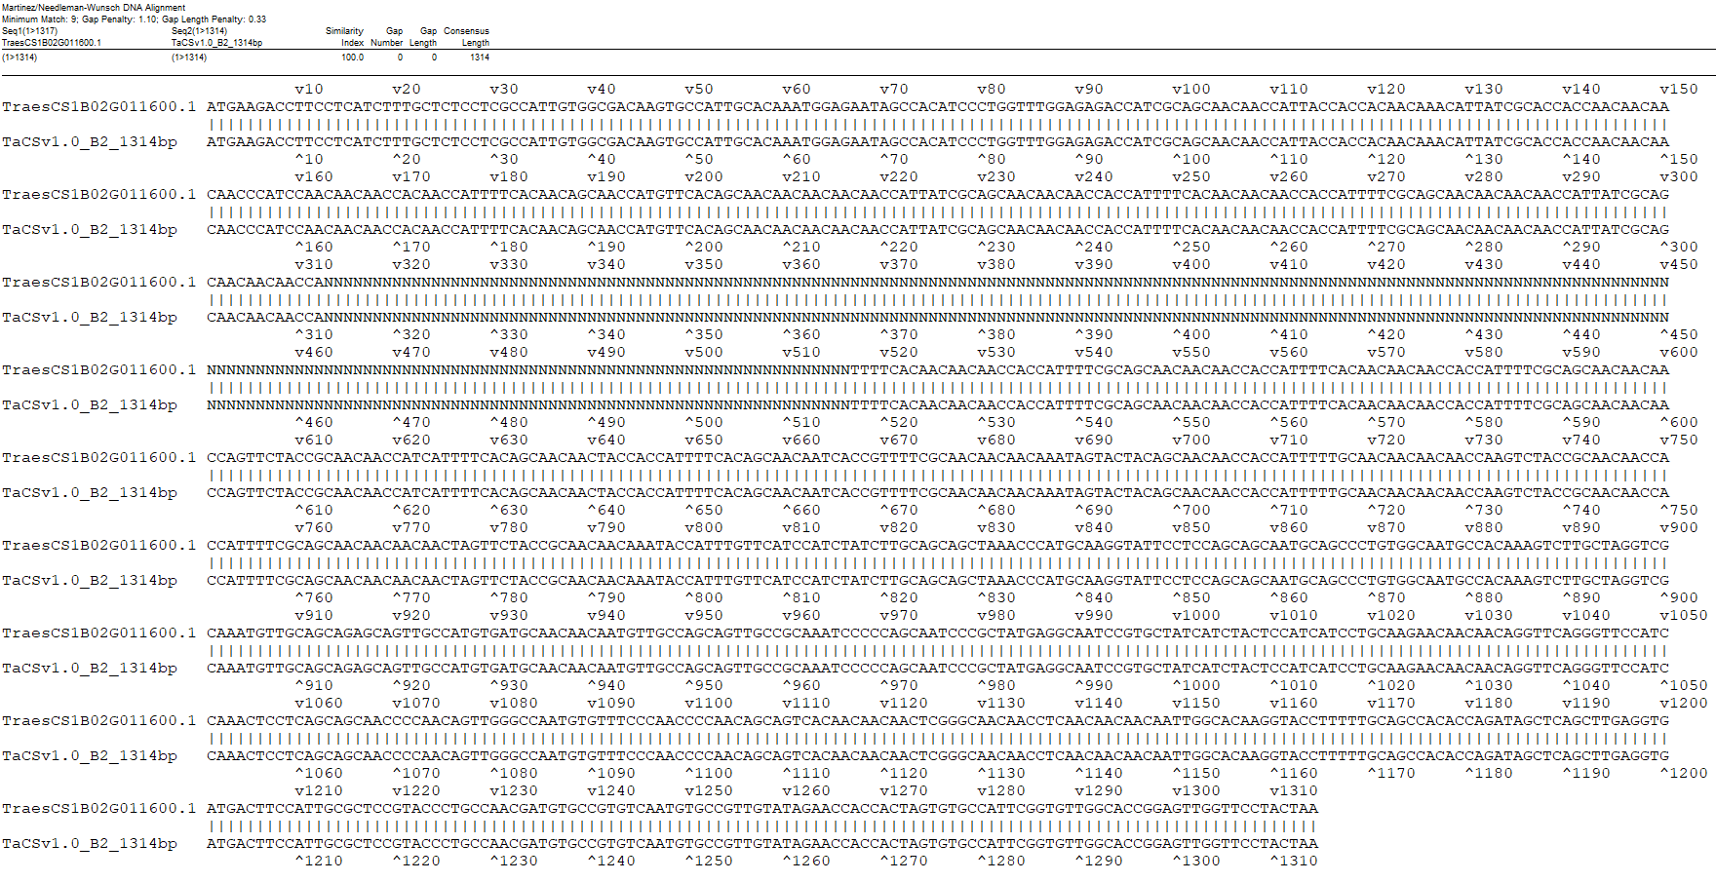
A
B
Fig. S3 Annotation comparison of B2 between IWGSCv2.1 (containing "03G" in gene names) and LMWgsFinder (A) and between IWGSCv1.1 (containing "02G" in gene names) and LMWgsFinder (B).

