Slide 1
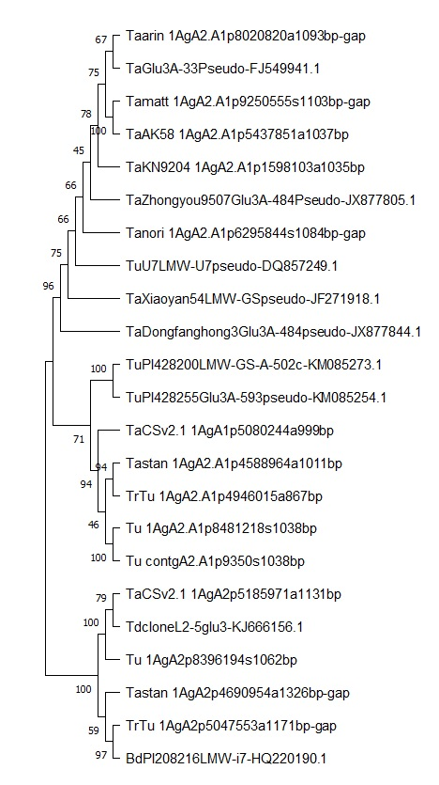
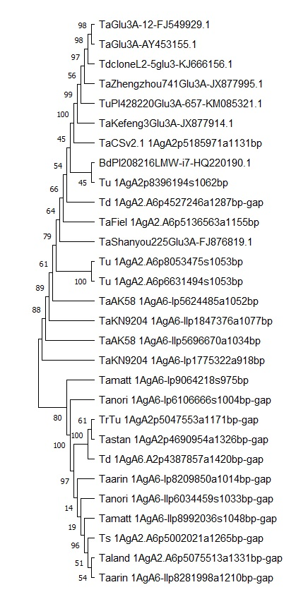
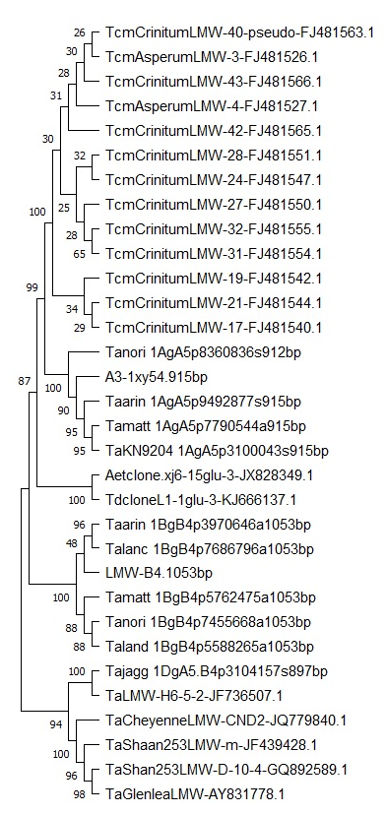
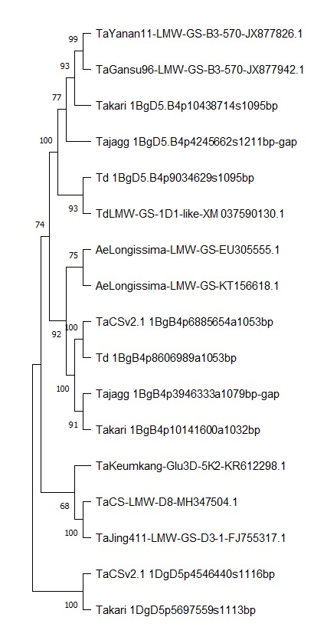
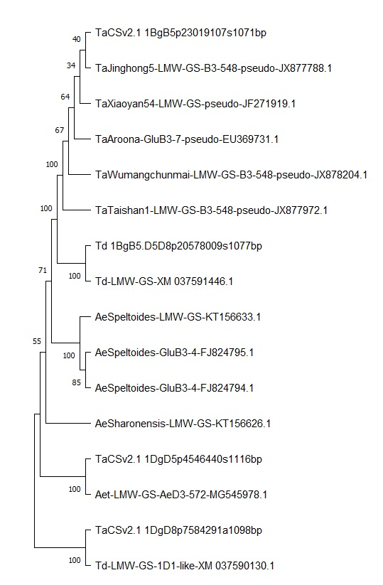
A
B
C
D
E
Fig. S14 Phylogenetic analysis of new LMW-GS genes identified in different genomes of wheat and its related species in this study. Statistical method: Neighbor-Joining; Phylogeny test: Bootstrap method with 1000 replications; Model/Method: p-distance; Gaps/Missing Data Treatment: Pairwise deletion.

