Slide 1
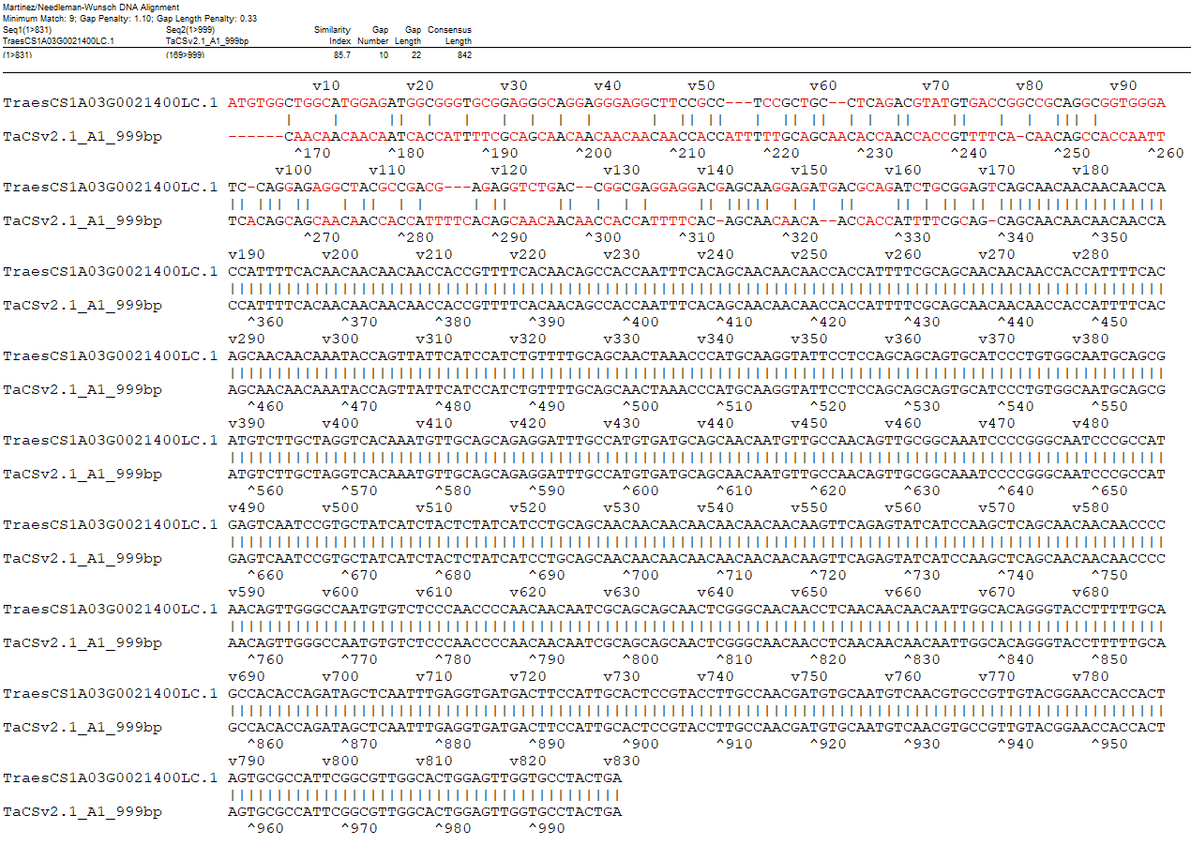
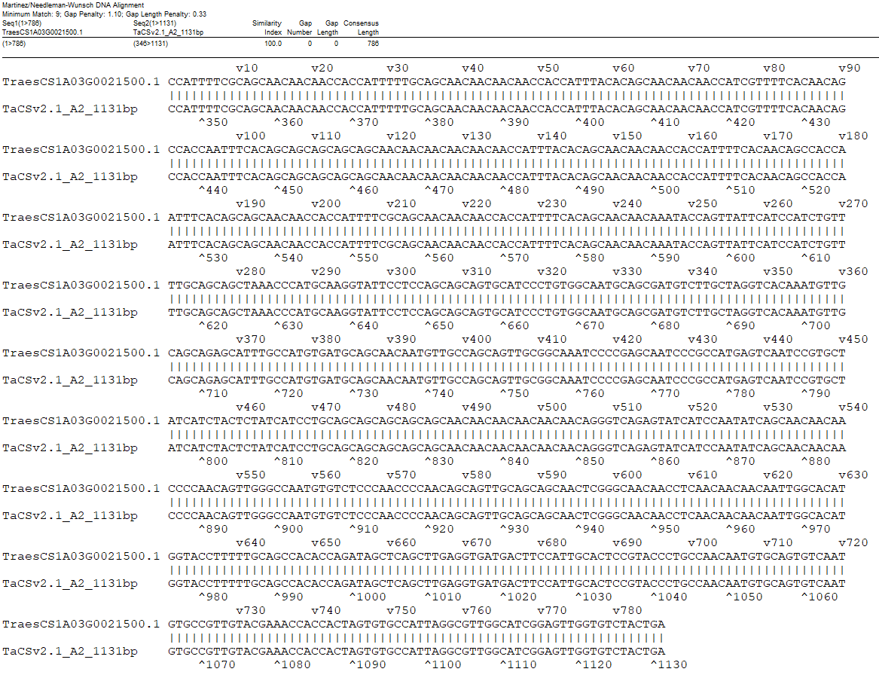
A
B
Fig. S2 Annotation comparison of A1 (A) and A2 (B) between IWGSCv2.1 and LMWgsFinder.

