Slide 1
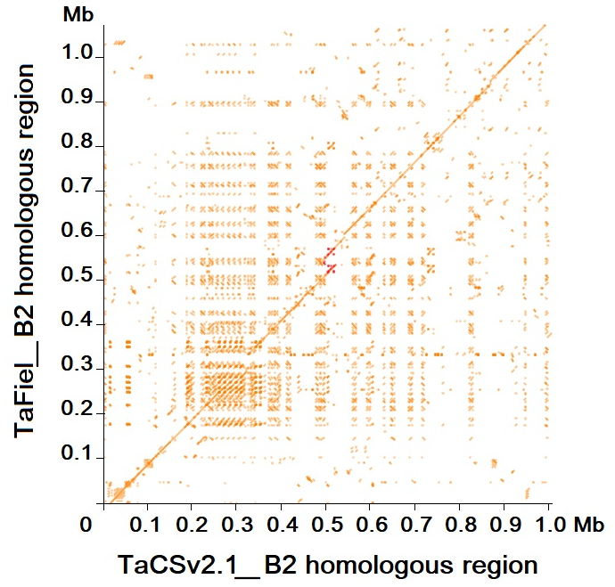
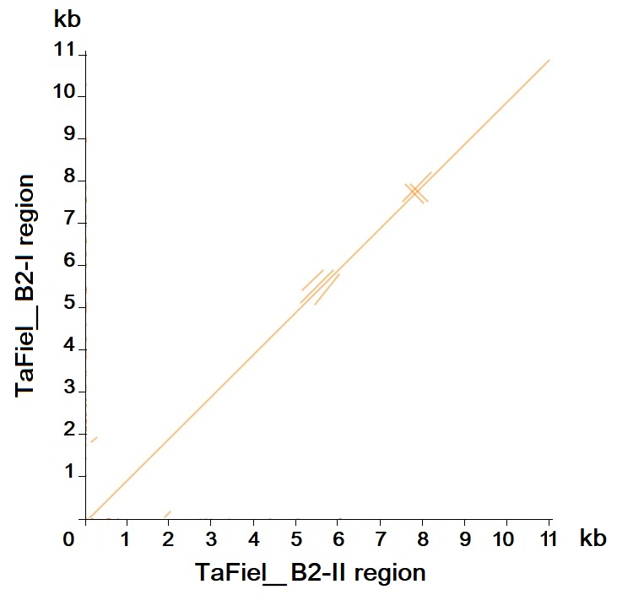
A
B
Fig. S20 Pairwise comparison of genome regions harboring B2 genes. (A) The dot plot between TaCSv2.1 and TaFiel genome regions harboring B2 genes is shown in Figure A. The approximately 1 Mb sequences used here are the same as those relevant sequences used in Figure 1D. (B) The dot plot between TaFiel_B2-I and TaFiel_B2-II genomic DNA fragments (approximately 11 kb, extended by 5 kb upstream and downstream of the genes, respectively) is shown in Figure B. The dot plot was performed using the r2cat program with default parameter settings (Husemann and Stoye, 2010). It can be inferred that the duplication region harboring B2 genes in the TaFiel genome is approximately 37 kb.

